Slide 1
Lower Extremity Balance as an Indicator of Upper Extremity Injury in Baseball Players: A Systematic Review
Isa Ortman, ATS
Lexie Mower, ATS
Shane Murphy, PhD, ATC

Slide 2
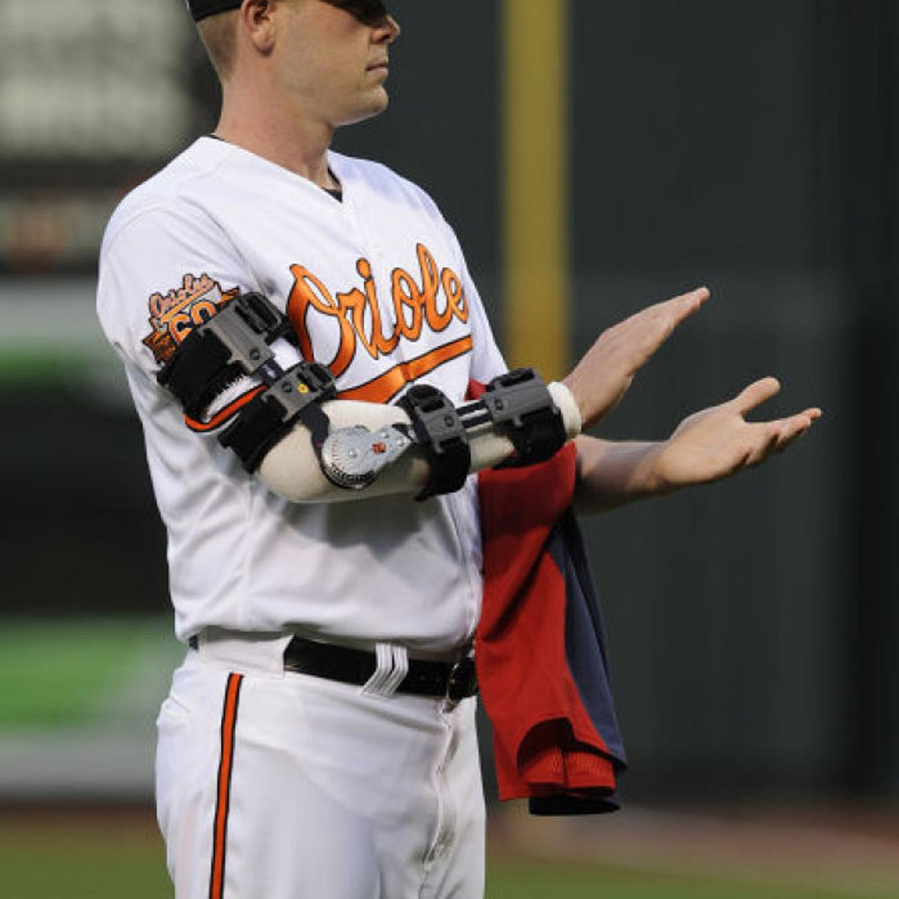
Elbow Injuries and Baseball
Elbow injuries in baseball have drastically increased in the past 3 decades
Influence Injury rate
Age
Throwing Mechanics
Overuse
Most common elbow injures are medial epicondylitis, ulnar collateral ligament injury and osteochondritis dissecans.
(Wang et al. 2006, Patrick et al. 2016)
Reference:

Slide 3
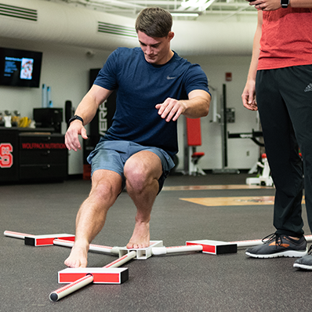
Lower Extremity Balance Testing
Can predict lower extremity injury
Provides percentage of lower limb reach capabilities in relation to athlete height
Star Excursion Balance vs Lower Quarter Y Balance Test
(Gribble et al., 2013)

Slide 4
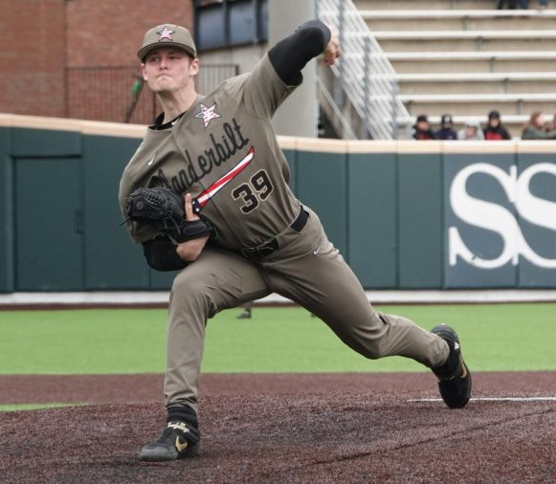
Balance and the Kinetic Chain
The throwing motion is a sequence of sequential body movements beginning at the feet.
Proper throwing mechanics essential for baseball
Increase throwing speed
Decrease injury risk
(Seroyer et al., 2010, Pinheiro et al., 2019)

Slide 5
Purpose of study
To determine lack of lower limb balance is a precursor for elbow injuries in baseball players.

Slide 6
Key words
“UCL injur*” or “UCL Tears” or “UCL sprain” or “Elbow injury”
“Tommy John”
“Balance” or “Lower Extremity”
“Kinetic Chain”
“Biomechanics” or “Kinematics”
“Throwing Mechanics”

Slide 7
Inclusion Criteria
Lower Quarter Y-Balance test or Star Excursion Balance Test
Male baseball players
Discuss elbow injuries

Slide 8
Exclusion Criteria
Articles discussing females
Articles with sole focus of overhead sports not including baseball
Articles with sole focus on injuries not including elbows
Lacked full text or English version

Slide 9
Records identified through database searching PubMed (n = 133)
Additional records identified through other sources (n=0)
PRISMA Flowchart
Identification
Records after duplicates removed (n = 133)
Screening
Records excluded, with reasons (n =99)
-Irrelevant title and abstract
-No English availability
Records screened (n = 34)
Eligibility
Full-text articles assessed for eligibility (n = 11)
Full-text articles excluded, with reasons (n = 23)
-No Lower Extremity Y Balance or SEBT included
-Did not include elbow injuries
-Did not include participant description
Included
Studies included in qualitative synthesis (n = 4)

Slide 12
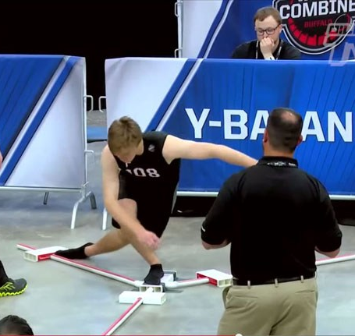
Lower Quarter Y-Balance Test
Found decrease reach capabilities in stance and lead limbs
Lacked 5.5% composite scoring overall compared to healthy counterparts
Statistically significant in both studies
Researchers determined positive correlation from decreased balance to chance of elbow injury

Slide 13
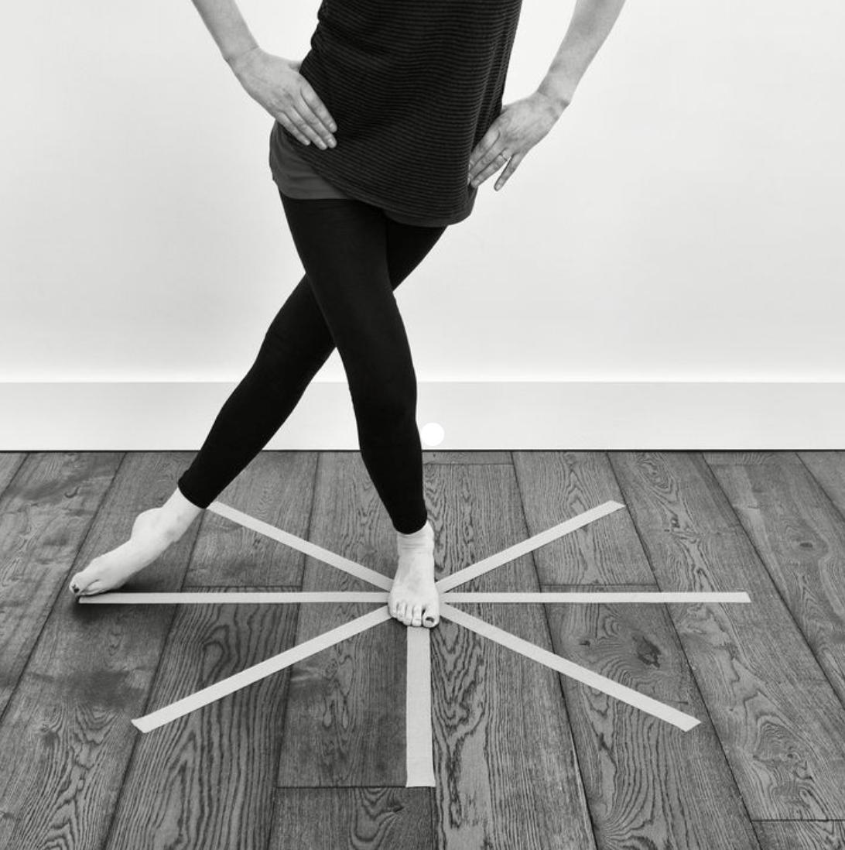
Star Excursion Balance Test
Athletes with elbow pain had increased reach range
Avg 2.5 cm greater on stance leg
Avg 1.5 cm greater on lead leg
These athletes were reported to throw harder
These studies reported shoulder pain at similar rates

Slide 14
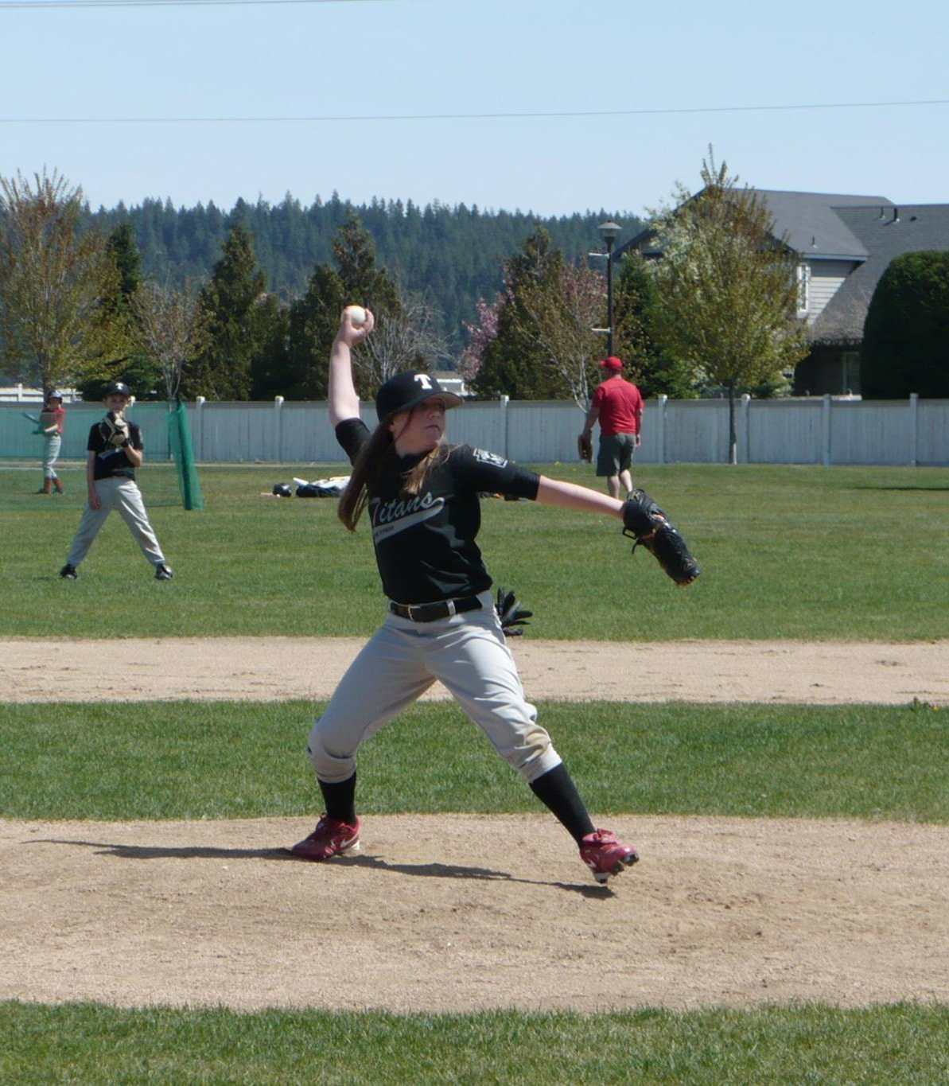
Factors Contributing to Elbow Injury
Rehabilitation Plans
Increased Hip ROM allows athletes to throw harder
Early throwing mechanic teaching decreases risk of injury later in career
(Endo et al.,2014, Sekiguchi et al., 2020, Hannon et al., 2014)

Slide 15
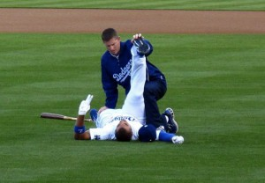
Factors Contributing to Elbow Injury
Hip Tightness and Strength
Athletes with stronger legs were more likely to have elbow injury
Athletes with increased hip tightness more likely to have elbow injury
(Endo et al., 2014, Sekiguchi et al., 2020)

Slide 16
Current and Future Research
There is a lack in studies researching balance and upper extremity injuries
Lack of research in all overhead throwing sports, not just baseball
There is a lack of research in lower limb stability and its correlation to UCL injury
There is a ton of research on throwing mechanics and UCL tears
Future research is necessary in order to understand correlation between lower extremity balance and upper extremity injury risk.

Slide 17
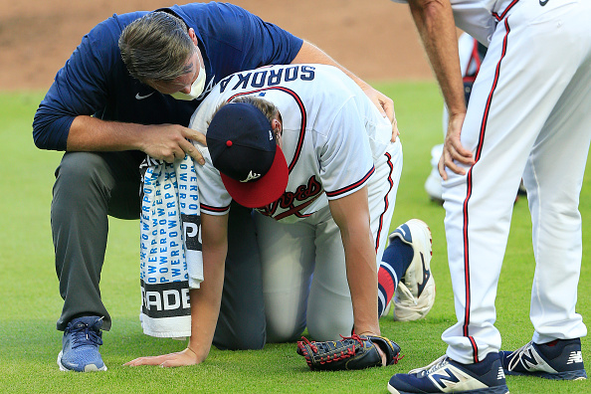
Conclusions
Athletes with elbow pain show greater lower limb stability
Athletes with UCL injury show less lower limb stability
Contributing Factors
Throwing Mechanics
Hip Tightness
Lower limb strength
(Endo et al., 2014, Sekiguchi et al., 2020, Hannon et al., 2014, Garrison et al., 2013)

Slide 18
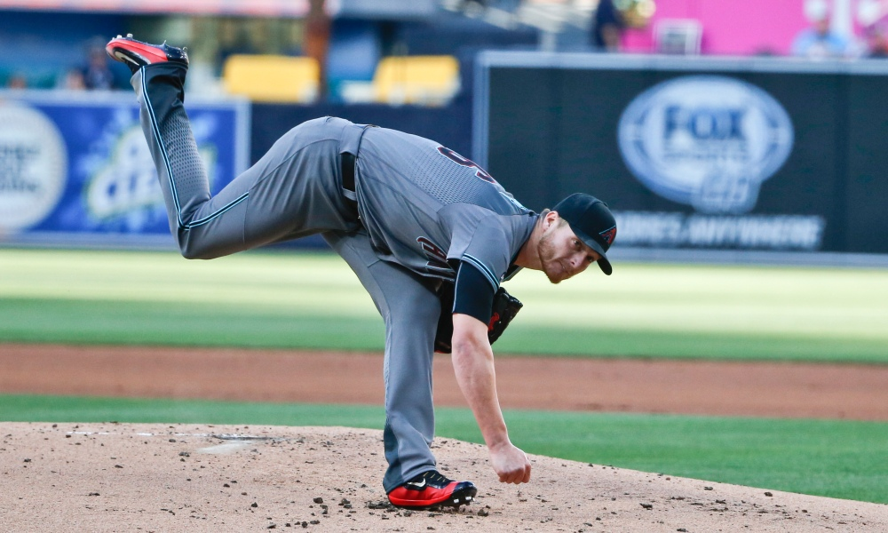
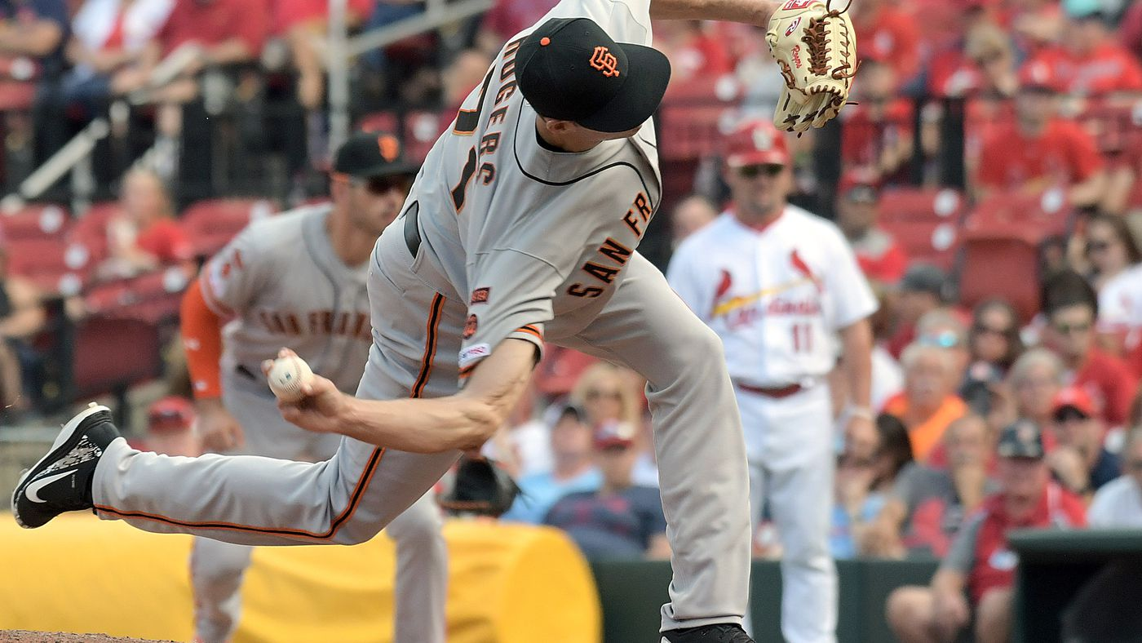
Questions?

