Slide 1
Dams, Displaced Tribes, Salvage Archaeology, and Cultural Resource Management in the Missouri River Basin in North and South Dakota. By Lisa Hunt

Slide 2
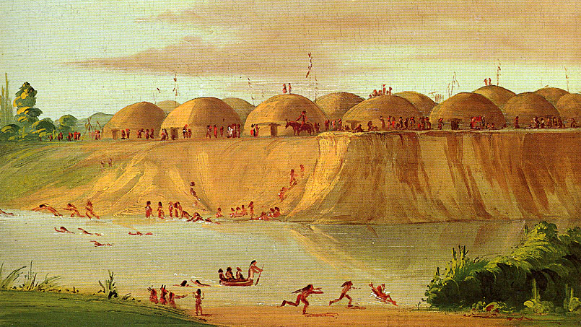

Slide 3
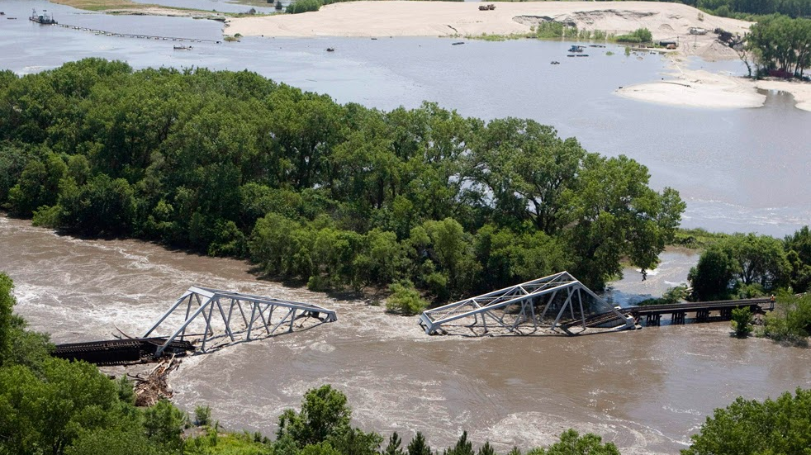

Slide 4
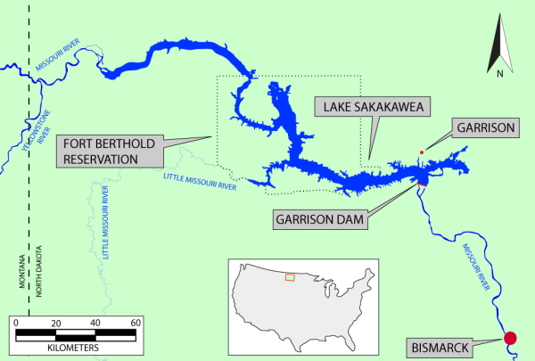

Slide 5
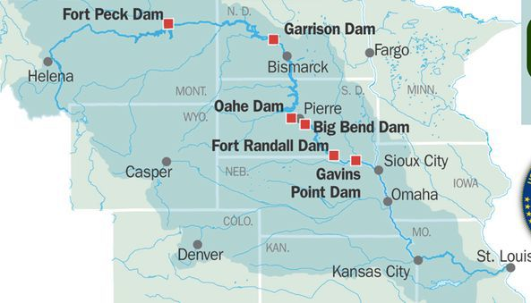

Slide 6
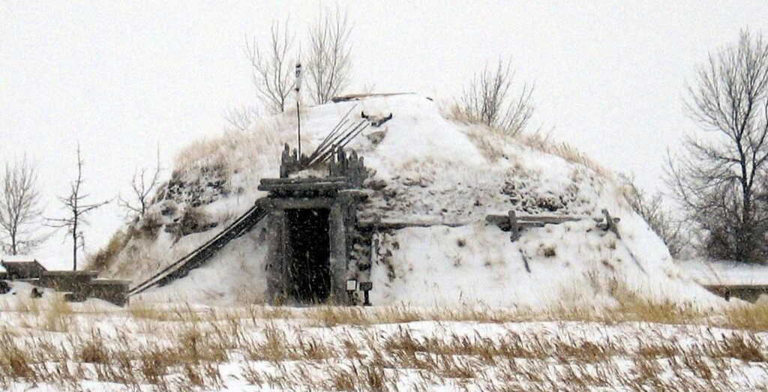

Slide 7
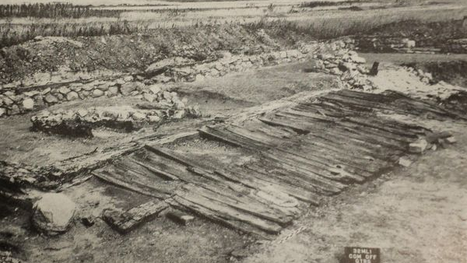

Slide 8
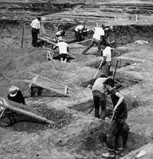

Slide 10
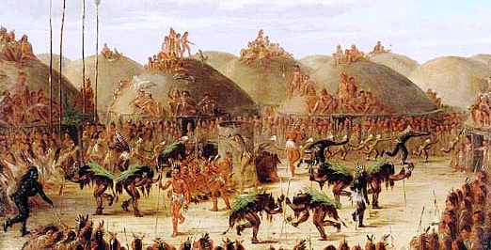

Slide 11
IMAGES CITED
https://www2.palomar.edu/users/scrouthamel/AIS120/cat02.jpg
http://1.bp.blogspot.com/-_HOIfXyhv6k/Td-xowzN1JI/AAAAAAAAMVE/Od7VJf9Gvs0/w1200-h630-p-k-no-nu/%25210_0000_MORGUE_Flood_BridgeCollapsed.jpg
https://bloximages.newyork1.vip.townnews.com/omaha.com/content/tncms/assets/v3/editorial/2/22/22288072-4a77-598e-b0a8-ab8df0ab2acb/5ca828cadae1c.image.jpg
https://nmnh.typepad.com/.a/6a01156e4c2c3d970c0263e991b8ad200b-600wi
https://nmnh.typepad.com/.a/6a01156e4c2c3d970c01a73ddc6d41970d-800wi
https://nmnh.typepad.com/.a/6a01156e4c2c3d970c01a511d12073970c-500wi
https://www.nps.gov/archeology/timeline/images/mrbsdig.jpg
https://archaeology-world.com/wp-content/uploads/2020/05/dakota-1-1-1024x640.jpg
https://nmnh.typepad.com/.a/6a01156e4c2c3d970c01bb09c99eec970d-600wi
http://www.lewis-clark.org/media/NewImages/Importing/AERIALBOOK/South-Dakota.gif
https://nmnh.typepad.com/.a/6a01156e4c2c3d970c01a73ddc6d8e970d-600wi
http://image3.slideserve.com/6736614/cultural-resource-management-n.jpg
https://www.warpaths2peacepipes.com/images/mandan-earth-lodge.jpg

Slide 12
WORKS CITED
Banks, Kimball M., Czaplicki, Jon S. 2016. Dam Projects and the Growth of American Archaeology: The River Basin Survey and the Interagency Archeological Salvage Program. Left Coast Press, Inc.
Banks, Kimball M, J. Signe Sortland, and Jon Czaplicki. 2011. "The Price We've Paid: From Salvage Archaeology to Cultural Resource Management and Beyond in the Missouri River Basin." Plains Anthropologist 56, no. 220: 371-85.
Caposella, Peter. 2015. “Impacts of the Army Corps of Engineers’ Pick-Sloan Program on the Indian Tribes of the Missouri River Basin” Journal of Environmental Law and Litigation. Vol. 30, 143.
“Dam Indians: The Missouri River.” 2010. Native American Netroots. March 10. Nativeamericannetroots.net/diary/405.
Establishing a Commission to Conduct a Study and Provide Recommendations on a Comprehensive Resolution of Impacts Caused to Certain Indian Tribes by the Pick-Sloan Program. 2010. United States. Congress. Senate. Committee on Indian Affairs.
Fuller, Reba. 2011. "Consultation in Cultural Resource Management: An Indigenous Perspective." A Companion to Cultural Resource Management, edited by Thomas F. King, Wiley-Blackwell, (373-384).
Govaerts, Lotte E. “Transformative Consequences of Garrison Dam: Land, People, and the Practice of Archaeology.” Great Plains Quarterly 36, no. 4 (2016): 281–307.
Jennings, Jesse D. 1985. "River Basin Surveys: Origins, Operations, and Results, 1945-1969." American Antiquity 50, no. 2: 281-96.
Johnson, Frederick. 1951. “The Inter-Agency Archaeological Salvage Program in the United States.” Archaeology 4, no. 1: 25–40.
King, Thomas F. 2013. Cultural Resource Laws & Practice. AltaMira Press.
King, Thomas F. 2000. Federal Planning and Historic Places: The Section 106 Process. AltaMira Press.
King, Thomas F. 2002. Thinking About Cultural Resource Management: Essays from the Edge. AltaMira Press.
King, Thomas F. 2009. Our Unprotected Heritage: Whitewashing the Destruction of Our Cultural and Natural Environment. Taylor & Francis Group.
Lawson, Michael L. 2009. Dammed Indians Revisited: The Continuing History of the Pick-Sloan Plan and the Missouri River Sioux. South Dakota State Historical Society Press.
Lawson, Michael L. 1982. Dammed Indians: The Pick-Sloan Plan and the Missouri River Sioux, 1944-1980. University of Oklahoma Press.
Lehmer, Donald J. 1954. River Basin Surveys Papers: Inter-Agency Archeological Salvage Program: No. 7 Archeological Investigations in the Oahe Dam Area, South Dakota, 1950-1951. Smithsonian Institution. United States. GPO.
Ritchie, Lucas. 2005. "Indian Burial Sites Unearthed: The Misapplication of the Native American Graves Protection and Repatriation Act," Public Land & Resources Law Review 26: 71-96.
Roberts, Frank H. 1953. River Basin Survey Papers: Inter-Agency Archeological Salvage Program, Numbers 1-6. Smithsonian Institution Bureau of American Ethnology-Bulletin 154. United States GPO.
Rose, Christina. 2017. “Echoes of Oak Flat: 4 Pick-Sloan Dams That Submerged Native Lands.” Indian Country Today. August 14.
Schneiders, Robert Kelley. 1997. "Flooding the Missouri Valley: The Politics of Dam Site Selection and Design.” Great Plains Quarterly 17, 237-49.
Silverberg, Robert. 1967. Men Against Time: Salvage Archaeology in the United States. The Macmillan Company.
Thiessen, Thomas D. 1999. Emergency Archeology in the Missouri River Basin: The Role of the Missouri Basin Project and the Midwest Archeological Center in the Interagency Archeological Salvage Program, 1946-1975. Lincoln, Neb: U.S. Dept. of the Interior, National Park Service, Midwest Archeological Center.
VanDevelder, Paul. 2009. Coyote Warrior: One Man, Three Tribes, and the Trial That Forged a Nation. University of Nebraska Press.
Wedel, Waldo R. 1947. Prehistory and the Missouri Valley Development Program: Summary Report on the Missouri River Basin Archeological Survey in 1946. Smithsonian Institution.
http://nativeamericannetroots.net/diary/405)

