Slide 1
Applying Counseling Theory to arts education
Person-centered pedagogy at the collegiate level

Slide 2
Why this research?
Observations about student (and my own) mental health prior to and during the pandemic.
Increasingly negative self-reports in mental health statuses from my students in private practice (as a voice teacher) and in the classroom at a GTA at UM from 2018-2021.
My personal journey from MFA to pursuing an MA in Clinical Mental Health Counseling.
The opportunity to explore the theories of Carl Rogers in a pedagogical setting.
I teach acting, directing, theatre history and dialects/voice at Gonzaga University

Slide 3
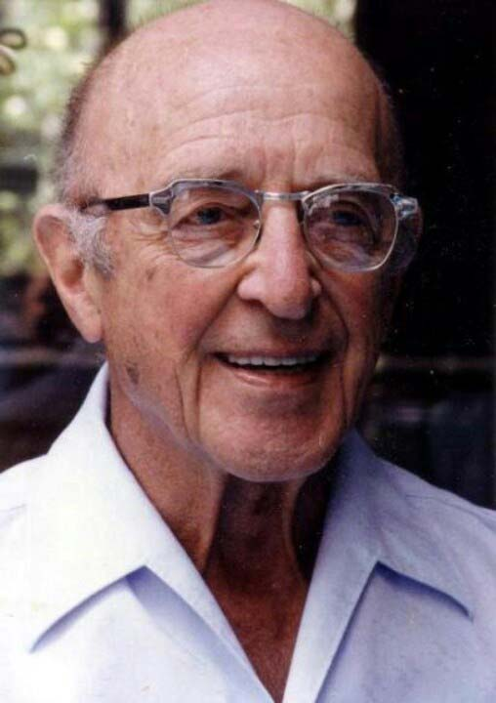
Carl Rogers (1902-1987) – American Psychologist
Person-Centered Therapy, or Rogerian Therapy - a philosophy holds at its forefront “a concern about the person and his becoming, in a modern world which appears intent upon ignoring or diminishing him.” –Carl Rogers
PCT is based on Rogers’ belief that every human being strives for and has the capacity to fulfill their own potential.
My hypothesis was: if a student feels as though they are wholly embraced exactly as they are, their expressive work will be freer and their overall sense of well-being will benefit, thereby connecting the ideas of creative work and positive self esteem, rather than putting them at odds – as is often the case with subjective feedback.
Photo Credit: TotallyHistory.com

Slide 4
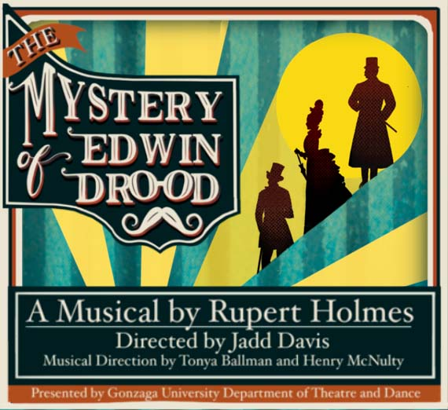
The research in action
- Practice constant approval for the entire person, even in group settings.
- Respond to questions and comments with positive engagement every time.
- Encourage students to problem-solve on their own, and approve of their solutions – even if they were not put into practical application.
- Encourage an interpersonal approval ethos amongst the members of the group.
- Allow greater flexibility for students’ needs, taking them at their word if they indicated that necessity. This is, happily, in keeping with the “Ignatian Presupposition of Good Intent” that is part of the Jesuit doctrine at Gonzaga.
- Finally, I held space for my own vulnerability and didn’t shy away from sharing my struggles and successes with my students.

Slide 5
The data
By way of a disclaimer, I acknowledge that with an experiment such as this, the possibility of generating empirical data is virtually impossible – the data is qualitative. In the subsequent slides, I provide examples of representative responses to my approach in the form of:
anonymous student feedback
Faculty and Collaborator feedback
my personal notes and observations

Slide 6
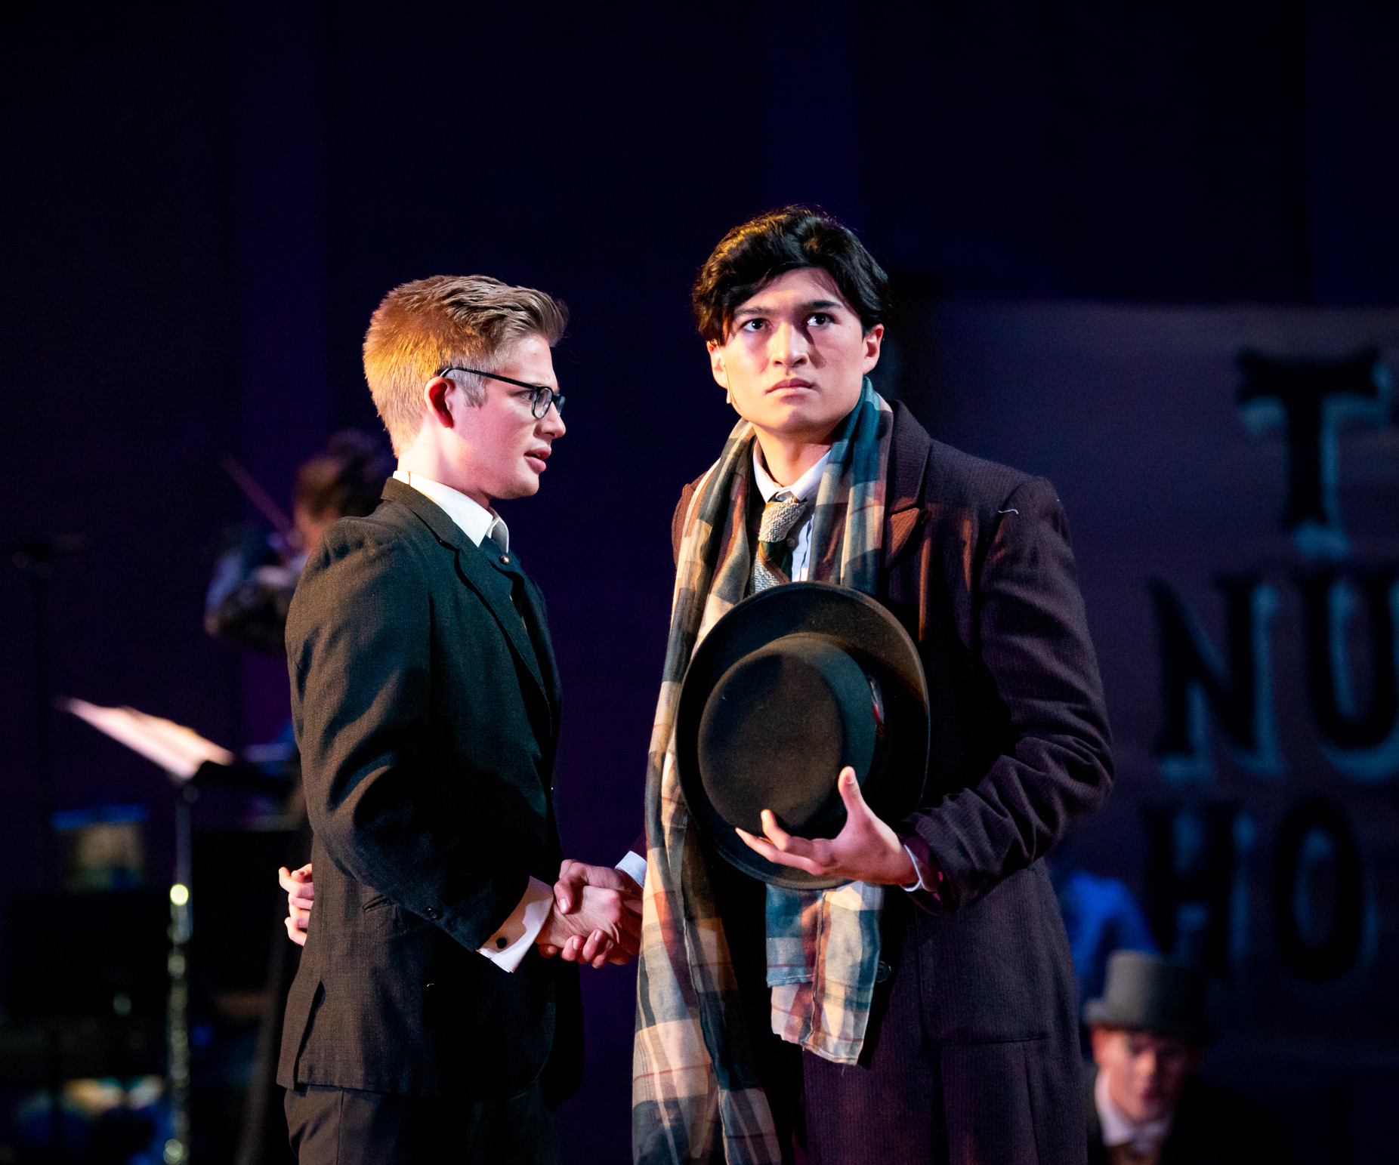
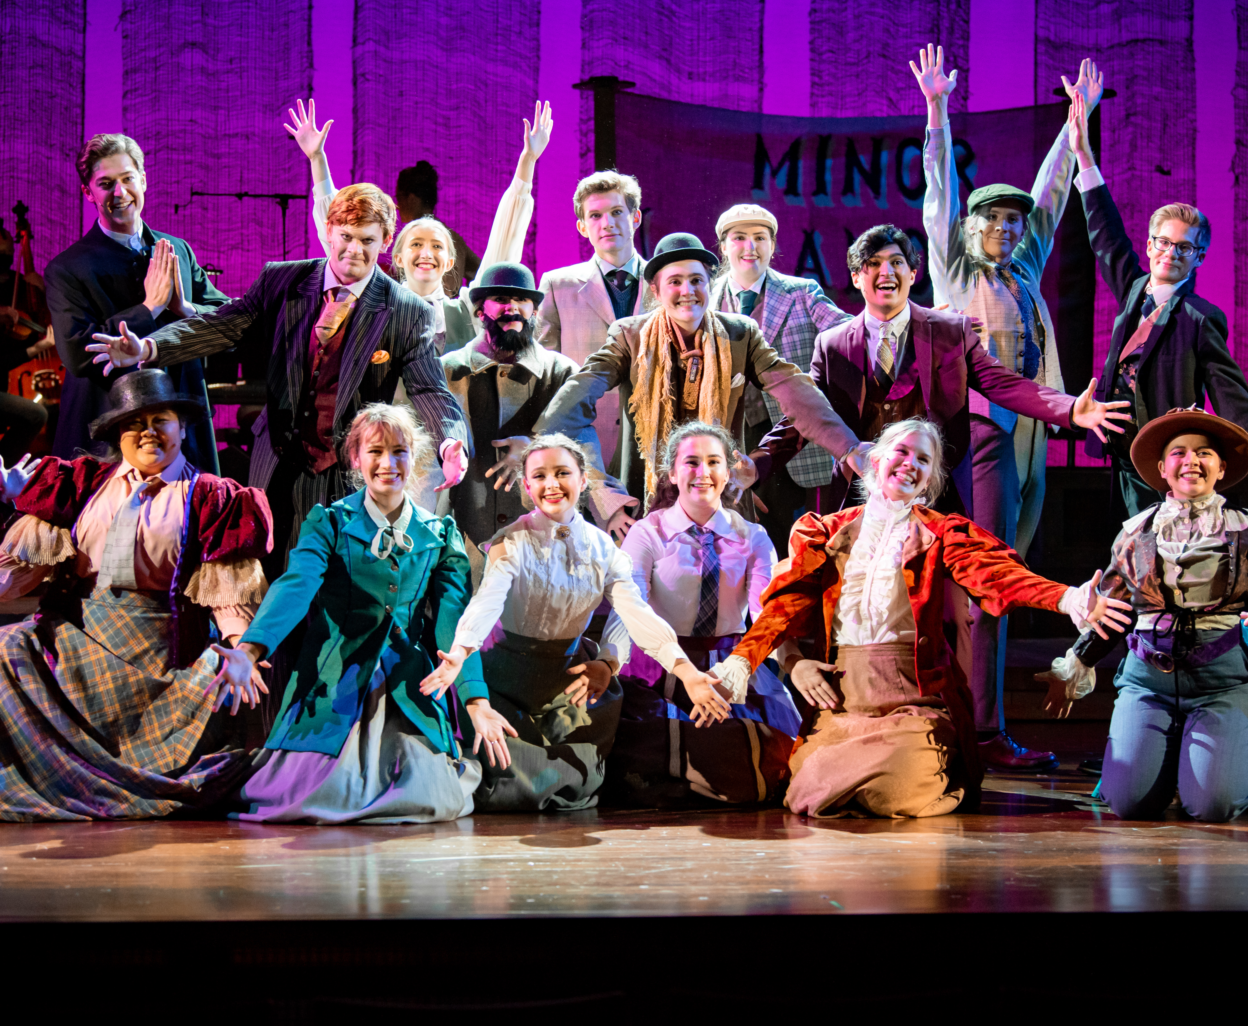
Student feedback
Anonymous student feedback
“It was a great start to acting, especially for those of us who hadn't participated or performed in acting much, if at all. Jadd was able to create a safe space for all of us to buy into performing and acting.”
“Our rehearsals were some of the best that I have ever had! Jadd had a way of directing that really gave the actors creative freedom but was also structured enough to create comprehensive scenes. The atmosphere at rehearsals was fantastic.”
Production Photos from The Mystery of Edwin Drood

Slide 7
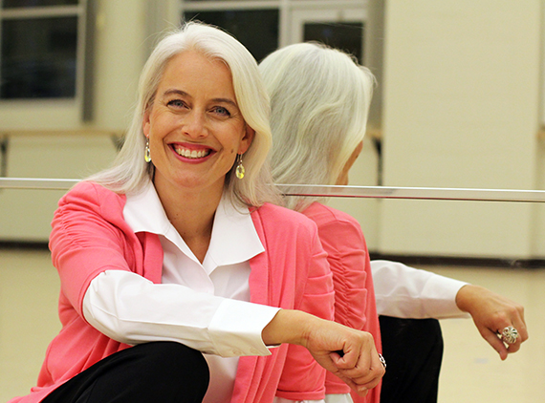
Faculty and Collaborator feedback
“Every student I talked to who participated said what a welcoming and positive experience it was! I was thrilled to hear them talk about how even though it was a lot of work it was a very positive experience because of your leadership, organization, enthusiasm, and professional compassion.” - Suzanne Ostersmith, Associate Professor of Dance
“During discussion with artistic team members, Jadd was fully present and engaged. Never interrupting, he would thoroughly listen to colleagues and make sure that he understood their thought process before responding. During difficult conversations, Jadd let his colleagues explore their issues fully. In high-stress situations, Jadd was capable of self-reflection to return to an empathetic mindset.” - Joseph Lyons-Wolf, Adjunct Dance Faculty and Choreographer for Drood.

Slide 8
Personal observations
Drood
Students consistently used language to indicate their approval of rehearsal.
I noticed a marked interpersonal support system between students playing leading roles and those in smaller parts or technical crew.
Students felt comfortable approaching me to indicate concerns about racial and gender stereotyping in the script, and we collaborated on mitigating those concerns with the entirety of the cast’s involvement.
Over the course of the rehearsal process, I noticed students taking greater initiative to support their colleagues’ work while exhibiting greater fearlessness in their own creative process.
Audiences consistently commented on the loose, playful-yet-disciplined nature of the performance, which was an intentional choice the company and I made collaboratively.
Acting I
Mostly total novice students who showed an increasing willingness to show vulnerability as semester progressed.
Two students registered in the next acting series I am currently teaching (Acting II), despite no academic requirement to do so.
One student was cast in a leading role in one of our spring productions (independent of my casting input).
Several students commented on what a positive and essential social need the class fulfilled, which was evident in classroom behavior.

Slide 9
What does the data suggest?
Based on the feedback from all parties and my own observations, the data suggests that a Person-Centered approach in this context provides, at minimum, a positive atmosphere in which to grow.
Students showed increasing autonomy in preparation throughout production and classes over the course of the semester.
In a surprise finding, my own feelings of obligation/inadequacy were mitigated by creating space for others’ needs first.

Slide 10
What does the data not suggest?
Without a time-machine, it is impossible to measure whether a different approach would have yielded different results. For instance, would a more traditionally-directive approach to Drood have created a “better” production from an audience experience? Would a more directive classroom environment have created yet more engagement from the students? There’s no way to assess these questions. As I am reminded over-and-over again in my psychology and counseling courses: correlation does not equal causation!

Slide 11
Red flags
Spring 2022 Attendance Concerns.
Is there a relationship between PCT and personal accountability in an academic setting?

Slide 12
Bibliography
Holmes, Rupert. The Mystery of Edwin Drood. Tams-Witmark, New York. 1987.
Rogers, Carl. On Becoming a Person: A Therapist’s View of Psychotherapy. Houghton-Mifflin, New York.
Sommers-Flanagan, John; Sommers-Flanagan, Rita. Counseling and Psychotherapy Theories in Context and Practice: Skills, Strategies and Techniques. Wiley and Sons, Hoboken. 2018.

