Slide 1
Q Methodology: A Underutilized and Powerful Approach to the Scientific Study of Beliefs and Values
Presented by: Adrienne Tauses, MSW, LCSW, CCTP
Phd student, Counselor Education & Supervision
Department of Counseling

Slide 2
Agenda
The Queries! The Quandaries! The Questions, Oh, My!
An overview of the obscure Q methodology:
The Query: Brief History (importance of knowing the roots of our research methodology to best present our findings)
The Quandary: Why use it?
The Question: What does it look like and how does it work?
Can I use it in my discipline?
I will leave with…
This Photo by Unknown Author is licensed under CC BY

Slide 3
The Query: Where did it come from?
Developed by William Stephenson psychologist and physicist, in the 1935
Specific new method, at the time, to study the values and beliefs of research participants.
Desire and focus was to preserve subjectivity and by-person analysis
In this case subjectivity is a person’s communication of their point of view
The analysis compares groups of people rather than the variables of hypothesized traits or tests
Interesting fact that Q methodology is also referred to in Carl Roger’s work, however, he did not complete the bi-person factor analysis, therefore not a complete replication of Stephenson’s work nearly 20 years earlier.

Slide 4
The Quandary: Why Use This?
Combines qualities of quantitative and qualitative techniques to empirically study:
Points of views
Beliefs
Values of participants
Subjectivity
Now, who enjoys the rich descriptive narrative we get from qualitative?!
Who is drawn to the transparency and quantitative analysis?
CABAM! It’s a combo deal
Ideal method for exploring complex or controversial topics, unacknowledged views, and differing perspectives
Allow exploration of data from different angles
Analysis follows hunches or discoveries often finding new perspectives and insights.
Its less directive:
Q methodology and Q sorting (I’ll get to in a minute) is designed to help people think
They have time to consider their views on certain topics
It elicits more of the person in their answers.
It’s holistic!
It is designed to catch the ‘wholeness view’
Created to illuminate real life situations helping people engage their meaning making for each statement they are sorting into a certain grid.
Here lies the qualitative meaning making.
While quantitative may analyze, qualitative brings heart and voice to your research.
It can be fun!
It can be used through expressive arts (with pictures) enabling it to have a wider participant range use for a variety of research disciplines.
I’ll give some examples of studies done with Q sort at the end so people have a better idea of ways they can apply it to their particular discipline.
Source Cherucca et al 2021

Slide 5
The Quandary Specific to the Researchers!
Q methodology is known as a socially constructivist methodology
The meaning is created and enhanced through the social interaction in interviewing that supports increasing knowledge of shared meanings and beliefs of participants.
The Rigor: Q methodology allows the creation of the participants own meaning while reducing potential bias of the researcher.
Richness of qualitative, rigor of statistical analysis, specifically through the use of factor analysis.
Small number of participants
Purposive selection-you are looking for the experts!

Slide 6
The Question: What Does It Look Like & How Does It Work?
Most Disagree
Neither agree nor disagree
Most Agree

Slide 7
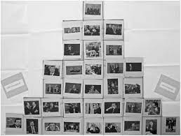

Slide 8
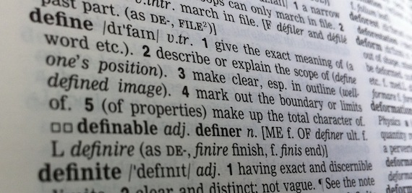
Let’s Start with Quirky Definitions, Shall We?
Q Sample
After collecting multiple statements from the media, literature, and the experts on the subject, the paired down final selection of statements Is the Q sample
Concourse:
The grid used to sort participants beliefs/points of view appears as an upside-down bell curve. Disagree all the way to agree with neutral in the middle. Capturing strongly held beliefs to the far left and right.
Q Sort
The act of the participant sorting each of the beliefs onto the entire grid (this sorting procedure allows participants to take their time and focus on the which of the statements holds the most meaning for them.
This Photo by Unknown Author is licensed under CC BY-SA

Slide 9
Find the experts and gather the statements
Prune down the statements to the Q sample
Select your participants!
The Steps of Q !
The participants create their Q sort of their own personal beliefs/thoughts and values
Correlation matrix-find the similarities and identify the significant factors of most commonly held beliefs
Support the strongest identified factors and start your interviews & create a narrative
Publish Results!

Slide 10
Step 1: The Research Question and the Gathering
Step 1: Gathering the statements about a certain phenomenon.
For example: Let’s imagine the research I am interested in using a Q sort for. It is the study of athletic practitioners and their awareness of how physical injury may relate to psychological stressors or traumatic experiences earlier in the athlete’s life. There are other pieces of this quandary, and, for purposes of the presentation, I have simplified to better understand the process of Q sorting.

Slide 11
Step 2: Find the experts! Lots of Statements with like and opposing or differing views
What do they say? Find it in the literature.
What does the media say?
What do athletic practitioners say?
What do athletes say?
What do coaches say?
What do the trauma specialists say?
What do counselors say?

Slide 12
Turns out…They have a lot to say! Statements, Beliefs, Perspectives, Oh, My
Stress can exacerbate physical symptoms.
There is a psychological component to a physiological stress response”
An athlete’s history of stressors can manifest physically
There is a high rate of childhood traumatic experiences in the current research
Injury in athletics is considered a weakness
There is space in bringing up mental health concerns with athletes
Athletic injury may lead to feelings of isolation
The curriculum of sports psychology includes mental health awareness
I have learned the skills of interacting with athletes about mental health concerns or stressors outside of their sport
I am comfortable speaking with athletes about difficult topics
I am aware of my own mind body connection
I rarely am emotionally dysregulated
I have sought mental health services in my life
Counseling was accepted in my culture growing up
Attending counseling is part of my inner social group
Its easy to talk about my emotions
Its overwhelming to prioritize these topics within my job scope with athletes
The perceived stress response is common knowledge and spoken about regularly.
Physical illness is weakness
Mental health support is for other people
Everyone deserves support
Fear can contribute to increase stress response in our nervous systems
Being an athletic trainer is overwhelming
There is space to talk about mental health distress we see in our athletes in collegial discussion
There is a trusting relationship between an athletic practitioner and athlete

Slide 14
Step 2: Creating the Q sample to Use
Pare down the statements, eliminate duplicates, combine where you need to.
Looking for balance in the statements
We want them to be conversational and relatable
Strongly held beliefs or view points

Slide 15
Now select your participants and send them Instructions
You will send them the number of statements as there are sections on the grid
Participants sort each statement into the upside-down grid
Then we have the concourse!

Slide 16
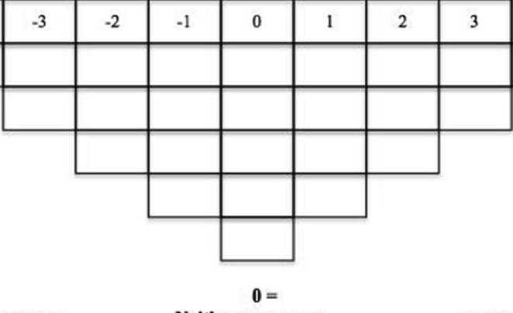
5
22
9
14
18
4
2
22
19
12
23
17
7
3
6
13
21
11
1
15
10
8
24
Most Disagree
Neutral
Most Agree

Slide 17
The Statistical Method: Factor Analysis (the down and dirty)
Takes large number of data and reduces it by finding underling patterns in the data to better explain the relationship
First, we use a correlation matrix which overlays the Q sorts and seeks out shared meanings (this can be all done through a software program which I will go over at the end).
Each factor is identified depending on the ‘loading’ or weighted average of participants Q sorts on that particular factor that has been identified as the most held belief (the averaging together of the Q sorts)
Now: Interview the participants to hear how and why they selected those particular beliefs. Get to know your participants and how they think, help them elaborate their perspectives. This provides rich descriptions.
This also helps clarify the character of the factor (why did this stand out, what is meaningful about this particular statement).
Most Agree
Most Disagree
Neutral

Slide 18
The Narrative and Interpretation
You begin to gather the interviews to support shared meanings and eventually identify the most held beliefs and shared meanings about a certain phenomenon.
In the case of my research, I hope to use it to gain meaning of the relationship between the variables of awareness and comfort through a Pre Q sort and a Post Q sort
This will assist in my creating a workshop with athletic practitioners that addresses introduction of stress response and physical injury in athletes, and, increase comfort in their role in helping athletes recover using mind/body approach to healing.

Slide 19
Studies Using Q Sort Across Disciplines
Barker, J. (2008). Q methodology: An alternative approach to research in nursing education
Anderson, R.H., Schulze, J.L. (2018) Pinning Down Democracy: A Q-Method Study of Lived Democracy.
Barker, S.L, Maguire, N., Bishop, F.L., & Stopa, L.L. (2019). Expert Viewpoints of Peer Support for People Experiencing Homelessness: A Q Sort Study.
Gao, J.& Soranzo, A. (2020) Applying Q-Methodology to Investigate People’s Preferences for Multivariate Stimuli.
Lundberg, A, Leeuw, R., & Aliani, R. (2020). Using Q methodology: Sorting out subjectivity in educational research.
Trepal, H. (2003). Adolescents Perceptions of their Pregnancy: A Q Methodology Study
Richardson, L.A., Fister, C.L & Ramlo, S.E (2014). Effect of an exercise and weight control curriculum; views of obesity among exercise science students.

Slide 20
Softwares & Q Website
Qmethod.org: Resources, publication, conference discussion, examples etc.
PQMethod, Peter Schmolck, based on FORTRAN code by John Atkinson at Kent State University.
PCQ, developed by Mike Stricklin (the one seen the most in my literature findings) Proprietary software, available only for Windows. qmethod package for the R software environment, created by Aiora Zabala with contributions by Maximilian Held.
KenQ Analysis a web application for Q methodology, free analysis software developed by Shawn Banasick. Runs in supported browsers (Firefox, Chrome, Edge).

Slide 21
References
Barker, S.L., Maguire, N., Bishop, F.L & Luisa, L. (2018). Expert Viewpoints of Peer Support for People Experiencing Homelessness: A Q Sort Study. American Psychological Association. 16 (3): 402–414. 1541-1559. http://dx.doi.org/10.1037/ser0000258
Churruca, K. Ludlow, K., Wu, W., Gibbons, K., Nguyen, H., Ellis, L., Braithwaite, J. (2021) A scoping review of Q methodology in healthcare research. BMC Medical Research Methodology. 21, 125 (2021).
McKeown, B. & Thomas, D. (1988). Q Methodology. Sage Publishing
Newman I, Ramlo S. (2010). Using Q methodology and Q factor analysis in mixed method research. In: Handbook ofMixed Methods in Social and Behavioral Research (2nd ed.), edited by Tashakkori A, Teddlie C. Thousand Oaks, CA: SAGE, p. 505–530.
Richardson, L.A., Fister, C.L, Ramlo, S.E (2014). Effect of an exercise and weight control curriculum; views of obesity among exercise science students. Journal of Advanced Physiological Education. (39): 43-48.
Watts, S. & Stenner, P. (2005). Doing Q methodology: theory, method and interpretation. Qualitative Research in Psychology, (2), 67-91.
Watts, S. & Stenner, P. (2012). Doing Q Methodological Research: Theory, Method and Interpretation. Sage Publishing

Slide 22
Thank you!
Contact information:
Adrienne.tauses@umontana.edu

