Slide 1
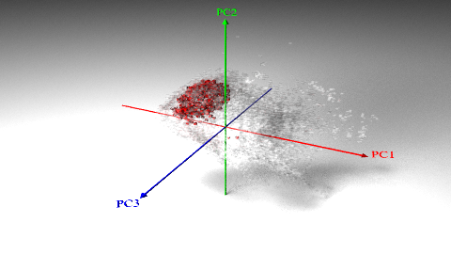
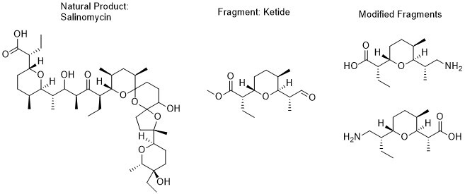
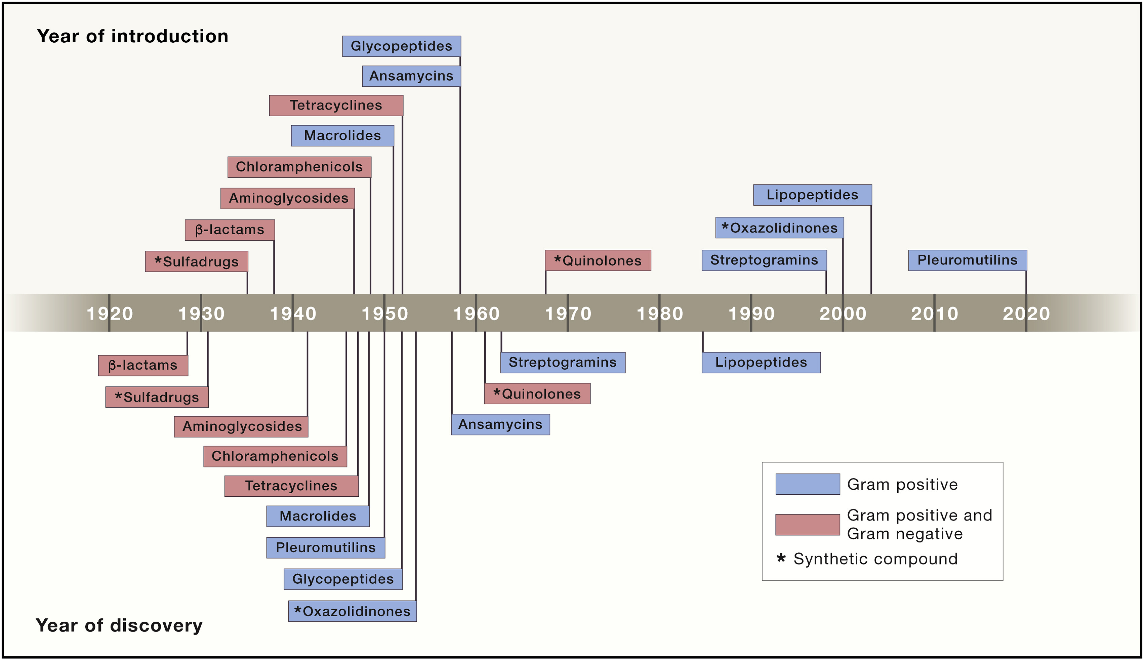
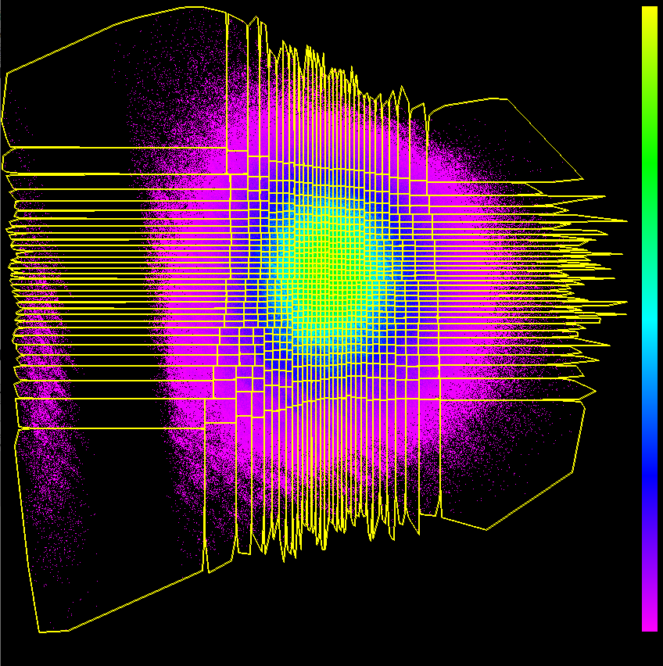
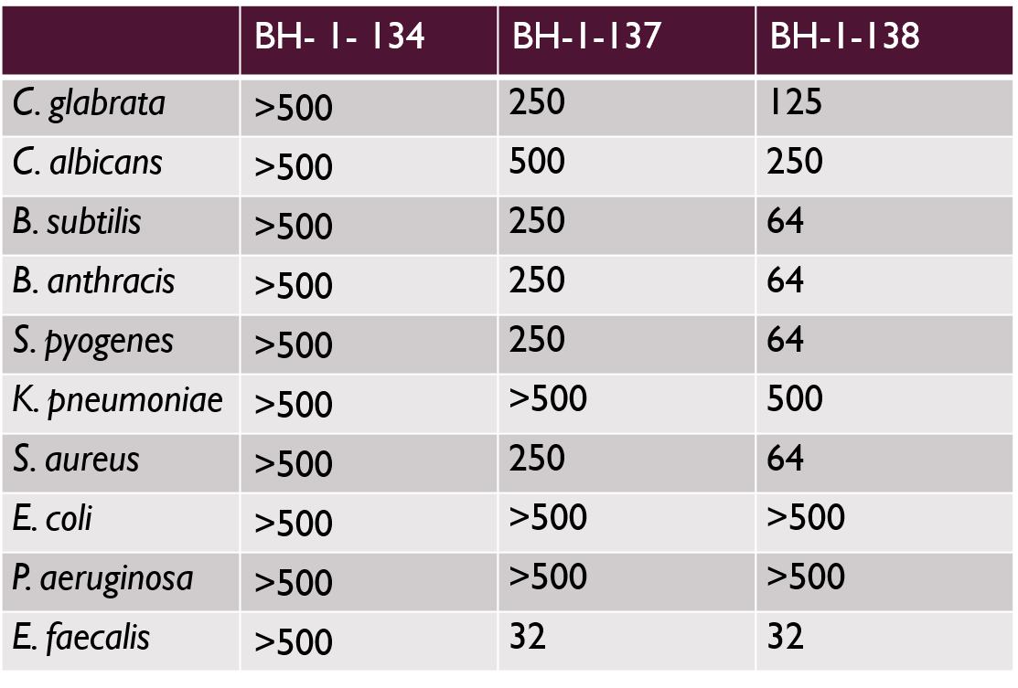
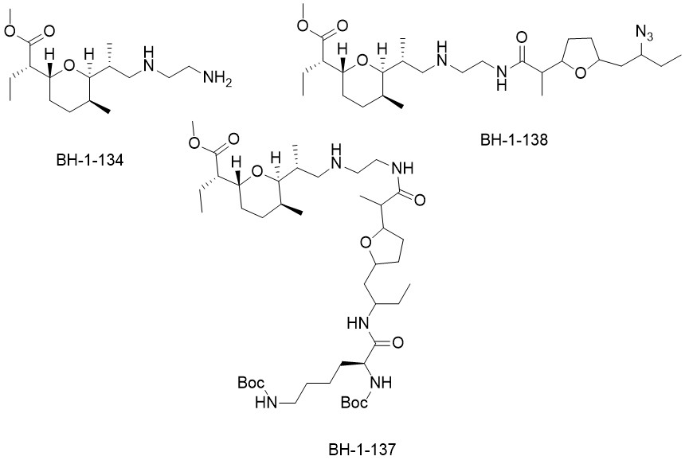
High Potential Hit-Rate of a Natural Product Fragment Reassembly Library
Evelyn Schwartz, Nalani Oines, Blaik Hopewell, John Hoody, Jeremy Alverson, Nathan Gibson, Nigel Priestley
Department of Chemistry and Biochemistry, University of Montana
1. Introduction
3. Selection of Compounds
4. Natural Product Fragments
Introduction of new antibiotics in crucial in the progression of modern medicine, as discovery of antibacterial drugs has stalled over the past two decades. The CDC (Center for Disease Control and Prevention) reports that in the United States there are an estimated 2.8 million AMR (antimicrobial resistant) infections that lead to 35,000 deaths per year. In addition, the CDC has moved three microbial strains from serious to urgent status ¹ Two primary sources of drug discovery have been through commercial screening libraries and natural products. Screening libraries tend to be simplified structures for ease of synthesis and availability of building block materials. Natural products tend to display a range of bioactivity, but isolation and synthetic modifications are limited due to the structural complexity. Here we present a new library that links natural product fragments by amide bonds similar to amino acids in peptides.
The “Natural Products Reassembly Library” (NPFR) has generated over 4 million compounds in silico that are to be synthesized and tested. A group of compounds will be selected to give an overall representation of the potential hit-rate of the library. These compounds were plotted in a multidimensional plot with 17 different parameters.
The use of natural product fragments overcomes the synthetic challenge of the whole compound. Though complete not original structure, a fragment still holds some unique structural characteristics and is more synthetically accessible. Many of the fragments are modified to have both a carboxylic acid and amine for amide coupling.
Donor count
Acceptor count
Pi-energy
Refractivity
Exact Mass
Isoelectric Point
Aromatic ring count
Chiral center count
Fsp³
Fused ring count
Hetero-ring count
Large String Size
MMFF95
Maximal Projection Radius
Minimal Projection Radius
Polar Surface Area
Rotable bond Count
Above is a 3D comparison of diversity of commercially available libraries (red) with the NPFR library (clear-gray). Below is a 2D image demonstrating the formation of 64 boxes which one compound will be selected from to represent the hit-rate of the library.
Natural products take on many various structure and are categorized into four general classes; alkaloids, phenylpropenes, polyketides (ketides), and terpenoids (terpenes). Alkaloids are the largest class of natural products and are general described as any nitrogen heterocyclic structure that can be derived from an amino acid. Phenylpropenes, all contain benzene rings with substitutions typically occurring at ortho and para positions of a propene functional group. Ketides are traditionally defined as structures derived from activated acetate, and terpenes contain a repeating C₅H₆ fragment². The NPFR library contains 12 alkaloids, 13 ketides, and 7 terpenoids categorized natural product fragments.
2. Traditional Drug Discovery
5. Antibiotic Activity
Natural Products
Listed are three samples that have been tested for biological activity from the NPFR library. This is a good indicator that the library will provide useful compounds but comparison with other libraries will be done after synthesis of the selected representative compounds are completed
Natural products are compounds extracted from a range of microorganisms, plants, and animals. Traditional medicinal plants have been a thoroughly sought source and any secondary metabolites from cultures of micro-organisms have been isolated. Natural products attribute their span of bio-activity to unique and complex structures but leaves minimal synthetic associability for modification. Total synthesis of such compounds are often a lengthy processes, and isolation from its original source can vary in quantity.
Screening Libraries
Screening libraries are massive with a long list of commercially available compounds. These compounds can be produced at a large industrial scale unlike natural products, but often they are more simplistic structures in comparison. Many vary slightly from each other and attribute they massive scale to synthetic simplicity and ease.
.
References
Acknowledgments
1) Centers for Disease Control, U. Antibiotic Resistance Threats in the United States, 2019. https://doi.org/10.15620/cdc:82532.
(2) Products, P. N. Plant-Derived Natural Products; Osbourn, A. A., Lanzotti, V., Eds.; Springer: New York, 2009.
Acknowledgements go to the University of Montana Chemistry Department, Promiliad research group, and the NIH-NIAID grant AI118104

