Slide 1
"Does Diversification in the Face of Increased Climate Risks Depend on Individual Risk attitudes? Evidence from Rondônia, Brazil"
Brenna Swinger
This work is supported by UM BRIDGES and the National Science Foundation.
NSF DGE-1633831 (UM Bridges) and NSF BCS-1825046 (Water Production Connections)

Slide 2
Background
Diversification is a farm management strategy under which farmers generate a mixed portfolio of different crops and activities in order to minimize their risk exposure (Ochieng et al., 2020)
Climate change is leading to increased rainfall variability for smallholder farmers and therefore greater risks to their crops, land, and livestock (Tefera, 2012; Waha et al., 2012; Jones & Thornton 2003)
Research has found diversification allows farmers to offset the risks of climate change (McNamara & Weiss, 2005)

Slide 3
Theoretical Model
Diversification strategies offer higher certainty → Relatively risk averse farmers will prefer certainty over higher income
Specialization strategies offer higher levels of income → Relatively risk neutral farmers will prefer higher income over certainty

Slide 4
Research question
Do farmers’ diversification decisions in response to increased rainfall variability change based on their individual risk attitudes?

Slide 5
Contribution
Understand how risk attitudes and climate risks interact to impact the farming decisions of smallholder farmers
Expand the scope of diversification research to include crop, production, and off-farm
Expand on the existing literature in terms of geographic area

Slide 6
Study region

Slide 7
Dependent Variable
Simpson's Diversification Index
SDI = 1- $\sum_{n=1}^{i}{P_{i}^{2}}$
Two different specifications
Grouped: Crops allocated into two categories, annual and perennial
Ungrouped: the 22 potential crops are counted individually

Slide 8
Sources of income
Grouped SDI
Ungrouped sdi
Annual Crops
Perennial Crops
Milk
Cattle
Other Livestock
Fish
Bees
Off Farm Activities
Other Sources
23 distinct crops
Milk
Cattle
Other Livestock
Fish
Bees
Off Farm Activities
Other Sources

Slide 9
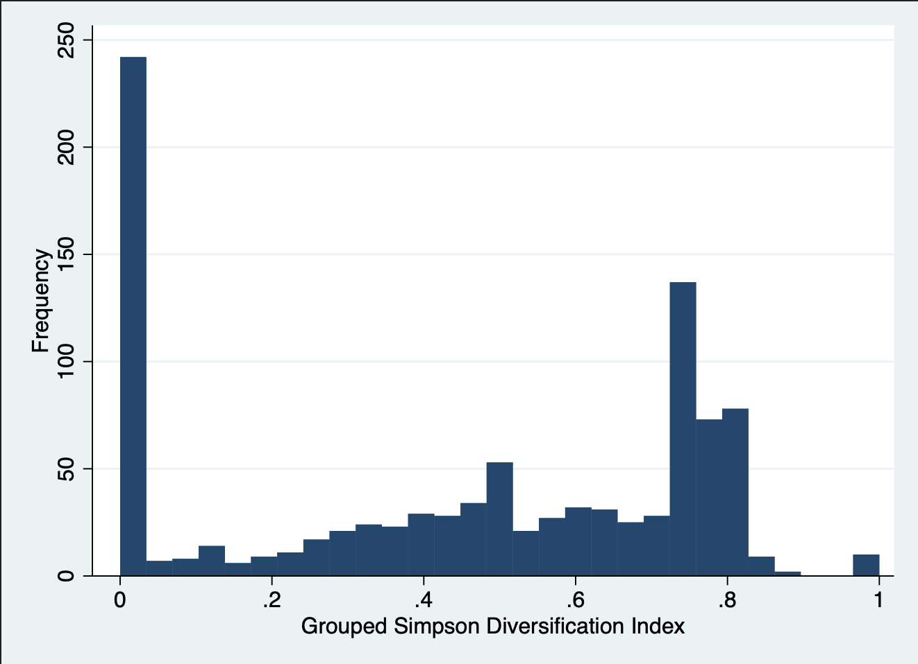
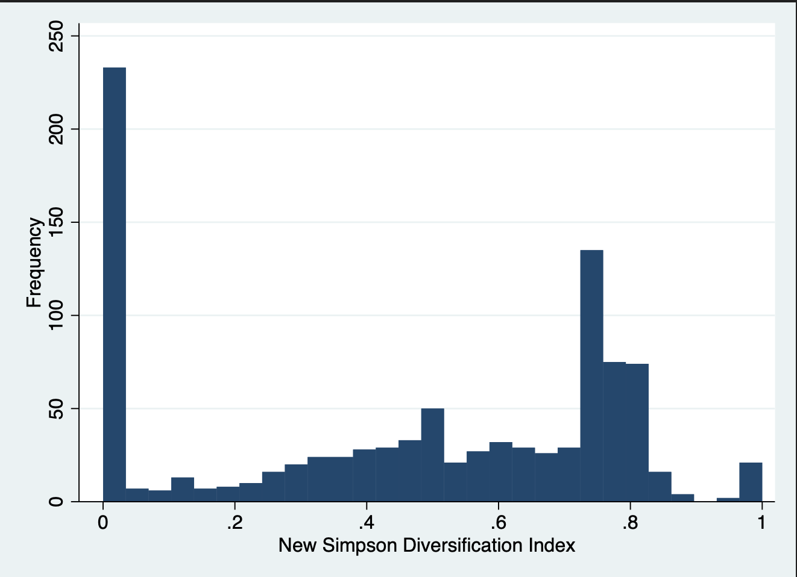
Distribution of sdi
GROUPED SDI
UNGROUPED SDI

Slide 10
Complete specialization
Activity | Number of Specialized Farmers
Milk | 109
Cattle | 49
Off-farm Activities | 37
Perennial | 10
Fish | 7
Annual | 5
Other Livestock | 0
Bees | 0

Slide 11
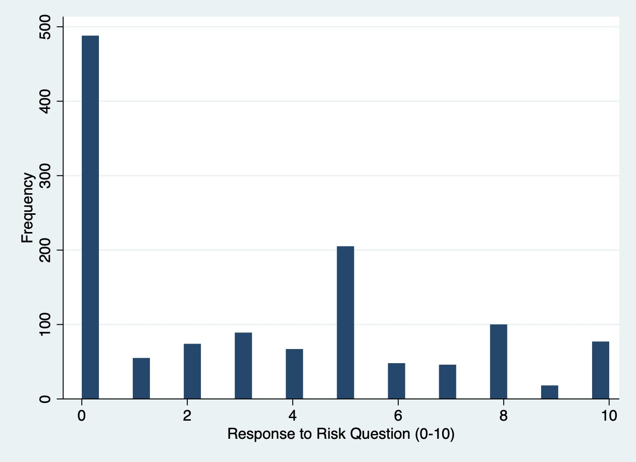
Explanatory variable – risk attitudes
“Please tell me how much you would say you are or are not willing to take risks in general. To answer, use a scale from 0 to 10, where 0 means you are ‘not willing at all to take risks’ and 10 means that you are ‘very willing to take risks’. You can use any number between 0 and 10 to indicate your answer”

Slide 12
Risk Categories
1 - 3: Risk Averse
4 – 6: Risk Neutral
7 – 10: Willing to Take Risks

Slide 13
Explanatory variable - rainfall
Standard Deviation of Rainfall Variables Since Farmers Moved to Their Property (mm/yr.)
 | mean | min | max
Yearly Rainfall | 184.44 | 32.19 | 303.35
Dry Season Rainfall | 29.08 | 0.71 | 42.98
Wet Season Rainfall | 105.04 | 11.50 | 245.37
Rainfall May | 36.38 | 1.41 | 80.01
Rainfall September | 32.60 | 2.12 | 58.84
N | 1217

Slide 14
Control Variables
 | mean | min | max | sd
Family Members | 3.73 | 0 | 15 | 2.16
Edu(F) - years | 3.56 | 0 | 14 | 3.95
Edu(M) - years | 3.47 | 0 | 14 | 3.24
Most Edu - years | 4.58 | 0 | 14 | 5.26
Age Cat(F) | 1.07 | 1 | 2 | .26
Age Cat(M) | 1.25 | 1 | 2 | .44
Durables | 12.08 | 0 | 67 | 6.30
Lot Size –hectares | 100.60 | .2 | 3146 | 220.82
Year Acquired | 1995.14 | 1960 | 2019 | 13.29
N | 1267

Slide 15
Possible Sources of bias
Unobservable characteristics that could be correlated with risk preferences and diversification
Unobservable characteristics that could be correlated with rainfall and diversification

Slide 16
equation
$$SDI= β_{0}+ β_{1}risk+β_{2}rain+β_{3}control+ μ$$

Slide 17
regression results

Slide 18
Interaction equation
$$SDI= β_{0}+ β_{1}risklevel+β_{2}rain{+ β}_{3}risklevel∗rain+β_{4}control+ μ$$

Slide 19
Interaction regression results

Slide 20
next steps
Regressions
Poisson model
Other specifications of diversification index
Results
Examine regression results
Describe findings

Slide 21
Questions?

