Slide 1
Effects of Concussions on Balance: A Systematic Review
Jason Nielsen, ATS
Shane Murphy, PhD, ATC

Slide 2
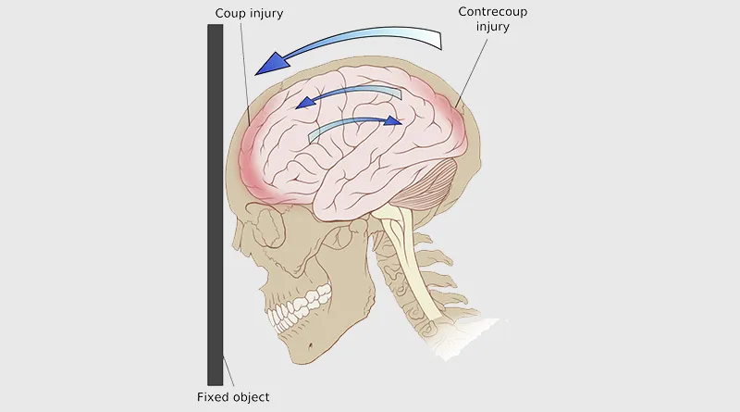
Concussions
Usual occurrence comes from participation in a sport with contact, where a blow to the head can occur.
This blow to the head causes a coup and contrecoup movement of the brain which in return affects the function of the brain.
Concentration, memory, balance, and coordination.
Reference:

Slide 3
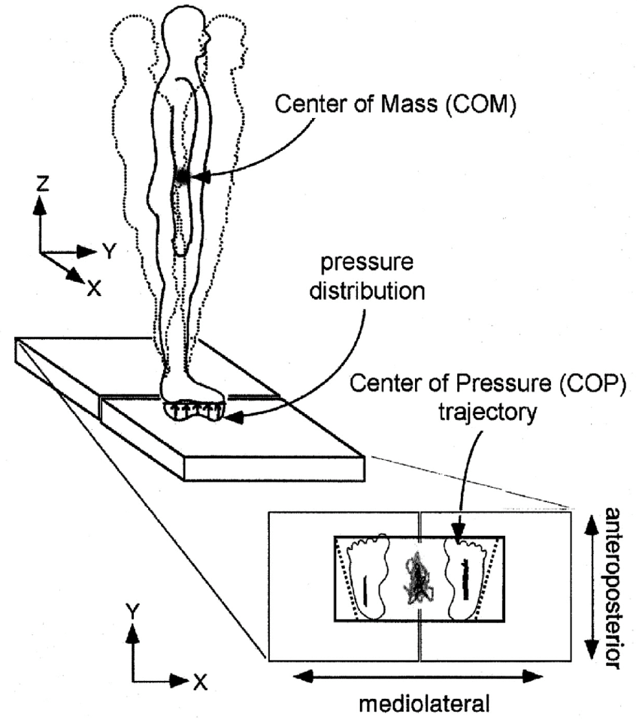
Center of Pressure
Measurement using a force plate to capture postural control in both the sagittal and frontal planes of motion.
Root Mean Square is the square root of the mean for displacement.
Displacement/ postural sway is the measurement of distance from center
Velocity is how fast the postural swaying was.
Reilly et al, 2020, Sweeny et al 2020, Powers et al, 2014

Slide 4
Purpose of study
To determine how much of an effect concussions have on balance, through the use of center of pressure measurements.

Slide 5
Key words
-Search Phrase= (Concussion or “mild traumatic brain injury” or mTBI’s) and (“center of Pressure” or COP).
-Concussion
-mTBI- (mild traumatic brain injury)
-COP- (center of pressure)
-Displacement or postural sway
-RMS (root mean square)
-Velocity
-A/P- Anterior/Posterior (frontal plane)
-M/L- Medial/Lateral (sagittal plane)

Slide 6
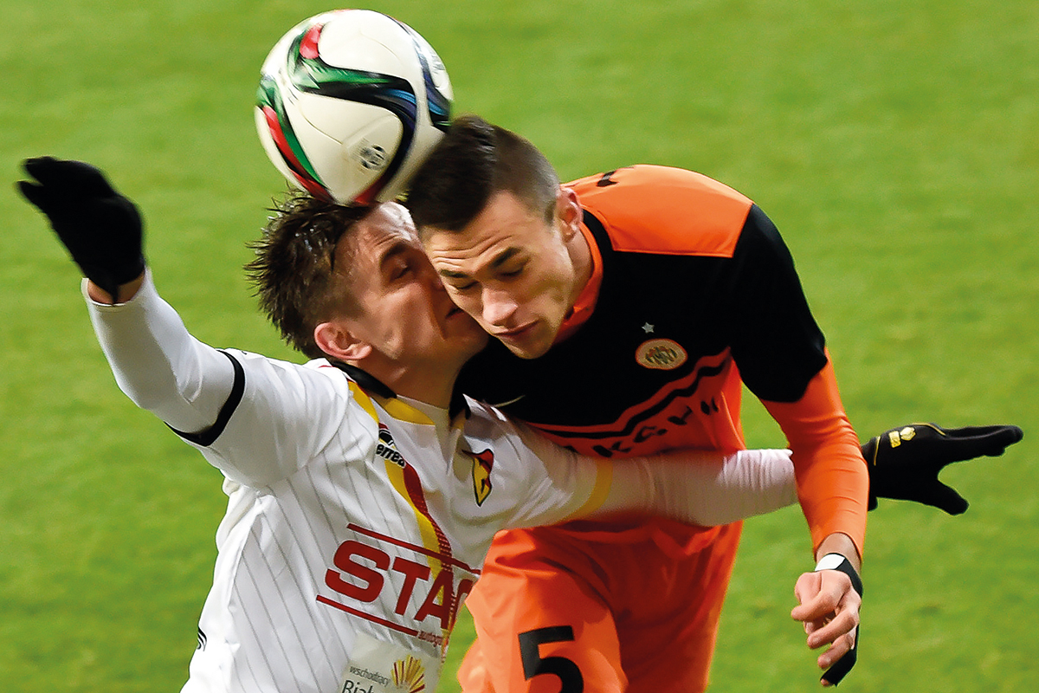
Inclusion Criteria
Center of pressure to measure balance.
Concussions or mTBI’s
Any gender, age, language, or ethnicity

Slide 7
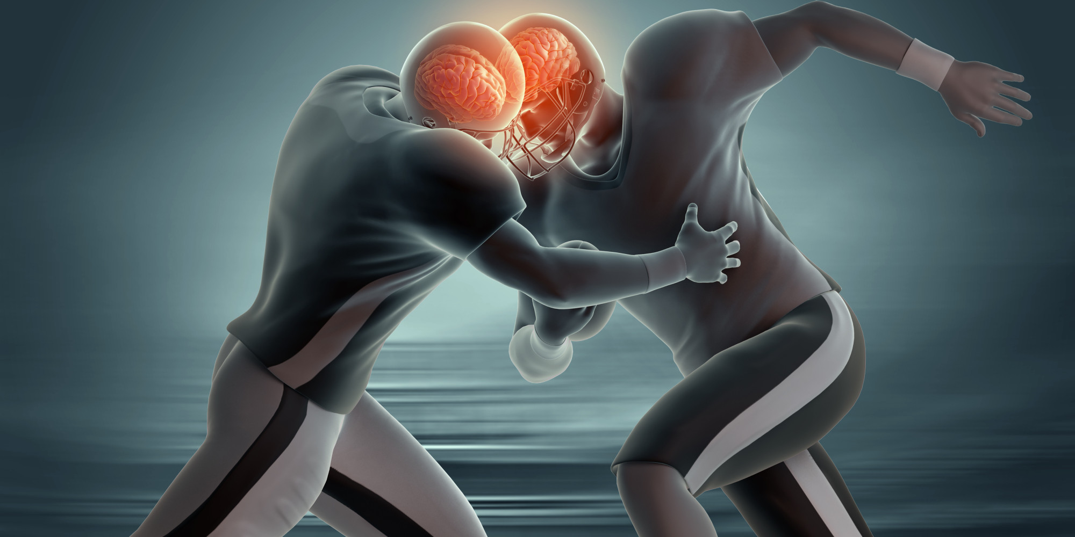
Exclusion Criteria
Using anything other than then COP for measuring balance, like BESS test.
No concussion/mTBI groups

Slide 8
Records identified through database searching PubMed (n = 90)
Additional records identified through other sources (n=0)
PRISMA Flowchart
Identification
Records after duplicates removed (n = 90)
Screening
Records excluded, with reasons (n =71)
-Irrelevant title and abstract
Records screened (n = 90)
Eligibility
Full-text articles assessed for eligibility (n = 19)
Full-text articles excluded, with reasons (n = 12)
-Didn’t use COP measurements
-Not enough data
Included
Studies included in qualitative synthesis (n = 7)

Slide 9
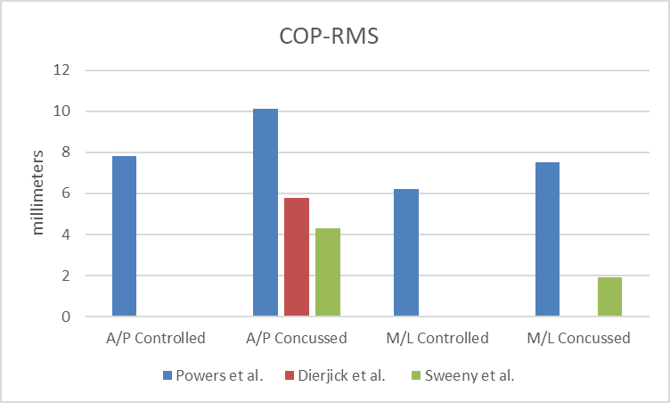
Powers et al, 2014, Dierjick et al, 2018, Sweeny et al, 2020

Slide 10
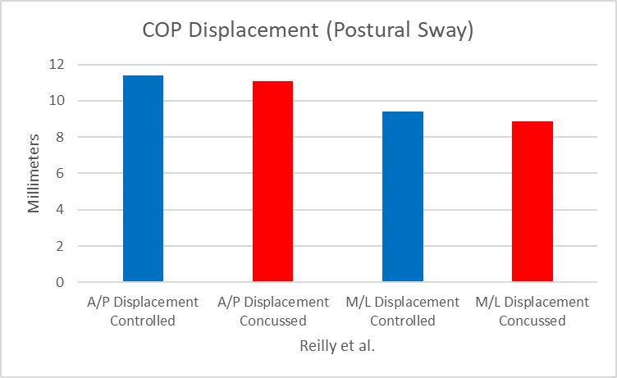
Reilley et al, 2020.

Slide 11
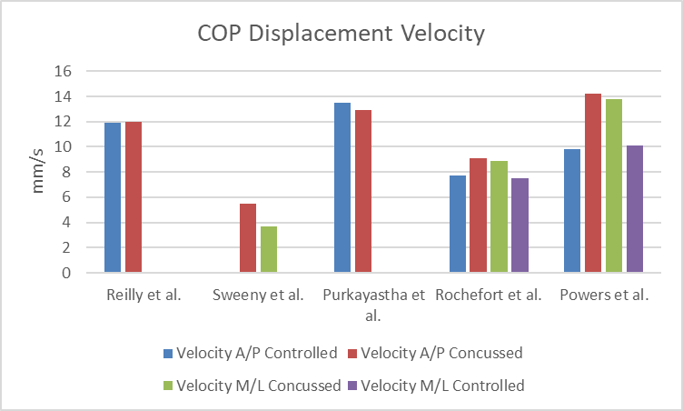
Reilly et al, 2020, Sweeny et al, 2020, Purkayastha et al, 2019, Rochefort et al, 2020, Powers et al, 2014.

Slide 12
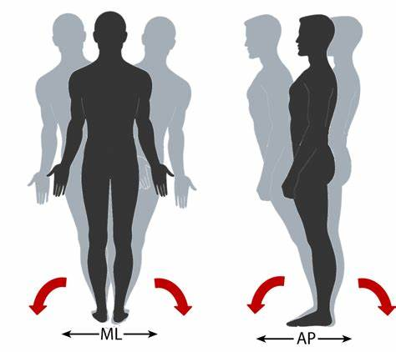
COP Displacement/Postural Sway
The one article that did just displacement shows that their data doesn’t show any significant differences between the controlled (non-concussed) and the concussed groups.
The other articles focused mainly on velocity, elliptical, RMS or area.
Would need more than this to get a better data set for displacement via COP.
Reilly et al, 2020

Slide 13
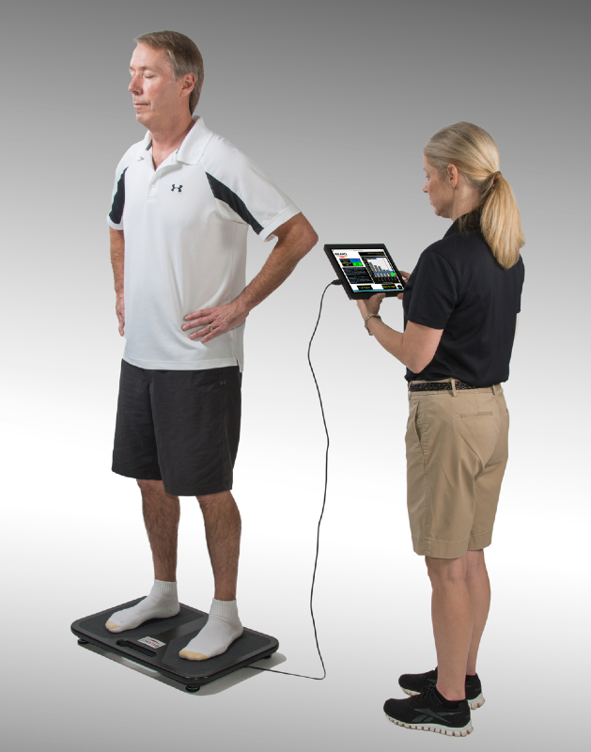
COP RMS
From the data we can say that the RMS for the concussed group is slightly more than the controlled group for both planes of motion (sagittal and frontal)
This means a bigger area was displaced during the COP measurement for the concussed group.
Powers et al, 2014, Dierjick et al, 2018, Sweeny et al, 2020

Slide 14
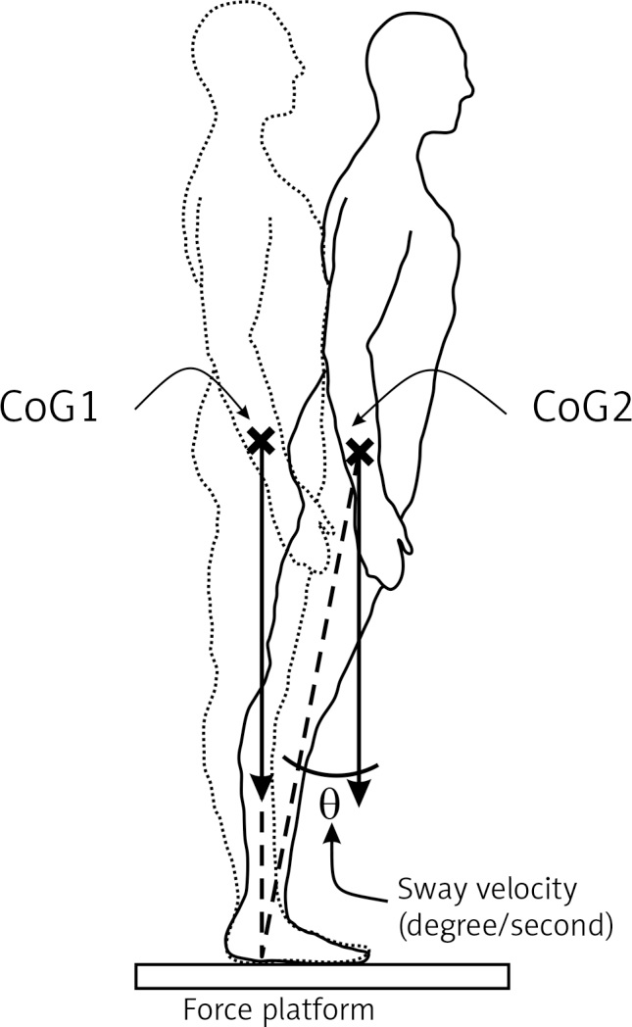
COP Displacement Velocity
The data shows a faster velocity for anterior/ posterior postural sway for the concussed group.
No significant amount of difference between the controlled and concussed groups for medial/ lateral postural sway.
Reilly et al, 2020, Sweeny et al, 2020, Purkayastha et al, 2019, Rochefort et al, 2020, Powers et al, 2014.

Slide 15
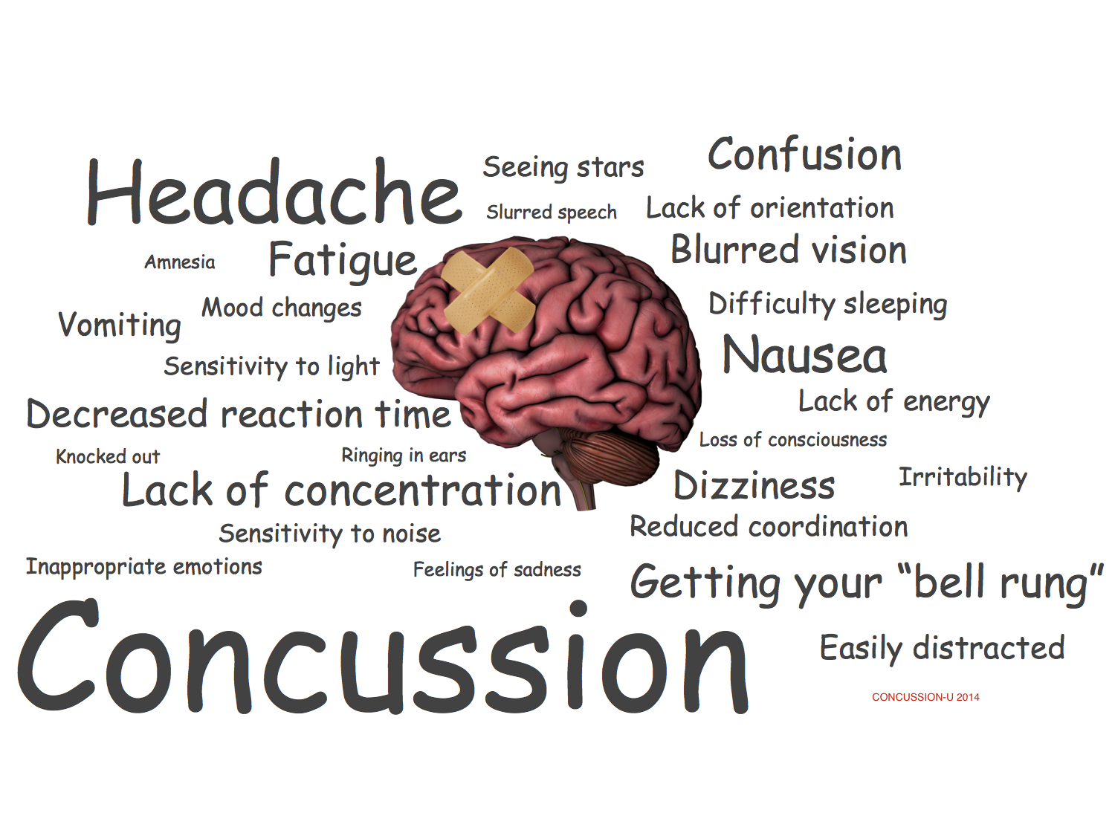
Factors Contributing to Balance Issues from a Concussion
Visual and vestibular system problems
These systems are the most used in balance, thus when disturbed they throw a person’s balance off with:
Double vision
Depth perception problems
Dizziness
Vertigo
Headaches
Confusion
Decreased Reactions
Veritas Health

Slide 16
Current and Future Research
Previous studies have more focus on return to play and symptoms then balance issues, which is why it is not a bigger part for RTP.
Future research is needed to better understand why balance should be tested throughout a concussion rehab along with be used a lot in rehab.
Hopefully adding to the RTP for most organizations.

Slide 17
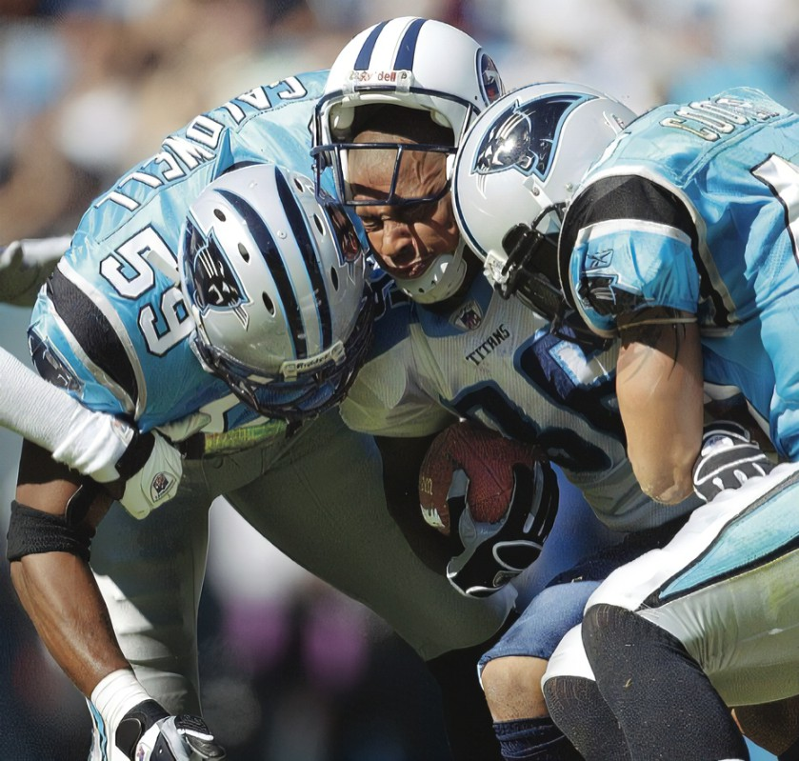
Conclusions
COP shows that concussions do have noticeable changes in postural sway through velocity, RMS, and displacement.
Some measures show more differences in the sagittal plane (medial/ lateral), while others show that the frontal plane (anterior/posterior) has a bigger difference.
In this review the biggest differences between control and concussion was the measure of RMS and Velocity.
Still needs more research to show true changes because this was not enough to be significant.

