Slide 1
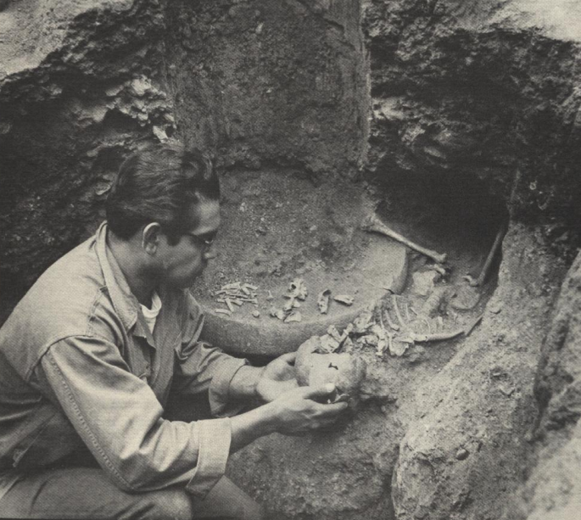
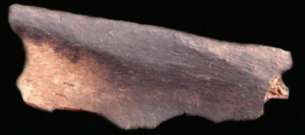
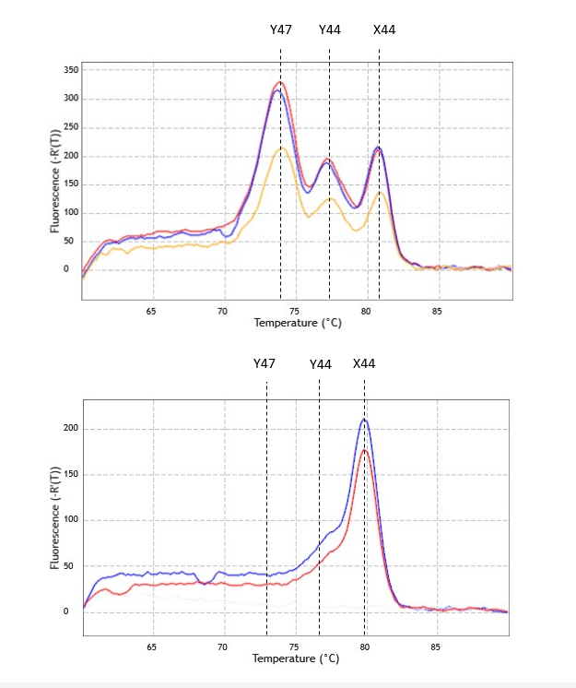
Molecular Sex Determination of Ritual Violence Victims at Paquimé in Chihuahua, Mexico
Lacy Hazelwood, BS & Meradeth Snow, PhD
Department of Anthropology, University of Montana
Introduction
Preliminary Results
At the prehistoric site of Paquimé in Chihuahua, Mexico, violence has been linked to the development and maintenance of ritual and social inequality through sacrifice and performance violence. Although bioarchaeological studies have identified the presence of sacrifice and cannibalism among 49 individuals, the question of who were the victims remains unanswered - that is, how were these individuals selected?
Research indicates that preferences for certain demographic variables such as age and sex may have played a significant role in the recruitment of sacrificial victims, and that these were often matched with the deities to whom they were offered. Sex identification in ancient humans remains using traditional osteological methods is a common problem, especially if the skeletons are sub-adult, incomplete, or damaged. Utilizing molecular analysis to determine biological sex provides an accurate and reliable method for understanding how specific aspects of an individual’s identity may or may not have predisposed them to suffer violence.
Hypothesis 1: Based on data from Mexico regarding other sacrificial victims, most of the remains of unknown sex will be female.
Hypothesis 2: Characteristic of cannibalized assemblages, males and females will be represented among the unknown remains.
30 individuals previously identified as sacrificial and cannibalized victims from Paquimé (AD 1200-1450) were subjected to the following methods.
Drilling & DNA Extraction
Collected ~0.3 g of bone dust was recovered through drilling into the petrous bones or teeth, followed by DNA extraction.
Real-Time PCR
Targeted amplification of specific regions on sex chromosomes (X44, Y44, and Y47) using real-time PCR.
To reduce false identifications, all amplifications were run in duplicates.
Accuracy assessed using positive controls of known biological sex.
Sex Determination by High Resolution Melting Analysis
PCR products were subjected to HRM analysis for sex determination based on differences in melting temperatures of the targeted regions.
Agilent AriaMx Software version 1.71 used to generate melting curve profiles obtained from individuals showing a clear difference in shape between sexes.
Molecular sex estimations were assigned for all individuals.
Males and females are roughly equally represented among the cannibalized assemblage.
Females were sacrificed more frequently than males.
For all remains analyzed in this study, estimation of individual sex had been previously attempted using traditional osteological methods. Compared to initial sex assignments, molecular sex estimations:
Confirmed initial sex assignments for ten individuals
Provided biological sex for nine individuals for whom assignments could not be previously established by morphological criteria
Were discordant to morphological sex typing for 11 individuals
Currently, preliminary results support the proposed hypotheses, suggesting that biological sex was a determining factor in the recruitment of individuals for ritual violence. Results also indicate that the targeted amplification specific regions on the sex chromosomes followed by HRM analysis is a reliable and accurate method of sex estimation.
Ongoing research is focused on completing molecular sex determinations for the remaining 19 individuals previously identified as ritual violence victims, as well as expanding the sample size through the identification of more victims at Paquimé. Results will add to the existing knowledge on the ritual practices and social structure present at Paquimé.
Dabney, Jesse and Matthias Meyer. 2019. "Extraction of highly degraded DNA from ancient bones and teeth." Pp. 25-29 in Ancient DNA."Extraction of highly degraded DNA from ancient bones and teeth." Springer.
Di Peso, Charles C. 1974. Casas Grandes: A Fallen Trading Center of the Gran Chichimeca. Amerind Foundation Publication.
Madel, Maria-Bernadette, Harald Niederstätter and Walther Parson. 2016. "TriXY—Homogeneous Genetic Sexing of Highly Degraded Forensic Samples Including Hair Shafts." Forensic Science International: Genetics 25:166-174
Turner, Christy G., II C. G. Turner and Jacqueline A. Turner. 1999. Man Corn: Cannibalism and Violence in the Prehistoric American Southwest. University of Utah Press.
Waller, Kyle D. and Adrianne M. Offenbecker. 2020. "The Politics and Poetics of Performance Violence at Casas Grandes, Chihuahua, Mexico." The Poetics of Processing: Memory Formation, Identity, and the Handling of the Dead:41.
White, Tim D. 2014. Prehistoric Cannibalism at Mancos 5MTUMR-2346.Princeton University Press.
 | Male | Female | Total
Cannibalism | 10 | 6 | 16
Sacrifice | 4 | 10 | 14
Grand Total | 14 | 16 | 30
Cut marks on left clavicle
(Waller and Offenbecker, 2020)
Child Sacrifice at Paquimé
(Di Peso et al., 1974)
Burning on acromion process of scapula
(Waller and Offenbecker, 2020)
Skeletal Indicators of Sacrifice and Cannibalism:
Slicing cut marks on bone shafts and surrounding joints
Cut marks located on skull, scapulae, clavicles, anterior surfaces of vertebrae, and at muscle attachment points along bone shafts
Various forms of heat exposure
Evidence of burning concentrated on surfaces of bones such as the cranium, mandible, and tibiae
Pot polish: shiny, smooth texture that forms when fragmented bones are boiled
Conclusion
Materials and Methods
References
Acknowledgements: Thank you to Dr. Meradeth Snow and the University of Montana Genomics Core for providing access and help.
Melting temperature curve profiles produced by male and female samples in HRM analysis.

