Slide 1
English Witchcraft Pamphlets
By: Tsea Francisconi

Slide 2
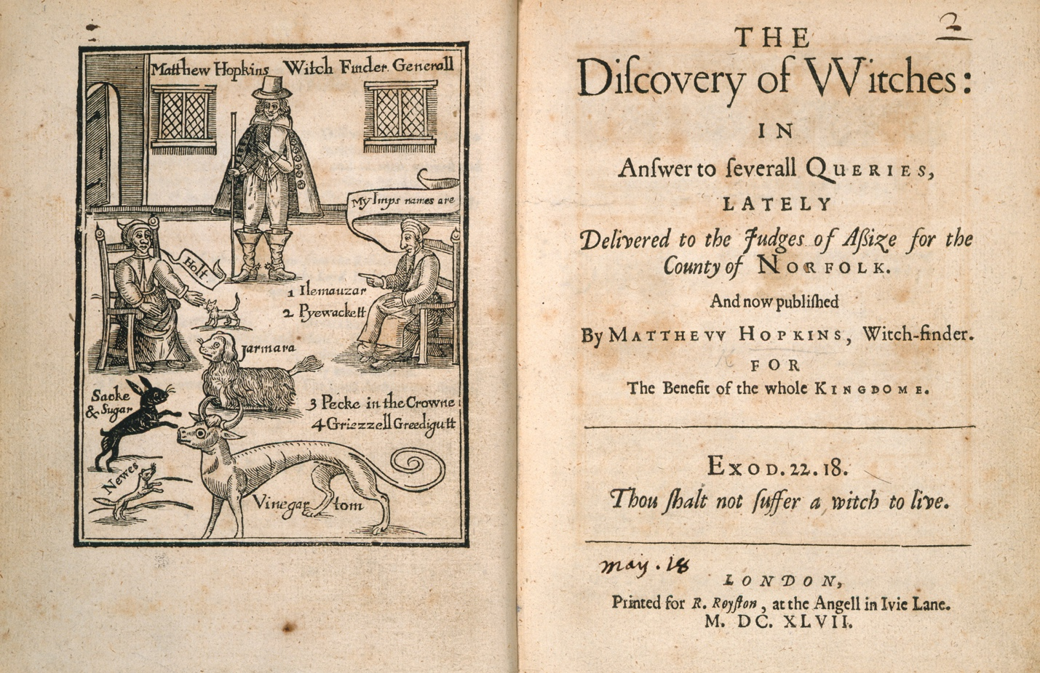
The Discovery of Witches: in answer to several queries lately, delivered to the judges of aßize for the county of Norfolk. And now published by Matthew Hopkins, Witch-finder, for the benefit of the whole kingdome, Printed in London for R. Royston, at the Agell in Ivie Lane.
Source: British Library

Slide 3
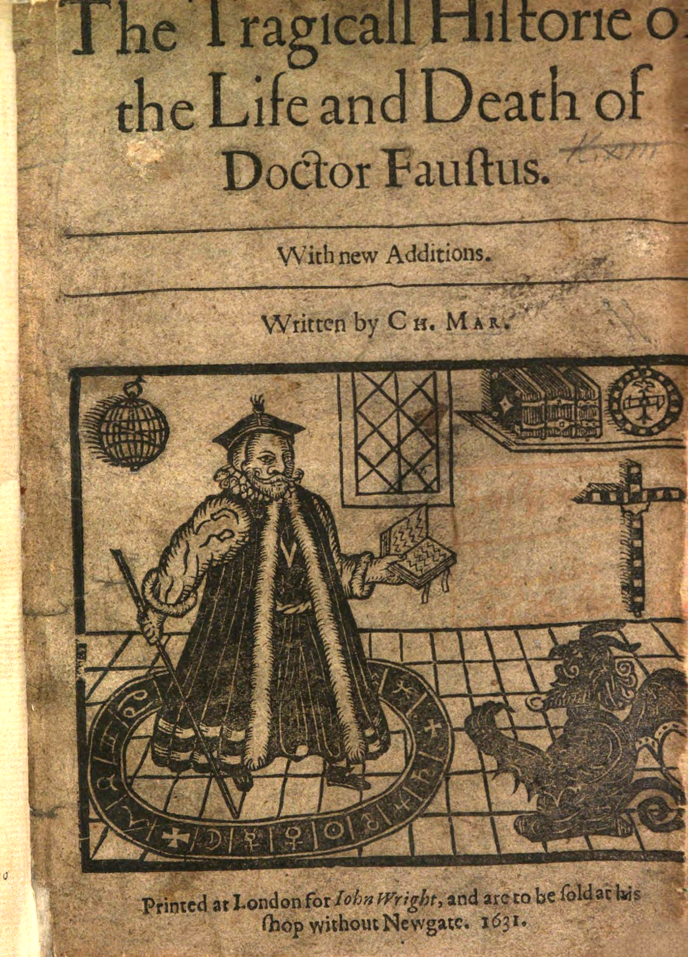
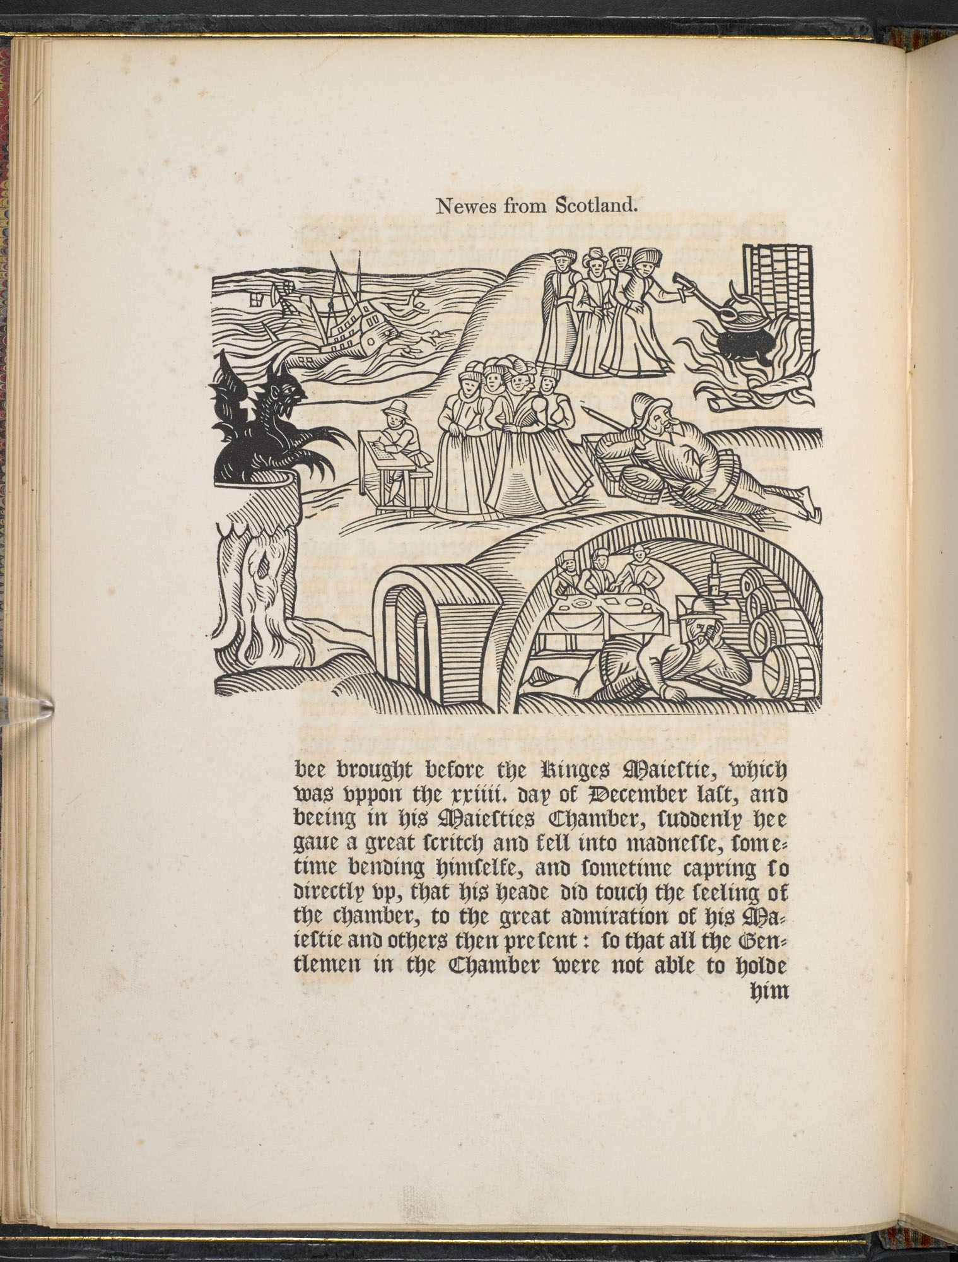
Newes from Scotland, printed in 1591 in London
Source: British Library
The tragicall Historie of the life and death of Doctor Faustus. By Christopher Marlowe, printed in London for John Wright, and are to be sold at his shop without Newgate, 1631.
Source: British Library

Slide 4
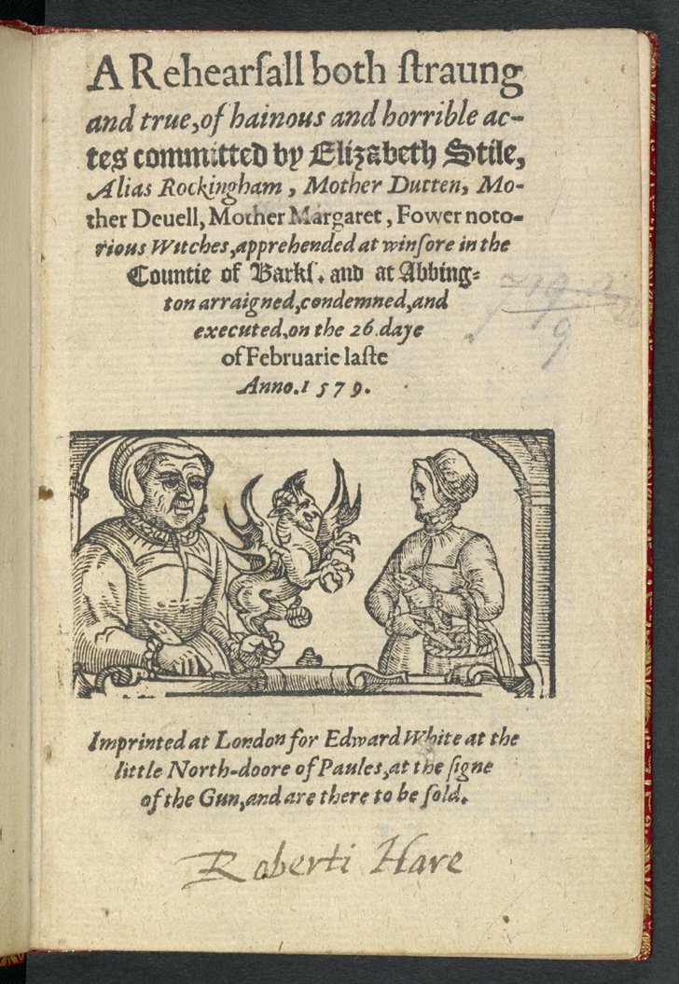
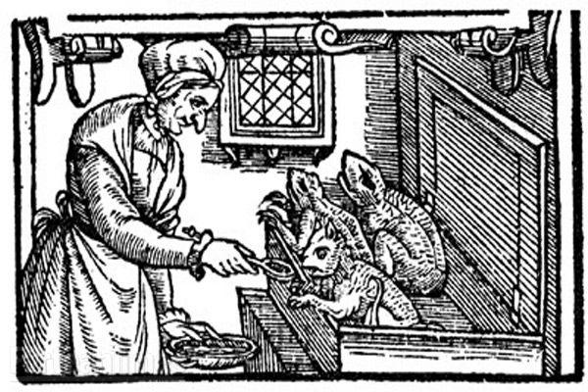
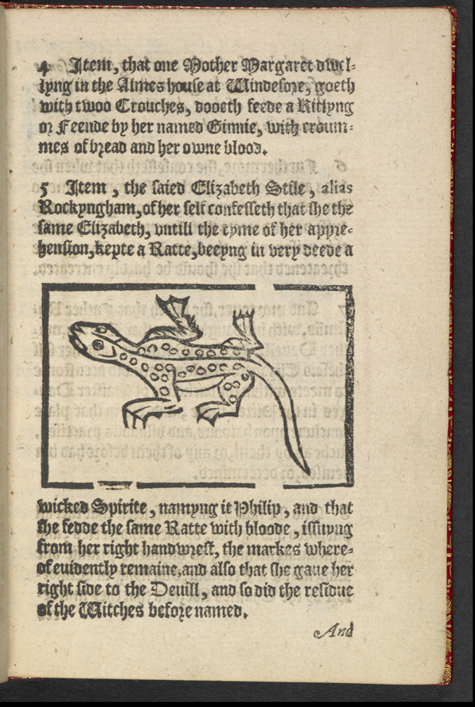
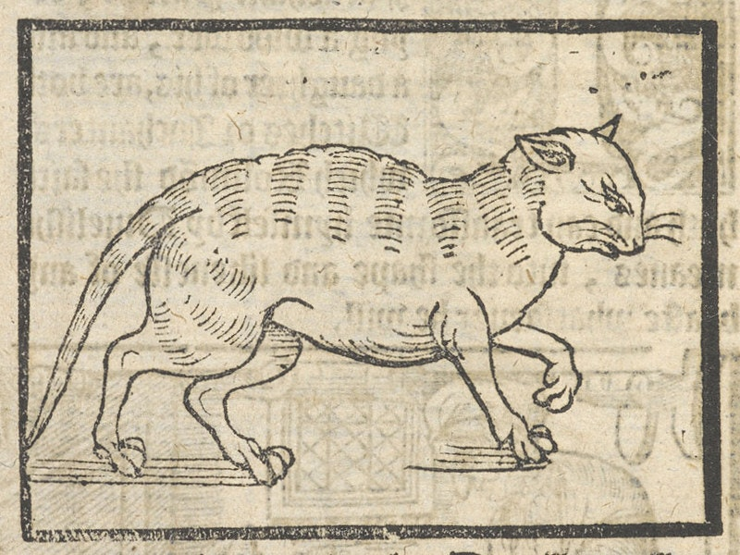
A Rehearsall both straung and true, of heinous and horrible actes committed by Elizabeth Stile, Alias Rockingham, Mother Dutten, Mother Deuell, Mother Margaret, Fower notorious Witches , Apprehended at winfore in the Countie of Barkl, and at Abbington arraigned, condemned, and ececuted on the 26 daye of Februarie laste. Printed in London 1579 for Edward White at the little North-doore of Paules at the sign of the gun, and are there to be sold.
Source: British Library

Slide 5
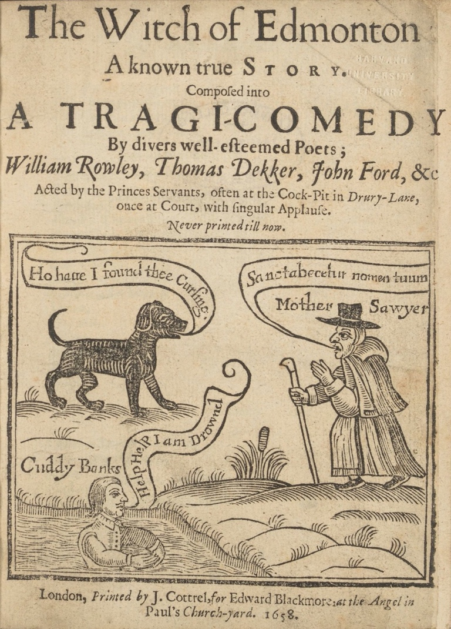
A Witch of Edmonton A known true Story. Composed into A tragic-comedy by divers well-esteemed poets; William Rowley, Thomas Dekker, John Ford, & Co. Acted by the Princes Servants, often at the Cock-Pit in Drury-Lane, once at Court, with singular applause. Never printed till now. Printed in London by J. Cottrel, for Edward Blackmore, at the Angelin Paul’s Church-yard 1658.
Source: Royal Shakespeare Company
The tragicall Historie of the life and death of Doctor Faustus. By Christopher Marlowe, printed in London for John Wright, and are to be sold at his shop without Newgate, 1631.
Source: British Library

Slide 6
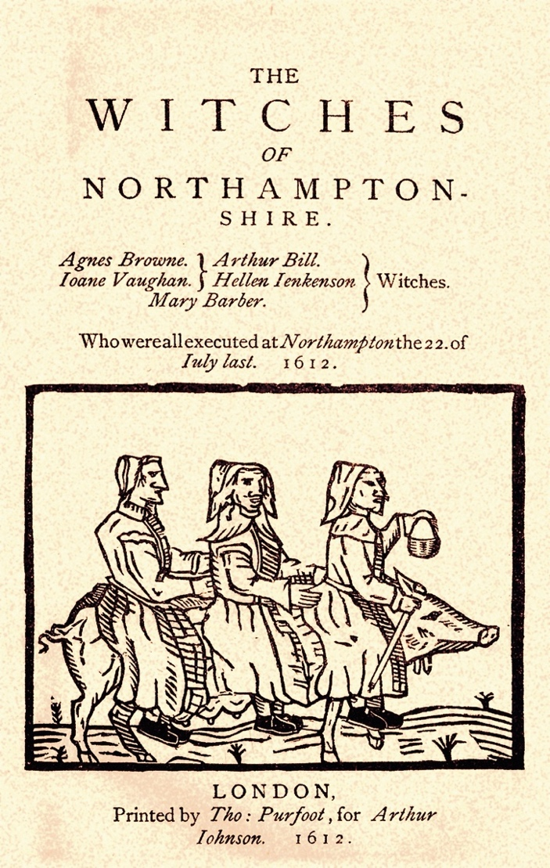
The Witches of Northampton-shire. Printed by Tho: Purfoot, for Arthur Johnson in 1612.
Sources: Northampton Chronical and Echo, Rose of the Shires
Newes from Scotland, printed in 1591 in London
Source: British Library
A Rehearsall both straung and true, of heinous and horrible actes committed by Elizabeth Stile, Alias Rockingham, Mother Dutten, Mother Deuell, Mother Margaret, Fower notorious Witches , Apprehended at winfore in the Countie of Barkl, and at Abbington arraigned, condemned, and ececuted on the 26 daye of Februarie laste. Printed in London 1579 for Edward White at the little North-doore of Paules at the sign of the gun, and are there to be sold.
Source: British Library

Slide 7
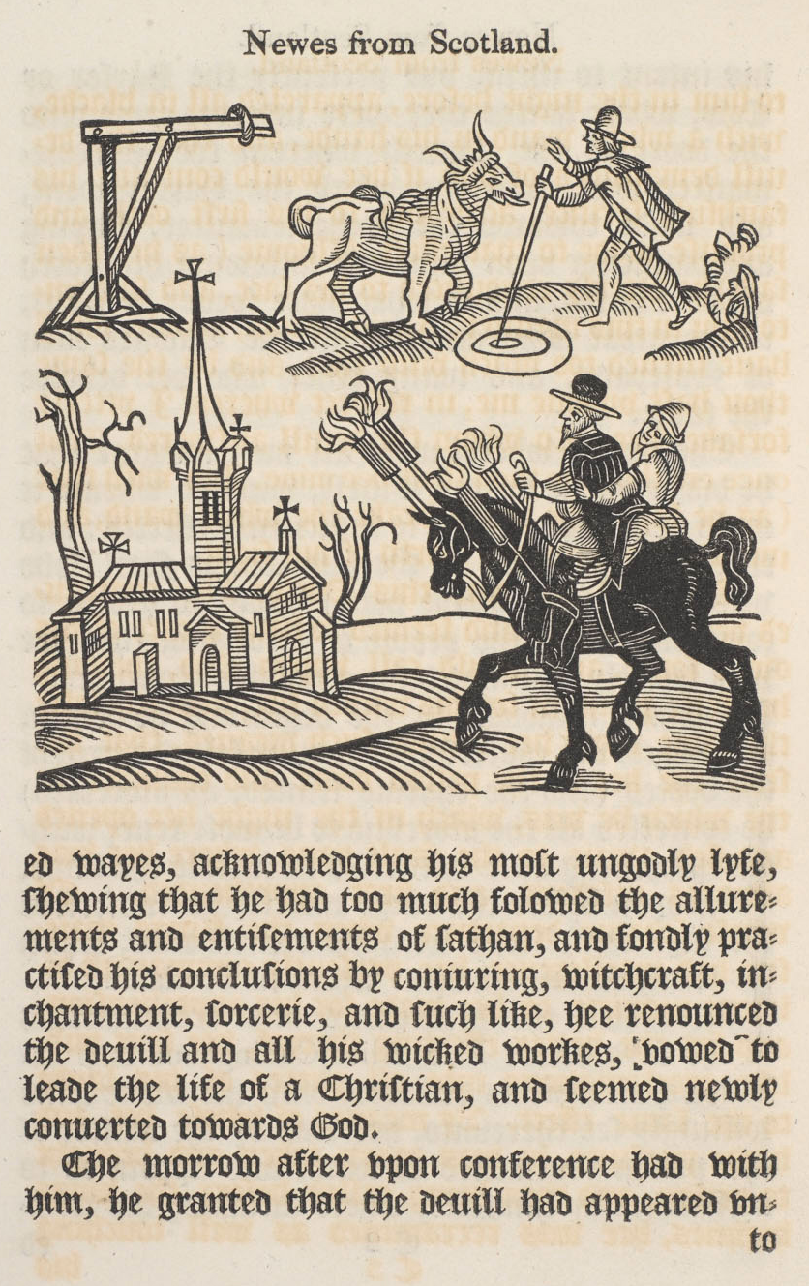
A Rehearsall both straung and true, of heinous and horrible actes committed by Elizabeth Stile, Alias Rockingham, Mother Dutten, Mother Deuell, Mother Margaret, Fower notorious Witches , Apprehended at winfore in the Countie of Barkl, and at Abbington arraigned, condemned, and ececuted on the 26 daye of Februarie laste. Printed in London 1579 for Edward White at the little North-doore of Paules at the sign of the gun, and are there to be sold.
Source: British Library
Newes from Scotland, printed in 1591 in London
Source: British Library

Slide 8
The Discovery of Witches: in answer to several queries lately, delivered to the judges of aßize for the county of Norfolk. And now published by Matthew Hopkins, Witch-finder, for the benefit of the whole kingdome, Printed in London for R. Royston, at the Agell in Ivie Lane.
Source: British Library

Slide 9
A Witch of Edmonton A known true Story. Composed into A tragic-comedy by divers well-esteemed poets; William Rowley, Thomas Dekker, John Ford, & Co. Acted by the Princes Servants, often at the Cock-Pit in Drury-Lane, once at Court, with singular applause. Never printed till now. Printed in London by J. Cottrel, for Edward Blackmore, at the Angelin Paul’s Church-yard 1658.
Source: Royal Shakespeare Company
The tragicall Historie of the life and death of Doctor Faustus. By Christopher Marlowe, printed in London for John Wright, and are to be sold at his shop without Newgate, 1631.
Source: British Library

Slide 10
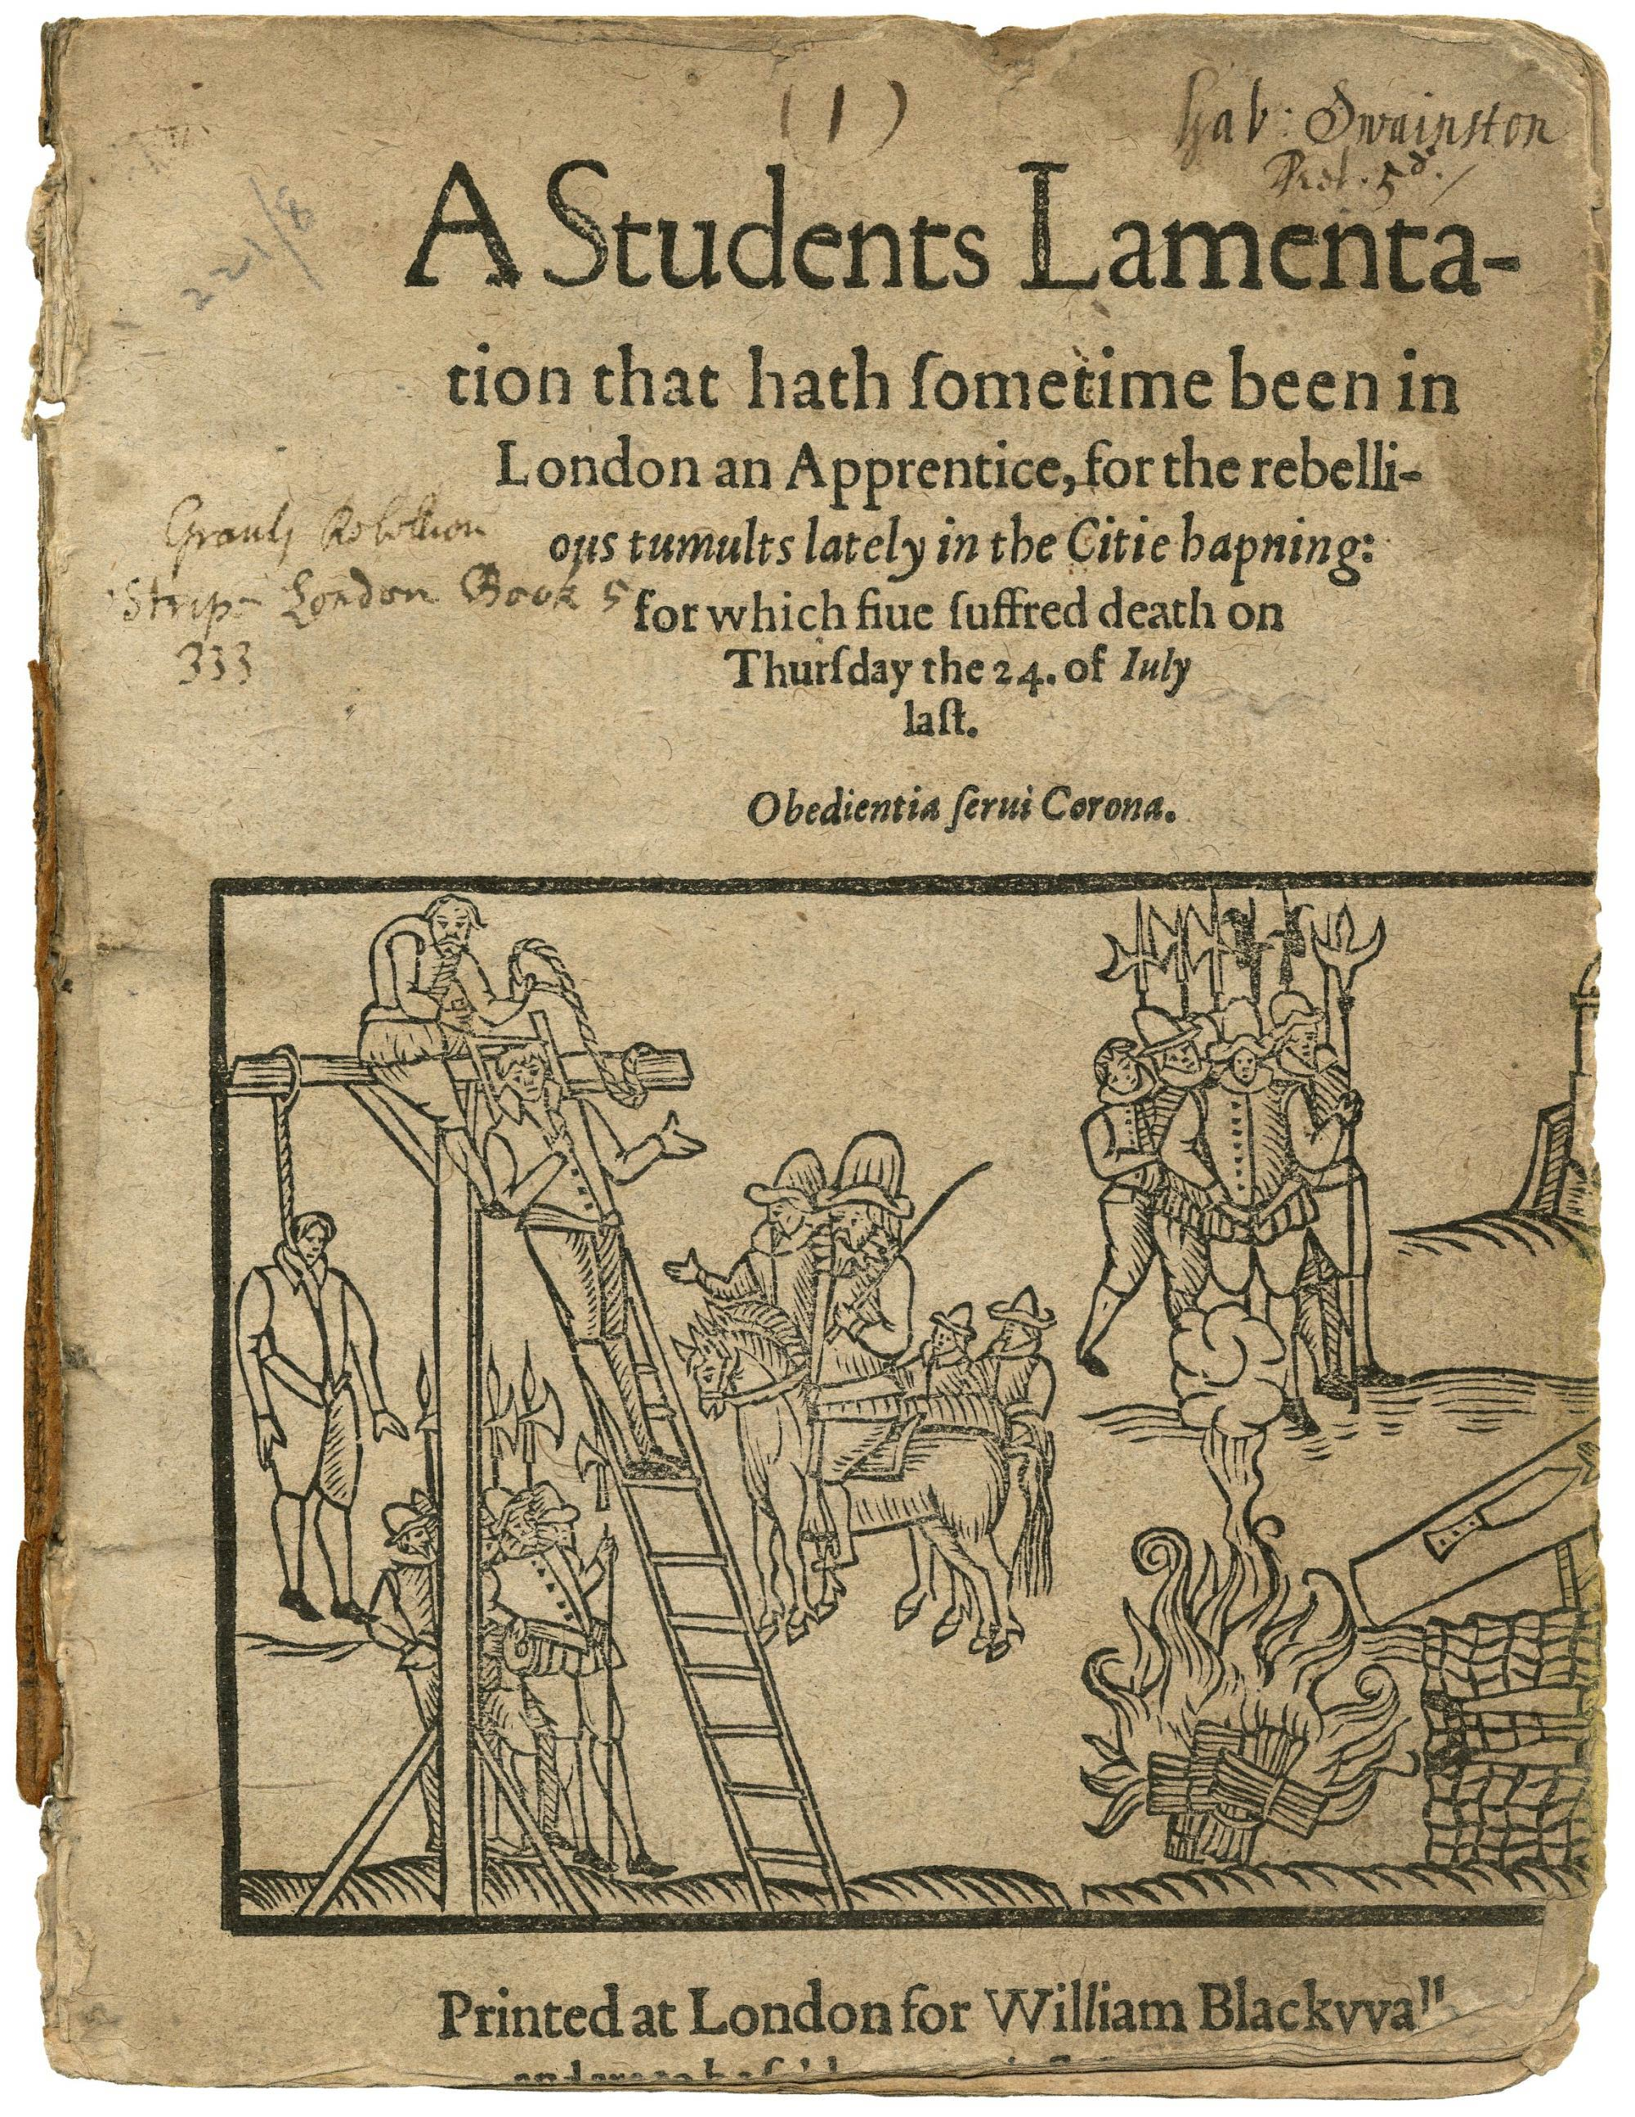
Newes from Scotland, printed in 1591 in London
Source: British Library
The tragicall Historie of the life and death of Doctor Faustus. By Christopher Marlowe, printed in London for John Wright, and are to be sold at his shop without Newgate, 1631.
Source: British Library
A Students Lamentation that hath sometime been in London an Apprentice, for the rebellious tumults lately in the citie hapning: for which fiue suffered death on Thursday the 24 of July last, Printed in London for William Blackwall.
Source: British Library

Slide 11
A Witch of Edmonton A known true Story. Composed into A tragic-comedy by divers well-esteemed poets; William Rowley, Thomas Dekker, John Ford, & Co. Acted by the Princes Servants, often at the Cock-Pit in Drury-Lane, once at Court, with singular applause. Never printed till now. Printed in London by J. Cottrel, for Edward Blackmore, at the Angelin Paul’s Church-yard 1658.
Source: Royal Shakespeare Company
The Witches of Northampton-shire. Printed by Tho: Purfoot, for Arthur Johnson in 1612.
Sources: Northampton Chronical and Echo, Rose of the Shires
A Rehearsall both straung and true, of heinous and horrible actes committed by Elizabeth Stile, Alias Rockingham, Mother Dutten, Mother Deuell, Mother Margaret, Fower notorious Witches , Apprehended at winfore in the Countie of Barkl, and at Abbington arraigned, condemned, and ececuted on the 26 daye of Februarie laste. Printed in London 1579 for Edward White at the little North-doore of Paules at the sign of the gun, and are there to be sold.
Source: British Library

Slide 12
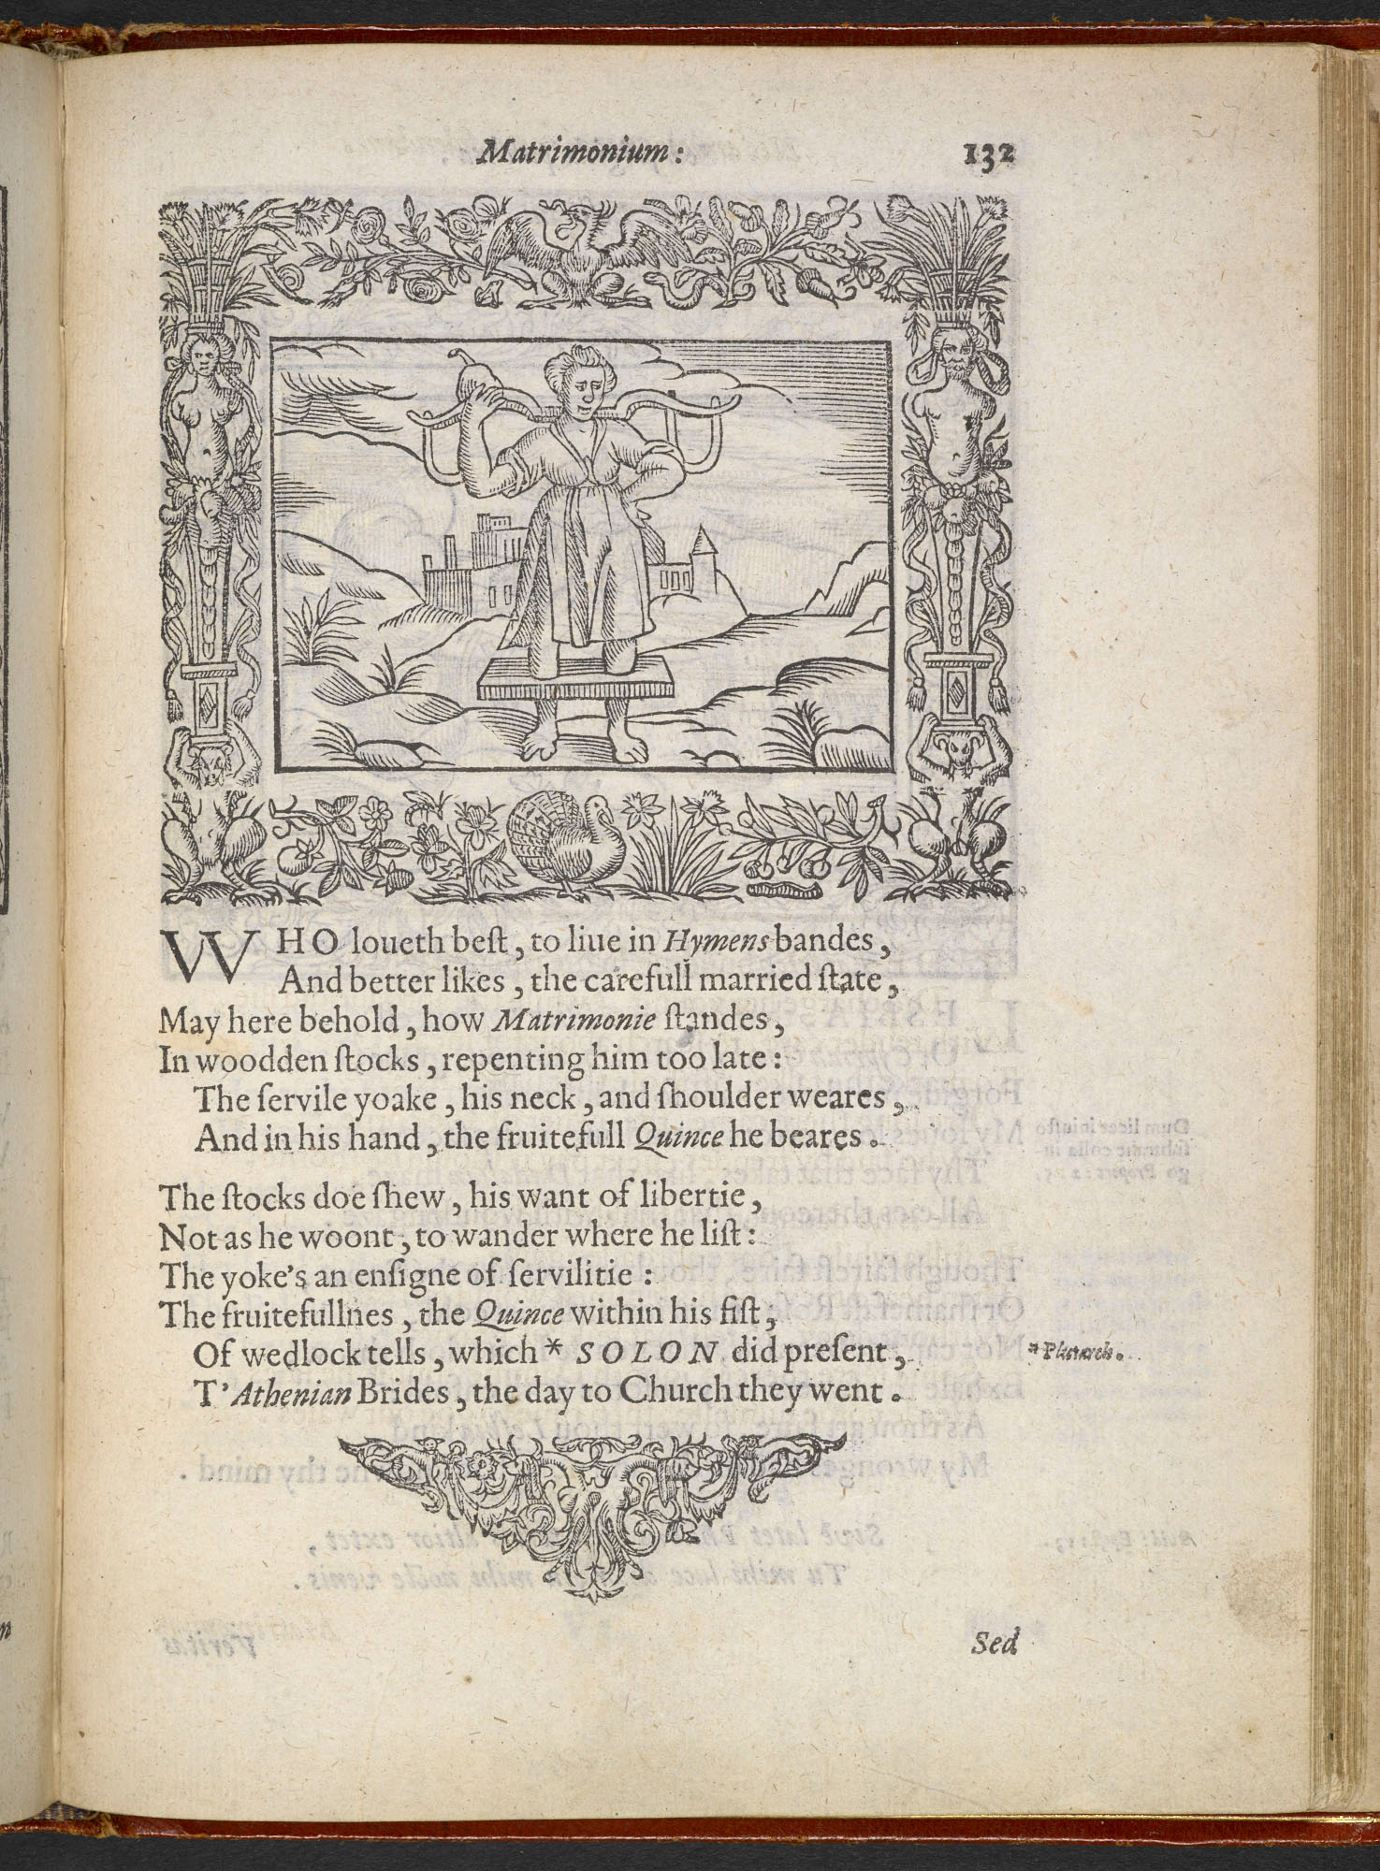
Minerva Britanna, or a garden of herorical devises, furnished, and adorned with emblems and impresa’s of sundry natures, Newly devised, moralized, and published by Henry Peacham, Mr. of Artes,
Source: British Library
A Rehearsall both straung and true, of heinous and horrible actes committed by Elizabeth Stile, Alias Rockingham, Mother Dutten, Mother Deuell, Mother Margaret, Fower notorious Witches , Apprehended at winfore in the Countie of Barkl, and at Abbington arraigned, condemned, and ececuted on the 26 daye of Februarie laste. Printed in London 1579 for Edward White at the little North-doore of Paules at the sign of the gun, and are there to be sold.
Source: British Library

Slide 13
The Witches of Northampton-shire. Printed by Tho: Purfoot, for Arthur Johnson in 1612.
Sources: Northampton Chronical and Echo, Rose of the Shires
Newes from Scotland, printed in 1591 in London
Source: British Library
A Rehearsall both straung and true, of heinous and horrible actes committed by Elizabeth Stile, Alias Rockingham, Mother Dutten, Mother Deuell, Mother Margaret, Fower notorious Witches , Apprehended at winfore in the Countie of Barkl, and at Abbington arraigned, condemned, and ececuted on the 26 daye of Februarie laste. Printed in London 1579 for Edward White at the little North-doore of Paules at the sign of the gun, and are there to be sold.
Source: British Library

