Slide 1
Inclusion in Theatre: The melting of Design and Acceptance
By: Kylie McDonald
University of Montana: Fall 2021

Slide 2
Let’s Start with the Basics: What is Theatre?
Theatre is, “an art concerned almost exclusively with live performances in which the action is precisely planned to create a coherent and significant sense of drama.”
Theatre comes from the Greek Word, “theaomai” which means To See
Theatre is born when live performers enact a story that connects with the audience as if the audience themselves are looking through a wall in someone’s house (often called the 4th wall)
It is subject to the audience's perspective and connection to the story, often emphasized with theatrical design.

Slide 3
We get Theatre, but what is Theatrical Design?
It is the visual aspects of the play, sometimes called, “the plays spectacle.”
It involves lighting, sound, scenic, costume, props, and hair and makeup designs.
It helps bring the audience into the reality of the play.

Slide 4
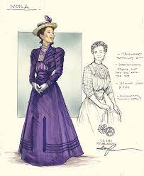
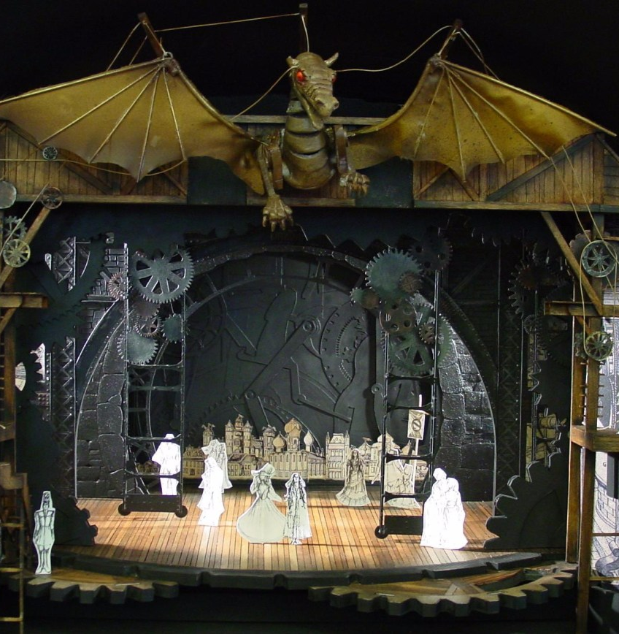
Some Lighting, Costumes, and Scenic Designs

Slide 5
What is Inclusion?
“The practice or policy of providing equal access to opportunities and resources for people who might otherwise be excluded or marginalized, such as those who have physical or mental disabilities and members of other minority groups.”
Theatre inclusion is defined as, “the belief that everyone can flourish when everyone is included.”
“theatre teacher consulting with special education teachers and becoming familiar with individual students' IEPs so that abilities and disabilities of each student are known, and appropriate goals and accommodations are applied.”

Slide 6
Inclusion in Theatre
Sensory performances, sometimes called relaxed performances alter the designs to be inclusive for all audience members.
Includes Trigger warnings at the begins of shows
House lights (where the audience sits) are always lit for the entire performance.

Slide 7
Sensory Friendly and Relaxed Performances: Otherwise known as Melting Together
“Reduction of sound levels, particularly loud or startling sounds.
Reduction of overwhelming stage lighting.
Low ambient lighting in the theater throughout the performance so patrons can see should they need to move around or exit the theater.
Patrons can talk and move around the theater as much as they wish during the performance.
Preparatory materials called Previsit Guides will be provided to patrons so they will know what to expect from the performance. Previsit Guides include pictures with simple captions of the theater going experience.
The use of mobile electronic devices are allowed during the performance if they are being used as a communication device.
Designated break spaces will be available for those who might feel overwhelmed and need a break from the performance.”

Slide 8
Relaxed shows are always happening, right?
About 30% of all theaters across the country provide relaxed shows in their performance schedule.
Broadway only started doing relaxed shows in 2011, which is 10 years ago but is still a relatively new idea for theaters
Most relaxed shows are only one or two performances in the entire performance schedule
Theaters have started to use the online performances to have sensory friendly performances instead of relaxed performances, something most people in theater don’t enjoy.

Slide 9
Why aren’t they melting together?

Slide 10
Unknowns of Relaxed Shows
There are little to no guidelines for what qualifies as a relaxed show for the inclusion of the audience members, so most theaters must do the research themselves with limited time for productions.
Since there are no regulation guidelines for relaxed theatre performances, there’s a possibility the performance may not be as relaxed as it needs to be. You have the potential to trigger your audience members on accident.
The theaters don’t know how many tickets will sell on relaxed nights.

Slide 11
Fabled at The University of Montana
Fabled was a play build of five 10-minute musicals along with 2 dance pieces that talked about different fables within storytelling.
From the begging of producing these musicals, the Director John DeBore wanted them to be relaxed shows for the entire run of the show. Each show was a relaxed showing where the audience members were encouraged to whoop, laugh, and wiggle during the performance.
We gathered information on what a relaxed production looked like for us and proceeded with those regulations in mind.
I was the Assistant Lighting Designer, under Hannah Gibbs the Lighting Designer, and we had to brighten the stage through transitions, no strobe or flash effects, and keep the audience lights (house lights) up the entire performance.
Other considerations were sounds effects being lowered, nothing flashy or shining onstage, and safety restrictions on the stage and audience.

Slide 12
Inclusion in Theatre and Theatrical Education
“Inclusive performances can make the audience realize that people with and without disabilities – actors as well as others – together can make a valuable contribution to society and contribute to make them look upon diversity as a normal characteristic of humankind. “
“Start by asking the question: Are people with disabilities, people from different racial and ethnic groups, men and women, young and old people, and other groups represented throughout the organization in numbers proportional to the community? This include staff, artists, production team, board of directors, and anyone else involved in the organization.”
“People tend to feel more welcome in environments where they can see people who are like them, either in the audience or involved with the organization.”

Slide 13
Why should we care about Melting Together?
“Some propose that the arts have the potential to nurture talent, reduce stigma, and provide a platform for others to see the “ability” in disability .” In other words, it’s using theatre to help create conversations between disabled and non-disabled people.
Theatre is built upon empathy and inclusion of all, to deny someone of that is not Theatre or art.
“I want theatre organizations and artists to think about radically transforming their work to meet the needs of audience members and how that can help welcome new audiences. “

Slide 14
How We can Melt Together!
Fight
Fight for relaxed performances at your theatre and university. Inclusion is what Theatre is built upon.
Hire
Hire Inclusion specialists for the design process of the relaxed shows, as to not trigger any of the audience members.
Collect Data
Collect data and share with other members of the theatre community. Publish your findings so everyone has access to what works and doesn’t work in a relaxed setting.
Advocate
Be an advocate for the inclusion of everyone in theatre
Inclusion
Offer more relaxed performances
Follow Through
Follow some Inclusion Podcasts, Instagram's and Blogs to learn more!

Slide 15
Organizations to Follow for more Accessibility to Everyone!
https://twodisableddudes.com/
https://podcasts.apple.com/us/podcast/talkback/id1482424589
https://www.listennotes.com/podcasts/theatre-unwrapped-sue-lawther-brown-new-lDdPtG1-WRM/
https://lnns.co/iRrflEMAQ7F
https://www.instagram.com/nationaldisabilitytheatre/?hl=en
https://www.instagram.com/seesawtheatre.nu/?hl=en
https://www.instagram.com/csutdic/?hl=en

Slide 16
Works Cited
https://www.researchgate.net/publication/345728111_Diversity_opportunities_and_challenges_of_inclusive_theatre
https://howlround.com/envisioning-change
https://journalofethics.ama-assn.org/article/autism-art-and-accessibility-theater/2016-12
https://www.theatlantic.com/health/archive/2015/04/making-theater-autism-friendly/388348/
https://www.scfta.org/Plan-Your-Visit/Sensory-Friendly/Sensory-Friendly-Overview.aspx
https://www.britannica.com/art/theatre-art
https://www.nationalartsstandards.org/sites/default/files/Theater_resources/Theatre%20Inclusion%20Guidelines.pdf
https://www.nytimes.com/2020/09/11/theater/how-to-change-theater.html
https://www.independent.co.uk/arts-entertainment/theatre-dance/features/theatre-uk-diabled-access-covid-b1852893.html

