Slide 1


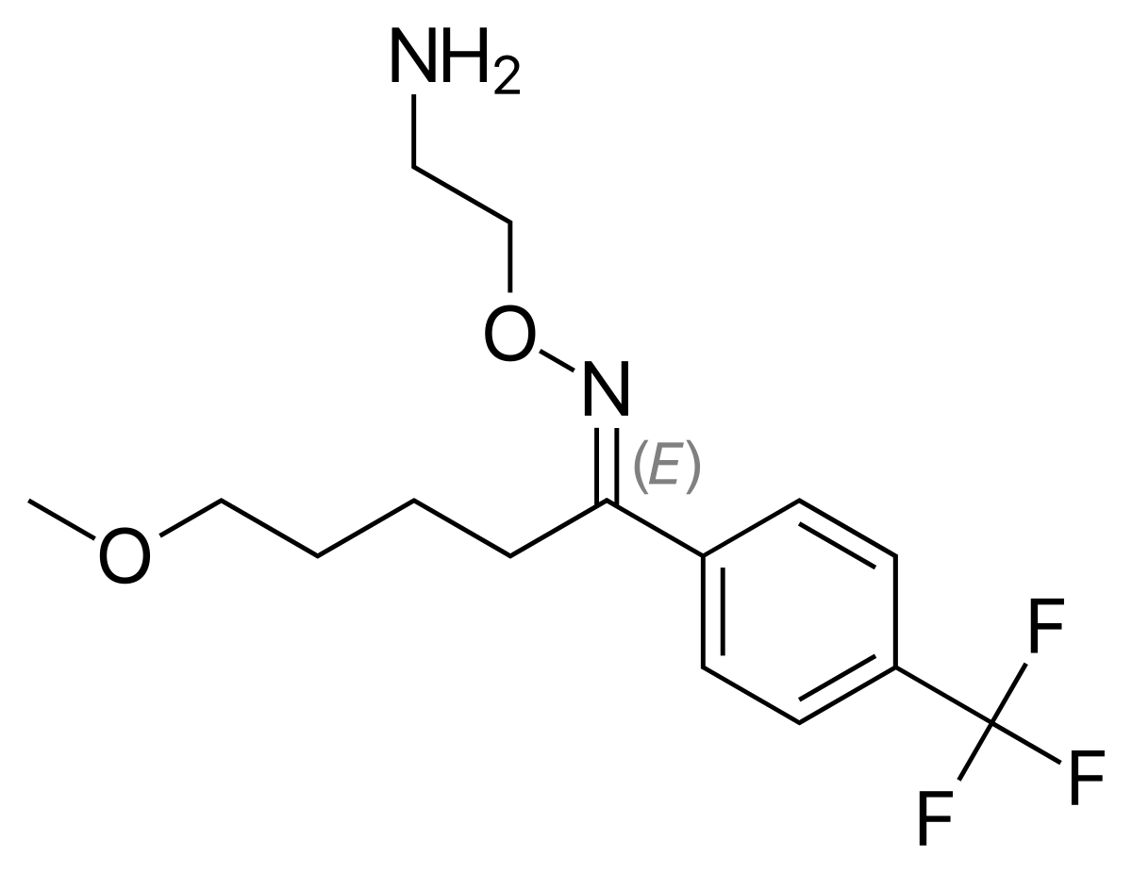
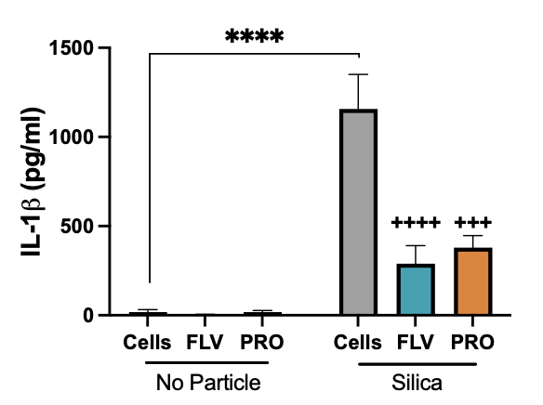
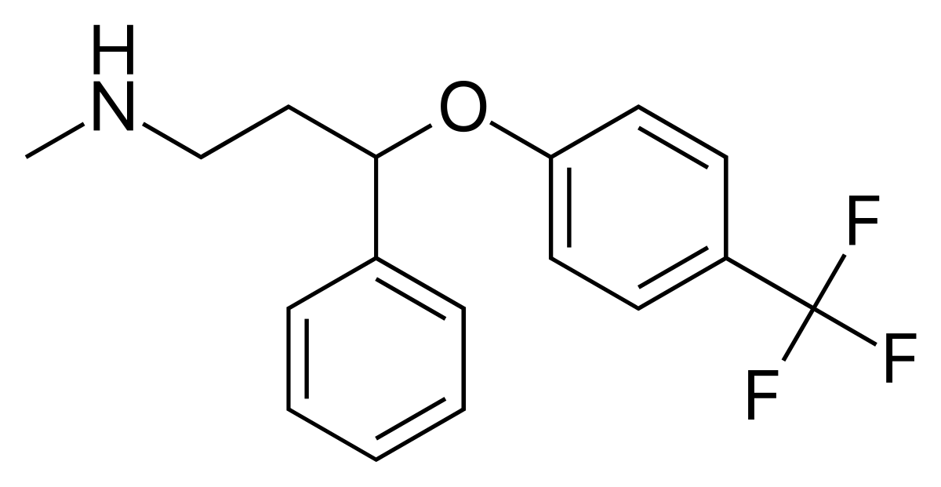
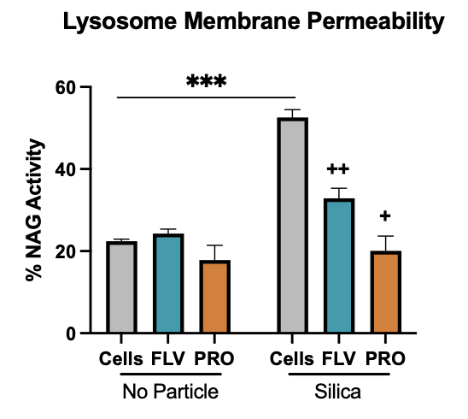
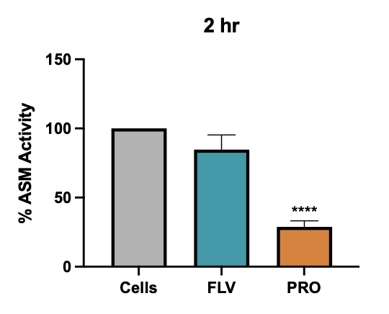
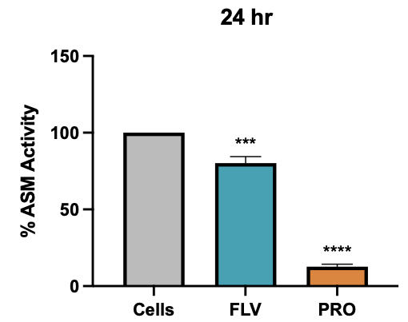
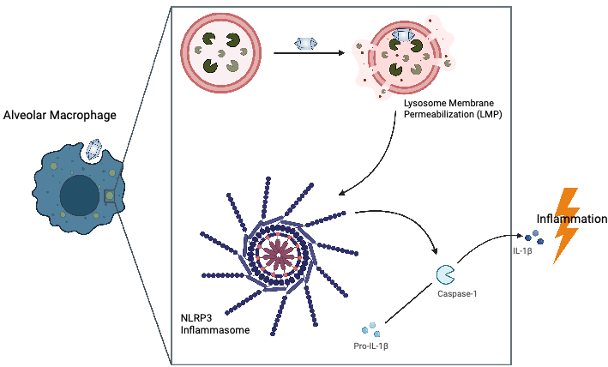
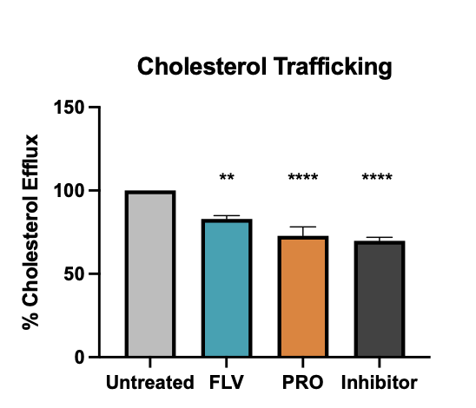
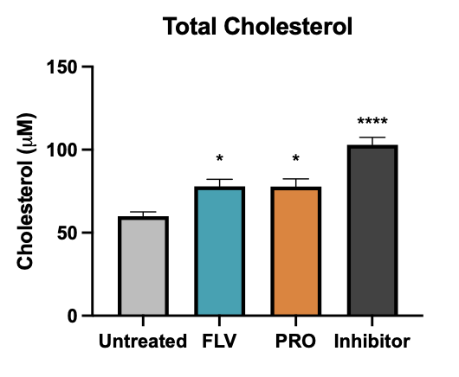
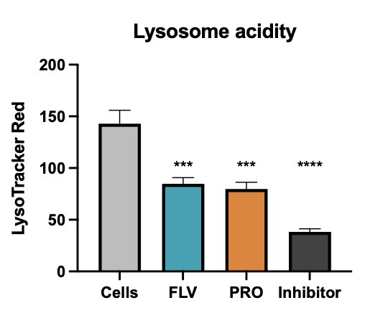
Antidepressants Reduce Silica-Caused Inflammation in Lung Macrophages
Becky Kendall & Andrij Holian
Center for Environmental Health Sciences, University of Montana
Poster #19
Introduction
Results
Methods and Rationale
Chronic respiratory disease remains a leading cause of death around the world, and recent events have only increased respiratory disease concerns ¹. As such, there is a growing need for effective therapeutics to combat these and other chronic inflammatory diseases. While the discovery and design of new pharmaceuticals can be a lengthy process there is an abundance of FDA approved drugs that can be repurposed for use in other than their originally intended uses. For example, the use of anti-depressants has been proposed as a potential therapy for COVID after multiple studies showed a correlation between regular anti-depressant use had fewer hospitalizations and deaths with COVID^{2,3}. Because of the potential to lessen the impact of a respiratory disease such as COVID, we propose that antidepressants can reduce the progression of other respiratory diseases such as the pervasive occupational-disease silicosis. Silicosis is a progressive lung disease marked by tissue scaring in the gas-air exchange regions of the lungs and currently there is no cure or effective therapy. While silicosis cases had been on the decline through efforts to change workplace conditions, there has been a troubling increase in atypical silicosis cases that result from brief, but highly concentrated amounts of crystalline silica being inhaled at the workplace. Occupations such as artificial stone countertop fabrication and sandblasting denim have seen an increase in silicosis cases⁴. The progression of silicosis and other respiratory disease depends largely on unresolved inflammation, therefore, understanding the mechanisms of inflammation is necessary to suggesting effective therapeutics. The lung (alveolar) macrophage is responsible for clearing particles and other foreign material that enter the lungs. In the case of silica particle, the macrophage phagocytosis the particle and the particle is taken to the lysosome within the cell. The lysosome contains a high pH and many enzymes responsible for degrading outside material. In the case of silica and other particles, there is lysosomal damage that allows the enzymes to leak into the interior of the cell. The leaked enzymes contribute to the activation of the inflammasome complex and promote inflammation in the lungs. We propose that by using a variety of drugs classified as FIASMAs (Figure 3), the inflammation caused by silica in lung macrophages will be prevented and suggest that the efficacy of the drugs is due to their changes to the lysosome function that prevent the leakage of inflammation promoting enzymes into the cell.
BMdM were treated with FLV (1μM) and PRO (25μM) 30 min before exposure to silica (50 μg/ml) and plated in a 96 well plate for 24 hrs. Cell supernatants were collected and analyzed by ELISA for IL-1β (Figure 4). Silica causes LMP and leads to increased IL-1β in macrophages. β-N-acetylglucosaminidase (NAG) is found in the lysosome and can be used as an indicator of LMP. BMdM were plated in a 96 well plate with FLV (1μM) and PRO (25μM) +/- silica (50 μg/ml) for 24 hours. Cells were washed with PBS and extracted with digitonin. Digitonin is non-ionic detergent that lyses membranes through its interaction with cholesterol. As cellular membranes contain more cholesterol than lysosomal membranes, a digitonin extraction allows the cell to be opened but the lysosome remains intact. Any lysosomal enzymes that have leaked into the cytosol due to silica will be measurable by a fluorescent substrate that is specifically cleaved by NAG (Figure 5). To understand the mechanisms that allow FLV and PRO to prevent inflammation, ASM activity in treated cells was analyzed. Cells were plated in 96 well plate and treated with FLV (1μM) and PRO (25μM) for 2 hr (Figure 6A) and 24 hr (Figure 6B). ASM activity was measured by fluorescent intensity of Amplex Red Sphingomyelinase Assay (Invitrogen). After 2 hr FLV and PRO both reduced ASM activity, though only PRO was significant. At the 24 hr mark both drugs had significantly reduced ASM activity, though the decrease in activity at 24 hr was little more than at 2 hr indicating ASM activity is decreased in a rapid manner with FIASMA treatment. Having hypothesized that the protective nature of FIASMA drugs in silica exposure is due to their increase in lysosomal membrane cholesterol causing resistance to LMP, the cholesterol trafficking and cellular content of treated BMdM was analyzed. BMdM were plated in 96 well plate and loaded with TopFluor fluorescently labeled cholesterol for 24 hours. After 24 hours, the cells were washed and FLV (1μM), PRO (25μM) and U18666A (25μM; sequesters cholesterol in the lysosome and prevents trafficking) were added in fresh media. After 24 hours, supernatants were removed to a new plate and fluorescent intensity measured by microplate reader (Figure 7). Total cholesterol was measured by Cholesterol/Cholesterol Ester Glo Assay Kit (Promega). BMdM were plated with FLV (1μM), PRO (25μM), and U18666A (25μM) for 24 hours and total cholesterol quantified by luminescent intensity (Figure 8). U18666A increased total cholesterol as expected and FLV and PRO both produced significant increases in total cholesterol. To understand FIASMA impact on lysosomal acidity, Lysotracker Red was used to measure lysosomal pH. Lysotracker Red enters acidic organelles where it is cleaved by protons in an acidic environment and fluoresces. Lysotracker Red accumulates in a normally functioning lysosome but cannot in one with an increased pH (reduced acidity). BMdM were plated in 96 well with FLV (1μM), PRO (25μM), and Bafilomycin A1 (a V-ATPase inhibitor that prevents lysosomal acidification; 25μM) for 2 hours. Lysotracker Red was added (100nM) for 30 min and cells were washed before fluorescence intensity was measured (Figure 9).
Fluvoxamine
Fluoxetine
(Prozac)
Created with BioRender.com
Figure 3. Chemical structure of FIASMAS fluvoxamine and fluoxetine (Prozac).
Figure 2. Proposed model of FIASMA drug entering lysosome and preventing acid sphingomyelinase (ASM) activity. Reduced ASM activity results in increased sphingomyelin in the lysosome. Increased sphingomyelin reduces cholesterol trafficking out of the lysosome, increased lysosomal cholesterol associates with sphingomyelin in the lysosomal membrane, displacing silica’s interaction with membrane lipids and preventing LMP.
Figure 4. IL-1β is reduced by FIASMA pre-treatment. BMdM exposed to silica (50μg/mL) for 24 hr showed significant increase in IL-1β secretion that was significantly reduced by 30 min pre-treatment with FLV or PRO. **** and ++++ indicate p<0.0001 by Two-way ANOVA with Tukey post hoc test. +++ indicates p < 0.001. n=4
A
ASM Activity
B
Figure 1. Silica creates inflammation through lysosomal membrane permeabilization (LMP), activating the NRLP3 inflammasome and promoting inflammation through the release of IL-1β from the cell.
Figure 5. Silica causes LMP in BMdM that is significantly decreased by FIASMA pretreatment. BMdM exposed to silica (50 μg/mL) for 24 hours. β-N-acetylglucosaminidase (NAG) activity was measured following digitonin (12.5 μg/mL) extraction. *** indicates p<0.001 by Two-way ANOVA followed by Tukey multiple comparison test. + indicates p<0.05 and ++ indicates p<0.01. n=4
Conclusion
Figure 6. Acid sphingomyelinase activity as measured by Amplex Red Sphingomyelinase Kit (Invitrogen). ASM activity in FIASMA treated cells compared to untreated cells for A.) 2 hr and B.) 24 hr. After 2 hours of drug treatment FLV and PRO reduced ASM activity to nearly the same levels as shown at the 24 hr mark, indicating ASM activity is reduced quickly with FIASMA treatment, and the reduction persists for the duration of the drug exposure. **** indicates p<0.001 and *** indicates p<0.01 for one-way ANOVA with Dunnett multiple comparisons post hoc test. n=4
FLV and PRO are antidepressants that are cationic amphiphilic drugs that are weakly basic and accumulate in the lysosome. Their ability to disrupt acid sphingomyelinase activity has classified them as functional inhibitors of acid sphingomyelinase (FIASMAs). Previously, it has been reported that imipramine (a cationic amphiphilic drug prevented inflammation in a silicosis model, additionally FLV and PRO have been correlated to better health outcomes with COVID infection, making FIASMAs a drug class of interest in preventing lung inflammation. Silicosis and other particles contribute to inflammation by causing LMP and IL-1β release. Here we show that FLV and PRO both significantly reduced IL-1β caused by silica exposure in macrophages by reducing LMP measured by NAG activity in BMdM cytosolic extracts. FLV and PRO reduced ASM activity within 2 hours confirming their reported inhibition of ASM. Cholesterol has been shown protective of LMP as well as to associate with the phospholipid sphingomyelin in lipid rafts to decrease membrane disruption. It is hypothesized that by reducing ASM and increasing sphingomyelin in the lysosome cholesterol efflux is reduced and cholesterol increased in the lysosome, protecting the macrophages from LMP and reducing chronic inflammation. Here we showed a decrease in cholesterol efflux from FLV and PRO treated BMdM as well as increased total cholesterol. It is unknown if the inhibition of ASM is by direct displacement of the enzyme from the lysosomal membrane by the FIASMA drugs or through an increase in lysosomal pH causing lack of function of the enzyme. When lysosomal acidity was measured by Lysotracker Red, it showed a reduced fluorescence with FLV, PRO or lysosomal acidification inhibitor Bafilomycin A1 indicating an increase in lysosomal pH. This supports the idea that lysosomal pH increase contributes to lack of ASM activity with FIASMA treatment. Future work will examine the lysosomal proteolytic activity to understand the mechanism of FIASMA’s anti-inflammatory capabilities in a particle exposure model to shape proposed therapeutic strategies for lung inflammation.
Created with BioRender.com
Materials
Cells: Bone-marrow derived macrophages from C57Bl/6 mice, cultured for 10 days with macrophage colony growth factor (MCSF) before use in experiments.
Reagents: Fluvoxamine (Cayman Chemical), Fluoxetine (Cayman Chemical), U18666A, Bafilomycin A1 (Cayman Chemical), Cholesterol Glo Assay (Promega), Amplex Red Sphingomyelinase (Invitrogen), Lysotracker Red DND-99 (Invitrogen), TopFluor Cholesterol (Avanti), murine IL-1β Elisa Kit (R&D), 4-methylumbelliferyl-2-acetamido-2-deoxy-β-D-glucopyranoside (Cayman Chemical).
Particle: crystalline SiO₂ (Min-U-Sil-5)
Statistical Analysis: data presented as mean +/- standard error of the mean (SEM). Differences between groups analyzed by one or two-way analysis of variance (ANOVA) with Dunnett or Tukey post hoc comparison test.
References
Forum of International Respiratory Societies. The Global Impact of Respiratory Disease –Second Edition. Sheffield, European Respiratory Society, 2017.
Hoertel, Nicolas, Marina Sánchez-Rico, Erich Gulbins, Johannes Kornhuber, Alexander Carpinteiro, Eric J. Lenze, Angela M. Reiersen, et al. 2021. “Association Between FIASMAs and Reduced Risk of Intubation or Death in Individuals Hospitalized for Severe COVID-19: An Observational Multicenter Study.” Clinical Pharmacology and Therapeutics 110 (6): 1498–1511.
Hoertel, Nicolas, Marina Sánchez-Rico, Raphaël Vernet, Nathanaël Beeker, Anne Sophie Jannot, Antoine Neuraz, Elisa Salamanca, et al. 2021. “Association between Antidepressant Use and Reduced Risk of Intubation or Death in Hospitalized Patients with COVID-19: Results from an Observational Study.” Molecular Psychiatry 1.
Barnes, Hayley, Nicole S.L. Goh, Tracy L. Leong, and Ryan Hoy. 2019. “Silica-Associated Lung Disease: An Old-World Exposure in Modern Industries.” Respirology 24 (12): 1165–75.
Figure 7. Cholesterol trafficking through the lysosome as measured by fluorescent intensity of TopFluor labeled cholesterol in supernatants following 24 hr FIASMA drug exposure. Cholesterol transport inhibitor (U18666A) used as control to indicated reduced cholesterol efflux. ** and **** indicate p<0.01 and p<0.0001, respectively. One-way ANOVA with Dunnett post hoc test. n=4
Figure 8. Total cellular cholesterol of FIASMA treated cells compared to untreated BMdM cells. Cholesterol Glo Assay (Promega) used to quantify cholesterol in μM per 100,000 cells and normalized to cell death. Cholesterol trafficking inhibitor U18666A causes cholesterol accumulation and is used as a positive control. * and **** indicate p<0.05 and p<0.0001 by one-way ANOVA with Dunnett post hoc test. n=4
Figure 9. Lysosomal acidity changes with FIASMA treatment. BMdM treated with FIASMA drugs and Bafilomycin A1 (a lysosomal acidification inhibitor) showed a decreases in LysoTracker Red fluorescent intensity after 2 hours of drug treatment. *** and **** indicate p<0.001 and p<0.0001 by one-way ANOVA with Dunnett post hoc multiple comparisons test. N=4
Funding
This work was supported by National Institute of Environmental Health Sciences (NIEHS) award F31ES033562. The content is solely the responsibility of the authors and does not necessarily represent the official views of the NIH.

