Slide 1
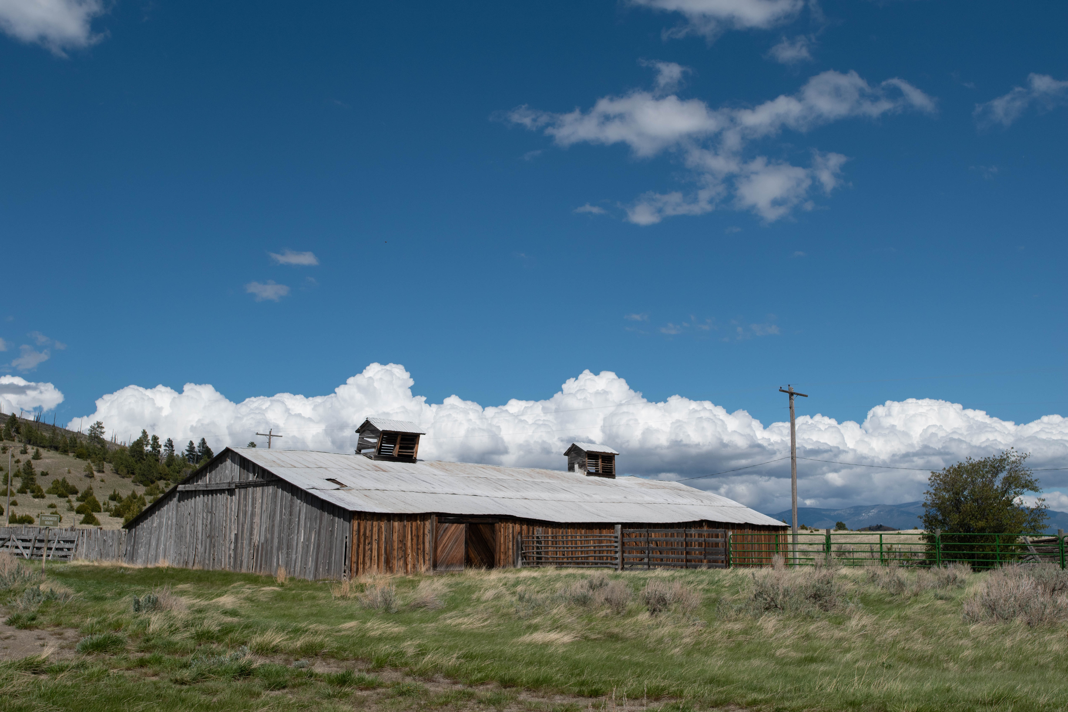
Health, Land, and Heritage
HEALTH, LAND, AND HERITAGE:
Understanding Montana Suicide through Culture
Deepening Understanding of Montana Suicide through Culture
Emory C. Padgett

Slide 2
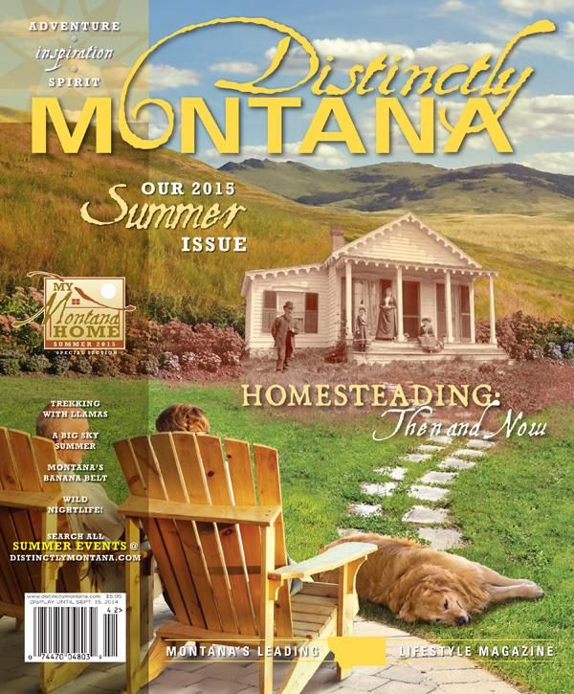
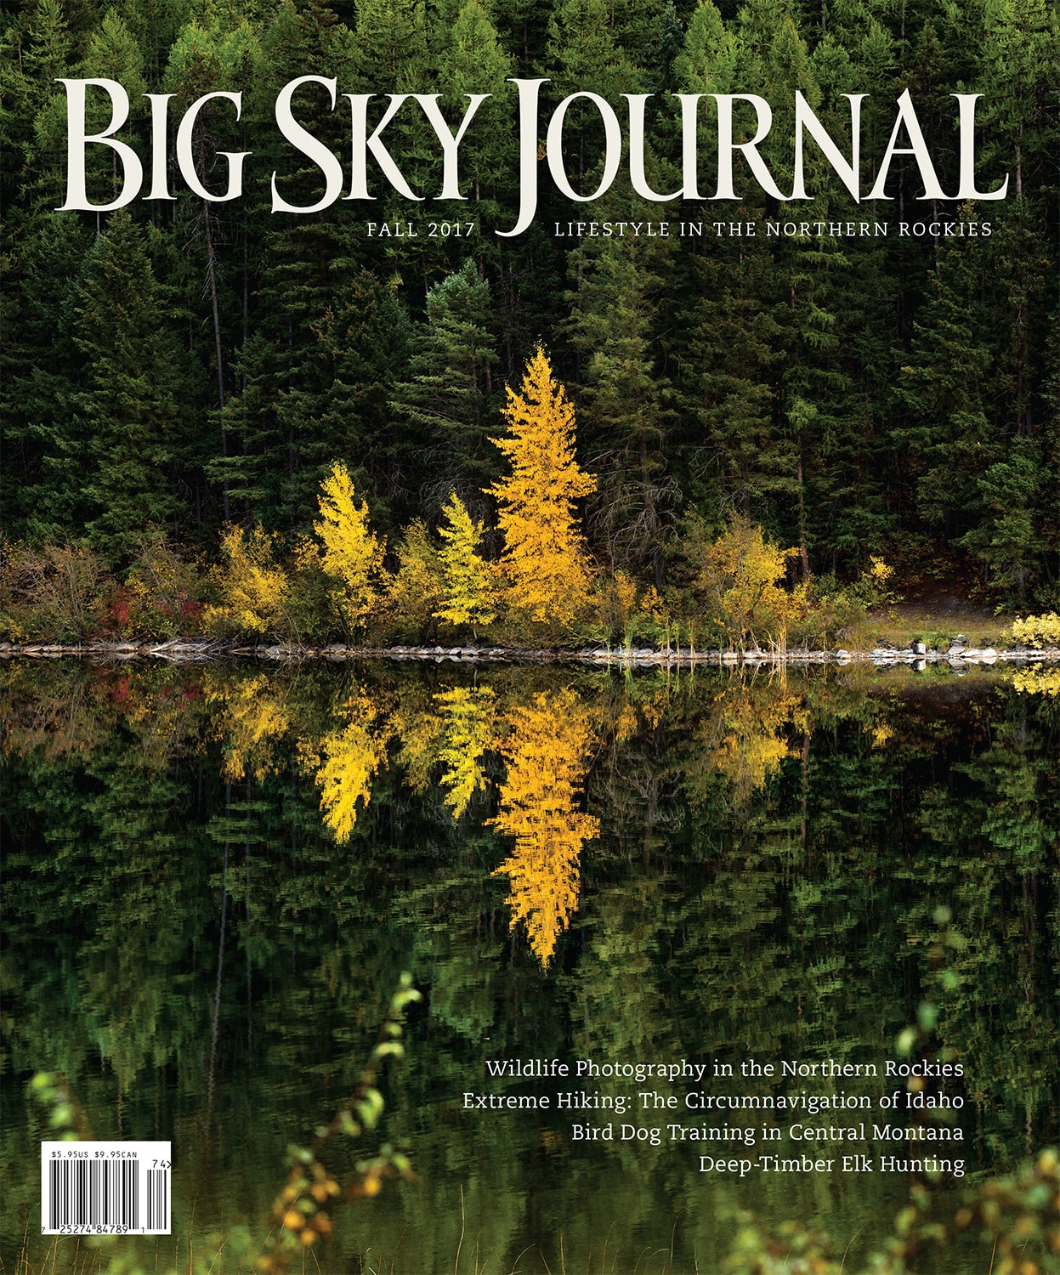
Suicide—in Montana?
“in the Arctic half-light of the canyon, all existence fades to a being with my soul and memories and the sounds of the Big Blackfoot River and a four-count rhythm and the hope that a fish will rise.”
- Norman Maclean, A River Runs Through It (1976, 104)

Slide 3
Suicide in Montana
Montana top 5 nationwide in suicide rate since 1990 (MTDPHHS, 2020); high internationally
Increasing rates since 2000
No. 1 cause of injury related death in US (CDC, 2018)
Understudied
Age-adjusted suicide rate, 1999-2020 (CDC 2020; MTDPHHS 2021)

Slide 4
MTDPHHS 2020

Slide 5
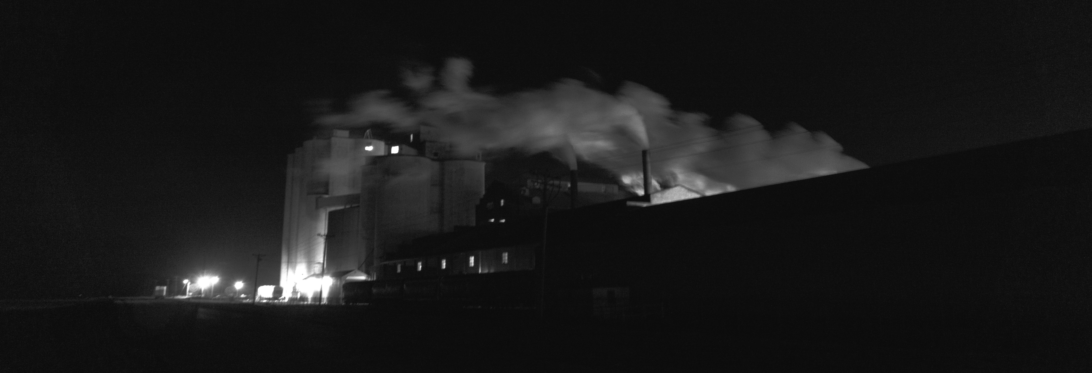
Research Questions
RESEARCH
QUESTIONS
Why does Montana have such a high suicide rate? Do local conditions affect suicide etiology?
What is currently being done to prevent suicide in the state? Could consideration of culture contribute to prevention and understanding of suicide etiology?

Slide 6
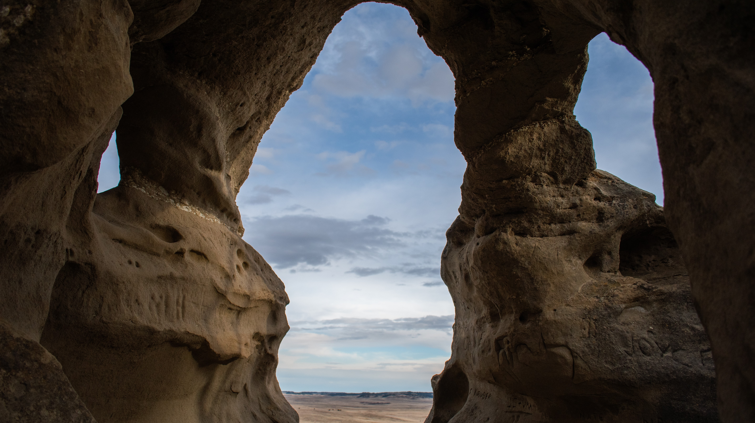
Theoretical background
Cultural Heritage Studies: heritage as a “basic element of civilization” (Yu et. al 2018, 2)
Indigenous Health Studies: incorporates traditional belief and cultural practice as essential to wellbeing, and which focuses particularly on disruptions of heritage and landscape as detrimental to health {Life Beside Itself (Stevenson 2014), Disciplined Hearts (O’Nell 1998), Empire’s Tracks (Karuka 2019)}
Syndemics: “social and health conditions travel together through a population, interact in meaningful ways via social, biological, or psychological pathways, and are driven by social and political forces” (Mendenhall 2019, 9)
Processual Landscape: “We live embedded in landscape and…we perceive it through our whole body, and therefore it affects our well-being” (Menatti and Casado da Rocha 2016, 5)

Slide 7
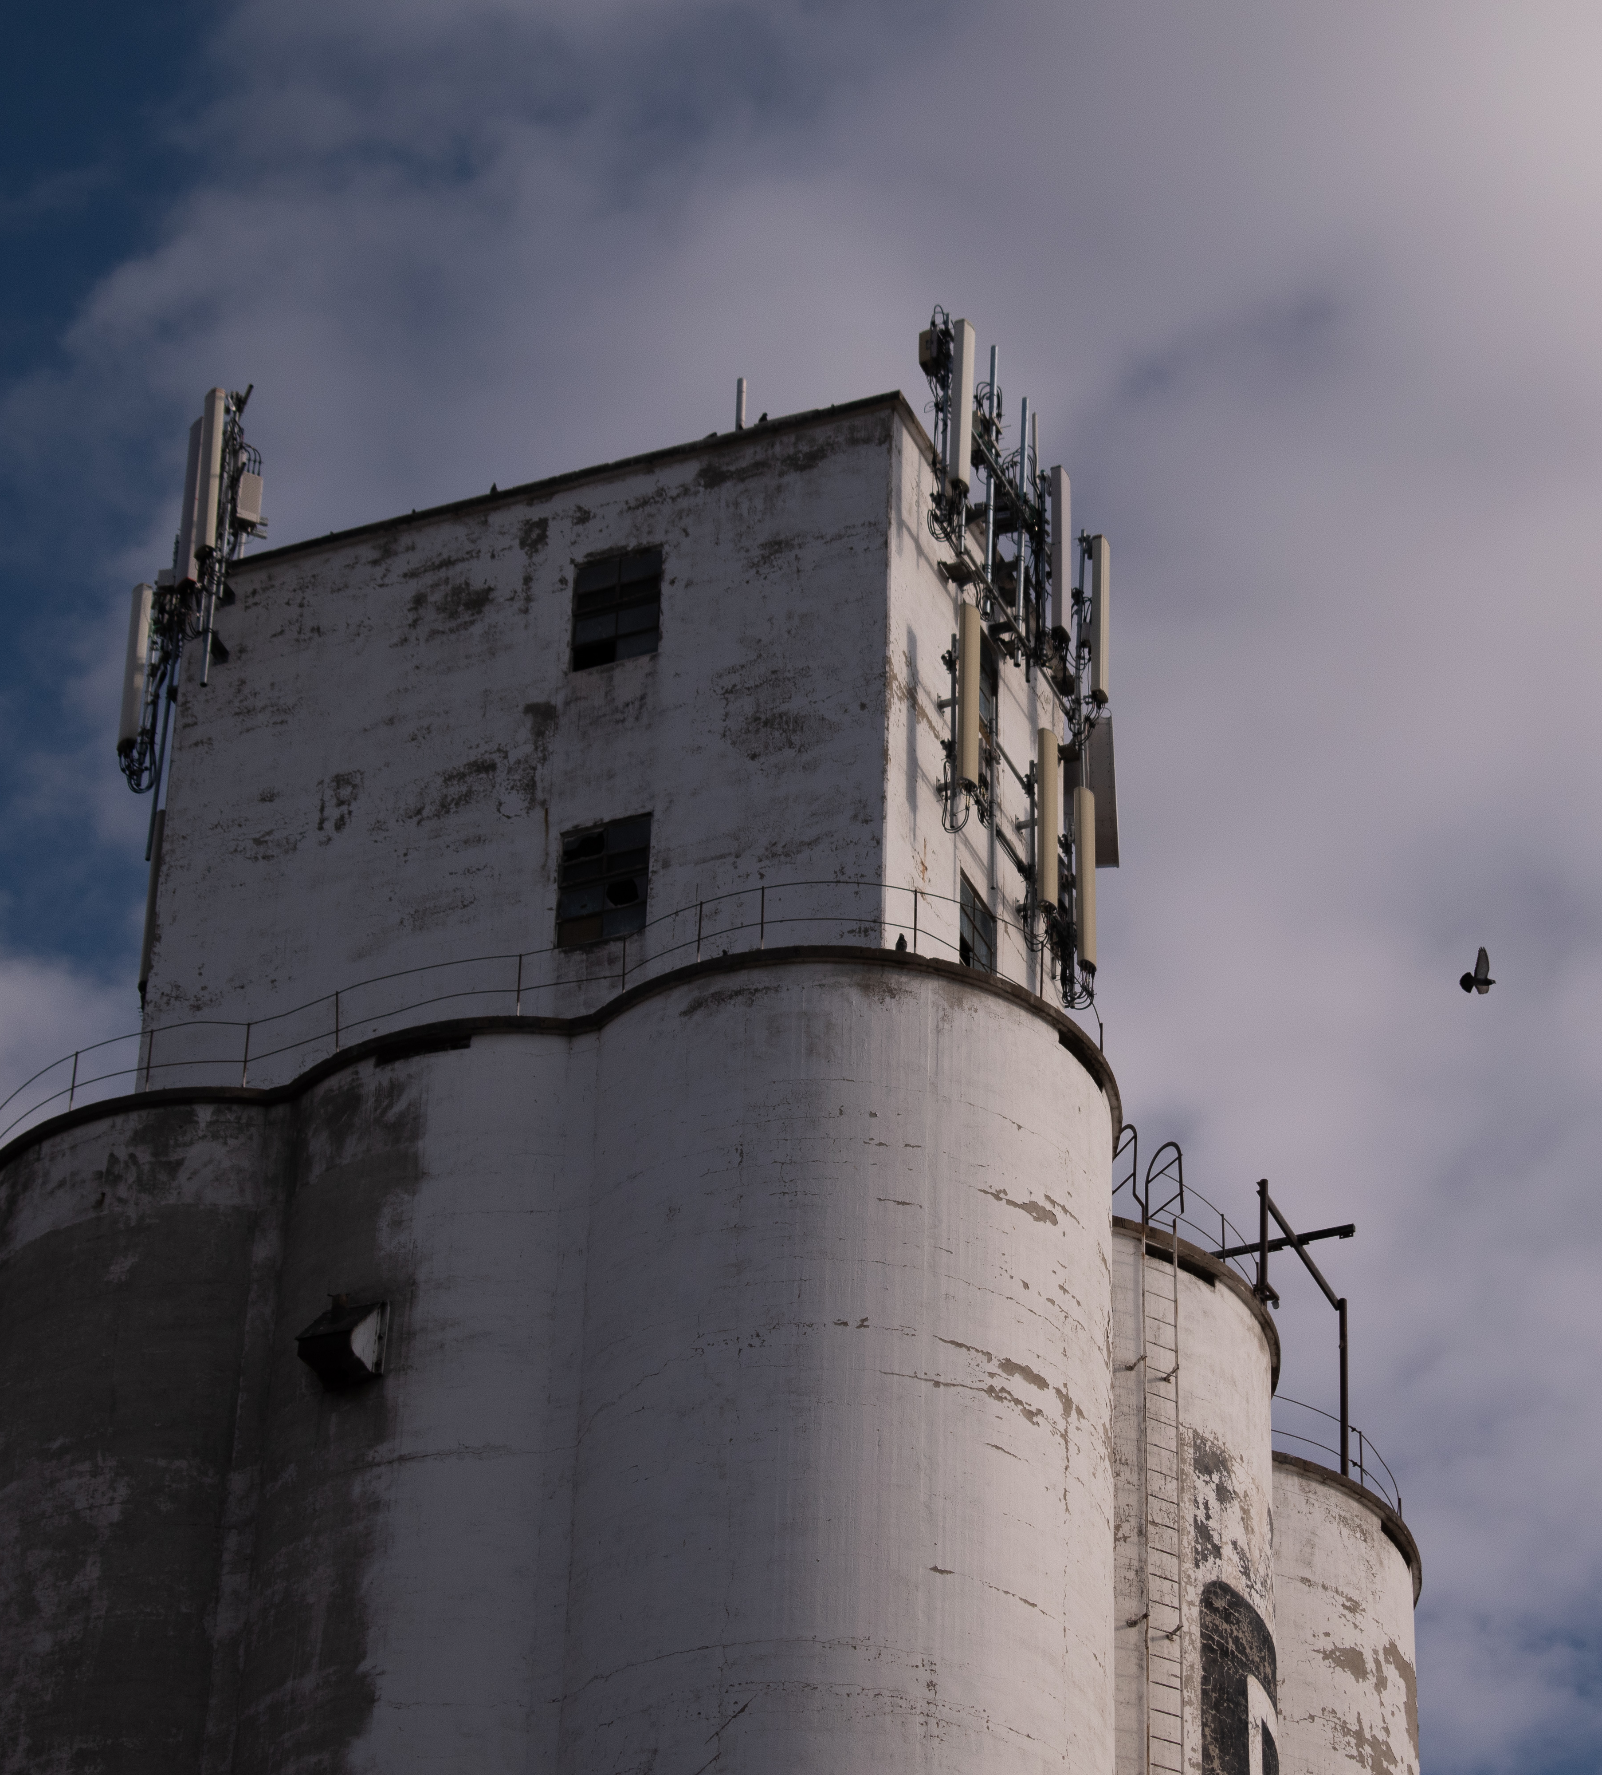
“Recent population changes and the influx of professional-class and part-time residents in western Montana have challenged many traditional land stewardship practices and questioned well-established norms regarding the state's funding of public utilities, education, and social services. Few employment opportunities—combined with more qualified applicants—has limited the potential for residents to attain meaningful and well-paying careers, and an ongoing population decline in the rural counties of central and eastern Montana has resulted in a steady out-migration of high school and college graduates, an aging demographic, and an increase of wealthy part-time residents as the new occupants of longstanding family farms and ranches. These new tensions, along with drastically changing technologies and a growing dependence on a service and tourism economy, have not been captured in Montana's slogans yet have created a challenging context for the emotional and economic well-being of individuals, families, and communities.”
Knee and Finn (2011)

Slide 8
arguments

Slide 9
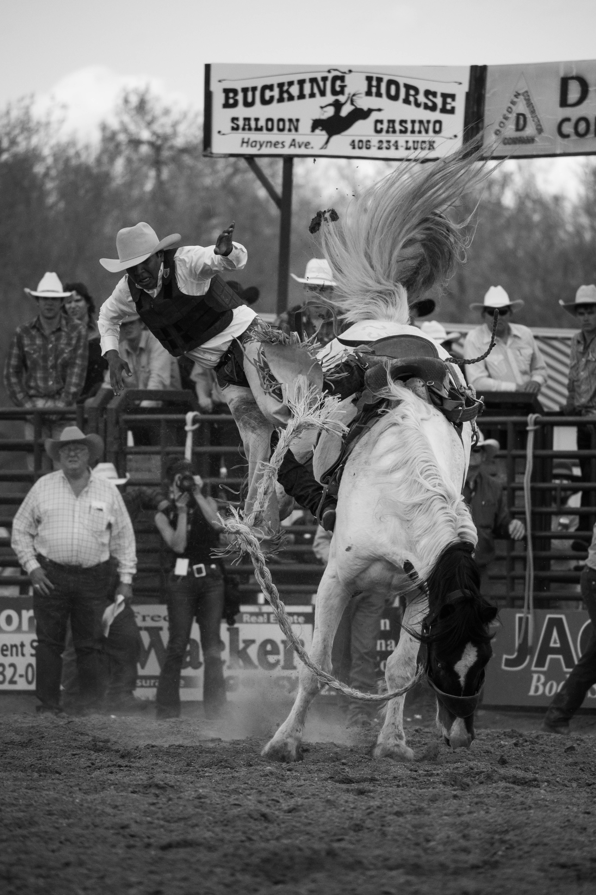
Identity, history, and environment have shaped Montanans and affect their wellbeing
“Surely the legacy of failure, the memory of devastated crops and withering dreams, haunts the region’s culture” Egan (2003, 46).
Traditional Montana vs New Montana
Generational memory
Climate uncertainty & extreme weather
Cowboy myth, “Montana” occupations
Built heritage, preservation
Loss of community
APR/Save the Cowboy
Big Sky Heritage Area
Health insurance

Slide 10
“The clean lines of this fresh landscape everywhere declared purpose and capacity, seemed to trumpet: Here are the far bounds, all the extent anyone could need. Now live up to them.”
- Doig (1976, 10)

Slide 11
“And so we shared this secret in the presence of ghosts, in wind that called forth the muttering tepees, the blowing snow, the white air of the horses’ nostrils. The cottonwoods behind us, their dead white branches angling to the threatening clouds, sheltered these ghosts as they had sheltered the camp that winter. But there were others, so many others”
- Welch (1974, 125)

Slide 12
My home is in me
Like the smell of cold
Lake water in my skin,
My lungs
Wherever I go.
Wherever I go,
My grandfather’s hands,
Plum colored and strong,
Are touching mine.
- Jennifer Greene, 1999

Slide 13
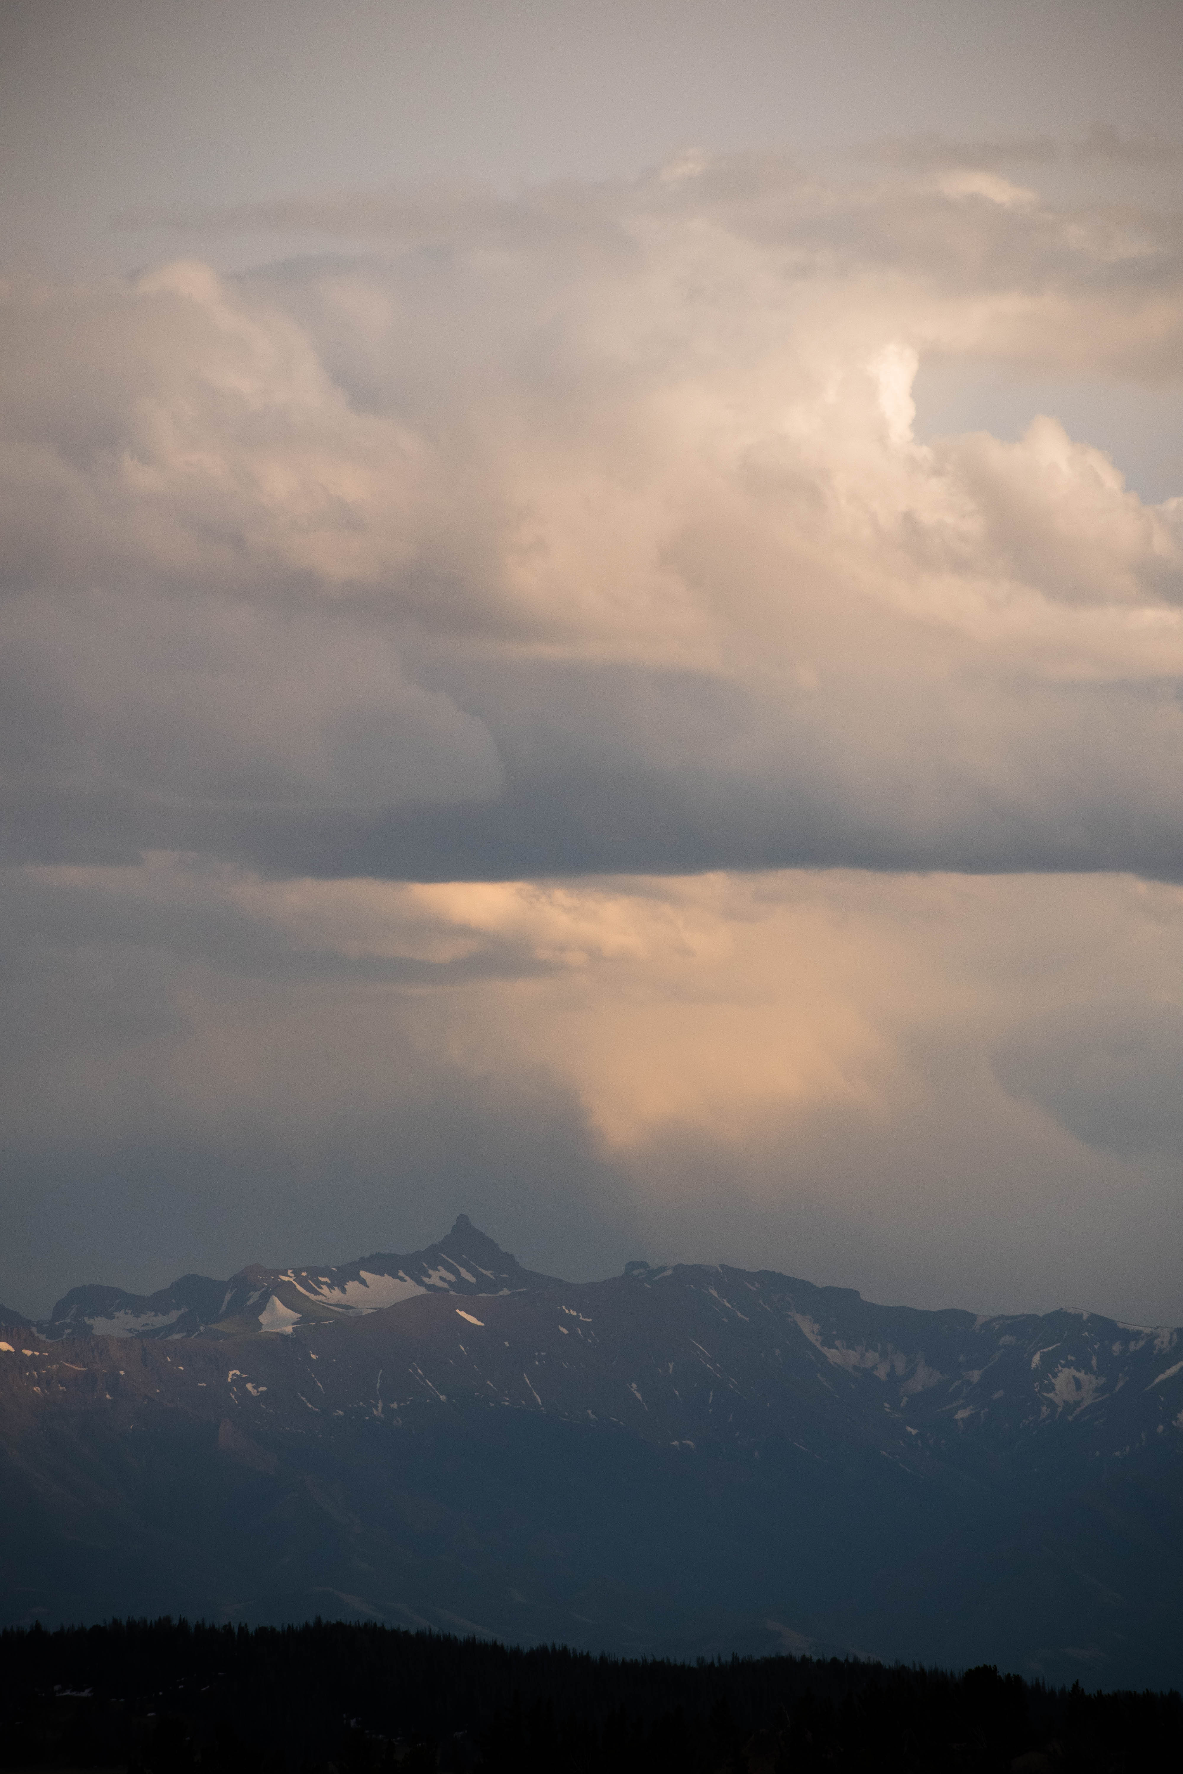
Suicide is more than statistics: it is a complex biopsychosocial phenomenon that must be holistically studied at a local level
Altitude & Vitamin D
Social Isolation & Stigma
Poverty
Native American & Veteran Population
Firearm Access
Healthcare Access

Slide 14
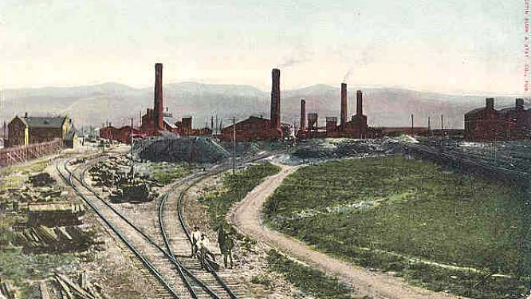
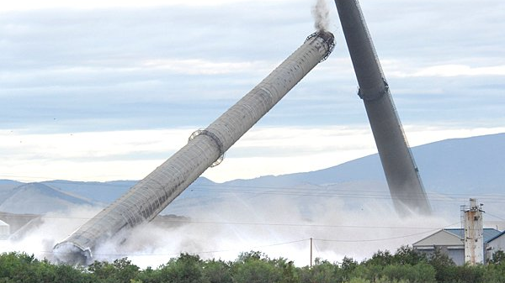
Case Study: ASARCO SMELTER

Slide 15
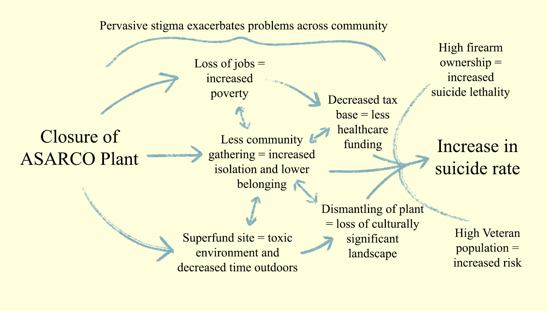
Syndemic Landscape
HYPOTHESIS:

Slide 16
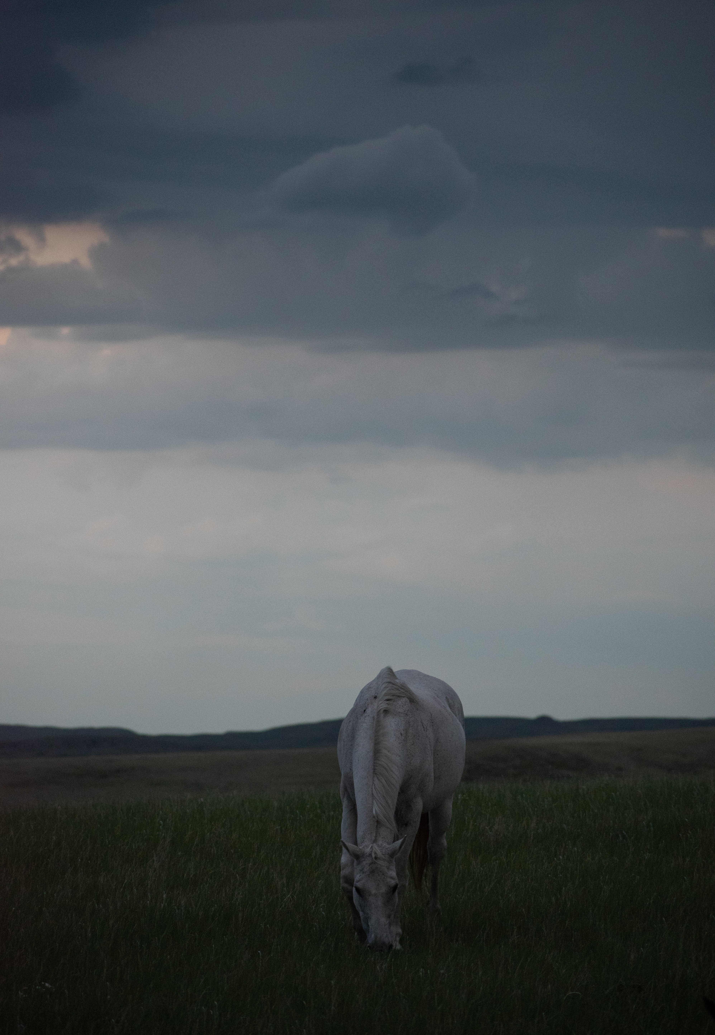
Relevance and Future Research
Potential for prevention efforts outside of strained healthcare system; relief of suffering/increased wellbeing
Deeper understanding of contemporary cultural issues
Statistical analysis
Cultural Consonance study

