Slide 1
Expanding Double SNAP Dollars – Equitably
Tate Besser
Research done for Community Food and Agriculture Coalition
Scientific Approaches to Environmental Problems

Slide 2
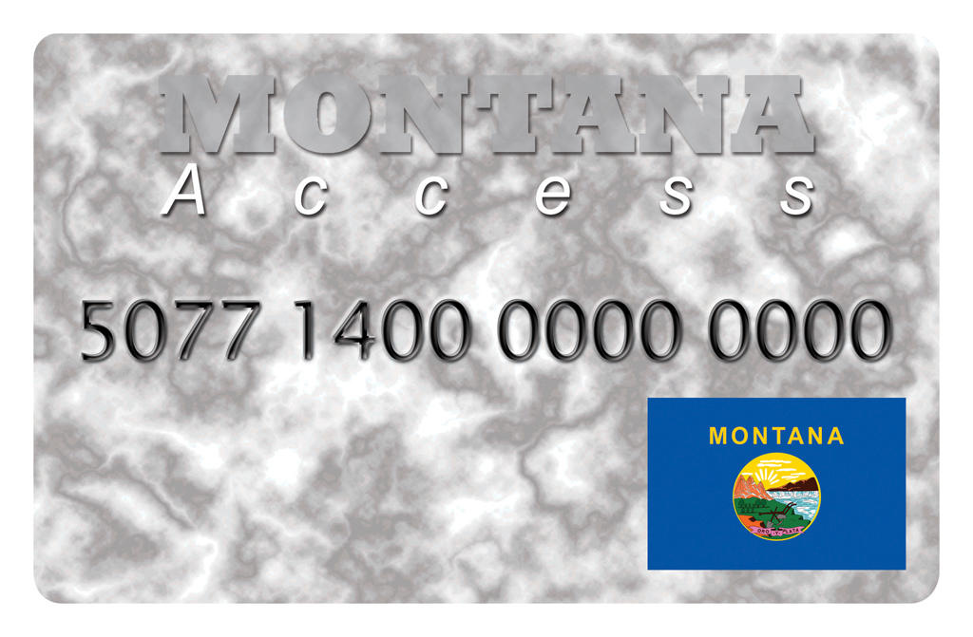
Let’s Learn the Lingo!
Community Food and Agriculture Coalition (CFAC)
Supplemental Nutrition Assistance Program (SNAP)
Food Stamps!
Electronic Benefit Transfer (EBT) Debit Card
Montana Access Card
Double SNAP Dollars (DSD)

Slide 3
DSD Impact and expansion
Helps families in need get healthy, local, fresh food
Over 6,400 Montanans since 2015
Keeps money recirculating within local farmers, ranchers, and farmers markets
$500,000 Gus Schumacher Nutrition Incentive Program (GusNIP)
Expand equity and food access via DSD
From USDA’s National Institute of Food and Agriculture (NIFA)

Slide 4
Data collection
US Census
Center on Budget and Policy Priorities
CFAC’s own research

Slide 5
County Matrix Data Collection
Categories
1. Food Insecurity Rate (FI)
2. % Population 65 plus (Seniors)
3. % Population participating in SNAP
4. % Population who identify as Native American or Alaskan Native
Turn 2-4 into percentages
Ex. (SNAP Participants/Total Population) x 100 = SNAP %

Slide 6
County Matrix Data Collection
Percentage | Corresponding value
0<x<5 AND x=5 | 1
5<x<10 AND x=10 | 2
10<x<15 AND x=15 | 3
15<x<20 AND X=20 | 4
20<x | 5

Slide 7
County Matrix Data Collection
Used SUM, IF, & AND functions
IF (AND(0<D2<.0499),1,0)
Returns 1 if between 0 and 0.0499, 0 for all other values
IF ( D2 = 0.05 , 1 , 0 )
Returns 1 if 0.05, 0 for all other values
=SUM((IF(AND(D2>0,D2<0.0499),1,0))+(IF(D2=0.05,1,0))
Returns 1 if between 0 and 0.0499 and if .05, 0 for all other values

Slide 8
County Matrix Data Collection
Final equation: =SUM((IF(AND(D2>0,D2<0.0499),1,0))+(IF(D2=0.05,1,0)
+(IF(AND(D2>0.05,D2<0.0999),2,0))+(IF(D2=0.1,2,0)
+(IF(AND(D2>0.1,D2<0.14999),3,0))+(IF(D2=0.15,3,0)
+(IF(AND(D2>0.15,D2<0.19999),4,0))+(IF(D2=0.2,4,0)
+(IF(AND(D2>0.2,D2<1),5,0)))))))
For Food Insecurity Rate (FI), % Population 65 plus,% Population on SNAP, and % Population who identify as Native American or Alaskan Native

Slide 9
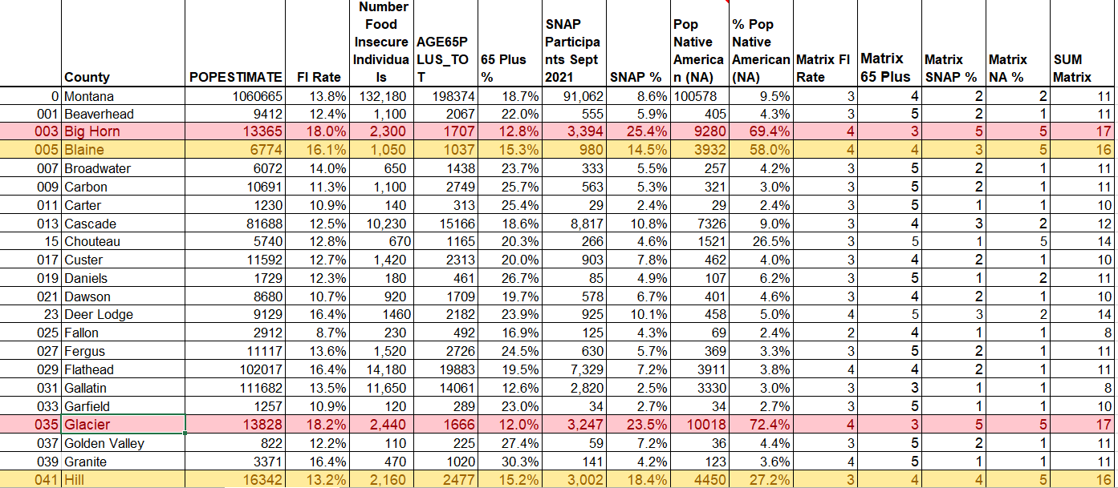

Slide 10
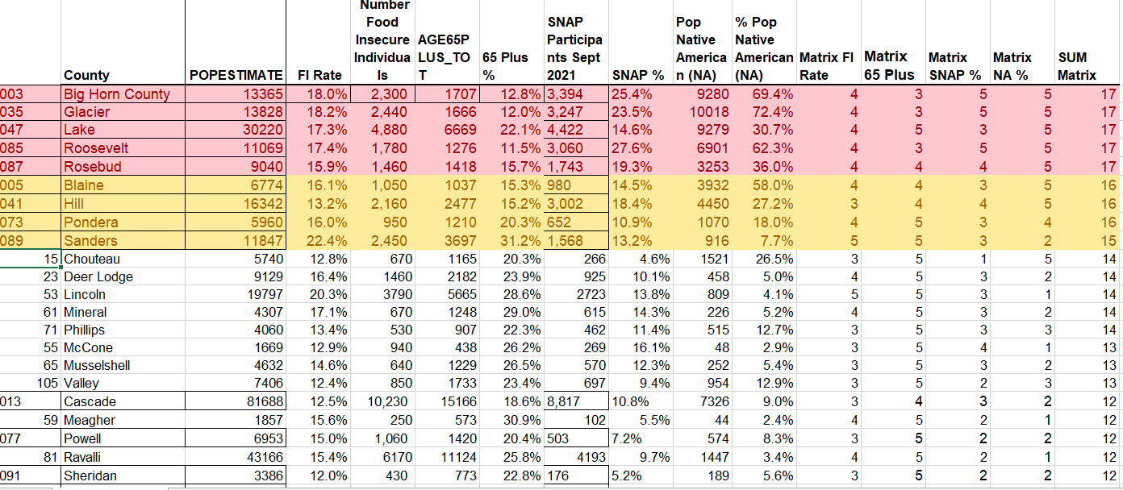

Slide 11
Growth Decision Matrix Calculations
Category | Weighting | Factor Definition
Food Insecurity Rates | 1 | 1 = 0<x<5%, x=5%; 2 = 5<x<10%, x=10%; 3 = 10<x<15%, x=15%; 4 = 15<x<20%, x=20%; 5 = x>20%
SNAP Usage
In Opportunity Zone | 2 | Yes = 1, No = 0
Rural location | 3 | Yes = 1, No = 0
Tribal owned/operated | 4 | Yes = 1, No = 0
In Central/Eastern Montana | 4 | Yes = 1, No = 0
Location Accepts SNAP | 3 | Yes = 1, No = 0

Slide 12
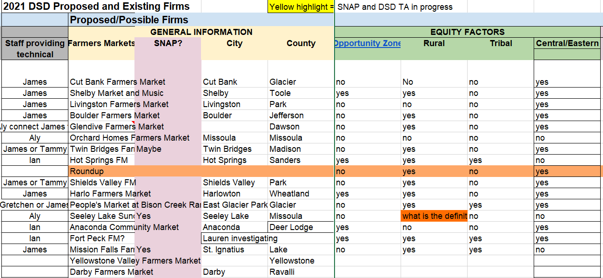

Slide 14
Growth Decision Matrix Calculations
=VLOOKUP(C15,'County Matrix '!$B$3:$N$58,11,FALSE)
Cell C15 = “Glacier”
Looks through ‘County Matrix’ sheet
Area B3:N59
11th column = Matrix value Food Insecurity
18.2% - 4

Slide 15
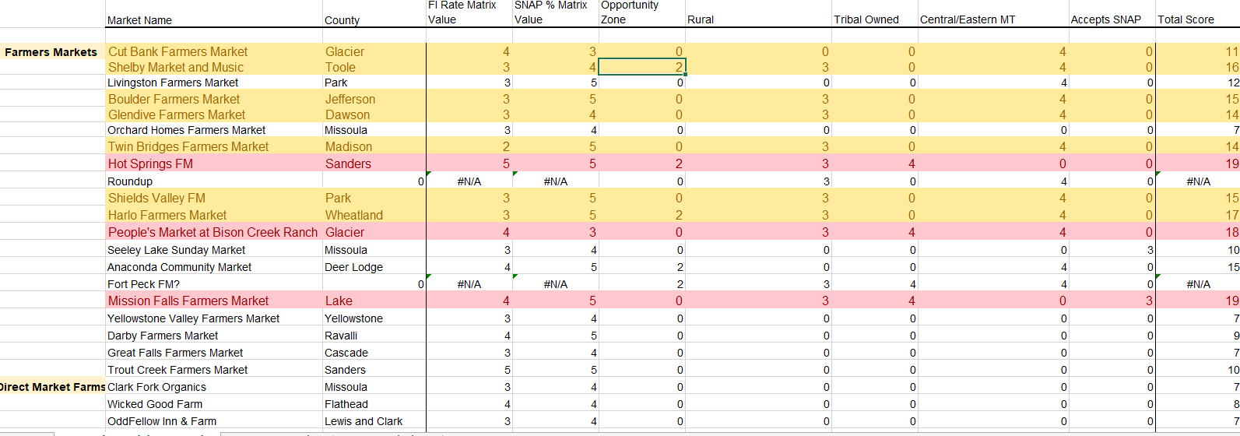

Slide 16
Growth Decision Matrix Calculations
=IF('Proposed Sites'!N6 = "yes", F$5,0)
Looks through ‘Proposed Sites’ Sheet
Finds Cell N6 in Opportunity zone column (N)
If “yes”, returns weighting factor of in cell F$5 (2)
If anything else, returns 0

Slide 17
Results
The top 5 Counties in Montana all received a score of 17
Big Horn, Glacier, Lake, Roosevelt, Rosebud
The top 5 locations and scores are as follows:
Hot Springs Farmers Market in Sanders County (19, tie), Mission Falls Farmers Market in Lake County (19, tie), Red Paint Creek Trading Post in Phillips County (19, tie),
People’s Market at Bison Creek Ranch in Glacier County (18),
Harlo Farmers Market in Wheatland County (17).

Slide 19
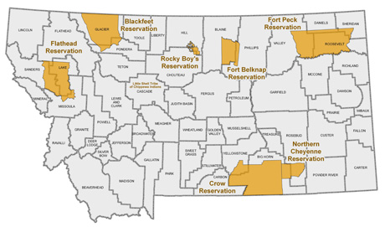

Slide 20
Discussion
Overlap of Glacier and Lake Counties (from County Matrix) with locations found in Growth Decision Matrix
Only 3 proposed locations…
Where are Big Horn, Roosevelt, and Rosebud Counties? No proposed locations in these counties
County lines arbitrary
Ex. River Valley Farmers Market (17) in Big Horn County (17) across from Crow Reservation
Billings Healthy by Design Gardeners’ Market (14) in Yellowstone County (12)

Slide 21
Conclusion
More research and work with tool to be done
Does the Subcommittee want to alter the tool/weighting factors?
Look into Top 5 Counties for DSD sites
Use Growth Decision Matrix to evaluate new locations

Slide 22
CFAC usage
CFAC is directly outreaching to the top ten markets on the list to offer one on one technical assistance (TA)
First “cohort” of markets include top 10 scores on the Growth Through Equity Matrix
Second “cohort” will be next highest markets as CFAC has capacity to offer TA
Outreach to similar SNAP enhancing program “Fresh Access Bucks” in Florida

Slide 23
References
America Counts Staff. (2021, August 25). Montana Population Topped the 1 Million Mark in 2020. United States Census Bureau. https://www.census.gov/library/stories/state-by-state/montana-population-change-between-census-decade.html
Center on Budget and Policy Priorities. (2021). SNAP Is an Important Public-Private Partnership. Center for Budget and Policy Priorities. https://www.cbpp.org/snap-is-an-important-public-private-partnership#Montana
Community Food & Agriculture Coalition. (2021). Double SNAP Dollars. CFAC. https://www.missoulacfac.org/programs/food-access/double-snap-dollars/
Double SNAP Locations. (2021). Double SNAP Dollars. https://www.doubledollarsmt.com/locations/
Feeding America. (2021). Food Insecurity in Montana. Feeding America. https://map.feedingamerica.org/county/2019/overall/montana
Finch, Ian. (2021). DSD Growth through Equity. Community Food & Agriculture Coalition. https://docs.google.com/spreadsheets/d/19wbhE3CTwm0RyhCPdRCX6fRSPPWCcnqMzF1fBqart0o/edit#gid=0
Governor’s Office of Indian Affairs. (2021). Tribal Nations. Montana Official State Website. https://tribalnations.mt.gov/tribalnations
IRS. (2020, August 13). Opportunity Zones. Internal Revenue Service. https://www.irs.gov/newsroom/opportunity-zones
Lindsey Haynes-Maslow, Isabel Osborne, Stephanie Jilcott Pitts, Marilyn Sitaker, Carmen Byker-Shanks, Lucia Leone, Adriana Maldonado, Jared McGuirt, Lauri Andress, Lisa Bailey-Davis, Barbara Baquero, Jane Kolodinsky, Brian Lo, Emily Morgan, Rebecca Senguin, Alice Ammerman. (2018, December). Rural corner store owners’ perceptions of stocking healthier foods in response to proposed SNAP retailer rule changes. Food Policy, Vol 81, 2018, Pages 58-66, ISSN 0306-9192, https://doi.org/10.1016/j.foodpol.2018.10.004
Montana DPHHS. (2021). State of Montana SNAP Program Overview. Montana.gov. https://dphhs.mt.gov/InteractiveDashboards/publicassistancedashboard
USDA. (n.d.). Montana – Rural Definitions. United States Department of Agriculture. https://www.ers.usda.gov/webdocs/DataFiles/53180/25581_MT.pdf?v=39329
World Population Review. (2021). Population of Counties in Montana (2021). World Population Review. https://worldpopulationreview.com/us-counties/states/mt

Slide 24
Results

