Slide 1
An RNA Vaccine Protects against Crimean-Congo Hemorrhagic Fever Virus Infection in Mice
Shanna Leventhal
Disease Modeling and Transmission Section, NIAID, NIH
University of Montana, Molecular and Biomedical Sciences

Slide 2
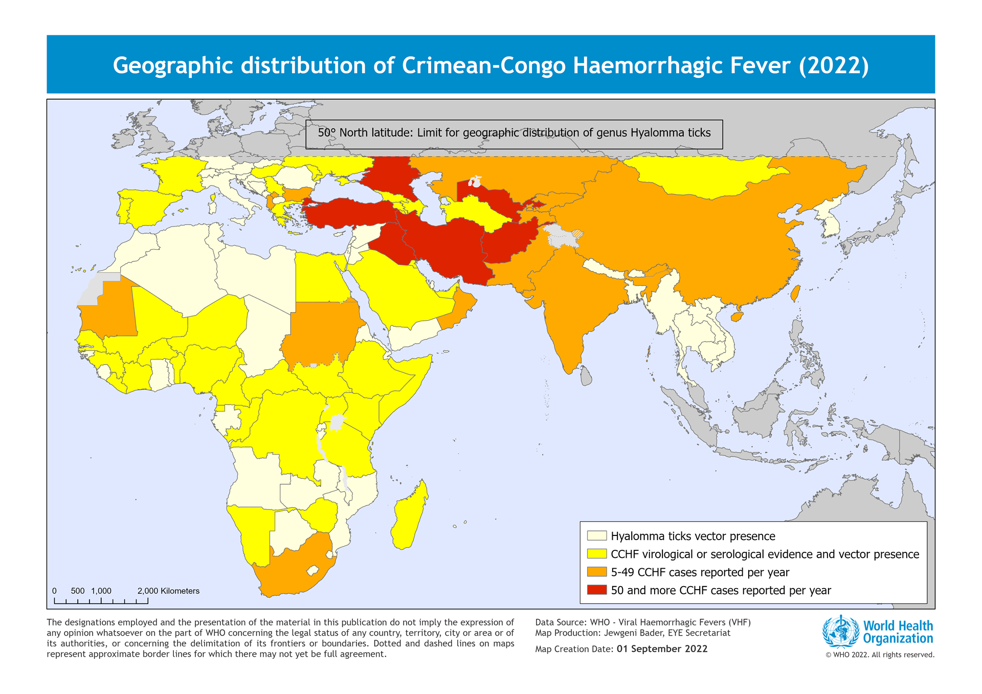
Crimean-Congo Hemorrhagic Fever Virus (CCHFV)
Endemic in Africa, Southern and Eastern Europe, Middle East, India, Asia
Many cases subclinical but infects ~10k-15k a year
Disease begins as a non-specific febrile illness and may progress into severe hemorrhagic disease
Case fatality: 9% to 50%
World Health Organization

Slide 3
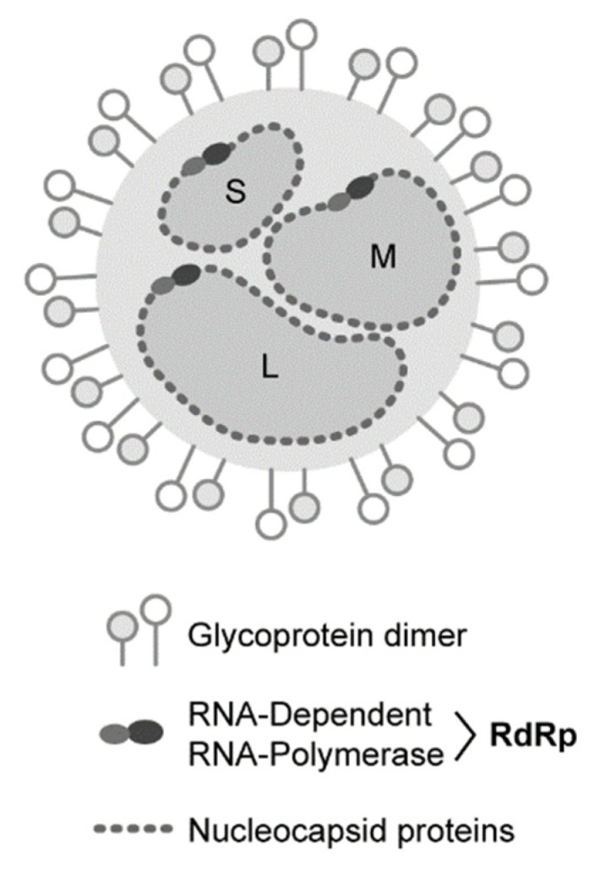
CCHFV Genome
NP: Nucleocapsid protein
Encapsulates and protects the RNA
Roles in genome packaging
Potential roles in virulence
RNA
NP
Leventhal et al. 2021

Slide 4
CCHFV Genome
GPC
M Segment encodes the glycoprotein precursor (GPC)
GPC is processed and releases mature Gn and Gc protein
Mediate viral entry into the cell
Target of neutralizing antibodies which prevent virus from infecting a cell
Gc
Gn
Leventhal et al. 2021

Slide 5
CCHFV Genome
L Segment
Encodes the RNA-dependent RNA-polymerase (RdRp)
Important role in viral replication
Not much else known about its function
Leventhal et al. 2021

Slide 6
CCHFV Genome
Both Np and GPC have promise as vaccine antigens
Np: highly conserved and expresses well
Not all NP-only vaccines are protective
GPC: target of neutralizing antibodies and has multiple protective epitopes
High genetic diversity
Currently no widely approved or highly efficacious vaccine available
Multiple vaccine platforms tested but no consensus or clear answer as to how these vaccines protect or why they do not protect
Neutralizing antibodies are neither necessary nor sufficient
Leventhal et al. 2021

Slide 7
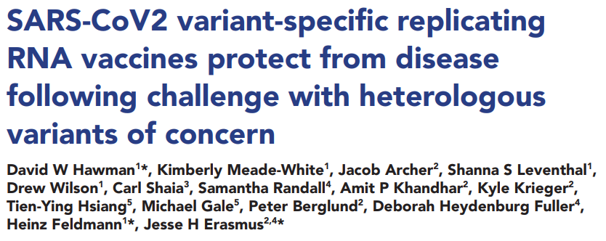
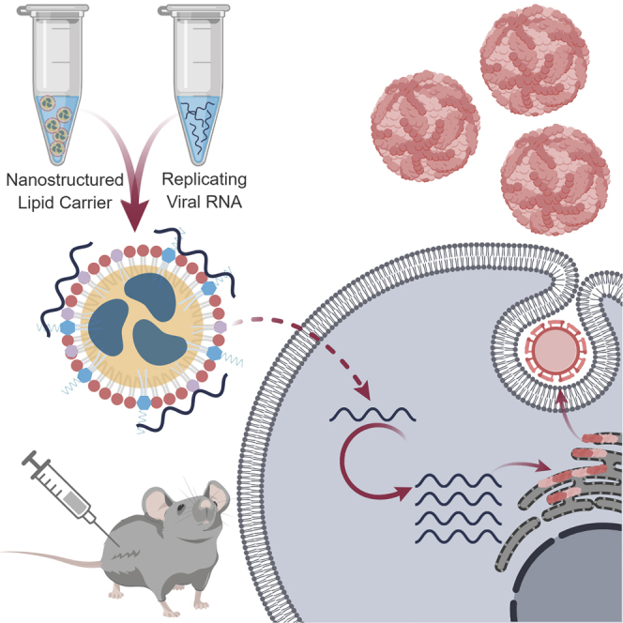
Replicating RNA Vaccine
Building off of our recent work with SARS-CoV-2
Currently in Phase I clinical trials
Erasmus et al. 2018

Slide 8
Replicating RNA Vaccine
Alphaviruses
Ns proteins evolved to efficiently drive expression of genes in the second open reading frame (ORF)
Advantageous over mRNA vaccines which are not self-replicating
The Replicon System
Leventhal et al. 2020

Slide 9
Replicating RNA Vaccine
Alphaviruses
Ns proteins evolved to efficiently drive expression of genes in the second open reading frame (ORF)
Advantageous over mRNA vaccines which are not self-replicating
The Replicon System
Leventhal et al. 2020

Slide 10
The Adaptive Immune Response
Vaccinate mice
Induce protective, adaptive immune response
B-cells
T-cells
Example: B-cells release neutralizing antibodies
T-cells recognize infected cells, leading to cell death
Virus cannot bind to cell
Immune attack
Neutralizing antibodies are just 1 type of the many possible antibodies
Infected cells are killed by T-cells
The Scientist

Slide 11
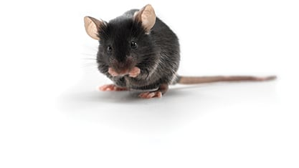
The Efficacy of Individual Antigens
4 Vaccine groups
Sham (irrelevant GFP)
repNP
repGPC
repNP + repGPC
Challenge: Lethal CCHFV model

Slide 12
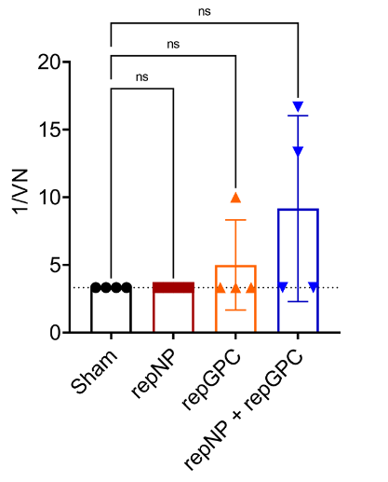
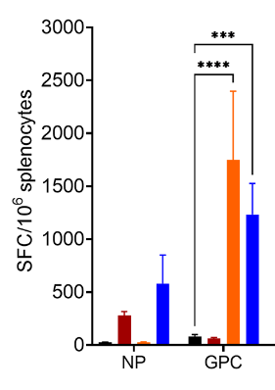
Vaccine Immunogenicity
Neutralization Assay
IFNγ ELISpot (T-cell Stimulation)

Slide 13
Vaccine Efficacy
Viral Loads
Indicates control of viral rep’l
Key Tissues of CCHFV infection
Liver, spleen, blood
repNP & repNP + repGPC - no signs of clinical disease and no infectious virus

Slide 14
The Efficacy of Individual Antigens
Summary
repNP: robust non-neutralizing Ab response, 100% survival
repGPC: robust T-cell response, incomplete protection
repNP + repGPC: strongest immune response and greatest control of viral replication
Moving Forward: repNP + repGPC

Slide 15
How does the repNP + repGPC vaccine protect?
B-cells?
T-cells?
repNP is protective and drives mainly, a robust antibody response
Hypothesis: Vaccine protection is primarily due to repNP-induced antibodies.

Slide 16
The Role of B-cells and T-cells
Vaccination: repNP + repGPC
Mice
Controls: WT mice
B-cell deficiency: µMT mice
T-cell deficiency: WT mice treated with α-CD4, α-CD8, or both
Challenge: Lethal CCHFV model

Slide 17
Timeline:
B-cell Deficient (µMT) Mice
Robust T-cell response
Incomplete protection
T-cell Depleted Mice
Robust Ab response
Less control over viral replication
100% survival
Conclusions
B-cells and antibodies are the primary correlate of protection

Slide 18
repNP + repGPC Vaccine Conclusions
B-cells and αNP antibodies are the primary mechanism of protection against lethal CCHFV challenge
GPC specific T-cell responses significantly enhance protection and may help control viral replication
Protection is conferred by as little as 1µg RNA
Boosting does not enhance protection

Slide 19
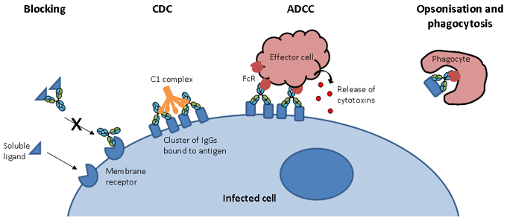
Future Directions
NHP studies and clinical trials
How do these NP Antibodies protect?
ADCC (NK cells)
Opsonization
Complement Activation
TRIM21 (intracellular Fc receptor)
Developing tools
Adoptive transfer model
Monoclonal antibodies

Slide 20
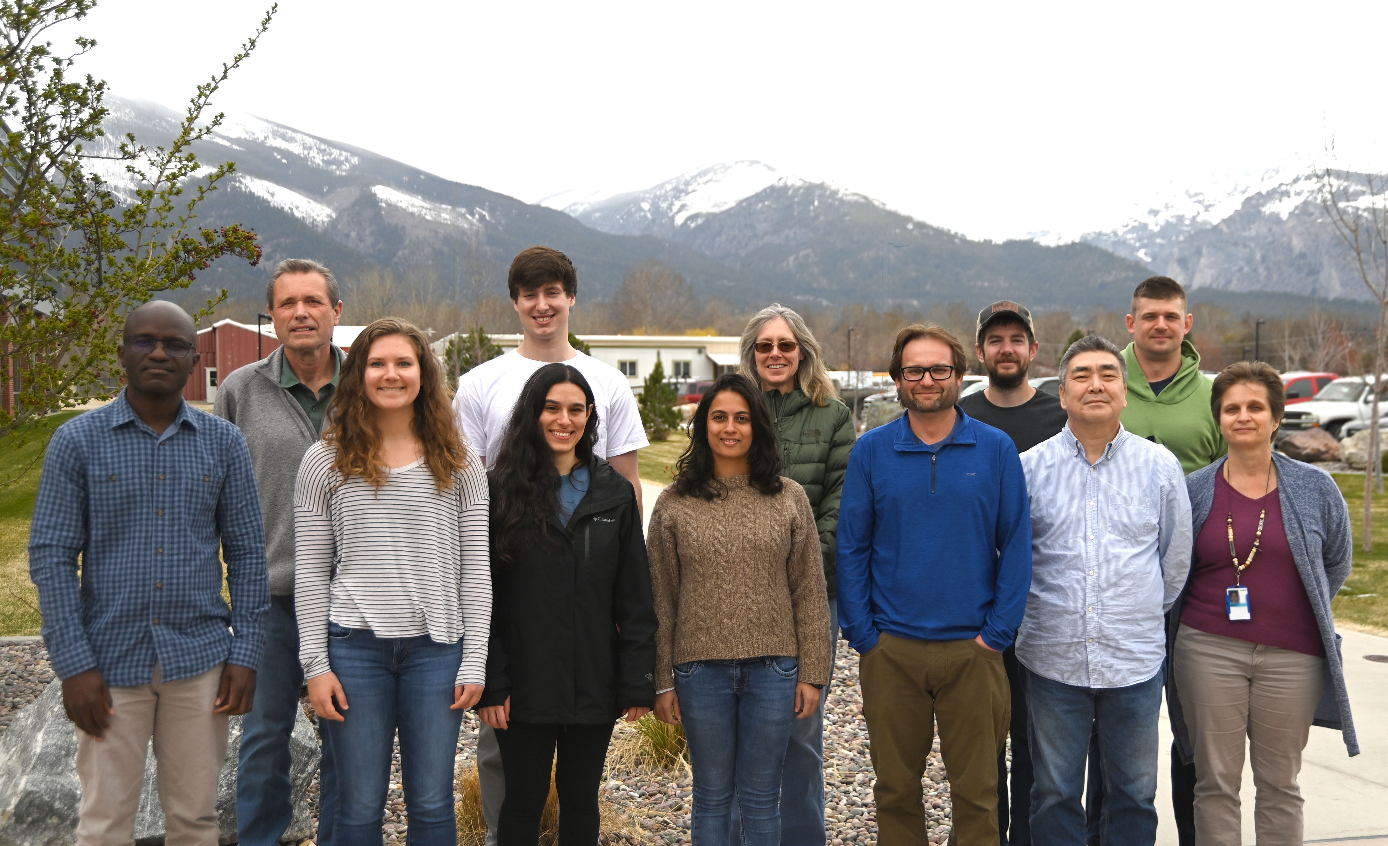
Acknowledgements and much Appreciation
The Rocky Mountain Labs, NIH, NIAID, Hamilton, MT
The University of Montana
Heinz Feldmann
David Hawman
Scott Wetzel
Steve Lodmell
Brent Ryckman
HDT bio; University of Washington School of Medicine
Jesse Erasmus
The OOC and RMVB
Elaine Haddock
BSL4 Facilities Support
Vet Staff
Animal Caretakers
Disease Modeling and Transmission Section
(Top) Heinz Feldmann, Forrest Bohler, Kimberly Meade-White, David Hawman, Matt Lewis
(Bottom) Thomas Tipih, Allie Stamper, Shanna Leventhal, Deepa Rao, Kyle Rosenke, Atsu Okumura, Ricki Feldmann
(Not pictured) Sam Smith and Evan Mihalakakos

Slide 21
Thank you for Listening! Please reach out if you have any questions!
Hamilton, MT by David Hawman

