Slide 1
" MOONLIGHTING AND WAGE DIFFERENTIALS: A CASE STUDY OF THE PUBLIC AND FORMAL PRIVATE SECTORS IN GHANA "
Matilda Kabutey-Ongor
Mentor:
Dr. Amanda Dawsey (Associate Professor of Economics)

Slide 2
Outline
Background and Research Problem
Research Questions
Statement of Hypothesis
Further Study
Research methodology and Preliminary results
Literature Review and Motivation
Policy Recommendation

Slide 3
BACKGROUND
Multiple Jobs
High Cost of Living
Poverty
Unfavorable Labor Market
Conditions
Notes:
Ghana is a country in west Africa with a population of 32.5 million. Several indicators and research classify the country under low-middle income country. Although there has a decline in poverty rate in developing countries. Ghana’s poverty rate has been increasing and a study in 2012 showed that about 50% of the population in
High cost of living in some cities in country compared to other developing countries. Salary levels in Ghana is very low and most Ghanaian cannot afford to live in some city. Cost of living in the country has also been increasing and its very expensive to live in a country like Ghana. An increase in unemployment rate.
There has been a decline in poverty rates in developing countries.
Poverty reduction in Ghana, however, is uneven in the country, with some regions having an increased poverty rate. A study in 2012 showed that about 50% of the people sampled lived in poverty in Ghana. Some studies have attributed the slow reduction of the poverty level in some clusters to the high standard of living in the country especially in major cities. All things being equal, for one to survive in this economy which is coupled with a high standard of living, the minimum job one has (primary job) will therefore not be able to cater for their living, hence the decision to take on a second job (moonlight) comes to play

Slide 4
What is Moonlighting
Moonlighting is simply a phenomenon of multiple job held at the same time
Notes:
According to Baah-Boateng et al. (2013), for a person to be deemed moonlighting, his or her other work (secondary job or occupations) must be compensated
moonlighting as doing a second job outside of normal working hours
. the general understanding of the term moonlighting is a person taking a second job
that is separate from his or her main source of income. For moonlighting to occur, the individual has to be directly involved in both jobs.

Slide 5
Evidence of Moonlighting in Ghana
‘Operation Feed Yourself’ era in 1972
Economic Recovery Program (ERP) era in 1983
Notes:
Moonlighting can be traced way back beyond the 1980’s back then, it intrigued a lot of researchers into studying the phenomena. in the US, a survey conducted in 1989
showed that more than 7.2 million people were engaged in moonlighting, which is an increase of 52% since 1980. Also in the US, approximately 5.9% of workers reported in 1995 held two jobs at the same time.
Operation Feed Yourself was an agricultural program administered in Ghana to increase levels of food crops produced in Ghana for domestic consumption. the government encouraged workers to take up a second job in the program to help with their standard of living.
the Economic Recovery Program which aimed at transforming the economy through various sectors such as the labor market led
to some public sector workers losing their jobs through the privatization of some State-Owned Enterprises
Hence such people sought employment in other sector and held different jobs at the same time to help them have an income level close to what they had before the reform

Slide 6
WHY AND IMPACT
Two Main Reasons
Financial Constraint
Hourly Constraint
Effects of Moonlighting
Increase in income
Developing new skills
Performance slippage

Slide 7
Public Sector
Controlled by government
Serve the Public
Job Stability
Private Sector
Controlled by Individuals/Groups
Earn Profits
Job Instability

Slide 8
BACKGROUND WAGE DIFFERENTIAL
Same Occupation
Same Wage
Notes:
earnings across occupations and among individuals in similar occupations may differ. (working environments, experience and skills level, responsibility among others). due to the differences in these capital accumulated over the years, it is therefore expected that the wages offered to each individual will differ.
public Vs. private formal sector (wage structure, objectives, employment policies, among others)

Slide 9
Moonlighting in Ghana ( 2016/2017)
Notes:
It is illustrated that 88.03% of the workforce have only one job, whiles 11.26% hold two jobs at the same time. females in the private formal sector engage
in multiple jobs more than males whiles in the public sector male engage in moonlighting more than females.

Slide 10
Relevant Literature and Motivation

Slide 11
Research Questions
Does the wage gap (if any) between these sectors increases moonlighting activities in the country?
What are the motives for moonlighting?
Notes:
Ghana’s labor market is characterized by underemployment, vulnerable and informality of employment
In Ghana, about ten percent of the employed population in Ghana are underemployed.
“The first motive of moonlighting is seen as a symptom of time-related underemployment” (Baah-Boateng, 2013)
As of 2015, about 5.3% of those employed in Ghana had a secondary activity. (GSS, 2016)
To what degree does moonlighting exist in the public and private formal sector and what are the factors behind employee's decision to moonlight in these sectors?
Could the wage gap between the sectors have some influence in determining the reasons for moonlighting in the sectors?

Slide 12
Statement of Hypothesis
Wage Gap
Increases Moonlighting
>
Public Moonlighting
Private Formal Moonlighting

Slide 13
Methodology
DATA
Ghana Living Standards Survey 7 (GLSS7) in 2017
GLSS 7 was the seventh round of the living standard survey conducted in Ghana since 1987
Notes:
It contains data collected on household economic activities and covers detailed data “demographic characteristics of the population, education, health, employment, migration, housing conditions, household income expenditure, sand agriculture, and data projection” (GSS, 2017).
The surveys contain information on the socio-economic characteristics of individuals and households, whether an individual holds multiple jobs and institutional characteristics of both jobs.

Slide 14
MOONLIGHTING MODELS
Notes:
Uses a probit regression estimation technique because the dependent variable is dummy
Ordinary Least Squares would be inappropriate because it could return values greater than 1 and less than 0, therefore it is necessary to transform the outcome variable using maximum likelihood estimation across a distribution function.

Slide 15
Descriptive Statistics
Variable | Mean | Std. Deviation | Min | Max
Hours of work (main job) | 40.84 | 54.213 | 0 | 120
Public sector wage | 1126.58 | 957.718 | 30 | 10000
Private formal sector wage | 1206.84 | 1360.08 | 4.167 | 12000
Age | 36.864 | 17.783 | 15 | 99
Household size | 6.053 | 3.544 | 1 | 28
Summary Statistics of Continuous Variables (Characteristics for Moonlighting and Wage Determinant)

Slide 16
Descriptive Statistics
Variables | Frequency | Percentage (%)
Sex of Individual: Female Male | 26,944 25,442 | 51.43 48.57
Location of Household: Urban Rural | 22,549 38,406 | 36.99 63.01
Educational Level: No education Basic education Secondary education Vocational/Technical Tertiary | 704 33,604 5,8411 1,647 2,100 | 1.6 76.55 3.31 3.75 4.78
Job Security in Primary Job: Secure | 1,300 | 25.77
Formal Sector: Public Private | 1,623 601 | 72.98 27.02
Moonlighting: Yes No | 3,548 25,969 | 12.02 87.98
Public Moonlighting: Yes No | 79 634 | 11.08 88.92
Private Formal Moonlighting: Yes No | 17 247 | 6.44 93.56
Summary Statistics of Continuous Variables (Characteristics for Moonlighting and Wage Determinant)

Slide 17
PRIMARY results Marginal Effect of Probit Models the Determinants of Moonlighting for the Public Sector, and the Private Formal Sector
Variables | Marginal effect for public | Marginal effect for private formal
Earnings | -0.038** | -0.030***
 | (0.014) | (0.006)
Age | 0.0244*** | 0.0111***
 | (0.0070) | (0.0026)
Job security | 0.0334 | 0.0677***
 | (0.0321) | (0.0130)
Hours of work (main job) | -0.078*** | -0.0545***
 | (0.0054) | (0.0027)
Male | 0.052** | 0.0532***
 | (0.019) | (0.0104)
Rural | 0.124*** | 0.113***
 | (0.021) | (0.0113)
N | 1300 | 3835
Notes:
The findings for the second objective using the probit analysis show that within the Ghanaian context and in the public and private formal sector, factors such as demographic, personal, and labour market characteristics can be used to explain why moonlighting activities are observed among workers.
The main factors found that were significant in the models (private formal and public sector) are age, income from the main job, hours worked in the main job, gender, size of the household, job security, and location of the worker.
The two main factors (income from the main job and hours of work) that literature attributes to moonlighting decisions were found to hold in both sectors as they reported the expected signs and were significant at all significant levels. This shows that, in both sectors, the hourly constraint and financial constraints motivation for moonlighting was present and the labour-leisure theory can be applied in this context.

Slide 18
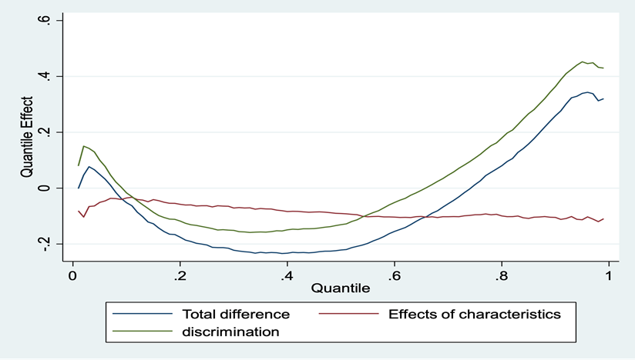
Cross-Sector Evidence on Wage Gap Using the Oaxaca-Blinder Decomposition GLSS7 (2016/2017)
 | Type of Sector
Private formal sector | 6.759*** (0.0209)
Public sector | 6.698***
 | (0.0380)
Difference | 0.0607
 | (0.0433)
Explained | 0.0531*
 | (0.0236)
Unexplained | 0.00763
 | (0.0379)
N | 2050
Notes:
Using the two fold Oaxaca blinder decomposition. There is wage differential between the two sectors and its in favor of the private formal sector. Out of which 5.31% is explained as differences in characteristics looked at and 0.76% due to pure discrimination.

Slide 19
Determinant of Moonlighting: Sector types of employees
Formal sector moonlight | marginal effect
Public sector | 0.1078 ***
 | (0.0190)
N | 2,222
$$H_{1}:public sector moonlight> 0$$
HYPOTHESIS
$$H_{0}:public sector moonlight= 0$$
Notes:
The third objective as well as the first and second statement of hypothesis findings show that, as predicted, public sector workers have a higher likelihood to moonlight compared to private formal sector workers

Slide 20
MOONLIGHTING AND WAGE DIFFERENTIAL
$$H_{1}:public wage< 0$$
Variable | Marginal Effect
Public Wage | -0.034*
 | (0.0111)
HYPOTHESIS
$$H_{0}:public wage= 0$$
Notes:
The third objective as well as the first and second statement of hypothesis findings show that, as predicted, public sector workers have a higher likelihood to moonlight compared to private formal sector workers

Slide 21
Policy Recommendations
Implementation of better public management approaches
Establishment of labor market information system
Improving the lives of rural inhabitants through Development
Notes:
Implementation of better public management approaches with performance-based incentives is that they would address a significant flaw in the current system
The establishment of an efficient labor market information system to facilitate effective job search particularly for the poor who may want to resort to multiple job-holding to supplement low income from main job is recommended
Policymakers in the labor market focus on improving the lives of rural inhabitants through infrastructure development, human capital development, and employment distribution to eliminate inequities in multiple job holdings between urban and rural workers

Slide 22
Further Research
Capturing the dynamics of moonlighting and wages.
High correlation between one’s age and years of experience.
Moonlighting and it’s impact in the USA labor Market
Notes:
Job experience from the primary job was obtained using the age of the individual and years of education as proxies, therefore there is a
Experience was dropped from moonlighting estimation and age was dropped from wage determinant estimation

Slide 23
THANK YOU

