Slide 1
Interpersonal Protective Factors of Suicide Ideation and Attempt Among Adolescents
Lillian Martz Doctoral Student
Department of Counseling
Faculty Advisors: Dr. Emily Sallee & Dr. Abraham Cazares-Cervantes

Slide 2
Agenda
Introduction
Adolescent Suicide
Interpersonal Theory of Suicide
Youth Risk Behavior Survey
Preliminary Data Results
Implications and Future Research

Slide 3
Adolescent Suicide in the US
36% of high school students experienced persistent feelings of sadness and hopelessness that lasted two weeks or more
1 in 6 report making a suicide plan (CDC, 2019).
Notes:
Poor mental health is a growing problem among youth in schools. (Read stats on slide). These numbers have increased since the pandemic. There was a 31% increase in adolescent suicide visits to the ER from 2019-2020.

Slide 4
Montana 2021 Data
41% sad for more than 2 weeks
22% seriously considered suicide
18% made a suicide plan
10% made a suicide attempt
Notes:
Montana’s #’s are a little higher than the national average and because they are more recent, you’re also seeing that increase

Slide 5
Interpersonal Therapy of Suicide (IPTS)
Joiner, 2009
Notes:
As educators we see the issue and try to wrap our heads around why this is happening. We try to use theory to explain so that we can intervene or prevent. IPTS used primarily with adults until Dr. Sallee recently applied it to adolescents

Slide 6
Thwarted Belonging + Perceived Burdensomeness = High Risk of Suicide Ideation Thwarted Belonging + Perceived Burdensomeness + Acquired Capability = High Risk of Suicide Attempt
*Thwarted Belonging: Dynamic: Extreme loneliness and rejection
*Perceived Burdensomeness: Dynamic: Belief that one is defective or flawed and poses an undue burden to loved ones, sense of hopelessness
Acquired Capability: Static: fearlessness, ability to cause oneself harm
Notes:
We don’t focus on the AC because it is the most difficult to intervene or change. It can be due to past childhood abuse or trauma, experience with self-harm and/or a history of previous attempts.

Slide 7
Risk Factors vs. Protective Factors
Most suicide prevention and intervention focuses on risk factors.
Dr. Sallee used this theory and found that being sad, poor emotional health, absences due to feeling unsafe, being not straight, NB and being bullied were significant risk factors for 8th graders with only those in bold holding for 11th grade.
Flip to look at what protects: Positive Psychology and Montana Happiness Project
Notes:
We are interested in encouraging a strengths-based approach to suicide before our students are at risk.

Slide 8
Oregon Health Teen Survey
Derived from the Youth Risk Behavior Survey (YRBS)
Developed by the Centers for Disease Control and Prevention (CDC)
Biennial survey administered to volunteering 8th and 11th graders in Oregon (OHA)
Utilizes a probability design and a randomization process
Intends to minimize possible selection biases and sampling error
2017 OHT Survey demographics:
8th grade - 14,852 participants (12,042 used in study)
47.6% female, 47.2% male, 5.2% non-binary/GNC-First year they could select that
59.2% White, 25.6% Hispanic/Latino, 3.9% Asian, 2.3% Black, 8.2% Other, 0.8% Multiple
11th grade - 11,895 students (10,703 used in study)
48.2% female, 45.9% male, 5.9% non-binary/GNC
62.9% White, 25.0% Hispanic/Latino, 3.6% Asian, 2.2% Black, 5.5% Other, 0.8% Multiple
Notes:
Because I’m working with Dr. Sallee and because post-covid data was not out yet, we used the same data set from her original study.

Slide 9
Research Questions
To what extent does positive emotional mental health predict lower suicide ideation and attempt?
To what extent physical health predict lower suicide ideation and attempt?
To what extent does consistent attendance predict lower risk of suicide ideation and attempts?
To what extent does self-agency predict lower suicide ideation and attempt?
To what extent having a caring teacher connection predicts/or is connected to students’ lower suicide attempt?
To what extent does food security predict lower risk of suicide ideation and attempts?

Slide 10
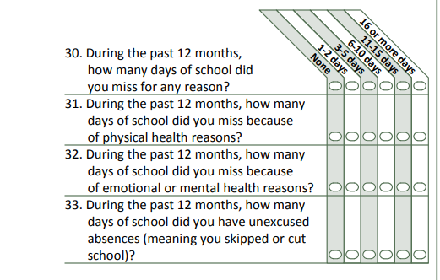
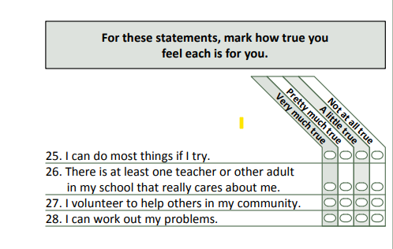
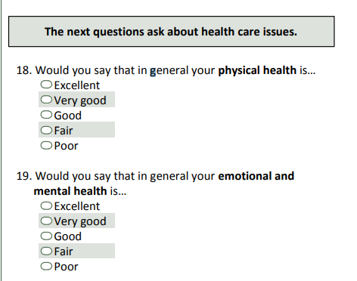
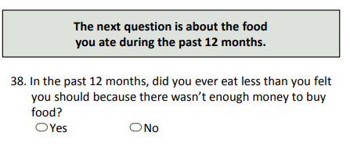
Proxy Items from survey
Thwarted Belonging | Perceived Burdensomeness
Caring Teacher | Emotional/Mental Health (inverse)
Absenteeism (inverse) | Self-Agency
Physical Health | Food Insecurity

Slide 11
Physical Health
Model Fitting Information
Grade (consistent with age range) | RECODE: How do you identify? (Female, Male, Non-Binary/GNC) | Model | -2 Log Likelihood | Chi-Square | df | Sig.
8th | Female | Intercept Only | 444.175
 |  | Final | 328.878 | 115.297 | 14 | <.001
 | Male | Intercept Only | 356.579
 |  | Final | 312.638 | 43.942 | 14 | <.001
 | Non-Binary/GNC | Intercept Only | 240.720
 |  | Final | 178.638 | 62.082 | 14 | <.001
11th | Female | Intercept Only | 375.370
 |  | Final | 292.085 | 83.285 | 14 | <.001
 | Male | Intercept Only | 361.053
 |  | Final | 293.589 | 67.464 | 14 | <.001
 | Non-Binary/GNC | Intercept Only | 240.063
 |  | Final | 173.673 | 66.391 | 14 | <.001
Notes:
Physical health as a predictor of sadness (2 + weeks). Based on previous data which indicated that gender NB/GNC were at increased risk we chose to separate for gender. We completed an ordinal regression analysis. This data was significant and explains about 3% of the variance

Slide 12
Attendance
Model Fitting Information
Grade (consistent with age range) | RECODE: How do you identify? (Female, Male, Non-Binary/GNC) | Model | -2 Log Likelihood | Chi-Square | df | Sig.
8th | -9.00 | Intercept Only | 32.661
 |  | Final | 15.955 | 16.706 | 5 | .005
 | Female | Intercept Only | 219.389
 |  | Final | 129.936 | 89.453 | 5 | <.001
 | Male | Intercept Only | 164.461
 |  | Final | 115.319 | 49.142 | 5 | <.001
 | Non-Binary/GNC | Intercept Only | 113.227
 |  | Final | 104.980 | 8.246 | 5 | .143
11th | -9.00 | Intercept Only | 11.128
 |  | Final | 6.672 | 4.456 | 4 | .348
 | Female | Intercept Only | 160.003
 |  | Final | 105.122 | 54.881 | 5 | <.001
 | Male | Intercept Only | 114.565
 |  | Final | 93.416 | 21.148 | 5 | <.001
 | Non-Binary/GNC | Intercept Only | 98.207
 |  | Final | 85.280 | 12.927 | 5 | .024
Link function: Logit.
Notes:
As an indicator of actual suicide attempts. This is not shown to be significant with gender NB/GNC youth

Slide 13
Caring Teacher
Model Fitting Information
Grade (consistent with age range) | RECODE: How do you identify? (Female, Male, Non-Binary/GNC) | Model | -2 Log Likelihood | Chi-Square | df | Sig.
8th | Female | Intercept Only | 211.307
 |  | Final | 95.069 | 116.237 | 3 | <.001
 | Male | Intercept Only | 130.877
 |  | Final | 77.385 | 53.491 | 3 | <.001
 | Non-Binary/GNC | Intercept Only | 90.019
 |  | Final | 76.021 | 13.998 | 3 | .003
11th | Female | Intercept Only | 120.788
 |  | Final | 82.420 | 38.368 | 3 | <.001
 | Male | Intercept Only | 108.874
 |  | Final | 78.873 | 30.001 | 3 | <.001
 | Non-Binary/GNC | Intercept Only | 75.377
 |  | Final | 61.123 | 14.254 | 3 | .003
Notes:
Having a caring teacher as a protective factor against youth who seriously considered making a suicide attempt. Again, not significant for GNB or NC, though it is close.

Slide 14
Self-Agency (Work out Problems)
Model Fitting Information
Grade (consistent with age range) | RECODE: How do you identify? (Female, Male, Non-Binary/GNC) | Model | -2 Log Likelihood | Chi-Square | df | Sig.
8th | Female | Intercept Only | 661.917
 |  | Final | 28.461 | 633.456 | 3 | <.001
 | Male | Intercept Only | 316.411
 |  | Final | 25.923 | 290.489 | 3 | <.001
 | Non-Binary/GNC | Intercept Only | 98.010
 |  | Final | 21.068 | 76.942 | 3 | <.001
11th | Female | Intercept Only | 444.432
 |  | Final | 27.572 | 416.860 | 3 | <.001
 | Male | Intercept Only | 256.697
 |  | Final | 25.473 | 231.224 | 3 | <.001
 | Non-Binary/GNC | Intercept Only | 106.984
 |  | Final | 20.902 | 86.081 | 3 | <.001
Explains 13% of variance
Notes:
Protective factor for a consideration of a suicide attempt. Significant for all and pseud R2 determines that this explains 13% of the variance.

Slide 15
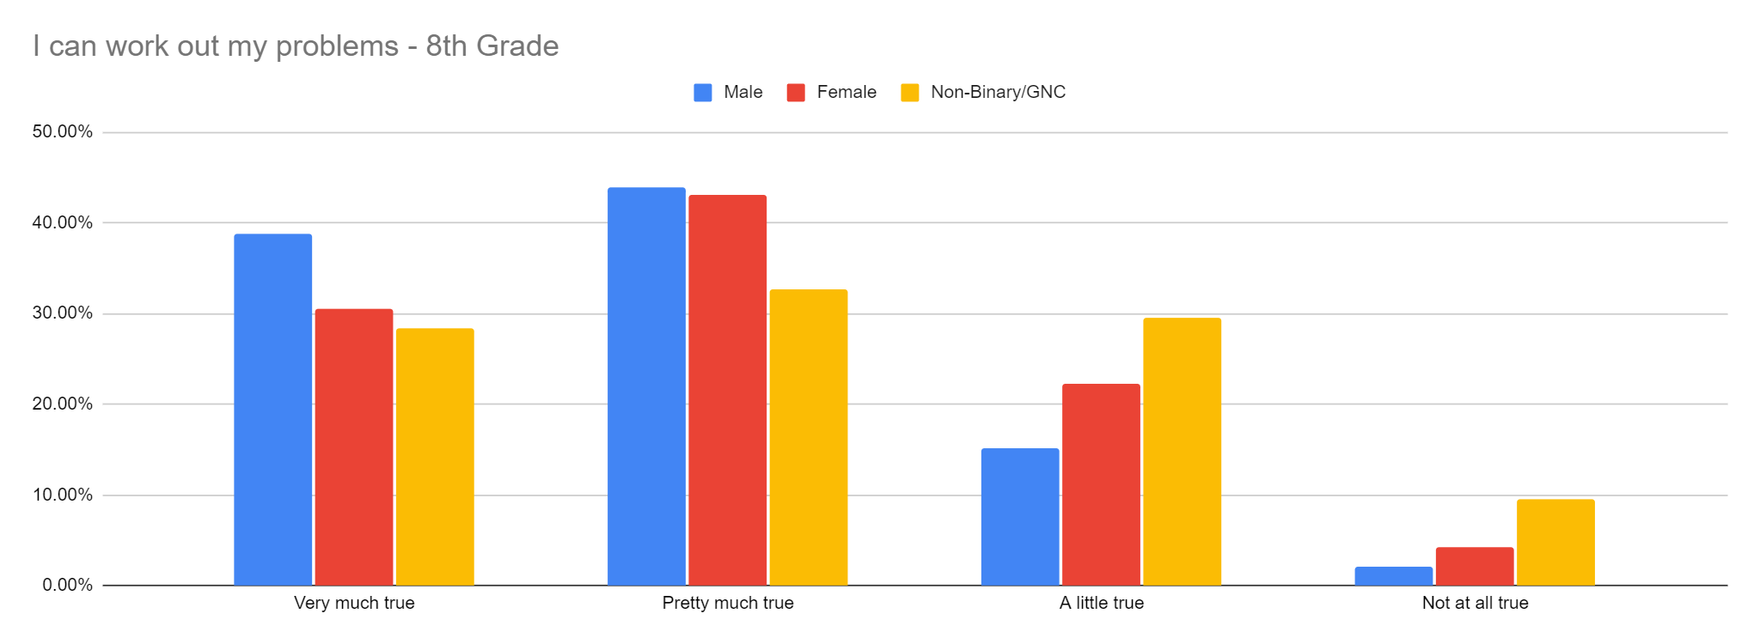
Self-Agency between gender identity
Notes:
Look at the descriptive statistics and the regression which indicates that self-agency is a strong protective factor. We want to examine this more in terms of change over time between 8th-11th grade as well as looking at race/ethnicity tied to self-agency

Slide 16
Implications
Continue analysis of data for all research questions and compare for all risk levels (sadness, ideation, attempt). Examine how self-agency differs among different race/ethnicity factors.
Schools can take steps to improve the sense of belonging for student through mentoring programs (caring teacher), efforts to improve overall attendance, and measures to promote physical health (Community Health centers/Community Schools).
Schools can take steps to reduce the feeling of burdensomeness on students through programs that boost self-agency, improved mental health supports for all students (Strengths-based Tier 1 and Tier 2 approaches) and by improve food security (universal free lunch).

Slide 17
Thank you
Lillian Martz​
Lillian.Martz@umconnect.umt.edu

Slide 18
References
Barzilay, S., Feldman, D., Snir, A., Apter, A., Carli, V., Hoven, C., . . . Wasserman, D. (2015). The interpersonal theory of suicide and adolescent suicidal behavior. Journal of Affective Disorders, 183, 68-74.
CDC. Web-based Injury Statistics Query and Reporting System (WISQARS). Atlanta, GA: US Department of Health and Human Services, CDC; 2021. https://www.cdc.gov/injury/wisqars/index.html
Davidson, C., Wingate, L., Rasmussen, K., & Slish, M. (2009). Hope as a Predictor of Interpersonal Suicide Risk. Suicide & Life-threatening Behavior, 39(5), 499-507.
Gallagher, E., Dever, B., Hochbein, C., & DuPaul, G. (2019). Teacher Caring as a Protective Factor: The Effects of Behavioral/Emotional Risk and Teacher Caring on Office Disciplinary Referrals in Middle School. School Mental Health, 11(4), 754-765.
Joiner, T. E., Van Orden, K. A., Witte, T. K., & Rudd, M. D. (2009). The interpersonal theory of suicide: Guidance for working with suicidal clients. American Psychological Association. https://doi.org/10.1037/11869-000
Montana Youth Risk Behavior Survey, (2021). Montana Office of Public Instruction.
Phillip, A., Pellechi, A., DeSilva, R., Semler, K., & Makani, R. (2022). A Plausible Explanation of Increased Suicidal Behaviors Among Transgender Youth Based on the Interpersonal Theory of Suicide (IPTS): Case Series and Literature Review. Journal of Psychiatric Practice, 28(1), 3-13.
Sallee, E., Ng, K.-M., & Cazares-Cervantes, A. (2021). Interpersonal Predictors of Suicide Ideation and Attempt Among Early Adolescents. Professional School Counseling. https://doi.org/10.1177/2156759X211018653
Sallee, E., Abraham Cazares-Cervantes, & Kok-Mun Ng. (2022). Interpersonal Predictors of Suicide Ideation and Attempt Among Middle Adolescents. The Professional Counselor (Greensboro, N.C.), 12(1), 1-16

