Slide 1
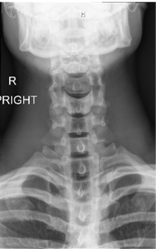
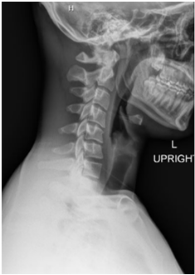
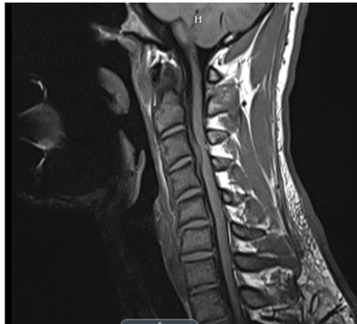
Cervical Disk Rupture in a Collegiate Football Player:
A Case Study
Kuracina, H*, Reisig, K^, Smith, B^, Moody, VJ*: *University of Montana, ^Montana State University
School of Integrative Physiology and Athletic Training, University of Montana, Missoula, MT
Background
Intervention & Treatment
Intervertebral disks have an inner nucleus and an outer annulus fiber, and a herniation occurs when the disk protrudes through the annulus
Common signs and symptoms include neck pain, ipsilateral arm pain or paresthesia, and other neurological symptoms
Cervical disk herniations commonly occur in patients between the ages of 51 and 60
In the NFL between 2001 and 2011 only 16 reported cases of CDH, and only 9 were from single traumatic events
Initial treatment included passive ROM, massage, and traction
Treatment was led by a Physical Therapist and supplemented by the Athletic Trainers
A soft collar was provided to help support the neck
cyclobenzaprine and Toradol to help with pain and spasm
After the imaging passive ROM, and a soft collar were used until surgery
Surgery included a single-level fusion at C3/4, with an anterior plate and a spacer
Post surgery ______________ rehab was done
Patient
Outcome
24-year-old male colligate football player
Self-reported a pillow change/ sleeping wrong, later amended to a head-down collision resulting in forced hyperflexion
Presented with pain in the neck, and decreased cervical ROM, no numbness or tingling
With no improvement and updated MOI referral to the physician was made, also the decision for imaging
Surgery was a success
Post-surgical rehab has gone well
Case is ongoing and the athlete plans to make a return to spring football, if there is clearance
Conclusion
Cervical disc herniation in young males rarely occurs
Presentation, in this case, was atypical with no focal neurological deficits on examination.
Imaging was warranted to achieve the correct diagnosis and treatment
Surgery was a success, allowing for complete resolution of signs and symptoms
Figure 1
Figure 2
Clinical Bottom Line
Provide insight into unique presentations of cervical disk herniation
A typical presentation of focal neurological deficits was not evident in this case.
Figure 1: Posterior view of the neck, post-injury and pre-intervention.
Figure 2: Lateral view of the neck, post-injury and pre-intervention.
Figure 3: MRI of the neck post-injury and pre-intervention
Figure 3

