Slide 1
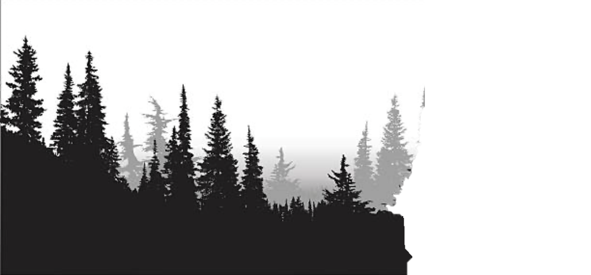
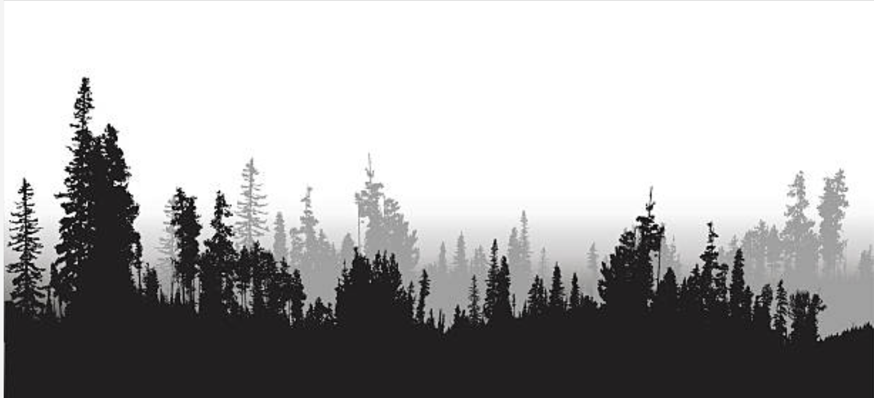
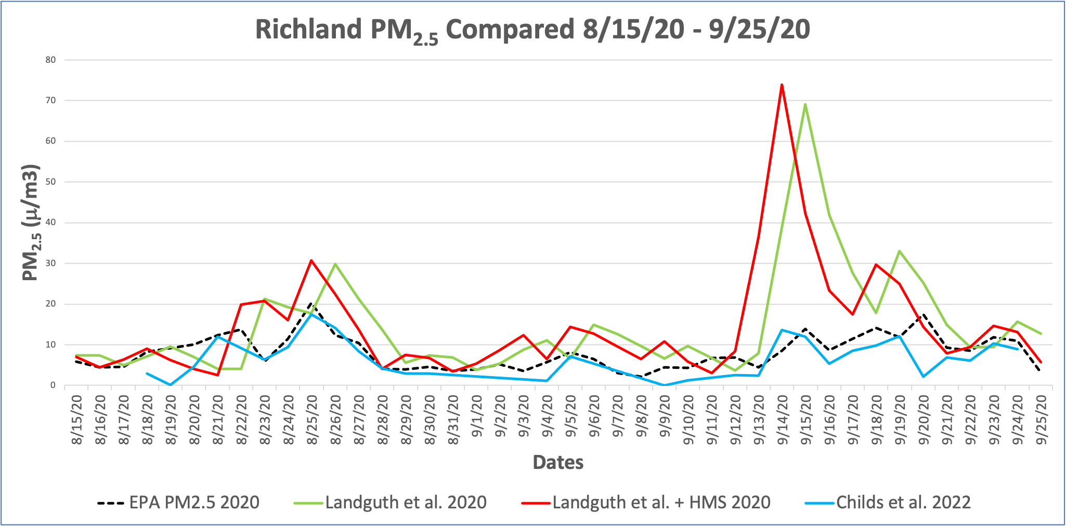
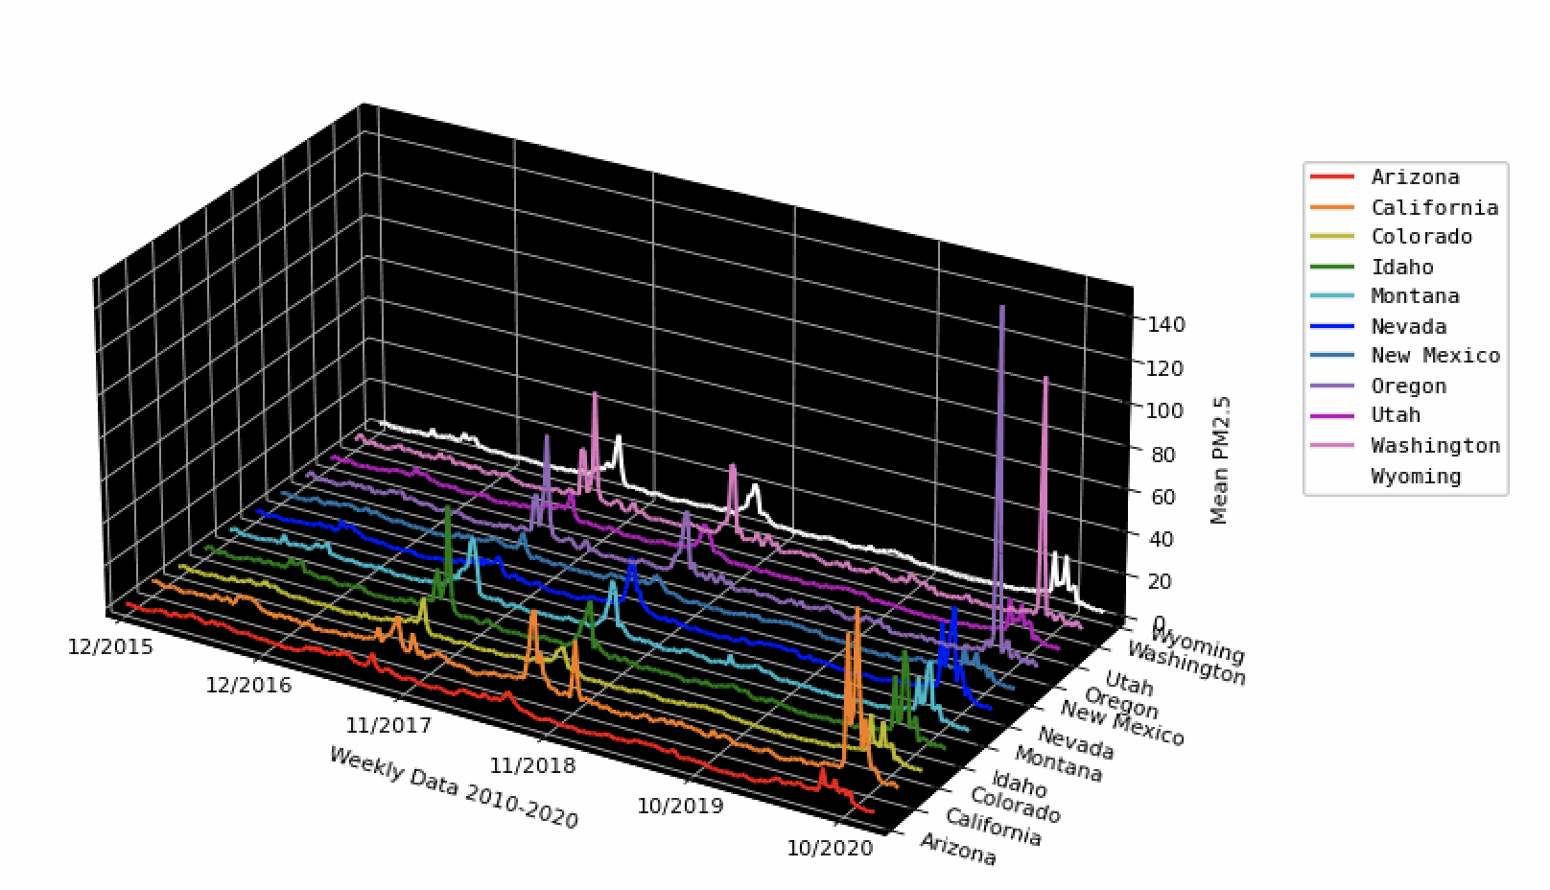
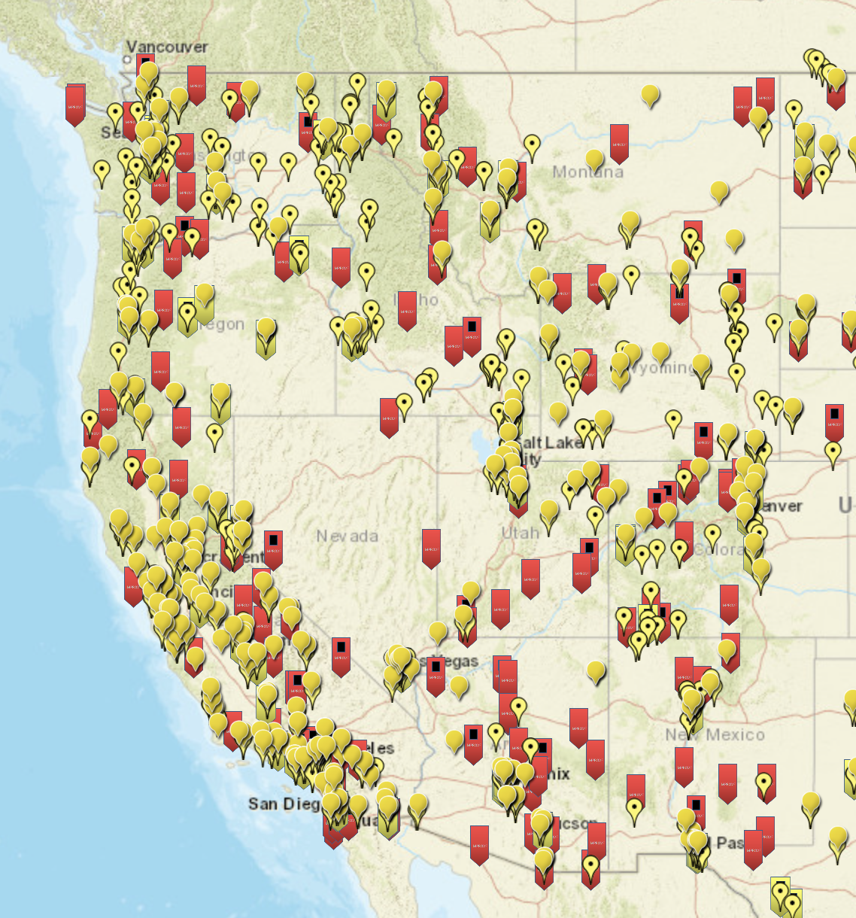
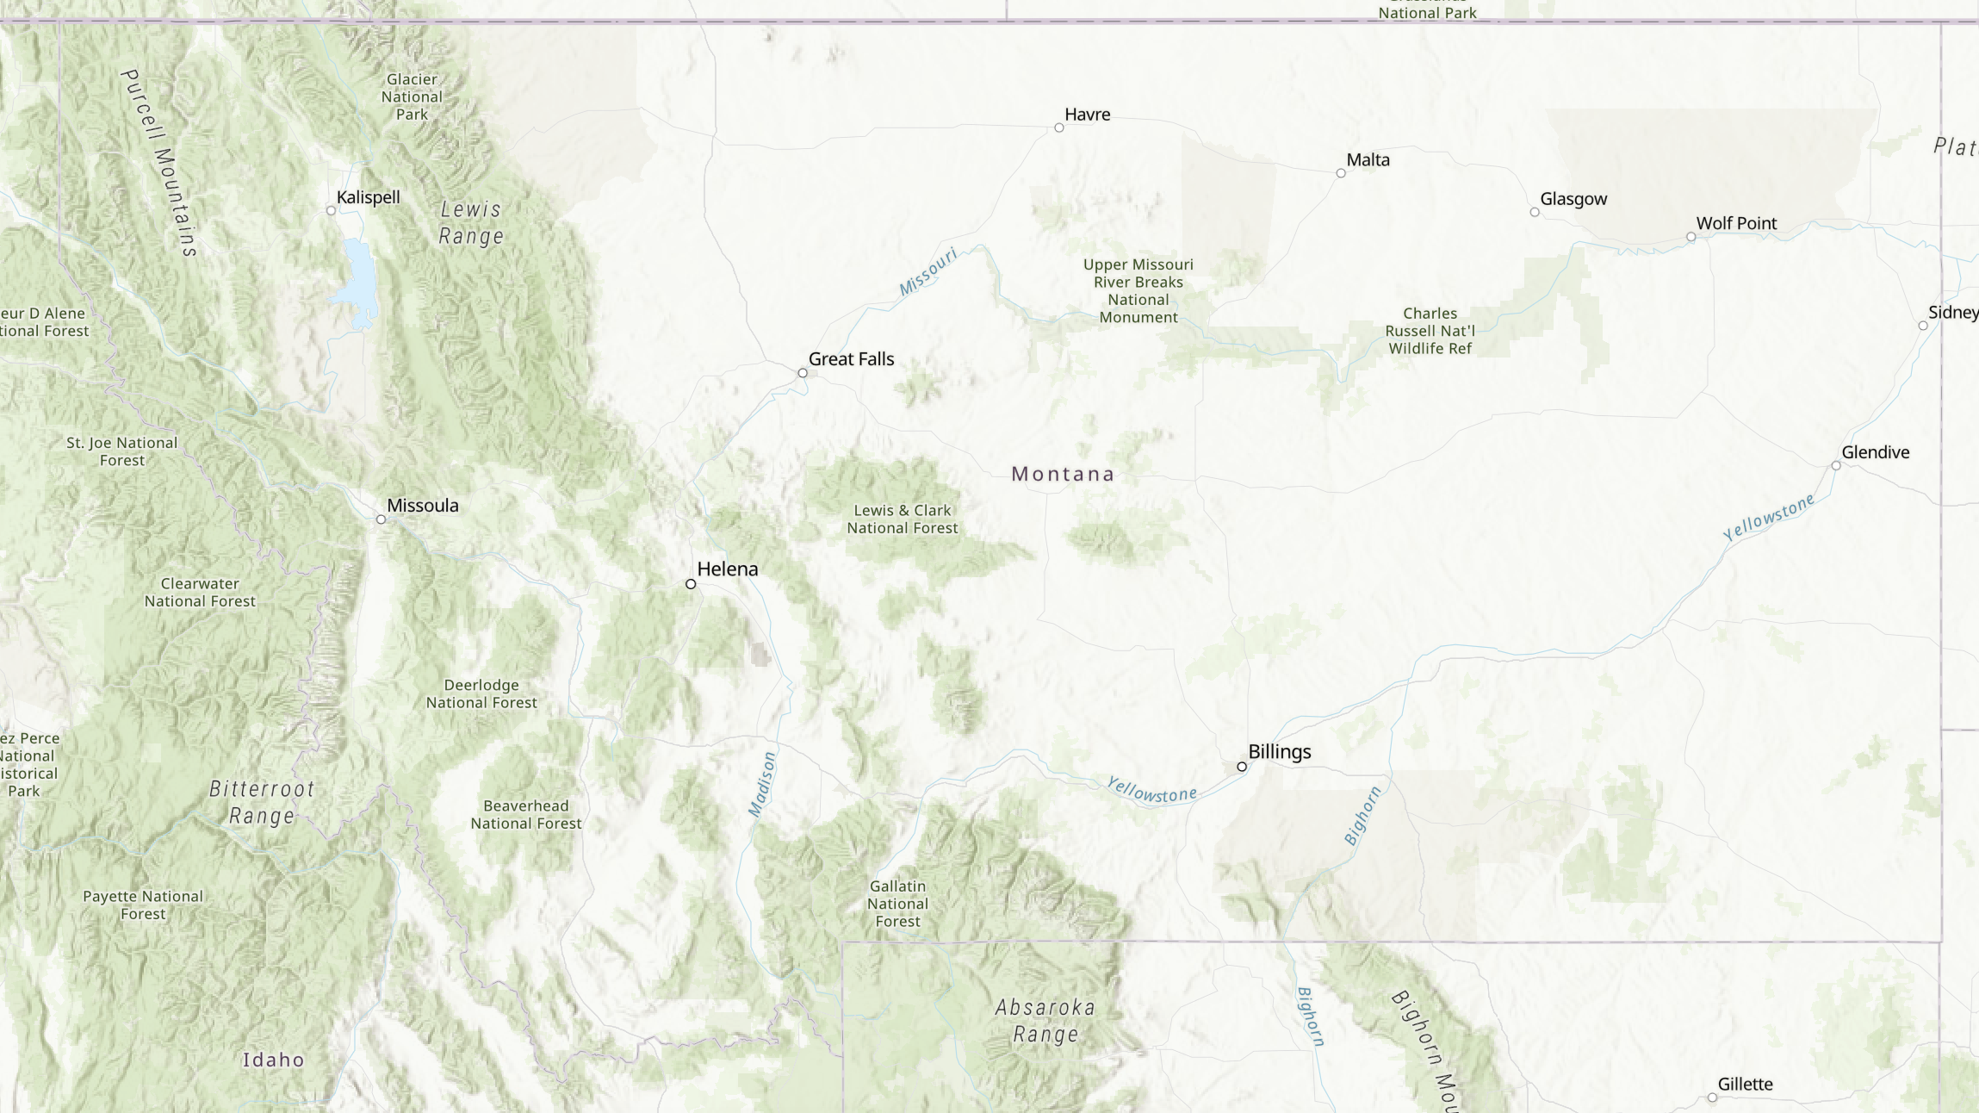
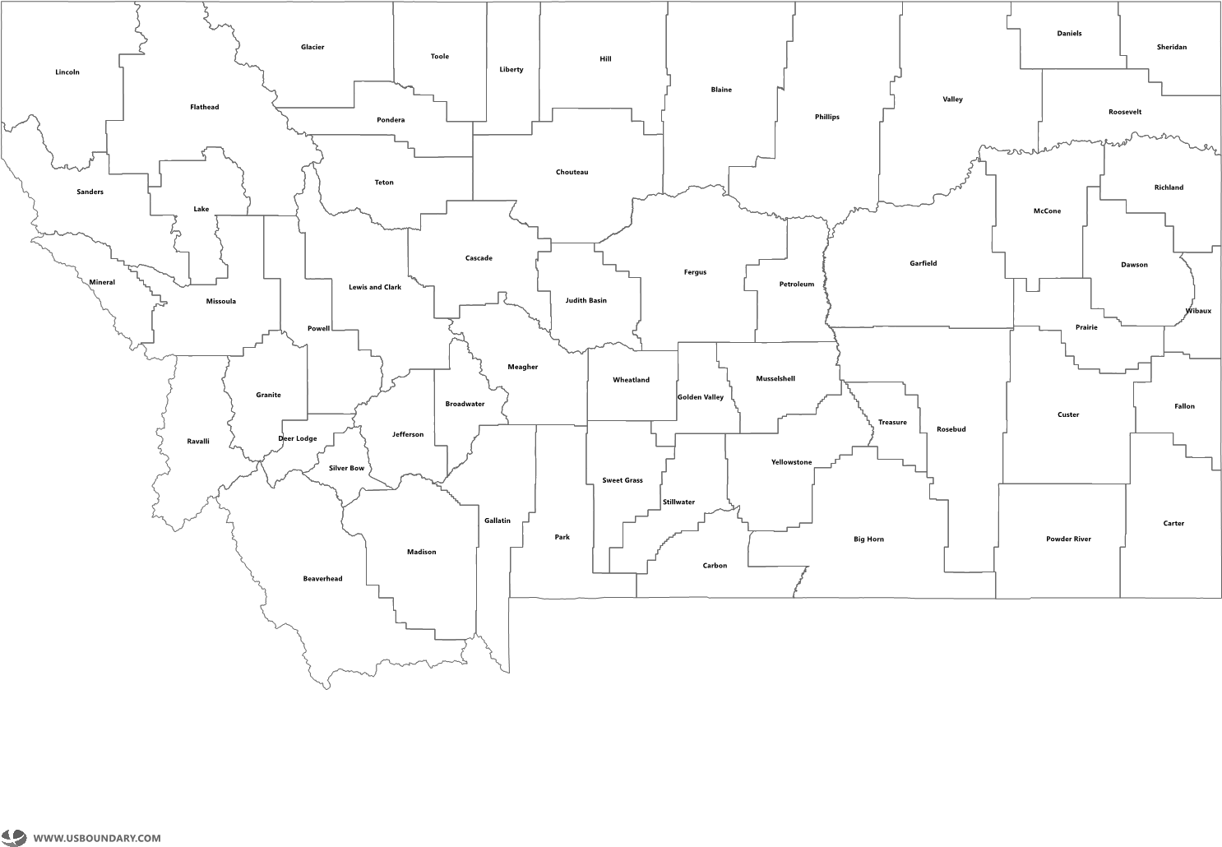
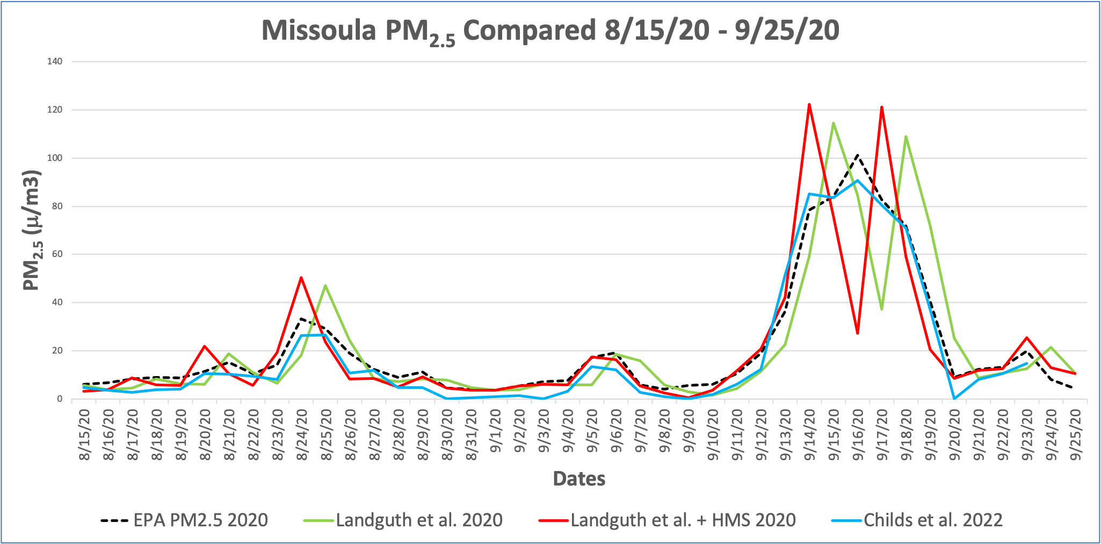
#3799
Methods for Extracting Wildfire Specific PM_{2.5} for the Western United States
Ava Orr¹ Erin Landguth²
¹The University of Montana Center for Environmental Health Sciences, ²The University of Montana Center for Population Health Research
Summary: Air pollution and fine particulate matter (PM_{2.5}) from wildfire smoke have steadily increased over the last decade despite decreasing anthropogenic emissions. The increase in wildfires in the western US has highlighted the need to understand better how wildfire-specific PM_{2.5} affects human health. Currently, the Clean Air Act does not distinguish between different sources of PM_{2.5} emissions. Accurate attribution and measurement are challenging as ground monitors measure concentrations of total pollutants and cannot attribute pollutants to their sources without more information. To support health risk assessment studies from wildfire smoke inhalation, differentiating between wildfire-specific PM_{2.5} and non-wildfire-specific PM_{2.5} is essential. Many studies that have connected wildfire-specific PM_{2.5} and human health effects have devised methods for differentiating PM_{2.5} proving a difficult standardization challenge. A literature search found that there are over 161 articles that have created a method for extracting wildfire-specific PM_{2.5} to quantify relationships between PM_{2.5} exposure and adverse health outcomes.
This study’s objectives were to evaluate methods and datasets used for determining wildfire smoke exposure associations with various health outcomes. We used published surface PM_{2.5} data (Landguth data²) with the following two methods for isolating wildfire-specific PM_{2.5}: (i) EPA sensor derived wildfire season PM_{2.5} extraction, (ii) wildfire season window (as described in (i) combined with National Oceanic and Atmospheric Administration Hazard Mapping System smoke plume satellite data to extract both temporally and spatially wildfire-season specific PM_{2.5}. We compared and contrasted the methods using two counties in Montana, MT: Missoula and Richland with populations 119,533 and 11,283, respectively. We also included data from the nearest observational EPA PM_{2.5} station data and a recent published dataset on daily local-level estimates of ambient wildfire smoke PM_{2.5} (Childs data²). Similar results were observed for the larger population county of Missoula, however, for the smaller population county of Richland, results diverged during high wildfire activity periods between the extraction methods and the station and Childs data. The results of our study highlight the need for more in-depth studies showing the impacts of PM_{2.5} on public health, as policies may need to be adapted based on the emission source.
Methods for Wildfire-Specific PM_{2.5} Extraction
Table 1. Different Data Sources Used in Comparisons
 | Years | Resolution | Modeling | PM_{2.5} Ground Monitors | Aerosol AOD, MODIS | HMS Smoke Plumes | Smog, Cold Air Drainage | Meteorology Temperature | Distance from Fires
EPA |  |  |  | X
Landguth et al. 2020 | 2003-2020 | 1-Km | Geographical Weighted Regression | X | X |  | X
Landguth et al. 2020 + HMS Smoke Plumes | 2010-2020 | 1-Km | Geographical Weighted Regression | X | X | X | X
Childs et al. 2022 | 2006-2020 | 10-Km | Machine Learning Model | X | X | X |  | X | X
Table 3. Richland 2020
 | Mean | Median | Max | Min
EPA PM_{2.5} | 8.093 | 7.5 | 20.2 | 2.1
Landguth et al. 2020 | 14.700 | 9.581 | 69.140 | 3.720
Landguth et al. + HMS Smoke Plumes 2020 | 14.354 | 9.480 | 73.940 | 2.600
Childs et al. 2022 | 6.825 | 6.589 | 17.471 | 0.001
Method i. Wildfire Season Time Extraction (Bottom Up)
5
4
3
2
1
1. EPA PM_{2.5} Stations
2. Cold Air Drainage
3. Smog Layer
4. Aerosol Measurements
5. Wildfire Season Time Window
Method ii. Spatial Smoke Plumes (Top Down)
5
4
3
2
1
Table 3. Missoula 2020
 | Mean | Median | Max | Min
EPA PM_{2.5} | 21.454 | 11.2 | 101.3 | 3.7
Landguth et al. 2020 | 20.743 | 8.617 | 114.542 | 1.680
Landguth et al. + HMS Smoke Plumes 2020 | 20.148 | 9.809 | 122.360 | 0.44
Childs et al. 2022 | 19.170 | 8.711 | 90.734 | 0.000
1. EPA PM_{2.5} Stations
2. Cold Air Drainage
3. Smog Layer
4. Aerosol Measurements
5. HMS Smoke Plumes
Figure 2. PM_{2.5} Comparison for 11 Western US States during peak wildfire season in 2020 data. PM_{2.5} data used is Landguth et al. 2020
Method iii. Combination
6
Richland
5
Missoula
4
3
2
1
Figure 4. Map of MT Counties, highlighted Missoula and Richland counties used in analysis
Figure 3. EPA PM_{2.5} Monitors throughout the Western US
1. EPA PM_{2.5} Monitors
2. Cold Air Drainage
3. Smog Layer
4. Aerosol Measurements
5. HMS Smoke Plumes
6. Wildfire Season Time Window
References
1. Landguth EL, Holden ZA, Graham J, Stark B, Mokhtari EB, Kaleczyc E, Anderson S, Urbanski S, Jolly M, Semmens EO, Warren DA, Swanson A, Stone E, Noonan C. The delayed effect of wildfire season particulate matter on subsequent influenza season in a mountain west region of the USA. Environ Int. 2020 Jun;139:105668. doi: 10.1016/j.envint.2020.105668. Epub 2020 Mar 31. PMID: 32244099; PMCID: PMC7275907.
2. Childs ML, Li J, Wen J, Heft-Neal S, Driscoll A, Wang S, Gould CF, Qiu M, Burney J, Burke M. Daily Local-Level Estimates of Ambient Wildfire Smoke PM_{2.5} for the Contiguous US. Environ Sci Technol. 2022 Oct 4;56(19):13607-13621. doi: 10.1021/acs.est.2c02934. Epub 2022 Sep 22. PMID: 36134580.
Acknowledgments
This work was supported by National Institute of General Medical Sciences of the National Institutes of Health, United States (Award numbers P20GM130418).
Figure 1. Spatial Representation of Methods for Extracting Wildfire-Specific PM_{2.5}

