Slide 1
Identity and Performance Anxiety in Classical Singing
A Counseling Perspective

Slide 2
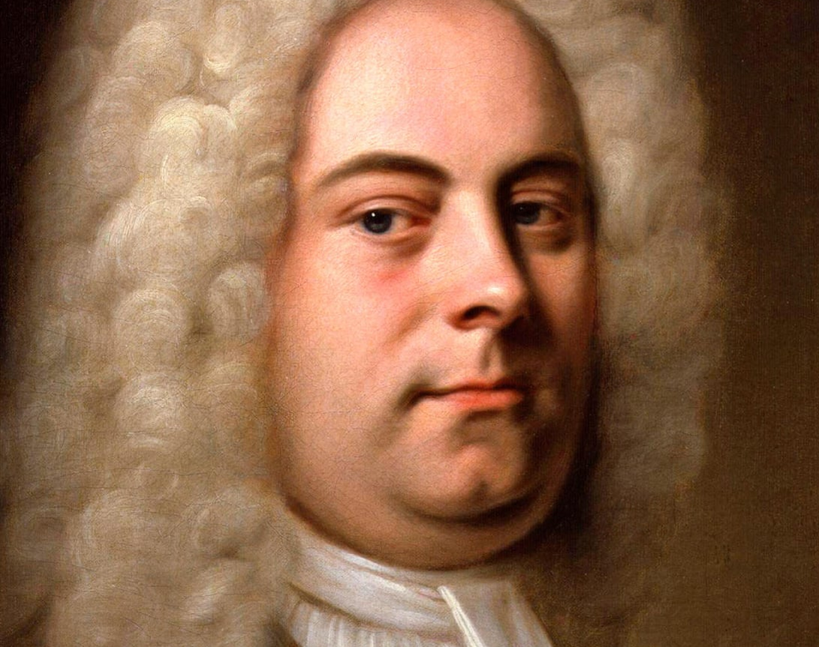
In which I compare my own experience with Music Performance Anxiety in two performances as the tenor soloist in Handel’s Messiah – one before I started studying counseling and one after.
Look at this guy. Judge much, Georg?

Slide 3
Case Study of Subjective Experience n=1 This is an artistic self-report, not a qualitative study!
I have been singing classically for 20+ years
As my resume and reputation grew, so did my stage fright, or Music Performance Anxiety. My identity was tied to my perceived success.
My performance experience was one where I was in survival mode. “Just get through it”.
During my first semester-and-change of counseling school, I’ve focused many of my efforts on reconciling my love of singing with my fear of doing so publicly.
Cognitive Behavior Therapy has proven to be an effective intervention at both mitigating in-the-moment anxiety and the maladaptive identity constructs that form the basis for my counterproductive automatic thoughts.

Slide 4
Defining Music Performance Anxiety
In The Handbook of Music and Emotion, Kenney (2010) posits that Music Performance Anxiety (MPA) forms a cognitive-emotional pathway. She forms her thesis using existing research by Izard (1977) to define an emotional model of anxiety broadly:
“Anxiety is defined as a complex (learned) emotion in which fear is combined with other emotions such as shame, guilt and excitement.”
And MPA more specifically by Salmon (1990) being defined as:
“The experience of persisting, stressful apprehension and/or actual impairment of performance skills in a public context to a degree unwarranted given the individual’s musical aptitude, training and level of preparation”.

Slide 5
MPA on the Yerkes-Dodson Curve (Spahn, 2010)
Affect: Feelings of anxiety, tension, apprehension, dread, or panic
Cognition: Loss of concentration, heightened distractibility, memory failure, catastrophizing
Behavior: Tremor, difficulty in maintaining posture and moving naturally
Physiology: Disturbances in breathing pattern, dry mouth, cardiovascular changes, gastrointestinal disturbances

Slide 6
Connecting MPA With Identity Formulation
One of the most challenging considerations for classical singers, indeed any individual for whom an aspect of identity is tied to a precisely-performed skill in a public arena (including athletes, dancers, public speakers), is the intricacy with which said identity is tied to “successful” performance outcomes.
Consider: Rigor of study, social identity, professional identity
Music Performance Anxiety is reputationally linked. If we take Izard at his word, that anxiety is a “a complex (learned) emotion”, the performer learns that their acceptability as a practitioner is based on their perceived proficiency.
In oratorio, for instance, the soloists are referred to by their voice type. I am a tenor and thus must function proficiently in that milieu or my sense of constructed self is impacted.
Rigor: identity of proficiency based on decades of training. “If I screw up, I’ve failed my training”
Social identity: I am known as a singer
Professional identity: my future work depends on my being predictably proficient

Slide 8
Enter
Cognitive-Behavioral Therapy!

Slide 9
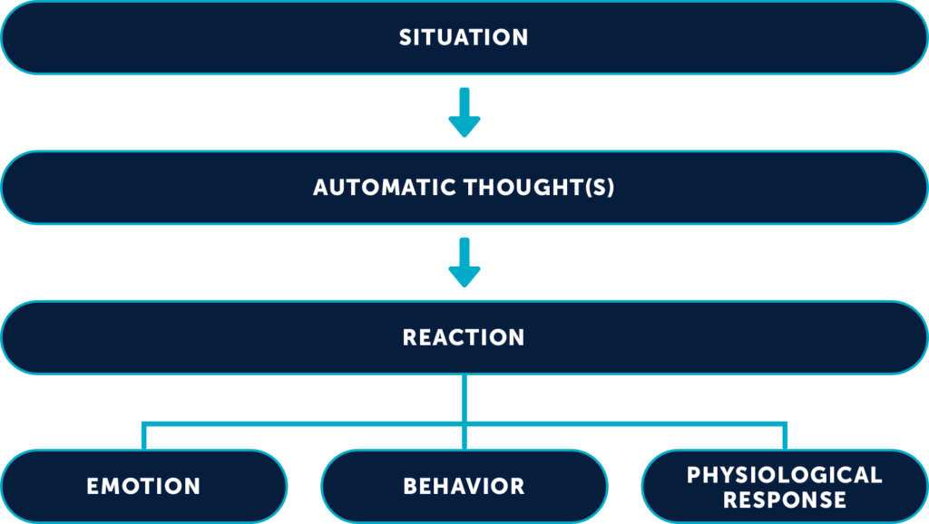
The Cognitive Model (Beck, 2021)
Tenor Soloist for Handel’s Messiah in 2021
“If I sing poorly, all my years of training will be wasted”
“I’ve got to prove the haters wrong”; adversarial thinking
Chest tightness, Tongue Root tension, raised larynx, shortness of breath
Anxiety, Fear
Avoid interaction, Ruminate

Slide 10
Tenor Soloist for Handel’s Messiah in 2022
“I am the kind of person who loves singing Handel!”
“I’m the kind of person who is going to have fun!”
Joy, Excitement, expectation of success
Engage with other performers, audience. Stay in the present.
Relaxed abdomen, calm throat, availability of breath

Slide 11
Implications for Singers and Teachers of Singing
Importance of cultivating a strong identity independent of singing outcomes.
“You are more than your last performance”
Direct work with Cognitive Behavior Therapy (or other effective anxiety-reduction technique)
Guest Counselor as part of voice instruction
Part of curriculum for vocal instruction at the collegiate/conservatory level
Reinforcement of adaptive thoughts after performances, regardless of outcome

Slide 12
Bibliography
Kenney, Diane T. The Role of Negative Emotions in Performance Anxiety. Handbook of Music and Emotions: Theory, Research, Applications. Pp 425-433. Oxford, 2010.
LeBlanc, Albert. A Theory of Music Performance Anxiety. Visions of Research in Music Education. Vol 16, No. 34. Uconn, 2021.
Spahn, Claudia; Echternach, Matthias; Zander, Mark F., Voltmer, Edgar; Richter, Bernhard. Music Performance Anxiety in Opera Singers. Logopedics Phoniatrics Vocology, 35: 4, 175-182.

