Slide 1
Missed Opportunities to Vaccinate Teens against HPV: Variation and Mechanisms between Public & Private Facilities
Boise, Patrick, Master of Arts, Spring 2023 | Economics
Chair: Katrina Mullan, Ph.D.

Slide 2
Motivation
Literature
Research Question & Hypothesis
Data
Methods
Results
Discussion
Motivation
Literature
Research Question
Discussion
Data
Methods
Results

Slide 3
Intersectional and interdisciplinary interests
Diversity, Inclusion, & Equity
Social Justice & Reform
Public Policy Reform
Systemization of Solutions
Democratization
Application IRL
Motivation
Literature
Research Question
Discussion
Data
Methods
Results

Slide 4
One of 14 high-risk HPV serotypes
‘Sexually Transmitted Infection’
Researchers may understand that ‘sex’ includes any intimate contact.
US population has a more complex understanding
HPV18 does not care how we define intimate contact
(Kombe Kombe et al. 2021)
Motivation
Literature
Research Question
Discussion
Data
Methods
Results

Slide 5
The issue of taboo topics
HPV is a girls’ disease and so it is a girls’ vaccine
Sex Education and onset of Sexual Activity
Uncomfortable => not discussed
Not discussed => not researched
Motivation
Literature
Research Question
Discussion
Data
Methods
Results

Slide 6
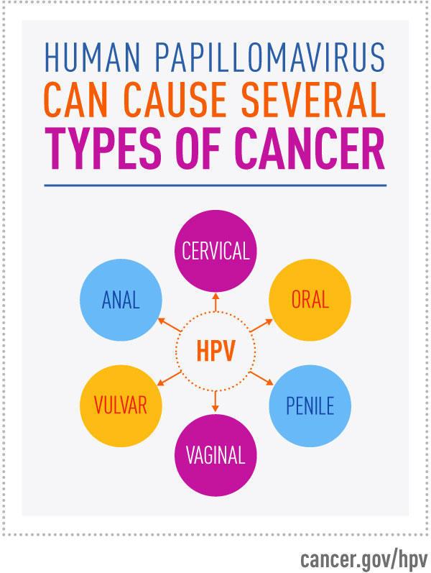
HPV is not a girls’ disease
Human Papillomavirus (HPV) is a leading cause of a number of cancers. →
37,300 new cases annually in the US
They are among the only cancers that are preventable with an approved vaccine!
Hepatitis B
NSCLC
Others in trial
Highly prevalent – virtually all will become infected.
Uptake rates remain low compared to other vaccines.
Motivation
Literature
Research Question
Discussion
Data
Methods
Results

Slide 7
Prevent Cancer Here
Vaccinate Here
0 – 36 months
3 – 21 years
21-29 years
30-65
years
Motivation
Literature
Research Question
Discussion
Data
Methods
Results
>1 visit
=1 visit
<1 visit
<1 visit

Slide 8
Two Key Studies
Charnetta L. Williams,
Tanja Y. Walker,
Laurie D. Elam-Evans,
David Yankey,
Benjamin Fredua,
Mona Saraiya,
Shannon Stokley (2020)
Factors associated with not receiving HPV vaccine among adolescents by metropolitan statistical area status, United States, National Immunization Survey–Teen, 2016–2017
Human Vaccines & Immunotherapeutics, 16:3, 562-572,
DOI: 10.1080/21645515.2019.1670036
Sophia R. Newcomer,
Rain E. Freeman,
Alexandria N. Albers,
Sara Murgel,
Juthika Thaker,
Annie Rechlin,
Bekki K. Wehner (2022)
Missed opportunities for human papillomavirus vaccine series initiation in a large, rural U.S. state
Human Vaccines & Immunotherapeutics, 18:1, 2016304,
DOI: 10.1080/21645515.2021.2016304
Motivation
Literature
Research Question
Discussion
Data
Methods
Results

Slide 9
Williams et al. (2020)
Newcomer et al. (2022)
Teens Aged 13-17
HPV Vaccine
Missed Opportunity
HPV Vaccine Uptake
Facility Type
US Population
MT Population
Motivation
Literature
Research Question
Discussion
Data
Methods
Results

Slide 10
Teens Aged 13-17
HPV Vaccine
Missed Opportunity
Facility Type
US Population
Motivation
Literature
Research Question
Discussion
Data
Methods
Results

Slide 11
Research Question
Does the likelihood of missed opportunities to vaccinate teens against HPV vary between public and private facility types?
What mechanisms help explain the trends?
Motivation
Literature
Research Question
Discussion
Data
Methods
Results

Slide 12
Data: National Immunization Survey - Teen
Random digit dialing survey of US households
If a 13-17yo in home, a survey is conducted
Provider IHQs
Annually published PUF
Motivation
Literature
Research Question
Discussion
Data
Methods
Results

Slide 13
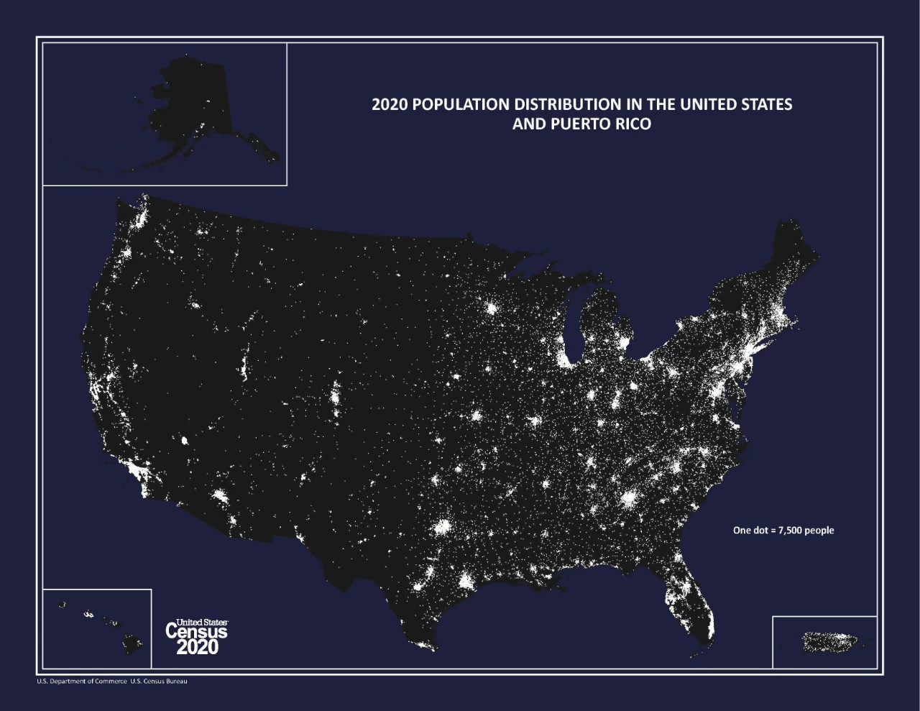
Data for this study
NIS-Teen
2018
2019
2020
Motivation
Literature
Research Question
Discussion
Data
Methods
Results

Slide 14
Types of Facilities
Other Facility Type
Higher Income
Private Insurance
White
Higher Education
Lower Income
Medicaid
Non-white
Lower Education
Rurality/Urbanicity
Motivation
Literature
Research Question
Discussion
Data
Methods
Results

Slide 15
Methods
TeenID
Adequate Provider Data?
No
Excluded – weights maintained
Yes
$$n = 57,651$$
Defining the outcome of interest:
Missed Opportunity
Tdap or Men 1+?
No
>0 visits?
Yes
No Opportunity
>0 doses?
No
Yes
Missed Opportunity
Motivation
Literature
Research Question
Discussion
Data
Methods
Results
HPV Vaxxed
$$n = 57,651 => n=20,834,784$$

Slide 16
Methods
$$P\left({HPV}_{i}\right)=logit\left(π\right)=β_{0}+β_{i1}F_{i}+β_{i2}{(F}_{i}{∗C}_{i1})+α_{i1:k}C_{i1:k}+ε_{i}$$
Logistic regression of binary outcome:
${HPV}_{i}=\left(\begin{matrix}0 & Missed Opportunity \\ 1 & At least one dose\end{matrix}\right)$ for teen $i$
Explanatory variables Facility type (4 levels), interacted with opportunity indicator $C_{i1}$
Control for teen’s insurance status, age, sex, race, and state, plus providers’ participation in IIS and/or VFC
Motivation
Literature
Research Question
Discussion
Data
Methods
Results

Slide 17
Preliminary Results
$$P\left({HPV}_{i}\right)=logit\left(π\right)=β_{0}+β_{i1}F_{i}+β_{i2}{(F}_{i}{∗C}_{i1})+α_{i1:k}C_{i1:k}+ε_{i}$$
Average Partial effects of facility type, reference case: Private Only
Factor | AME | SE | t | p | lower | upper
Only Public Facilities | -0.0456 | 0.013 | -3.5018 | 0.0005 | -0.0721 | -0.0211
Mixed Facility Type | -0.0067 | 0.0118 | -0.5706 | 0.5683 | -0.0309 | 0.0154
All Other Facility Types | -0.0111 | 0.0103 | -1.0783 | 0.2809 | -0.0311 | 0.0092
Motivation
Literature
Research Question
Discussion
Data
Methods
Results

Slide 18
Preliminary Results
Average Partial effects of facility type at visits = 0 or 1+, reference case: Private Only
Factor | AME | SE | t | p | lower | upper
Only Public Facilities, 0 visits | -0.0045 | 0.0267 | -0.1671 | 0.8673 | -0.0568 | 0.0479
Only Public Facilities, 1+ visits | -0.0535 | 0.0144 | -3.7137 | 0.0002 | -0.0815 | -0.025
Mixed Facility Type, 0 visits | 0.0279 | 0.0357 | 0.7806 | 0.435 | -0.0423 | 0.0977
Mixed Facility Type, 1+ visits | -0.0134 | 0.0115 | -1.1631 | 0.2448 | -0.0358 | 0.0092
All Other Facility Types, 0 visits | -0.0153 | 0.0259 | -0.5905 | 0.5549 | -0.0658 | 0.0355
All Other Facility Types, 1+ visits | -0.0103 | 0.0108 | -0.9562 | 0.339 | -0.0314 | 0.0108
Motivation
Literature
Research Question
Discussion
Data
Methods
Results

Slide 19
Limitations
NIS-Teen aggregation of facility type
Type of visit & whether any vaccination was given unavailable
Motivation
Literature
Research Question
Discussion
Data
Methods
Results

Slide 20
Next Steps
Expand/refine the model
Omitted variables
Alternate form
Statistical validity in complex survey
Motivation
Literature
Research Question
Discussion
Data
Methods
Results

Slide 21
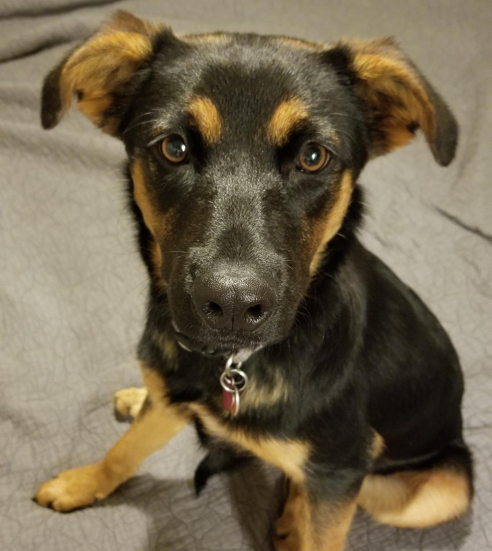
Thank you
Katrina Mullan, Ph.D.
My Committee
Chris Peterson
Akemi

