Slide 1
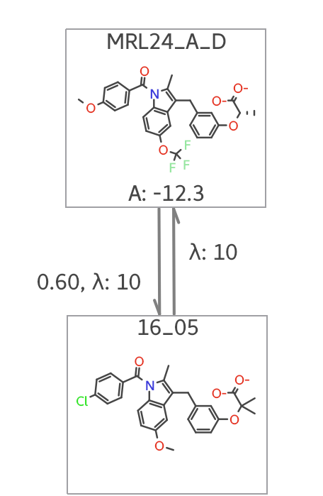
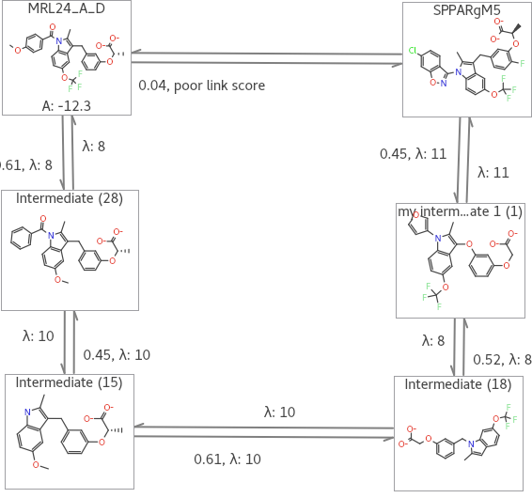
Comparing Computational Design Methods for a Type 2 Diabetes Medication
By Andrew Voss and Travis Hughes
University of Montana Department of Pharmaceutical Sciences and Drug Design and the Department of Biochemistry
Abstract
Peroxisome proliferator-activated receptor gamma (PPARγ) is a promising target for the treatment of type 2 diabetes because activating this receptor improves insulin sensitivity and helps manage glucose levels in patients. However, currently approved drugs that activate this receptor have side effects, such as weight gain, weakening of bones, and cardiac failure, which have limited or halted their use. The goal of my study is to compare computational methods that estimate the binding affinity of compounds to PPARγ. To achieve this, I will estimate the binding affinities of compounds that have published experimental binding affinities to determine if the estimated binding affinities correlate with the experimental binding affinities. The computational methods I will evaluate include free energy perturbation, docking, and a modified docking method that incorporates a minimization step. Each method has its own advantages and disadvantages, such as allowing movement of the compound within a rigid receptor or movement of both the receptor and compound, but the latter requires significant computational resources. The use of computational methods to estimate binding affinities of compounds to proteins will reduce the number of compounds that need to be synthesized and screened to discover new drug candidates that target a protein, in this case, PPARγ.
Docking
Free Energy Perturbation
Advantages
Place a compounded into the binding pocket of protein
Allows form movements in the compound
Don’t have to be a close in structure to a reference compound or have the same formal charge
Computationally inexpensive
Disadvantage
Doesn't allow for movement of the protein
Doesn’t consider water that could be in the binding pocket
Advantages
Allows form movement of the compound and protein complex
Simulates water in the binding pocket
Disadvantages
Compounds must be close in structure and have the same formal charge as the reference compound
Computationally expensive
Methods
To estimate the binding affinities of compounds to PPARγ, we will use docking and FEP methods. We will then compare the estimated binding affinities to published experimental binding affinities to determine if there is a correlation.
To perform the docking with minimization, we will first dock the compound and then perform a minimization step to account for small movements in the protein-compound complex. The minimized structure will then be used to estimate the binding affinity of the compound.
We conducted two sets of calculations on different compounds, which we will refer to as 'small changes' and 'big changes'. We did this because of the way FEP calculations are conducted. In FEP, you begin with a compound whose affinity is already known and transform it into the compound whose binding affinity you want to estimate. If the change between the two compounds is large, you must go through intermediate compounds to get the calculations to work. Examples of small and large changes are shown below.
Conclusion
The FEP predicted ΔG values for the small change group of compounds correlate the closest to the experimental ΔG values, with an R squared value of 0.8741 and a slope that was close to perfect correlation.
For the FEP calculation of the big change compounds, the R squared value dropped off significantly, but the slope remained close to perfect correlation.
The docking approach, with the minimization step, produced a good R squared value for the small change compounds, but the slope was opposite in sign to that of the perfect correlation.
Docking with Minimization step
Advantages
Allows for some movement of the protein/compound complex
Don’t have to be a close analog to a reference compound or have the same formal charge
Computationally inexpensive
Disadvantage
Dose not introduce water into the protein pocket
References
Acton, J. J., Black, R. M., Jones, A. B., Moller, D. E., Colwell, L., Doebber, T. W., MacNaul, K. L., Berger, J., & Wood, H. B. (2005). Benzoyl 2-methyl indoles as selective PPARγ modulators. Bioorganic and Medicinal Chemistry Letters, 15(2), 357–362. https://doi.org/10.1016/j.bmcl.2004.10.068
Acton, J. J., Akiyama, T. E., Chang, C. H., Colwell, L., Debenham, S., Doebber, T., Einstein, M., Liu, K., McCann, M. E., Moller, D. E., Muise, E. S., Tan, Y., Thompson, J. R., Wong, K. K., Wu, M., Xu, L., Meinke, P. T., Berger, J. P., & Wood, H. B. (2013). Erratum: Discovery of (2 R)-2-(3-{3-[(4-methoxyphenyl)carbonyl]-2-methyl-6- (trifluoromethoxy)-1 H -indol-1-yl}phenoxy)butanoic acid (MK-0533): A novel selective peroxisome proliferator-activated receptor γ modulator for the treatment of type 2 diabetes m. Journal of Medicinal Chemistry, 56(22), 9368. https://doi.org/10.1021/jm401718d
Einstein, M., Akiyama, T. E., Castriota, G. A., Wang, C. F., McKeever, B., Mosley, R. T., Becker, J. W., Moller, D. E., Meinke, P. T., Wood, H. B., & Berger, J. P. (2008). The differential interactions of peroxisome proliferator-activated receptor γ ligands with Tyr473 is a physical basis for their unique biological activities. Molecular Pharmacology, 73(1), 62–74. https://doi.org/10.1124/mol.107.041202
Small Change
MRL24 to MRL16
Big Change
MRL24 to SPPARgM5
Acknowledgement
Cresset – for the program Flare that was used to do the FEP and Docking calculations
Molecular Computation Core Facility – for providing the computation resources
Funding - R01DK129646
MRL16

