Slide 1
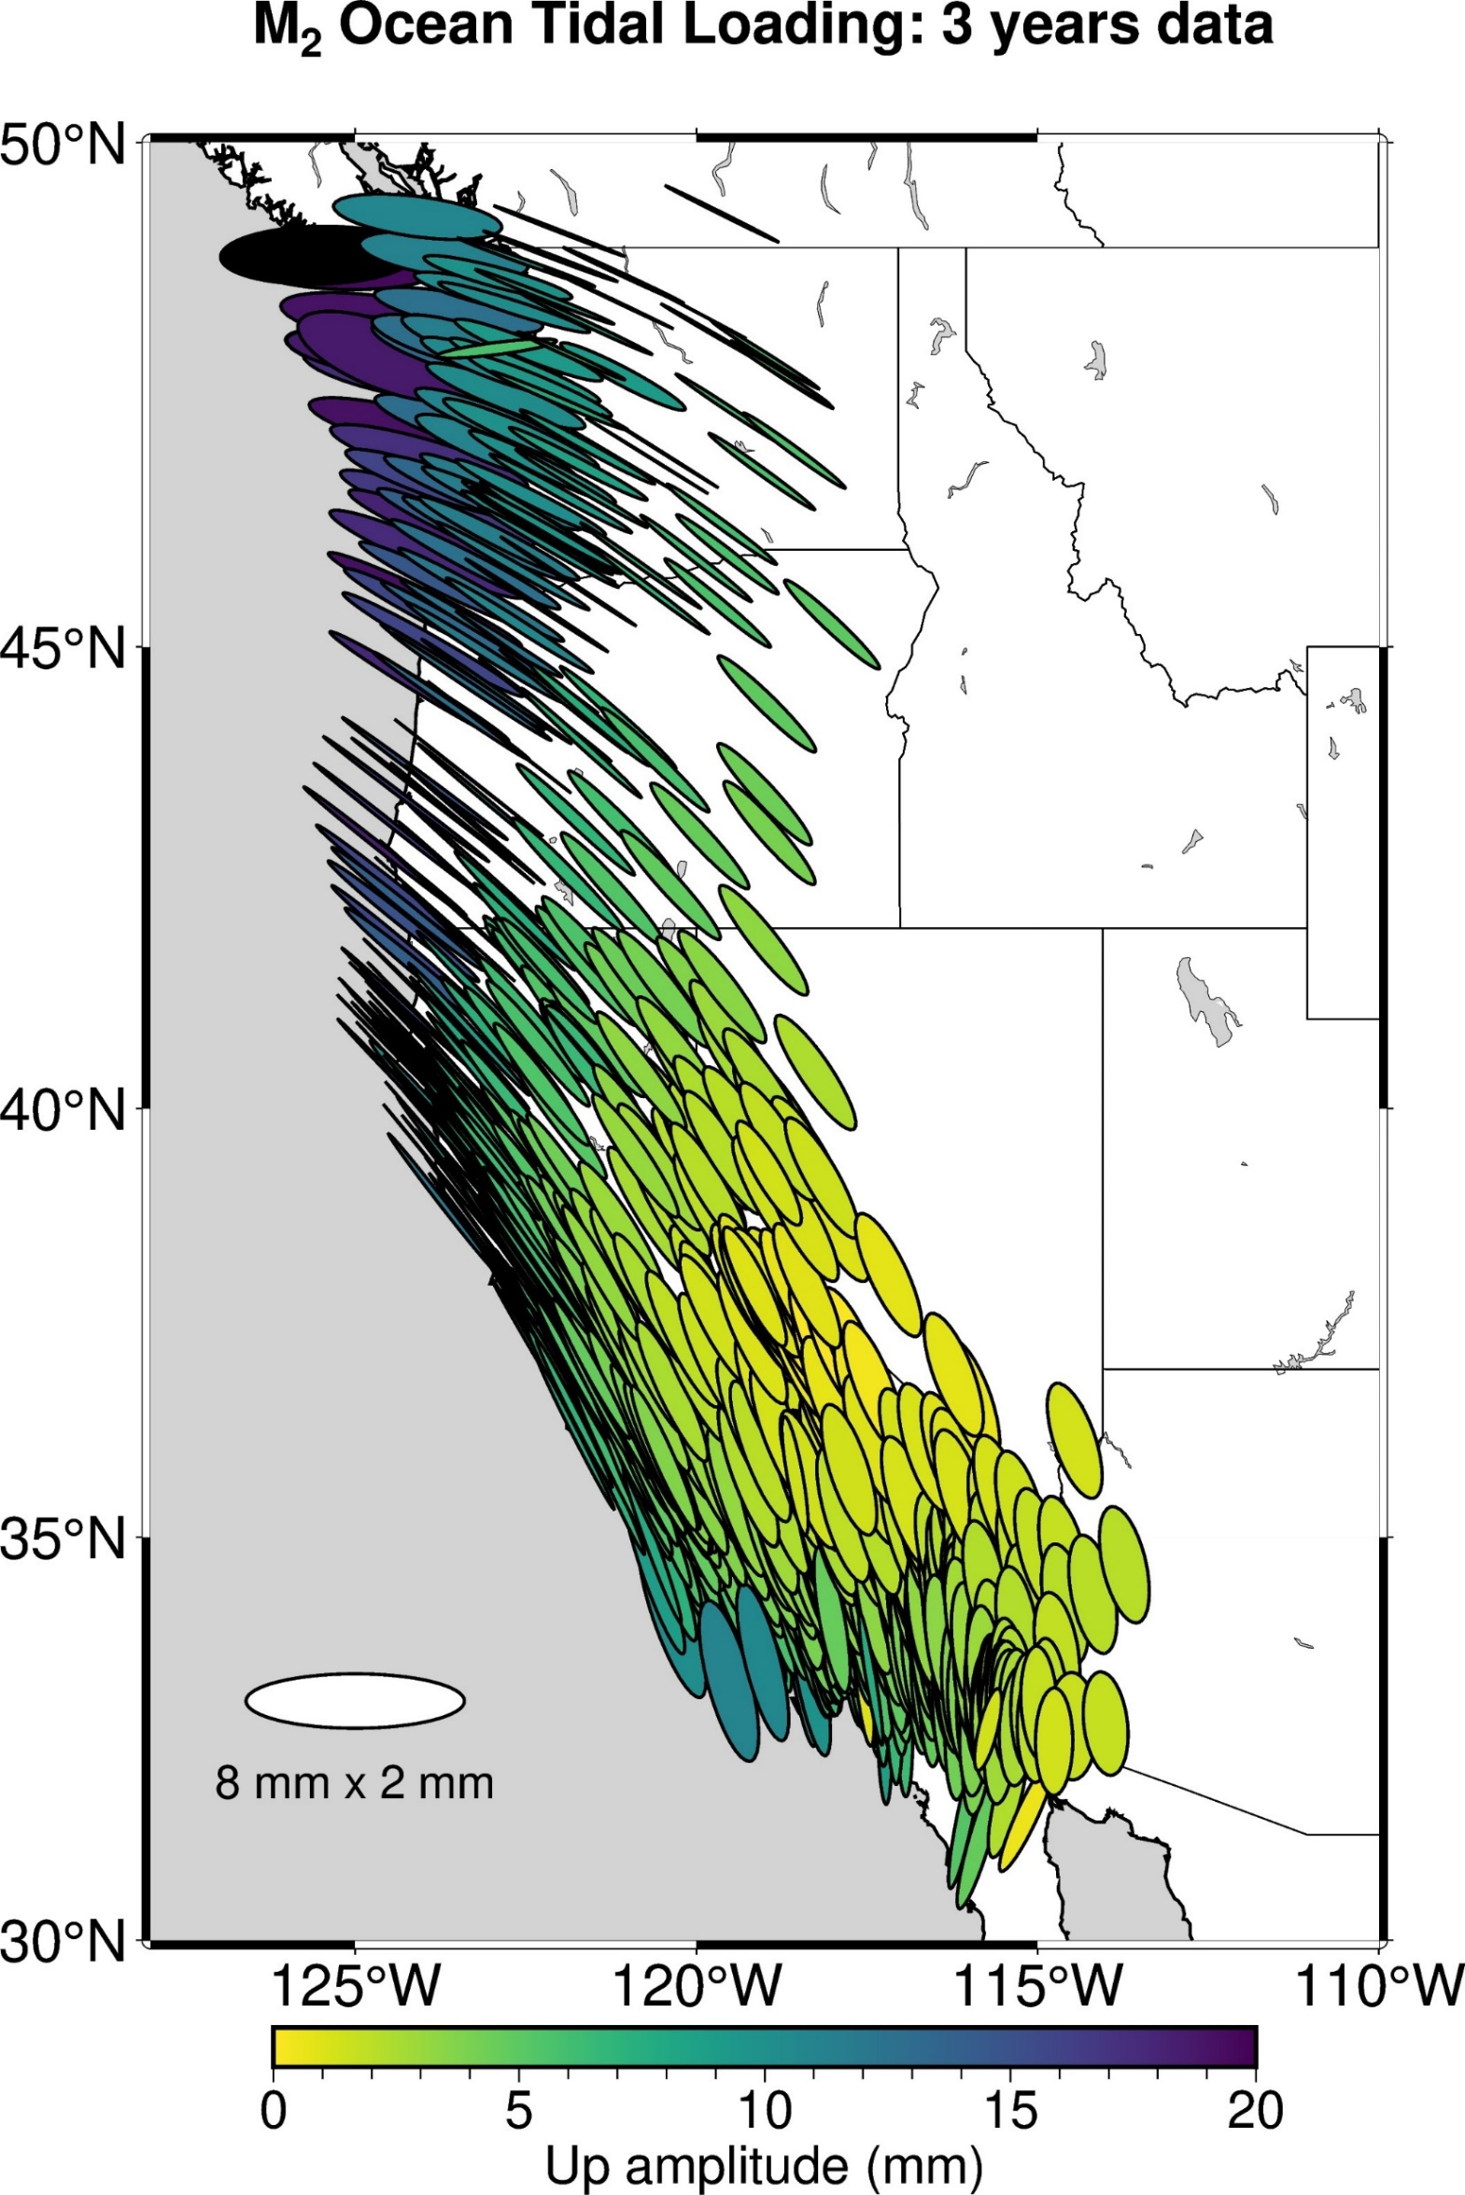
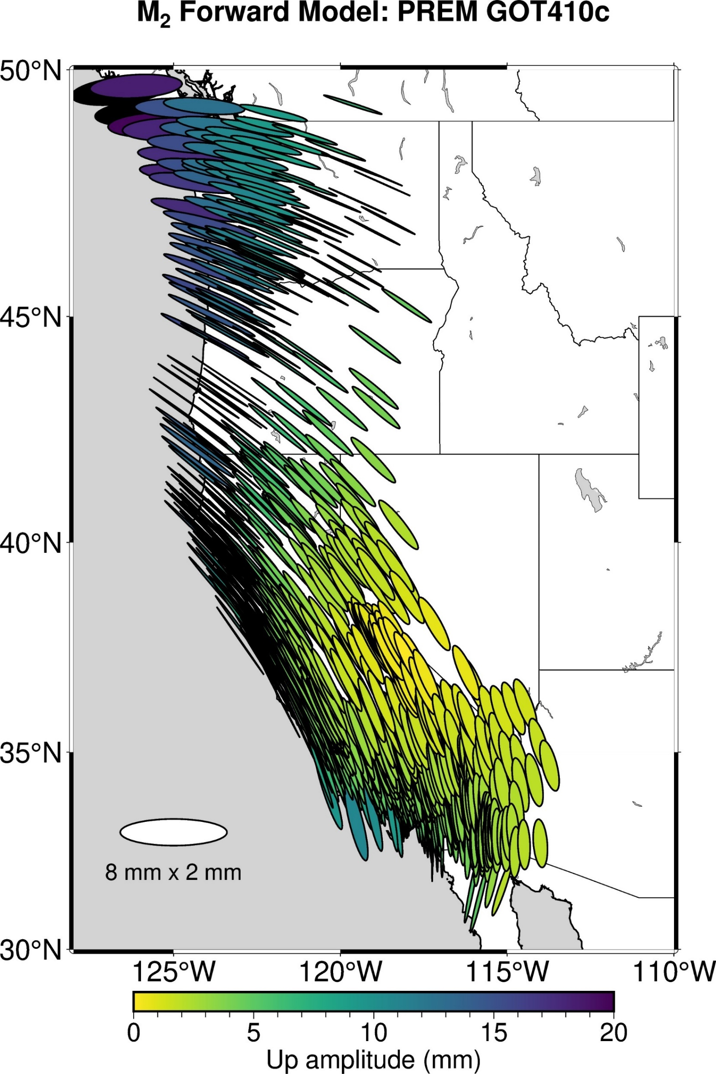
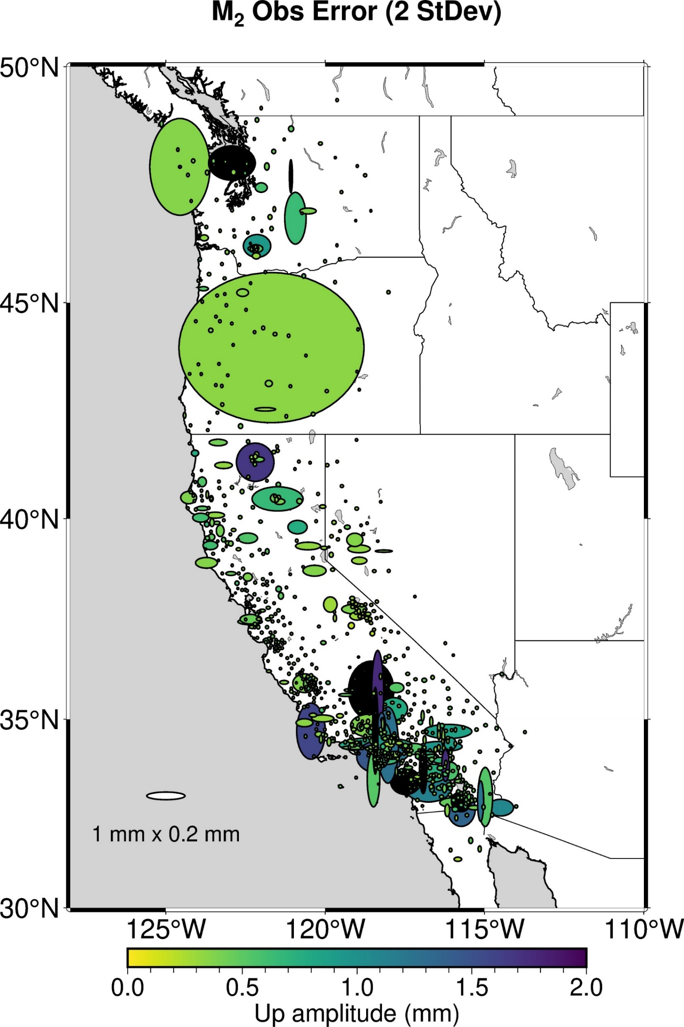
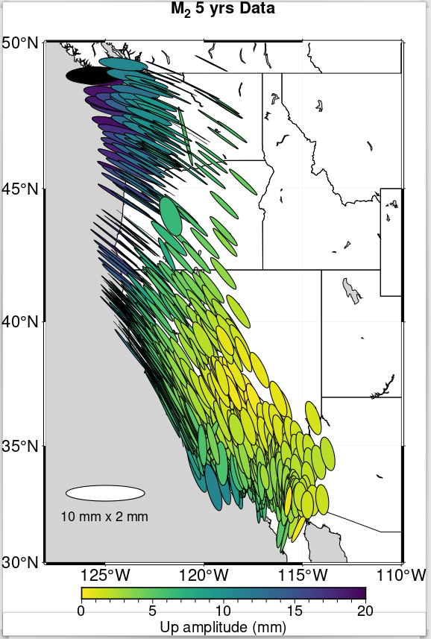
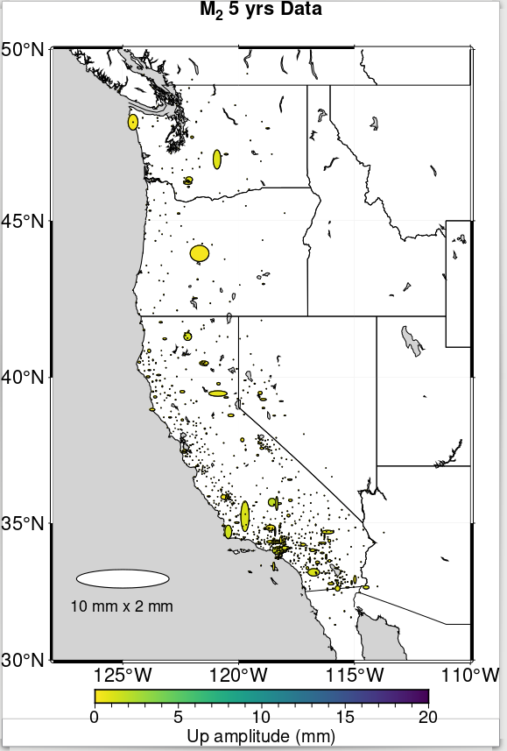
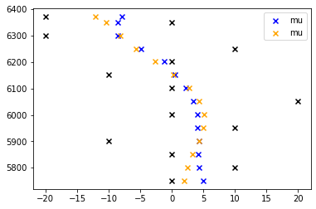
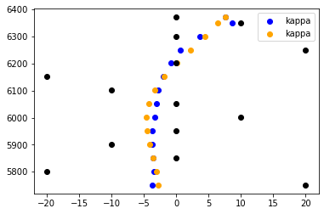
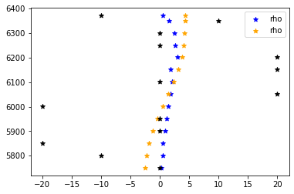
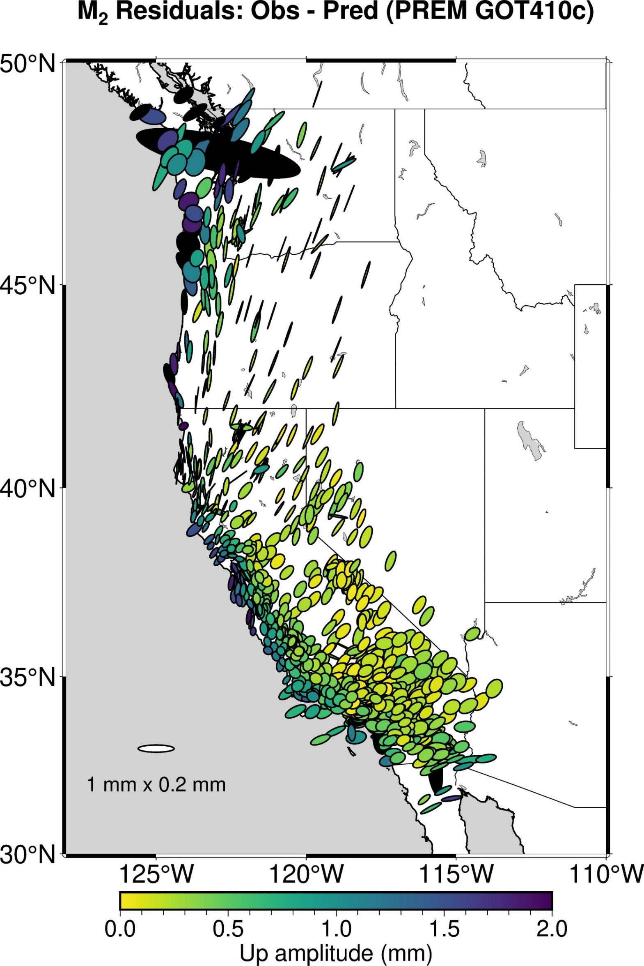
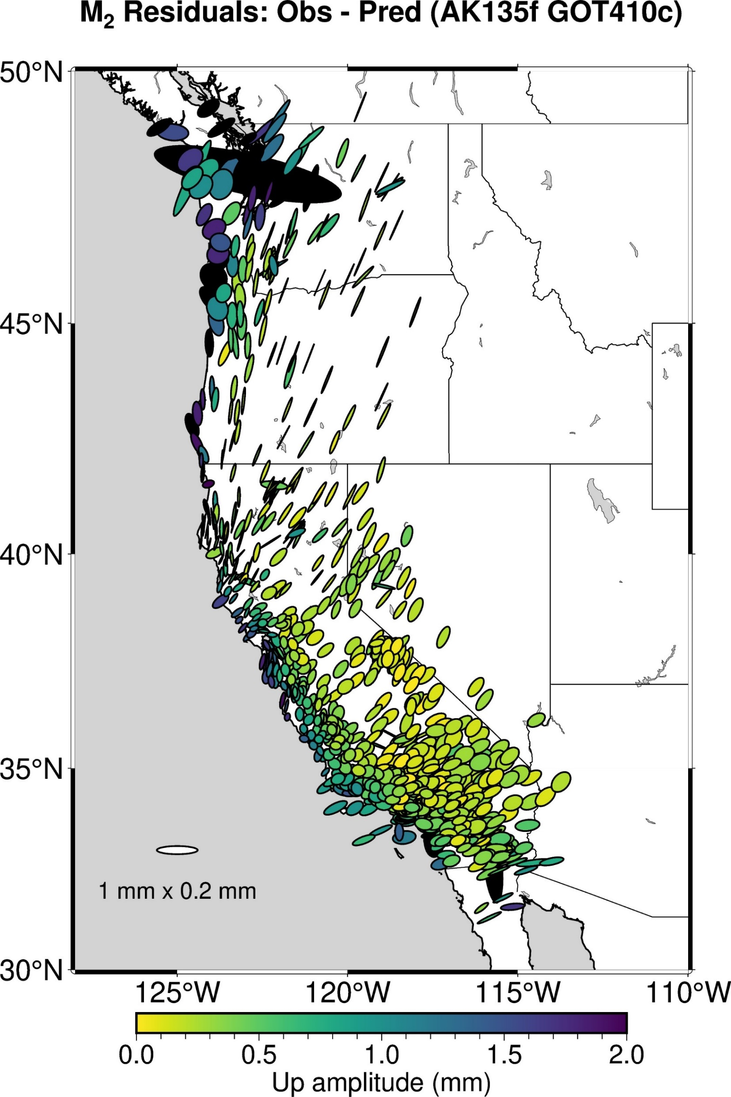
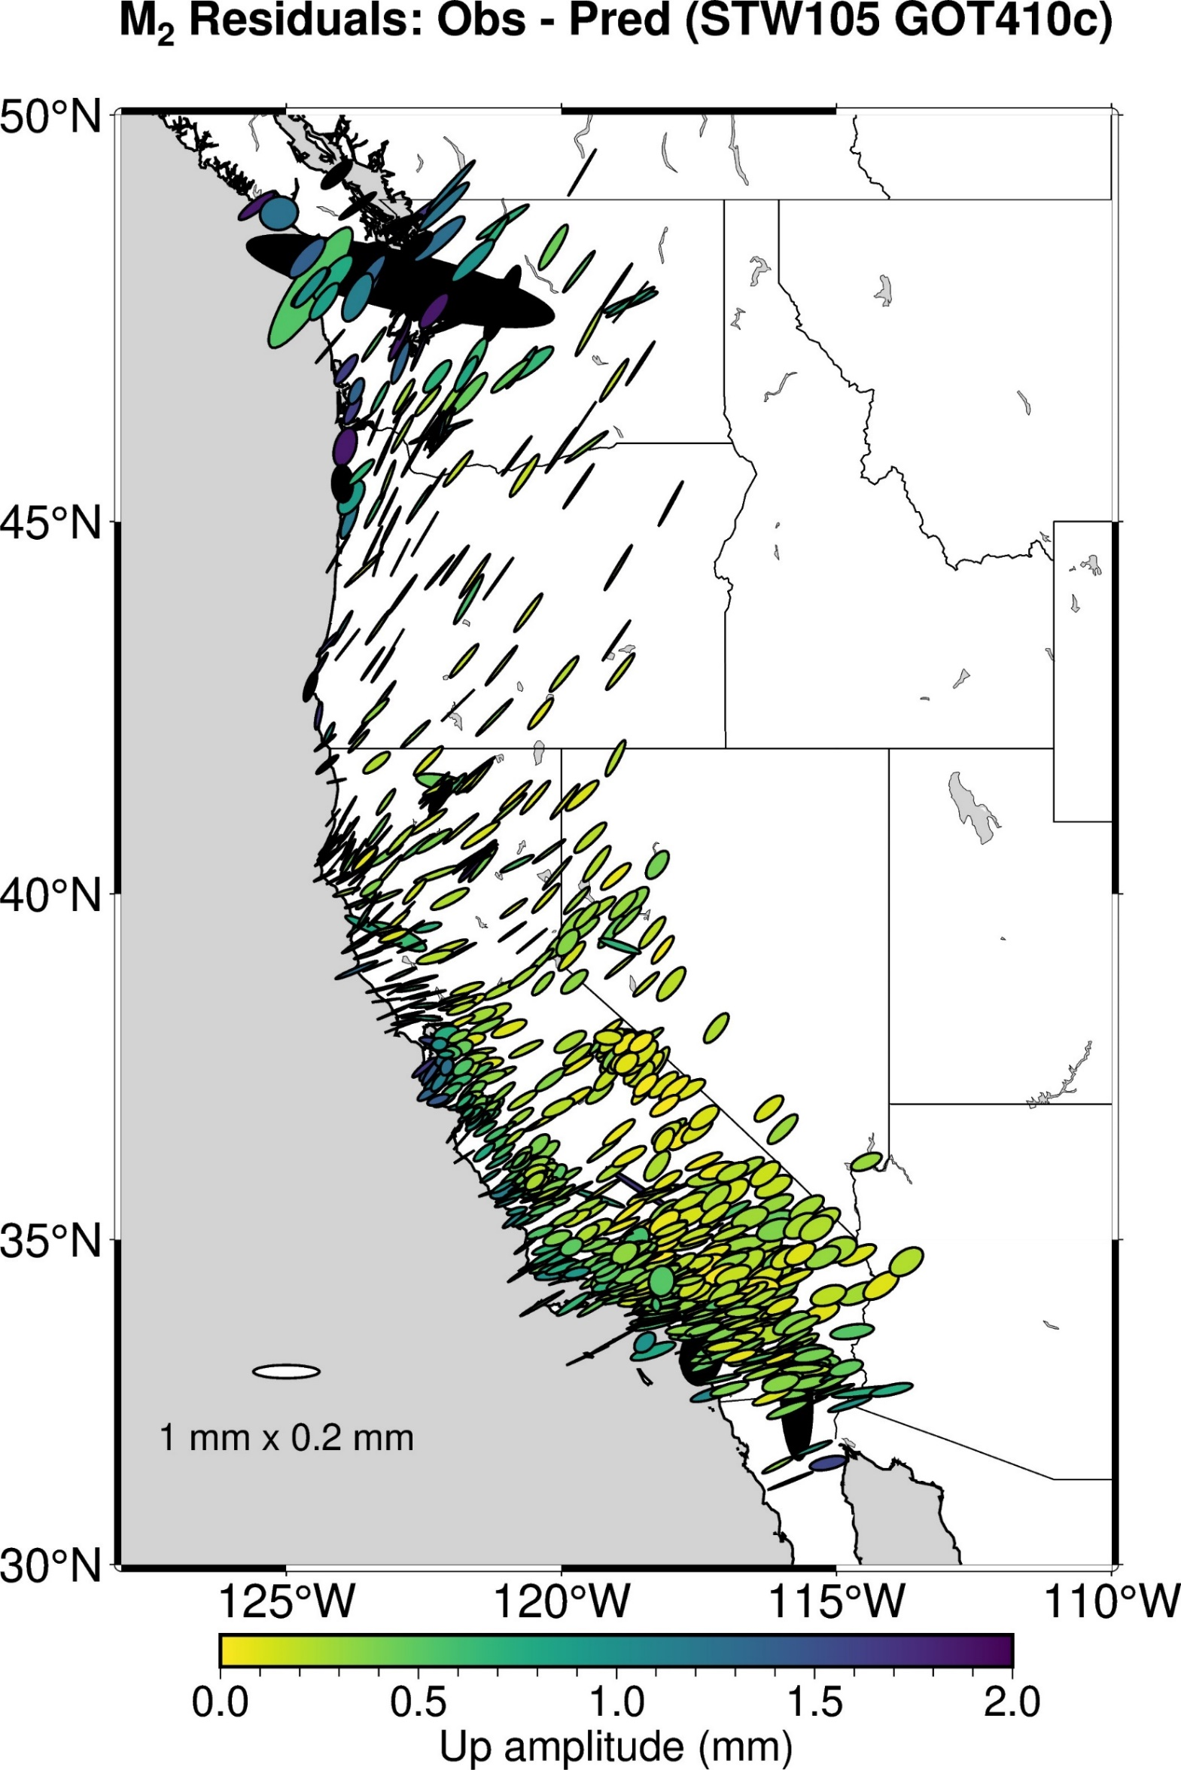
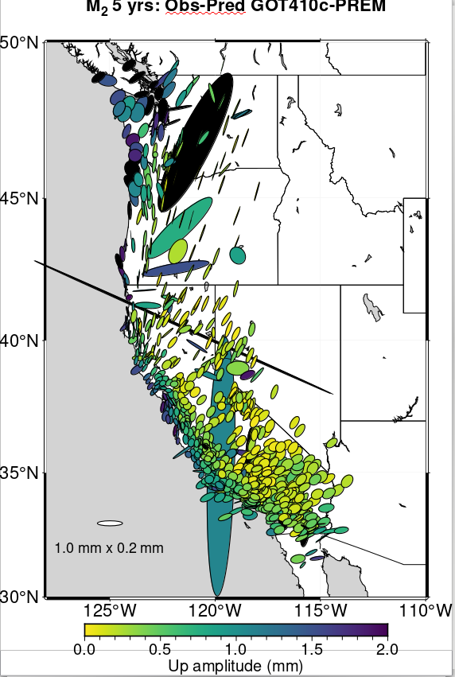
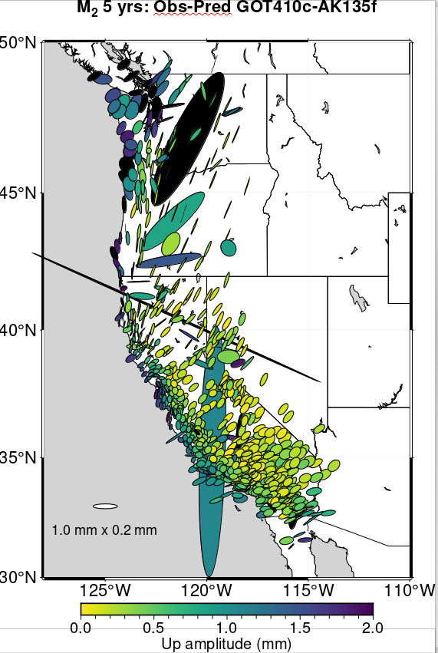
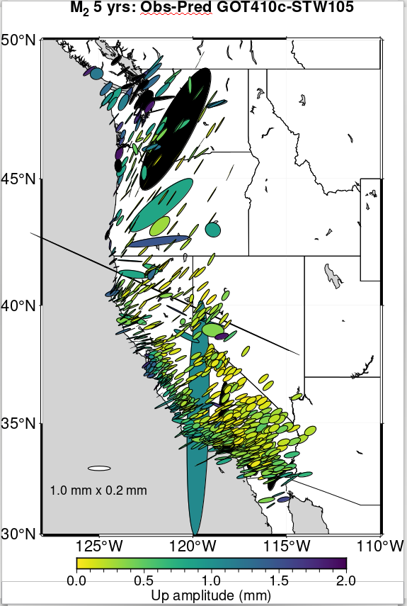
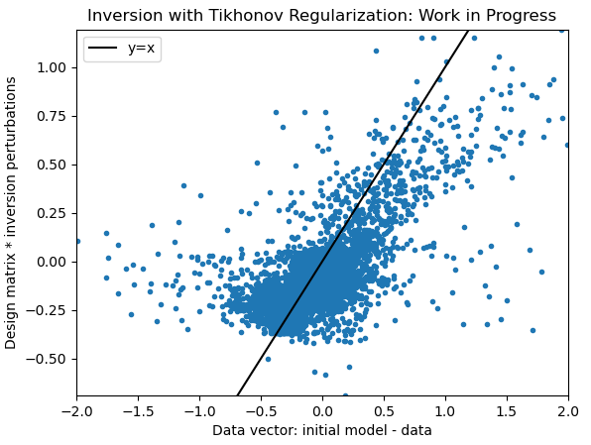
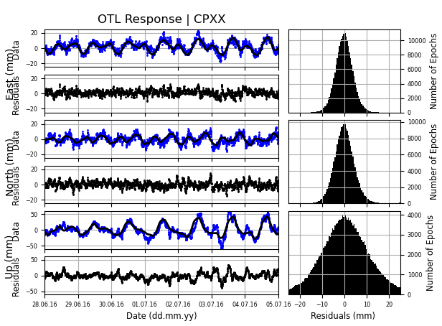
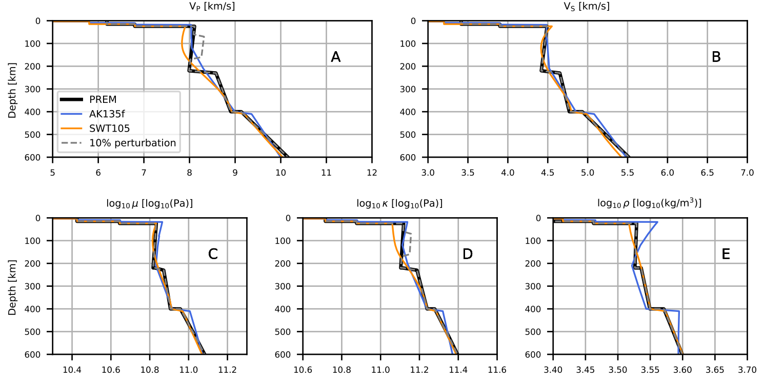
Inverting for Earth Structure Using Ocean Tides Loading the Surface
Eleanor I. Serviss¹, Hilary R. Martens¹, Mark Simons²
¹University of Montana, ²Caltech
Purpose: Earth Structure
Forward Model: Earth structure and an Ocean tide model
Inverting for Perturbations (cont)
Seismic models form the foundation of Earth structure, but in the crust and upper mantle, seismic models cannot separate small variations in shear modulus, bulk modulus, and density [1].
How Earth’s surface responds to a load is fundamentally a function of elastic moduli and density. During ocean tidal loading, tides load Earth’s surface by displacing the ocean and atmosphere. If we have a model for the ocean tides and measurement for the surface displacement, we can invert for Earth structure [2].
Our study updates Ito and Simon’s 2011 [2] inversion for structure for the western United States with more data, new tide models, and an investigation of reference frames [1].
4
A
B
C
Ocean tidal loading displacement (U) is a convolution of the tidal force and Earth’s elastic response [1]:
$$U= \int_{Ω′}{G\left(\left|r−r^{′}\right|,S\right) ρ\left(r^{′}\right) Z\left(r^{′}\right) dΩ′}$$
Compute forward model with LoadDef [4]:
Open-source Python software
Computes Green’s function and convolution
Input:
SNREI Earth structure model
PREM, AK135f, STW105, etc.
Ocean tide model
GOT410c, FES2014, EOT11a, etc.
Even with removing a harmonic common mode (common movement of all GNSS stations, not attributed to structure) the residuals between the data and forward model are above observational uncertainty.
Can we simply invert the forward model’s convolution and solve for Earth structure? Unfortunately, no. Because Earth structure is contained in the Green’s function, we need to linearize. To do this, we solve for perturbations to Earth structure.
So far, we have used closed form versions of Zeroth and Second Order Tikhonov Regularization (aka Ridge Regression or L2 Regularization) to solve the inversion.
Using the classic variables, $m={(G^{T}G+ αL)}^{−1}G^{T}d$
α: regularization parameter (α=0 for Least Squares)
L: roughening matrix (L=Identity matrix for zeroth order)
Elastic response by
Green’s function G:
r: observation point
r’: load point
S: Earth structure!
Force from load:
ρ: load density at r’
Z: load height at r’
Ω: Earth’s surface
Extracting the Ocean Tidal Load Signal
D
E
F
GNSS Data
Three years across western United States
Analyze three components: up, north, east
Figure 5. 2nd Order Tikhonov inversion on a checkerboard synthetic dataset (black) with 14 depth layers (20 km thick top layer, then 50 km layers to R=5700 km). Percent perturbed from starting model (PREM) is on the x-axis with depth in km on they y-axis.
Ocean Tidal Load Applied
GNSS station movement
Ocean tide load applied
Ocean tide load removed
Figure 6. How well does the inversion recreate the data residual vector (on actual data)?
Figure 1. GNSS station moves down and towards an applied load. When the load is removed, the station moves up and away from the load. For each tide harmonic, this motion forms a 3D ellipse.
Figure 3. Particle motion ellipses for the M2 ocean tidal load signal (A), a forward model created with PREM (Earth model) and GOT410c (ocean tide model) (B), observational uncertainty for the M2 data (C), and residuals between the M2 data and several forward models (D,E,F). PREM and AK135f have the most similar residuals, but STW105, PREM, and AK135f all show spatial trends in the residuals. One of these trends is a decrease in fit around Puget Sound because of the complicated coastline.
Harmonic Analysis
Total GNSS station motion: sum of solid Earth tides, all tidal load constituents, and non-tidal signal and noise
Harmonic analysis isolates tidal frequencies [3]
M2 frequency (semi-diurnal tide) for inversion
M2 is largest signal (centimeters)
Inverting for Perturbations to Structure (μ,κ,ρ)
What’s next?
Our inversion steps:
1. For a set of depth layers, separately perturb μ,κ, and ρ by 1% from a starting Earth structure model.
2. For each depth layer and each elastic parameter, compute Green’s functions and a convolution with an ocean tide model.
3. For real and imaginary north, east, and up components, compute the difference between the starting Earth model displacements and the perturbed Earth model displacements. This forms the design matrix.
Classic inversion problem: Solve for m
d$=G m$
d: data vector, G: design matrix, m: model vector
Our inversion problem: Solve for Δm
$$d=\left(Gm_{0}\right)+\frac{Δ(Gm_{0})}{Δm_{1\%}}Δm$$
Other inversion methods to solve for Earth structure:
Bayesian inversion
Other regularization besides Tikhonov (Using model resolution to weight layers with depth, LASSO, ElasticNet).
Literature Cited
[1] Martens, H.R., Rivera, L., Simons, M., Ito T. (2016). J. Geophys. Res. Solid Earth, 121, 3911-3938.
[2] Ito, T., Simons, M. (2011). Science, 332, 947-951.
[3] Martens, H.R., Simons, M., Owen, S., Rivera, L. (2016). Geophys. J. Int., 205, 1637-1664
[4] Martens, H.R., Rivera, L., Simons, M. (2019). Earth and Space Science, 6, 311-323
Acknowledgements
Figure 4. P-wave velocity, S-wave velocity, shear modulus (μ), bulk modulus (κ), and density (ρ) for three seismic Earth structure models (PREM, AK135f, and STW105).
The dashed gray line is a 10% perturbation from PREM in bulk modulus for a 100 km thick layer. Our inversion uses a 1% perturbation and multiple layers.
This work was supported by NASA’s Earth Surface and Interior Program under Grant Number 80NSSC21K0837.
Contact: Eleanor Serviss
eleanor.serviss@umontana.edu
Figure 2. Harmonic analysis for a single station (CPXX). After removing the signal from each component, the residuals are normally distributed. The up component is larger than east or north.

