Slide 1
Invalid vaccinations among US children ages 0-35 months: National Immunization Survey-Child 2011-2020
Grad Con
March 2024
Presenter: Alexandria Albers, Public Health
Dissertation Advisor: Sophia Newcomer

Slide 2
AGENDA
Background
Objectives
Methods
Results
Conclusions

Slide 3
BACKGROUND
U.S. children are recommended to receive multiple vaccinations by 24 months old (most are multi-dose series)
Recommendations are made by Advisory Committee on Immunization Practices (ACIP) via the early childhood vaccination schedule (which vaccinations & when)
Vaccination schedule is an incredible public health tool
Notes:
The recommended ACIP guidelines reflect the need to balance the presence of maternal antibodies^{6–8}, immunological development^{9,10}, and epidemiological trends of disease¹⁰ to optimize children’s immunity against VPDs.

Slide 4
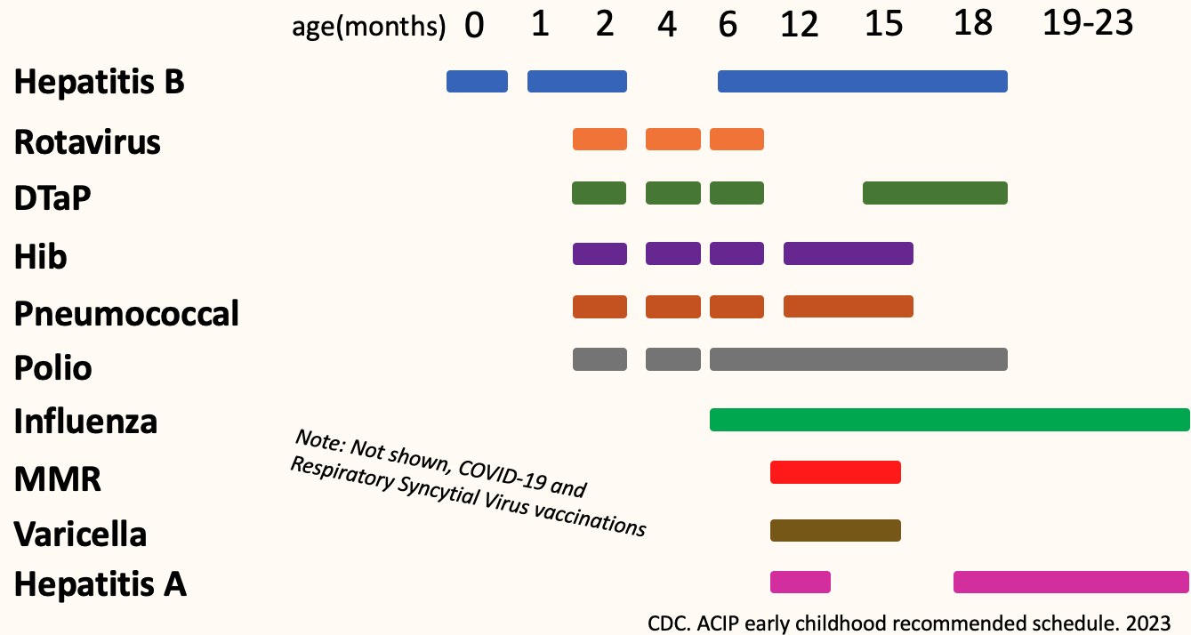
BACKGROUND
U.S. children are recommended to receive multiple vaccinations by 24 months old (most are multi-dose series)
Recommendations are made by Advisory Committee on Immunization Practices (ACIP)
Communicated through the early childhood vaccination schedule (which vaccinations & when)
Notes:
The recommended ACIP guidelines reflect the need to balance the presence of maternal antibodies^{6–8}, immunological development^{9,10}, and epidemiological trends of disease¹⁰ to optimize children’s immunity against VPDs.

Slide 5
BACKGROUND
ACIP also provides recommendations for:
- minimum age*
- minimum intervals between
vaccination doses
Invalid
Re-administered
*maximum age for rotavirus vaccination
Notes:
The recommended ACIP guidelines reflect the need to balance the presence of maternal antibodies^{6–8}, immunological development^{9,10}, and epidemiological trends of disease¹⁰ to optimize children’s immunity against VPDs.

Slide 6
BACKGROUND
ACIP also provides recommendations for:
- minimum age*
- minimum intervals between
vaccination doses
Invalid
Re-administered
*maximum age for rotavirus vaccination
Not considered in national vaccination coverage surveillance
Notes:
The recommended ACIP guidelines reflect the need to balance the presence of maternal antibodies^{6–8}, immunological development^{9,10}, and epidemiological trends of disease¹⁰ to optimize children’s immunity against VPDs.

Slide 7
BACKGROUND
ACIP also provides recommendations for:
- minimum age*
- minimum intervals between
vaccination doses
Problematic because
Children who are “undervaccinated” are overlooked
Measure of schedule adherence
Invalid
*maximum age for rotavirus vaccination
Both are associated with factors that reflect inequitable access to preventive services
Notes:
The recommended ACIP guidelines reflect the need to balance the presence of maternal antibodies^{6–8}, immunological development^{9,10}, and epidemiological trends of disease¹⁰ to optimize children’s immunity against VPDs.

Slide 8
Objectives
1) Quantify U.S. children who had at least one invalid vaccination (overall & each vaccination series)
2) Identify household, provider, and demographic factors associated with receiving an invalid vaccination dose
Hypothesis: Factors that indicate fragmented care would be associated with invalid vaccination
Notes:
The recommended ACIP guidelines reflect the need to balance the presence of maternal antibodies^{6–8}, immunological development^{9,10}, and epidemiological trends of disease¹⁰ to optimize children’s immunity against VPDs.

Slide 9
METHODS
National Immunization Survey-Child
Annual phone survey, provider-verified records children ages 19-35 months
Current dataset used for national vaccination coverage
2011-2020 survey years
10 vaccination series recommended during study period

Slide 10
METHODS
Vaccination series (# of recommended doses)
Diphtheria-tetanus-acellular pertussis (4 dose series)
Pneumococcal conjugate (4)
Haemophilus influenzae type b (Hib) (3 or 4, brand dependent)
Poliovirus (3)
Hepatitis B (3)
Rotavirus (2 or 3, brand dependent)
Hepatitis A (2)
Influenza (2)
Measles-mumps-rubella (MMR) (1)
Varicella (1)

Slide 11
Analyses
Looked through ACIP recommendations, compiled all minimum age and interval recommendations
(weighted, national estimates)
Descriptive
Quantified children with an invalid vaccination and reasons why doses invalid
Child | Age (days) Dose 1 Hep A received | Age (days) Dose 2 Hep A received
1 | 380 days | 400 days
Hepatitis A Example:
Minimum age, dose 1: 361 days
Minimum dose-interval: 177 days

Slide 12
Analyses
Looked through ACIP recommendations, compiled all minimum age and interval recommendations
(weighted, national estimates)
Descriptive
Analytical
Quantified children with an invalid vaccination and reasons why doses invalid
Logistic regression model
Exposures: Household, provider, demographic factors
Outcome: invalid vaccination (y/n)

Slide 13
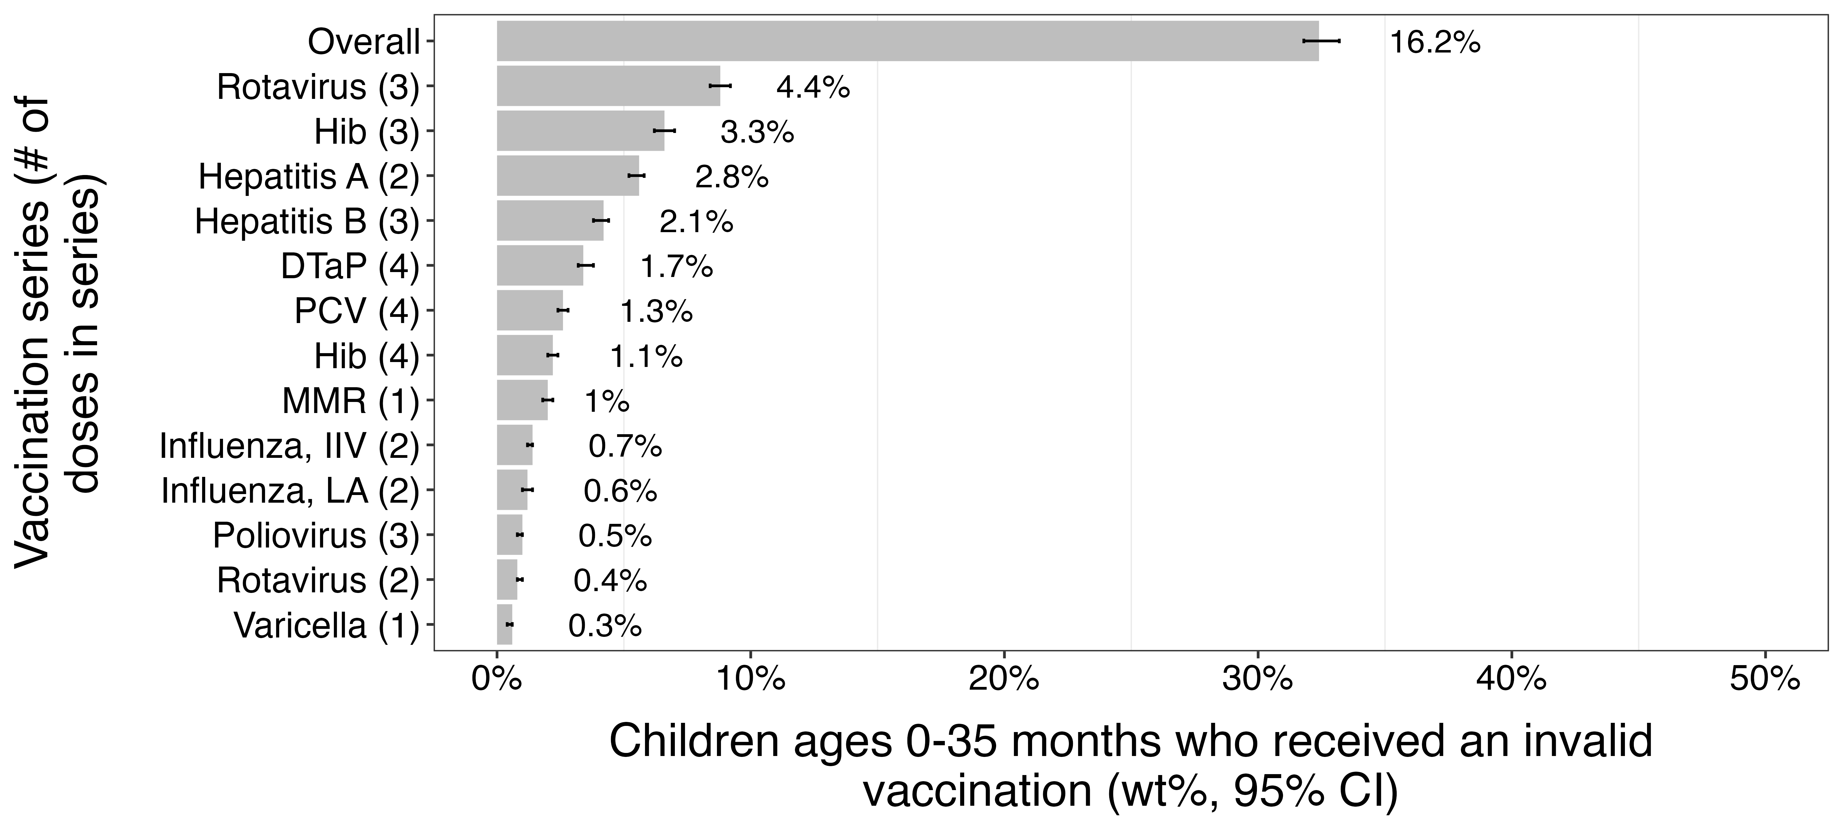
NIS-Child 2011-2020, N=161,187 16.2% (95% CI: 15.9-16.6%) of U.S. children 0-35 months with an invalid vaccination
RESULTS
n= 23,682

Slide 14
Most common reasons vaccinations considered invalid
RESULTS
Median days
Hib 3-dose, 3rd dose < minimum age (361d)
Rotavirus 3-dose, 1st dose > maximum age (104d)
Hepatitis A, 1st to 2nd dose interval (177d)
193 days
131 days
161 days

Slide 15
RESULTS
Factors associated with receiving an invalid vaccination dose aOR (95%CI)
Did not move from different state (ref)
Poverty (ref=Above poverty & >$75,000)
Number of providers (ref=1)
Moved from different state:
1.45 (1.32-1.59)
Below poverty: 1.16 (1.03-1.30)
2 providers: 1.14(1.04-1.25)
3+ providers: 1.50(1.24-1.81)
Factors not associated: If child was ever uninsured, child’s sex, if child ever received WIC benefits, first born, mother's education level, number of children in household <18 years

Slide 16
CONCLUSIONS
Result
Public health implication
16.2% of U.S. children 0-35 months had an invalid vaccination
Factors associated with invalid vaccination (>1 provider, geographic mobility, living below poverty)
Disease vulnerability
Deviations from schedule
Fragmented care
Inequitable care
Need to track invalid doses
Use to inform vaccination uptake strategies

Slide 18
RESULTS (MAIN HIGHLIGHTS)
Invalid doses (objective 1)
Extra doses + series completed (objective 2)
Invalid doses (objective 1)
Extra doses + series completed (objective 2)
Vaccination (# doses in series) | Unweighted n (wt%) | Unweighted n (wt% (95%CI)) |  | Unweighted n (wt%) | Unweighted n (wt% (95%CI))
DTaP (4) | 2225 (1.7%) | 969 [40.6% (36.6-44.7%)] | RV (3)* | 5733 (4.4%) | 53 [0.85% (0.4-1.3%)]
PCV (4) | 1836 (1.3%) | 675 [38.1% (32.9-43.4%)] | RV (2) | 703 (0.4%) | 12 [2.0% (0.5-3.6%)]
Hib (4) | 1508 (1.1%) | 649 [41.0% (35.3-45.7%)] | HepA (2)* | 4192 (2.8%) | 450 [11.2% (9.2-13.3%)]
Hib (3) | 5106 (3.3%) | 4309 [84.3% (82.0-86.7%)] | MMR (1) | 1678 (1.0%) | 1283 [73.4% (69.1-77.6%)]
HepB (3)* | 3011 (2.1%) | 423 [13.6% (11.1-16.2%)] | VAR (1) | 433 (0.3%) | 105 [23.0% (1687-29.2%)]
Polio (3) | 584 (0.5%) | 432 [78.0% (72.5-83.5%)]

