Slide 1
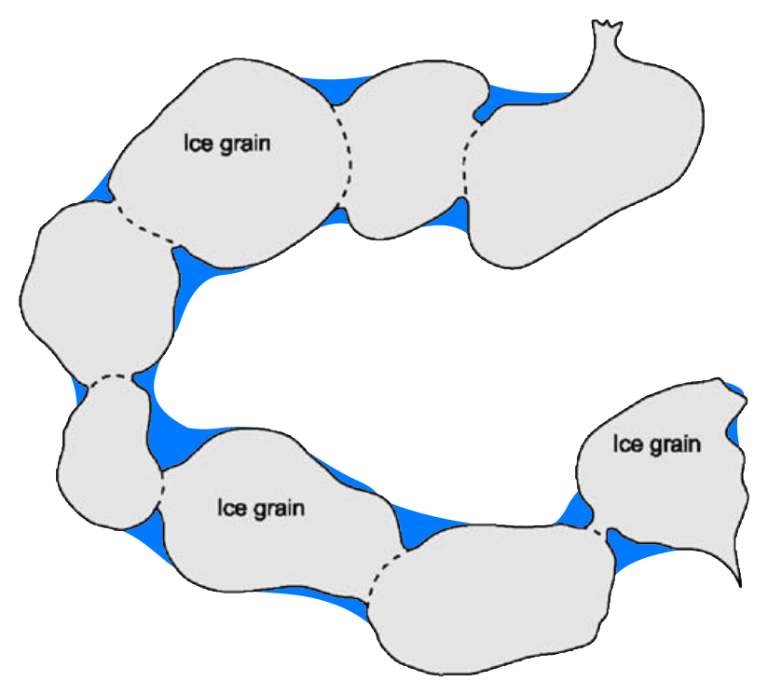
Identifying and Predicting Patterns of Snowpack Ripening with Machine Learning Methods
Clément Cherblanc; Dr. Joel T. Harper; Javier Perez Alvaro
Notes:
To define activation → define REH, then explain SNODAS, then show when REH goes to 0

Slide 2
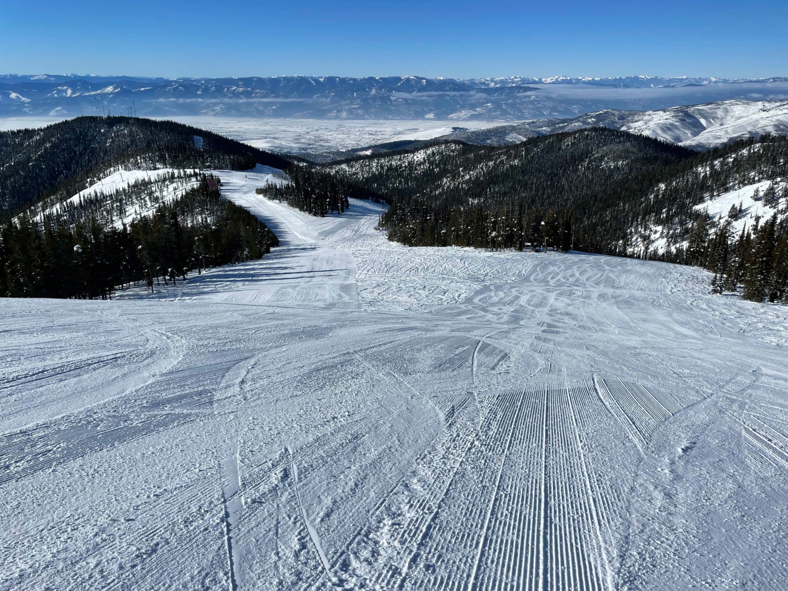
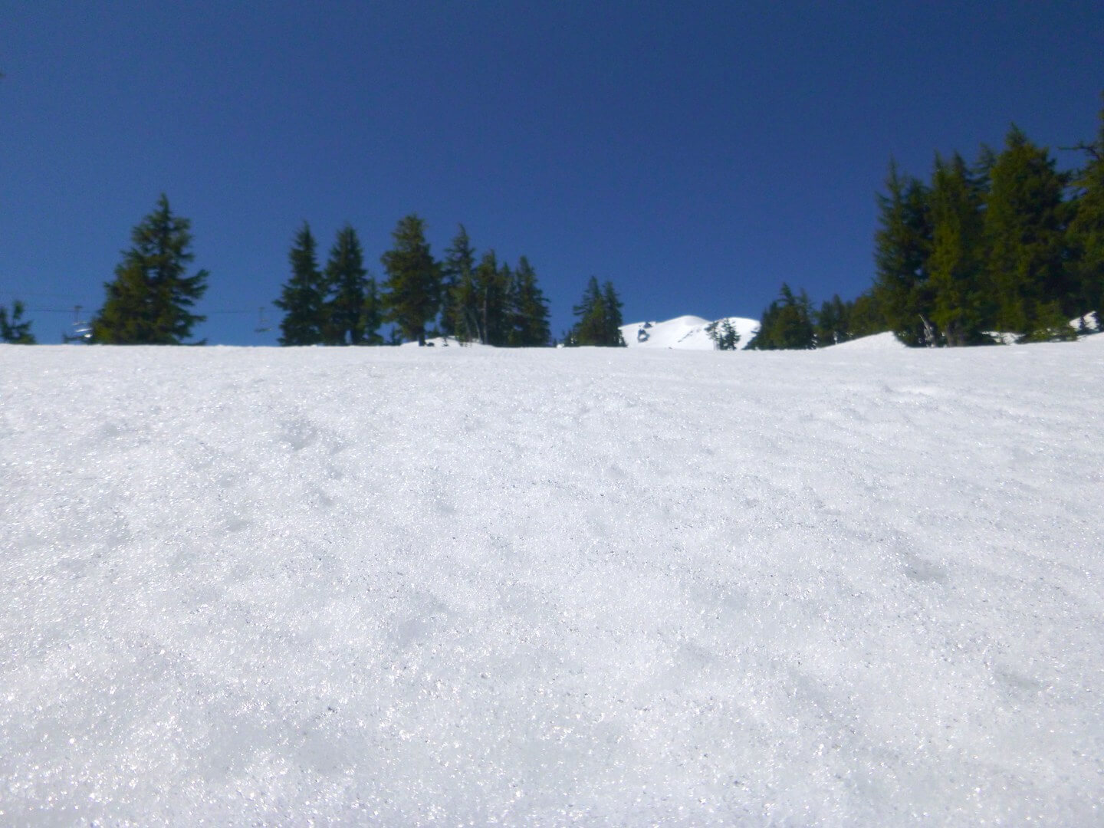
Snow Ripening = Snowpack becoming runoff-capable
DRY + COLD
WARM + WET

Slide 3
SWE Ripening = Snowpack becoming runoff-capable

Slide 4
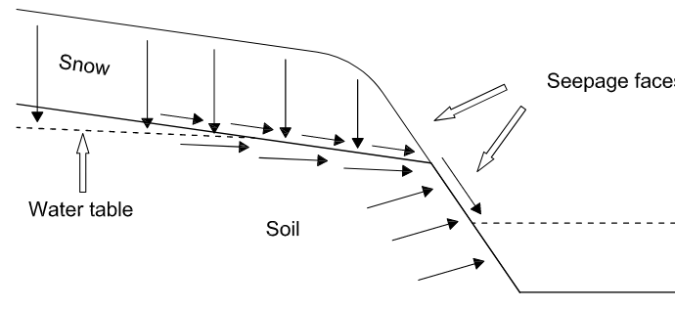
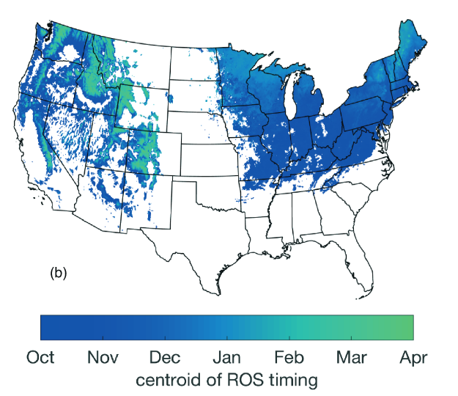
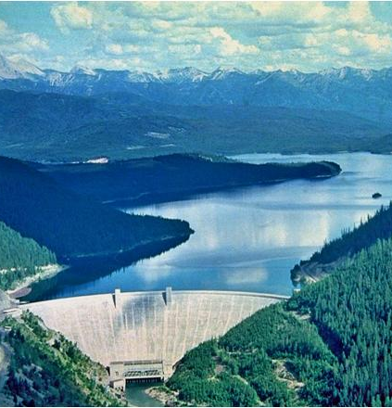
Motivations → Problem
Yet, poorly constrained in space; too complex to reason or to determine from simple factors such as elevation and aspect alone
Understanding the time-space variability
of snowpack ripening
Make predictions of the snowpack ripening
Stream/Soil Recharges
Rain on Snow
Hydroelectric Dams
Figure from Li et al., 2019

Slide 5
We need a metric: the Runoff Energy Hurdle (REH)
Snow accumulation
metric:
Runoff Energy Hurdle
Ripening
REH
SWE
(snow mass)
0
Fall Winter Spring

Slide 6
Runoff Energy Hurdle (REH) = Q_{CC}+ Q_{RS}:
Cold Content / Enthalpy
QCC = SWE Cice ΔT
Residual Saturation (equivalent of Latent heat of fusion of that liquid water) ~ 5% of SWE
QRS = 0.05 SWE Lice
Cold Content / Enthalpy
QCC = SWE Cice ΔT
Residual Saturation (equivalent of Latent heat of fusion of that liquid water) ~ 5% of SWE
QRS = 0.05 SWE Lice
Cold Content / Enthalpy
QCC = SWE Cice ΔT
Residual Saturation (equivalent of Latent heat of fusion of that liquid water) ~ 5% of SWE
QRS = 0.05 SWE Lice
Liquid water
J/m²
Modified from “Principles of Snow Hydrology” DeWalle and Rango, 2008

Slide 7
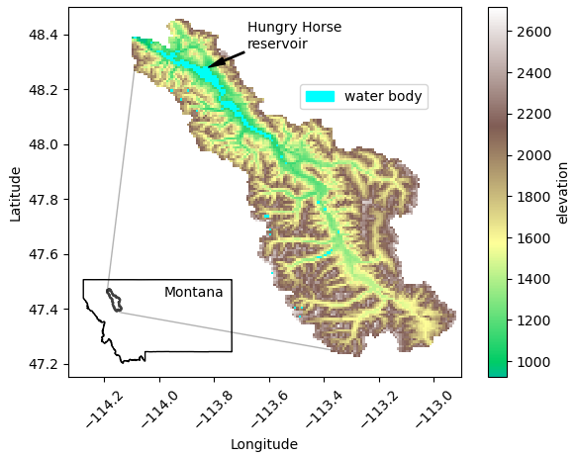
Study site
continental climate
4541km² watershed

Slide 8
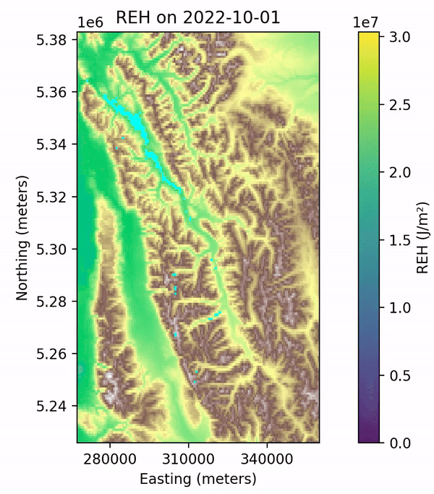
SNODAS model output
Operational model building a snowpack throughout the USA;
Compute REH from SNODAS output.

Slide 9
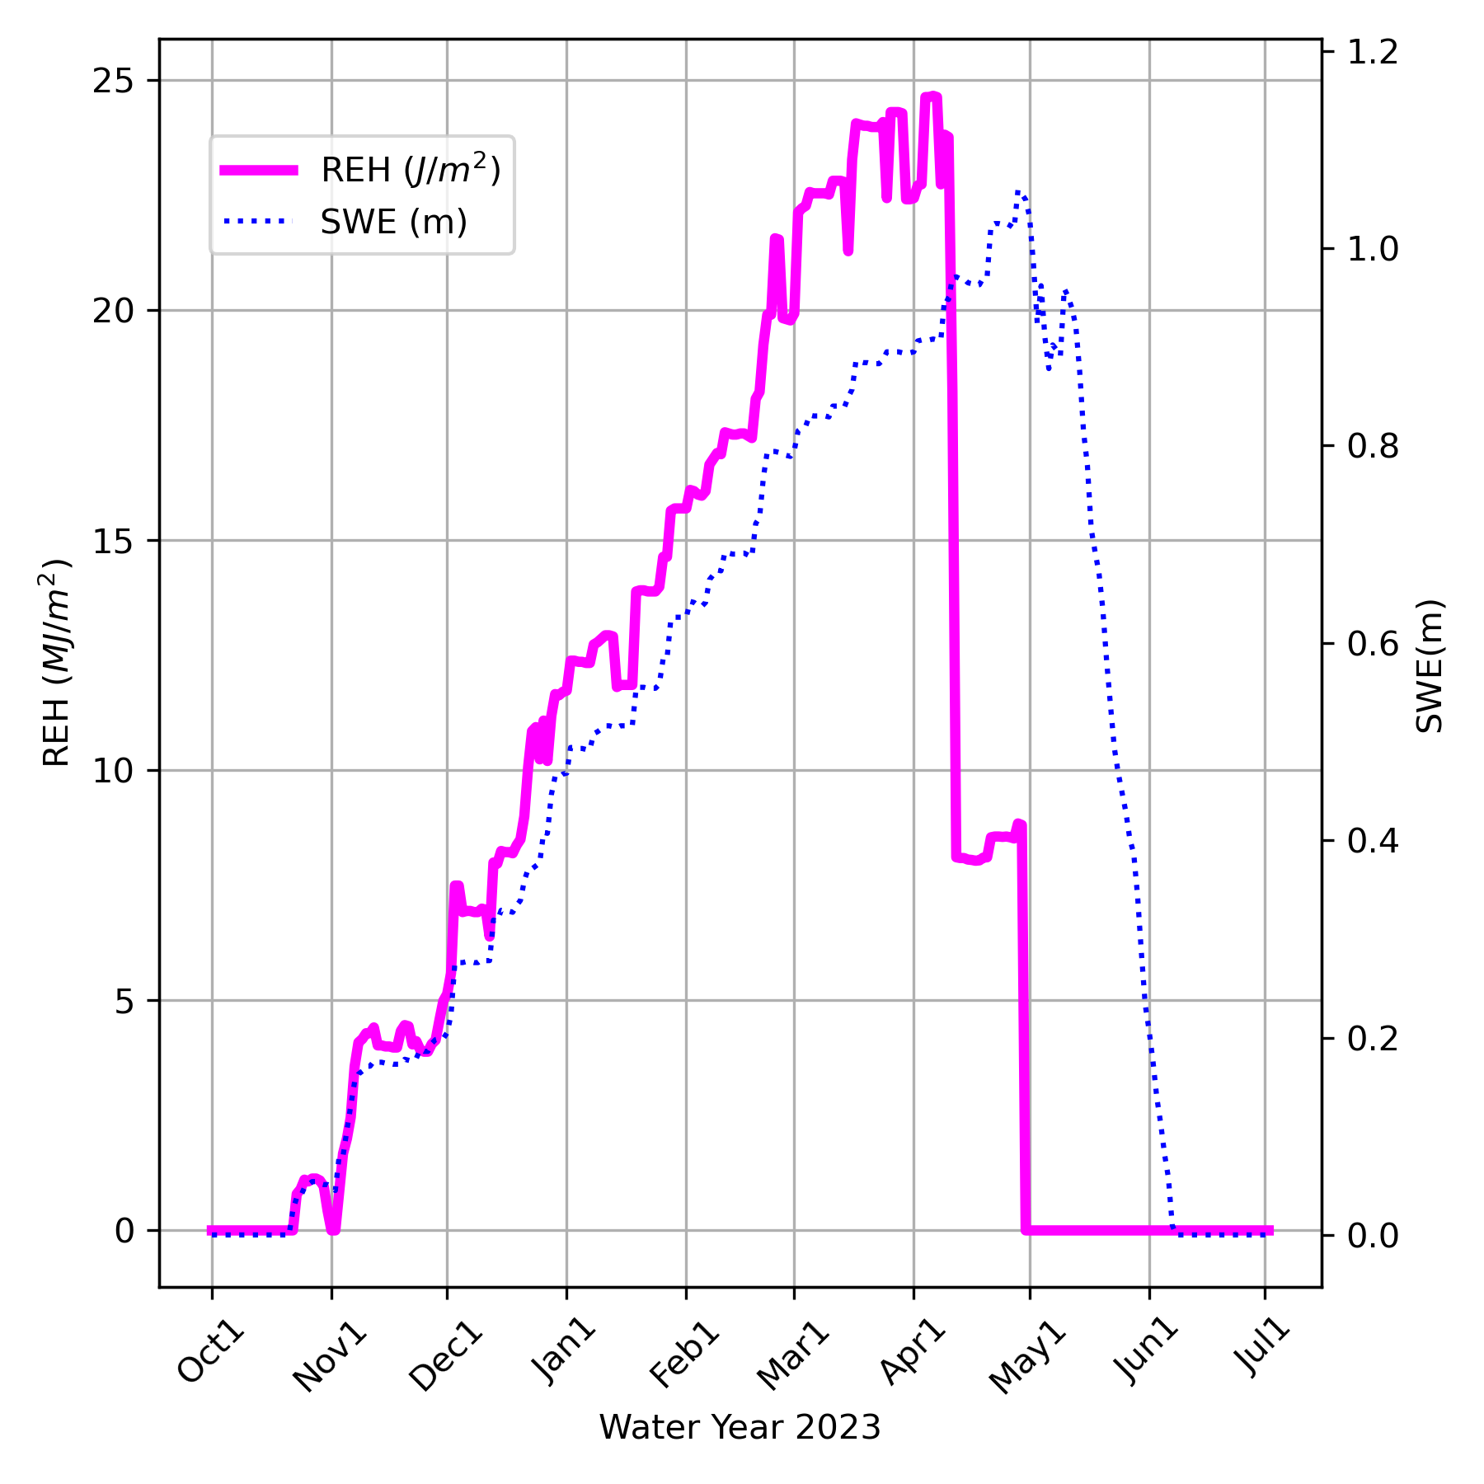

Slide 10
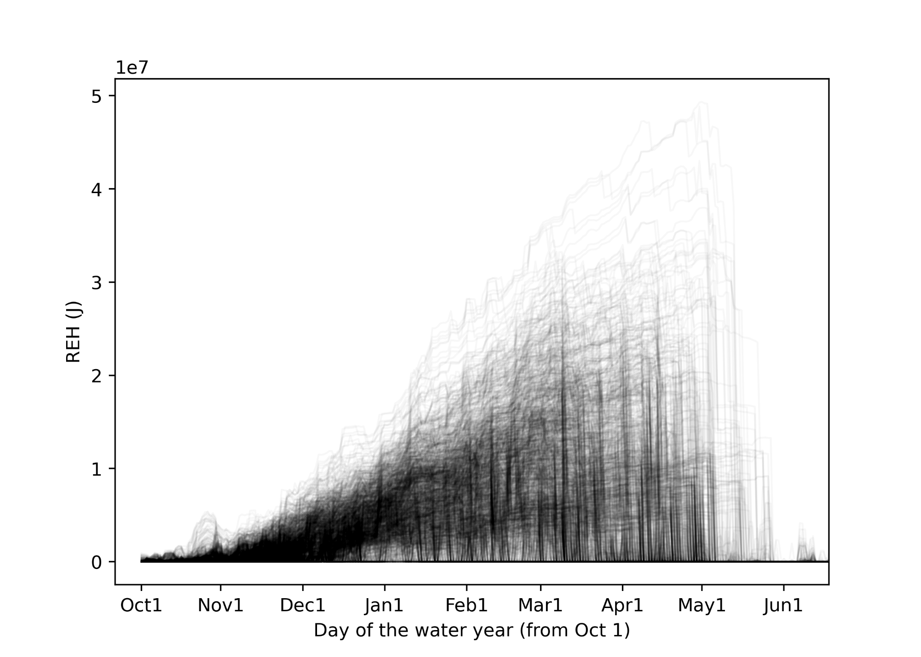
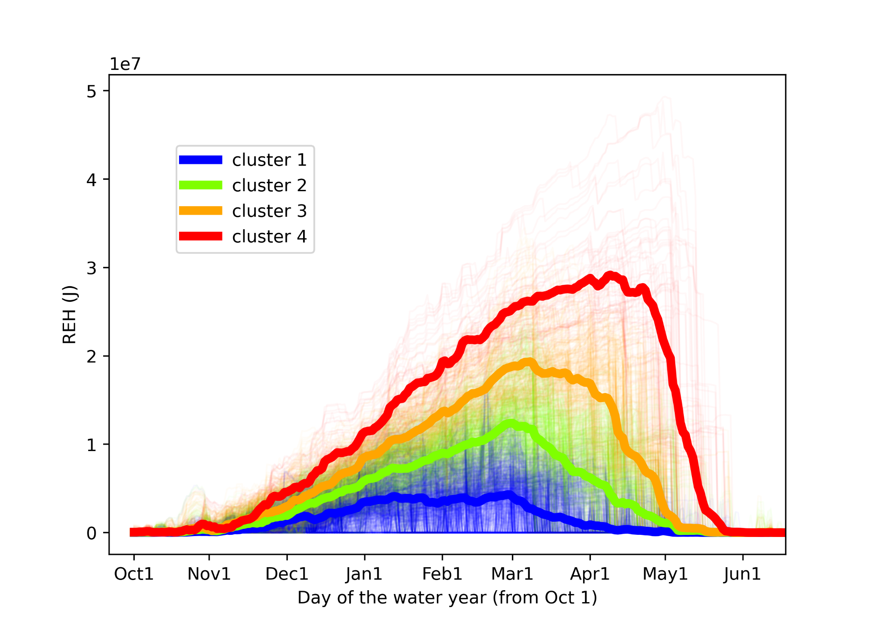
K-Means to identify similar behavior
19 years, 7889 cells

Slide 11
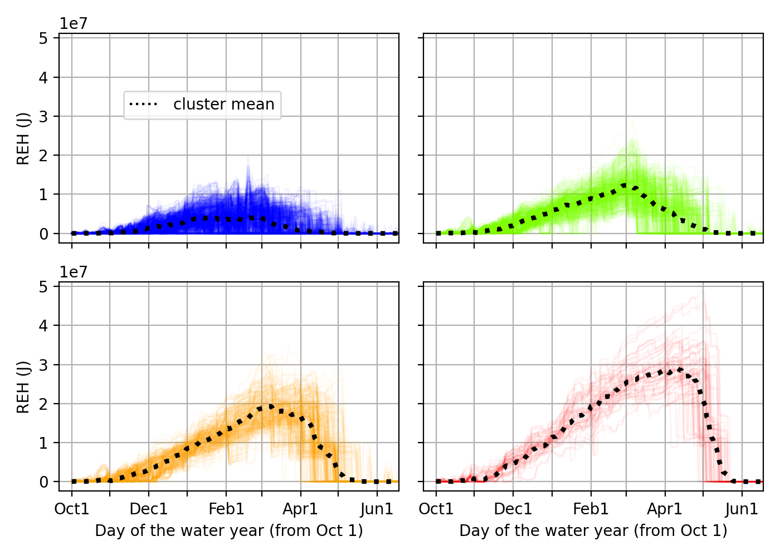

Slide 12
Inter-annual variability
warm, El Niño years, followed by droughts

Slide 13
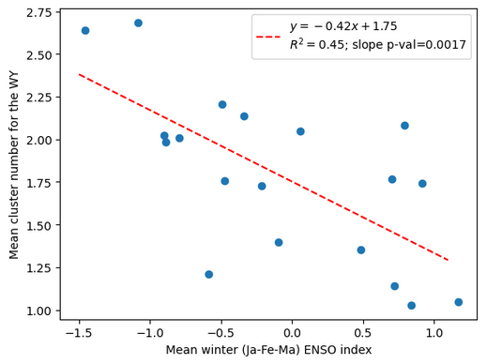
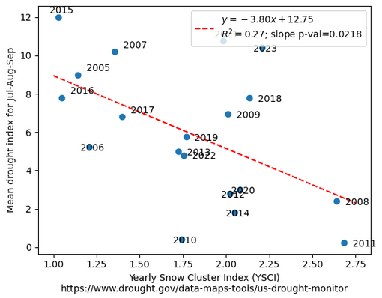
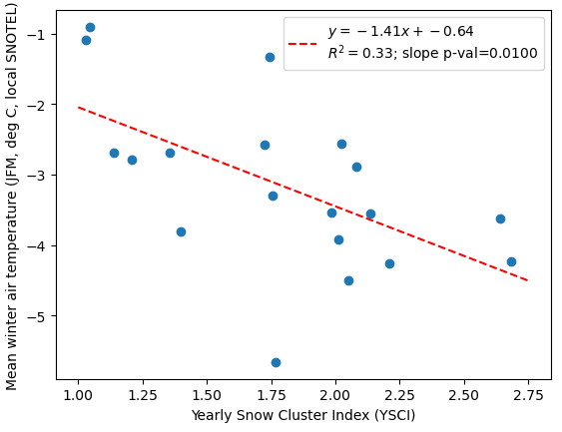
DROUGHT
ENSO
= El Niño
Winter Air Temperature

Slide 14
Ripening:
timing + SWE achieving REH=0

Slide 15
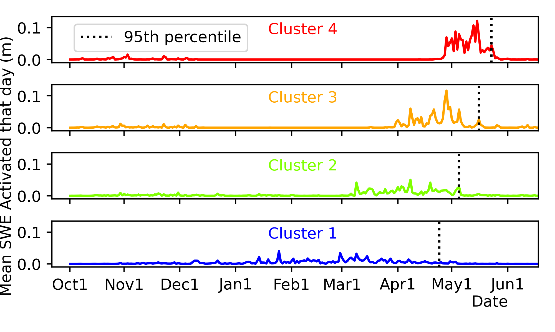
Mean ripening curves

Slide 16
Predicting the spring activation (ripening)
Predicting the cluster number; LSTM Neural Network

Slide 17
Practical predictions
2 Methods
K-Means:
Mean Absolute Error = 13 days
Long Short-Term Memory Neural Network:
Mean Absolute Error = 14 days
Weather variability!
???

Slide 18
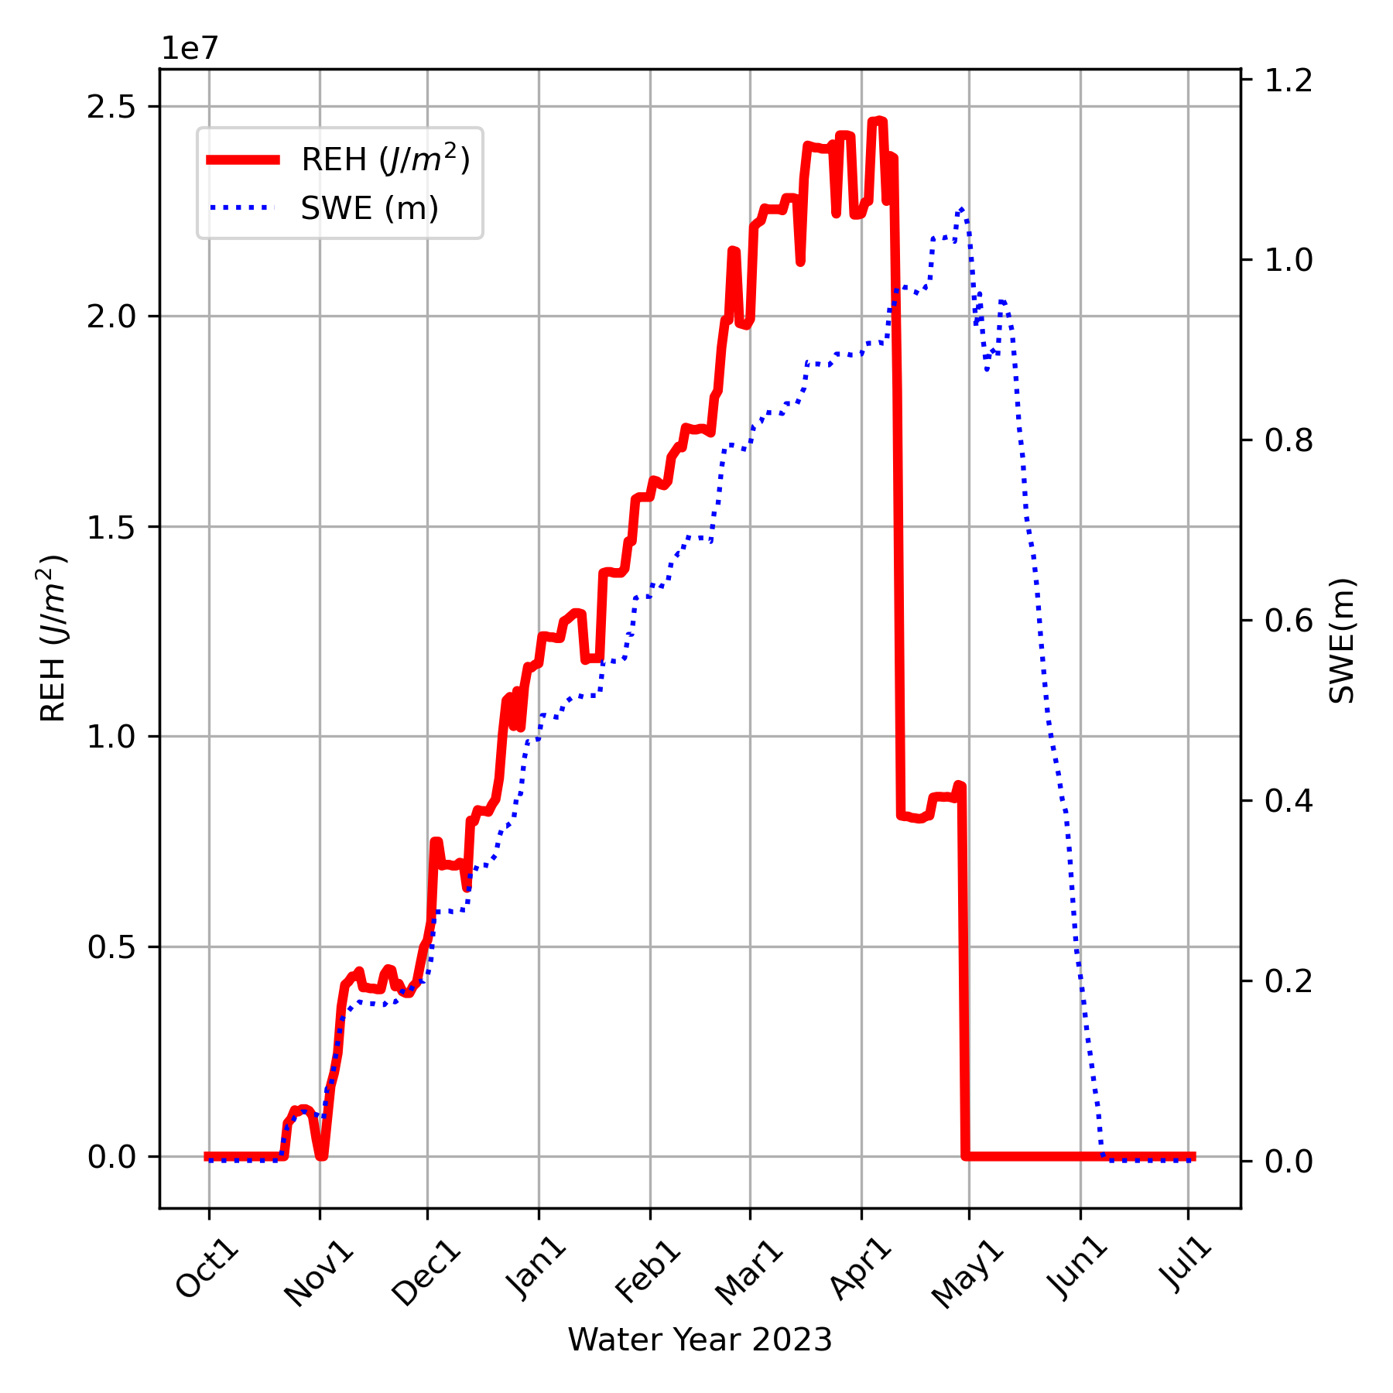
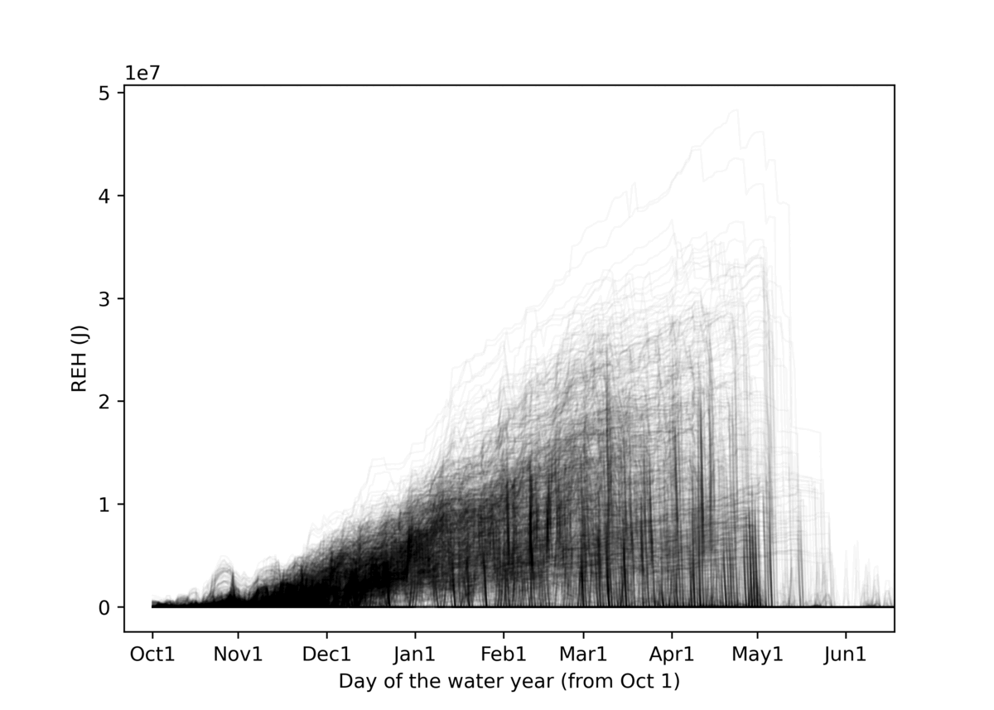
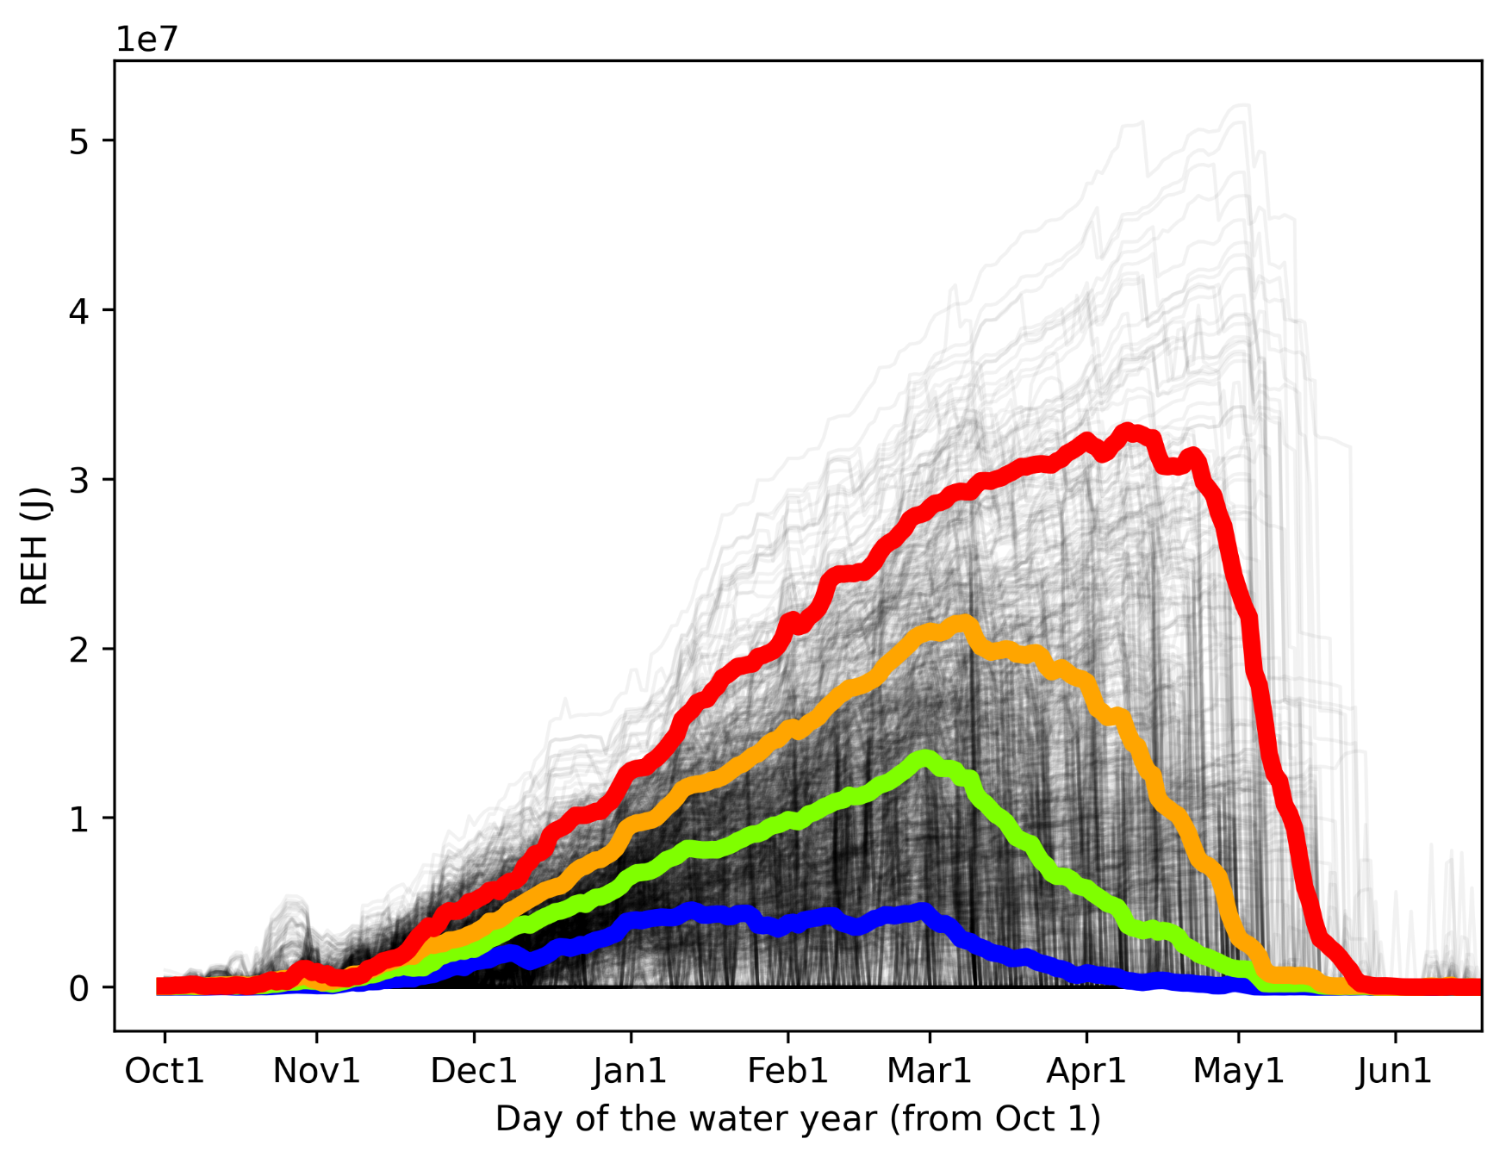
Take-homes
Creation of Runoff Energy Hurdle (REH) representing how far a snowpack is from ripening. The loss of REH is the ripening of the snowpack.
Clustering of REH time series shows a tipping point during low REH years, with very chaotic timing of ripening and water release.
Two methods to predict the spring ripening yield Mean Absolute Errors of 13 and 14 days, with potential improvement when considering weather.
???

