Slide 1
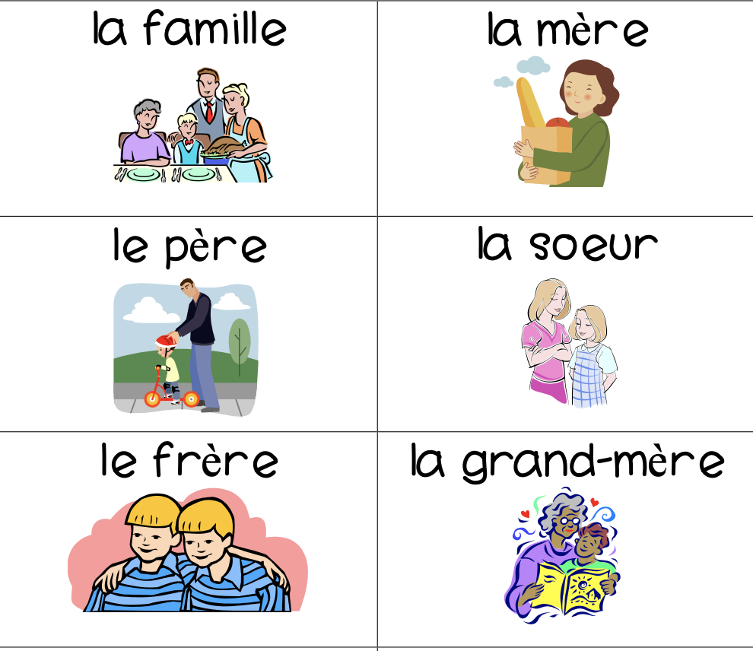
Is Circle Time Enough Language Input to Learn Grammatical Features? Madeline Strah-Farber University of Montana
Introduction
In most of the research on child second language acquisition, much of the focus has been on children who acquire a second language (L2) in an immersive environment
Immersion school
Parent or caretaker
However, there is only 3600 immersion programs nationwide (ARC, 2021).
3. Background
In this study, college students at the University of South Carolina were given 50-minute form- focused instruction through a variety of activities, and as a result performed substantially better on comprehension posttests (Wust & Roche, 2015).
Some of these activities included a noticing and awareness activity, where students looked for patterns in nouns endings that corresponded to either le or la (Wust & Roche, 2015).
Controlled practice activities, where students played a gender guessing game, by listening to a series of words, and raised either a blue (masculine) or pink (feminine) card depending on their predictions (Wust & Roche, 2015). There is also evidence about the impact of place-based learning on language
5.5. Post Tests
Post-tests will be given to the participants every Friday during the full three weeks of pedagogical intervention. The testing will consist of two tasks: a production task and a comprehension task.
The production task involves a bag task and consists of the children being given a bag of toys that represent the new learned vocabulary. The participants will then be prompted to take one toy out at a time and tell the researchers which toy they have grabbed, such as, example 2.
Example 2:
*Child takes a toy fish out of the bag*
Child: “Ah! It is un poisson!”
The comprehension test will be a “Where’s that?” task. By using the note cards, the researcher will ask for the children to identify the vocabulary they have learned. Children are then prompted to respond with a noun and its corresponding definite/indefinite article, like in example
Example 3:
“Where’s le poisson?” → Child points to the picture of a fish
or
“Where are les poissons? → Child points to a picture with multiple fish
5. Methodology Continued
2. Research Question
Are circle time activities (books, music, and games) enough language input for preschool aged children to pick up on a grammatical feature, like grammatical and lexical gender?
3. Hypothesis
After 1 year of pedagogical intervention, I expect the following to occur:
The children will produce French determiners (indefinite and definite articles) alongside a noun.
The children will produce the correct determiner(feminine or masculine) alongside a noun, with no more than a 20% error rate
The children will understand/notice the difference between masculine and feminine nouns
5. Methodology
5.1. Participants
8 four-to-five-year-old children currently enrolled at a local preschool. To be considered for the study the children must fulfill all the following criteria:
Currently enrolled full time at a preschool (at least 4 days a week)
Monolingual speakers of American English
Both parents are monolingual speakers of American English
No previous exposure to French (no previous instruction in French)
5.2. Materials
A computer for storing data, but also to show the YouTube stories from The Fable Cottage and other online sources
Flashcards
3. classroom toys, like fish, fruit, whales, birds, etc.
5.3. Time Frame
I anticipate that the children will need at least a year of pedagogical intervention. Again, the pedagogical intervention will be happening in the form of circle time activities. Subsequently, I believe it will be necessary to test every Friday for comprehension and production. Children who missed more than one day of school, will not be tested for that week.
5.4. Pedagogical Intervention
The pedagogical intervention will include three principal activities:
1. Form-focused instruction,
The form-focused instruction will primarily utilize notecards as seen in 5.2.
The purpose will be to draw the children’s attention to new vocabulary, specifically the gender of the noun and its corresponding determiner (le/la/les or un/une).
2. A story
a. The Fable Cottage
3. A game
the children will participate in a memory matching game using vocab learned during the form-focused instruction and story time.
I hope that the children will be motivated to respond with the indefinite/definite article, like in the example below.
Example 1:
Researcher: “ Ah, you found the matching pair! What is it?”
Child: “Un poisson!”
6. Implications
If preschool aged children can produce determiners as the hypothesis section has laid out, then:
This research will provide concrete evidence of the validity of the input from pedagogical intervention in the form of circle-time activities.
this research will expand the current literature on child second language acquisition to include data outside of immersion schools.
the research that can potentially be provided to motivate current early childhood education directors to include bilingual language learning in their curriculum.
3. Background
Acquisition of English
Current research tells us that supporting children’s oral language is rather critical for later reading development (Whorrall& Cabell, 2015).
Research conducted by Dickinson and Porche (2011) suggests that teacher-child interactions that involve sophisticated vocabulary, tap into the individual interests of the child, and contain open ended or challenging questions,
Helps children develop the prerequisite oral skills, that will be needed later in life for reading .
Although preschool aged children do spend a lot of time playing and are able to develop their oral skills in this linguistic setting, children do continue to develop language skills when they are required to listen, such as in a small group activity, like circle time.
For example, research on monolingual child language development (Weizeman& Snow, 2001) has shown that there is a correlation between the amount of language a child hears and their acquisition (Aukrust, 2007).
Children who were exposed to diverse and rare words, with discourse contexts also showed to have bigger vocabularies (Aukrust, 2007).
Another study found that children also greatly benefited from listening and talking with adults, resulting in larger language growth (McCartney, 1984).
Like, reading books together, which has been proven in reinforce vocabulary through play
leads to easier vocabulary recall and overall comprehensibility of new words (Hassinger-Das et al., 2017).
Acquisition of French
L1 or L2 learners of French, typically acquire determiners first (Grondin &White, 1996).
Have little to no errors in number agreement but will produce the wrong gender approximately 20% of the time, with a preference for the masculine definite article le (Grondin &White, 1996).
For example, a child might produce a construction like le plage ‘the (masc.) beach’, with the masculine definite article le, even though the correct form is la (femin.) plage, with the feminine definite article la.
These errors could be attributed to differences in usage of grammatical and lexical gender (Ayoun, 2007).
Between French and English, the two languages both utilize grammatical gender and rely on a plural marker to denote more than one, but only French relies on lexical gender.
Even if children and other second language learners of French tend to generate a lot of gender errors, there is a huge benefit to form-focused instruction (Wust & Roche, 2015).
7. Discussion
Does the methodology invoke more memorization or actual acquisition?
Is there more that can be done at circle time to increase the possibility of acquisition?
Is a year long enough to see the beginnings of acquisition?
Are their outside barriers that could affect results?
8. References
Arc completes national canvass of dual language immersion programs in U.S. public schools. American Councils. (2021, October 5). https://www.americancouncils.org/news/announcements-featured-content/arc-completes-national-canvass-dual-language-immersion-programs
Aukrust, V. G. (2007). Young children acquiring second language vocabulary in preschool group-time: Does amount, diversity, and discourse complexity of teacher talk matter? Journal of Research in Childhood Education, 22(1), 17-37.
Ayoun, D. (2007). The second language acquisition of grammatical gender and agreement. French applied linguistics, 16, 130-170
Dickinson, D. K., & Porche, M. V. (2011). Relation between language experiences in preschool classrooms and children’s kindergarten and fourth-grade language and reading abilities. Child Development, 82, 870–886. doi:10.1111/j.1467-8624.2011.01576.x.
Hassinger-Das, B., Hirsh-Pasek, K., & Golinkoff, R. M. (2017). The case of brain science and guided play. YC Young Children, 72(2), 45-50
McCartney, K. (1984). Effect of quality of day care environment on children's language development. Developmental psychology, 20(2), 244.
Nathalie Grondin & Lydia White (1996) Functional Categories in Child L2 Acquisition of French, Language Acquisition, 5:1, 1-34, DOI: 10.1207/s15327817la0501_1
Weizman, Z. O., & Snow, C. E. (2001). Lexical input as related to children’s vocabulary acquisition: Effects of sophisticated exposure and support for meaning. Developmental Psychology, 37, 265-279.
Whorrall, J., Cabell, S.Q. (2016) Supporting Children’s Oral Language Development in the Preschool Classroom. Early Childhood Educ J 44, 335–341. https://doi.org/10.1007/s10643-015-0719-0
Wust, V., & Roche, C. (2015). The Impact of Form-Focused Instruction and Consciousness-Raising Activities on L2 Learners' Acquisition of Grammatical Gender in French. The French Review, 88(3), 37-52

