Slide 1
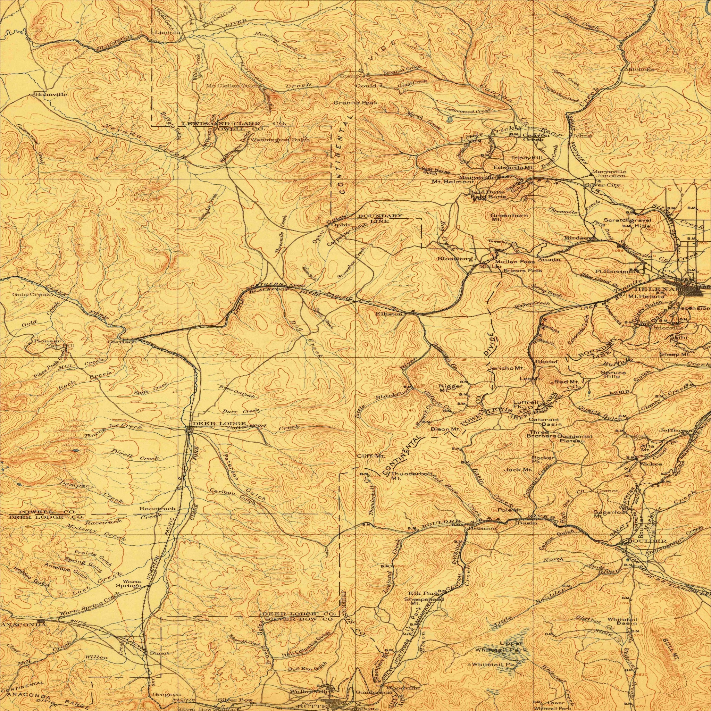
Feminine Felons: A History of Violent Female Offenders in Montana; 1909-1960
Cassidy Vander Voort
Figure 1: USGS, Helena Montana, 1903, https://ngmdb.usgs.gov/img4/ht_icons/overlay/MT/MT_Helena_268762_1903_250000_geo.jpg

Slide 2
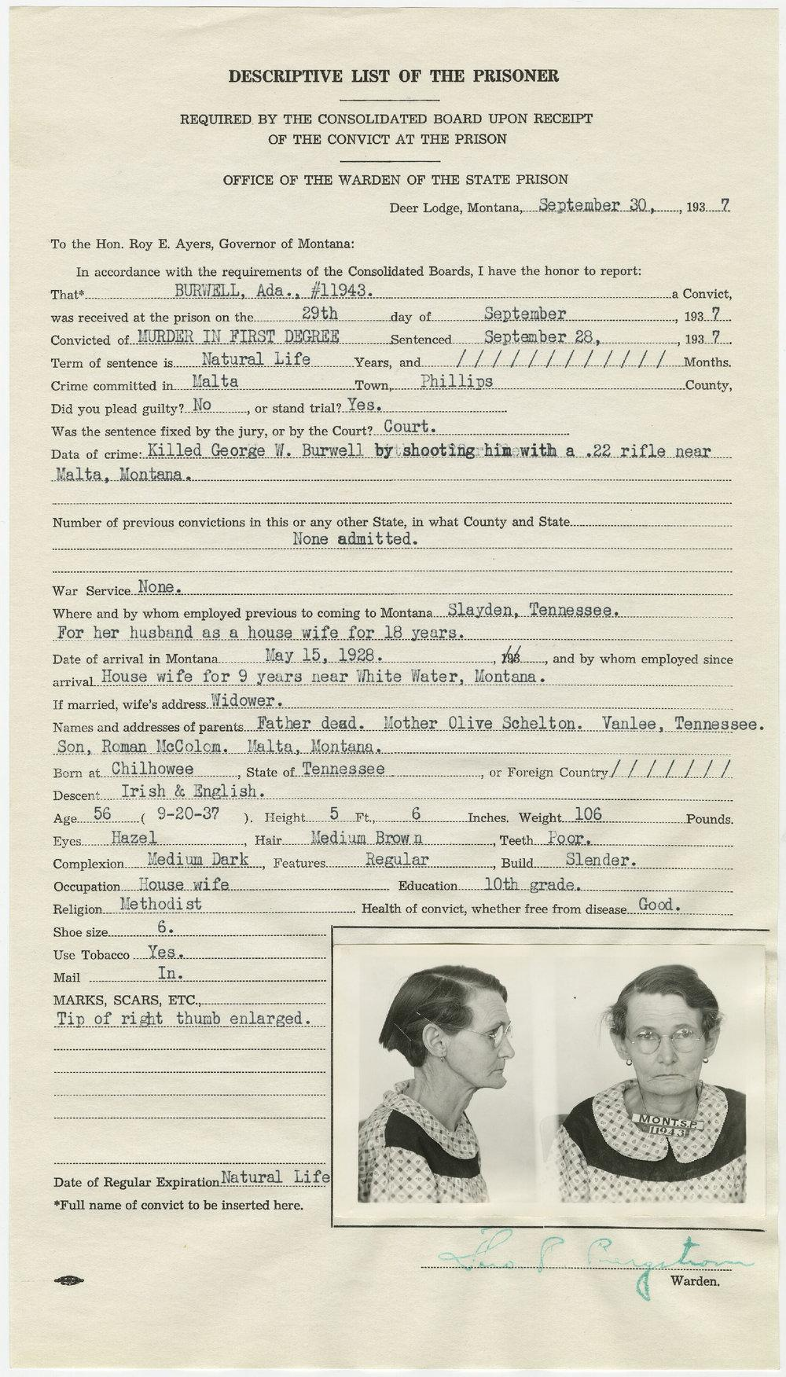
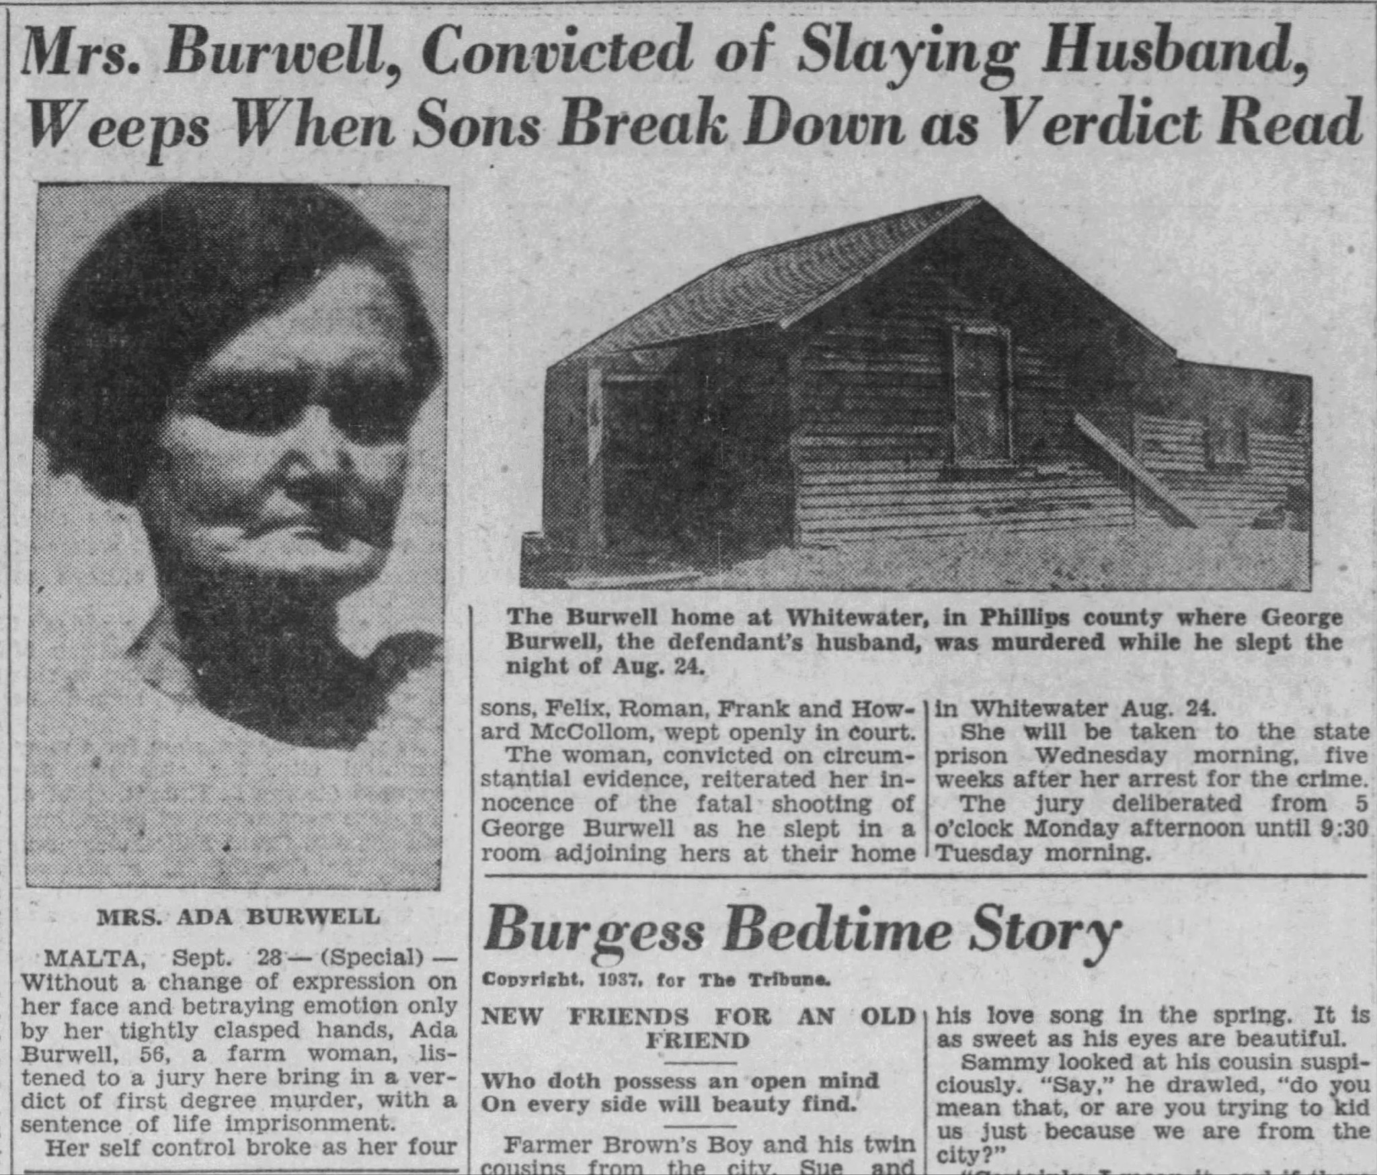
Ada Burwell
56, Housewife, Tennessee
1st Degree Murder
Accused of Killing her husband George Burwell

Slide 3
Figure 3: Women’s separate quarters Ellen Baumler, Dark Spaces: Montana’s Historic Penitentiary at Deer Lodge, 1908.

Slide 4
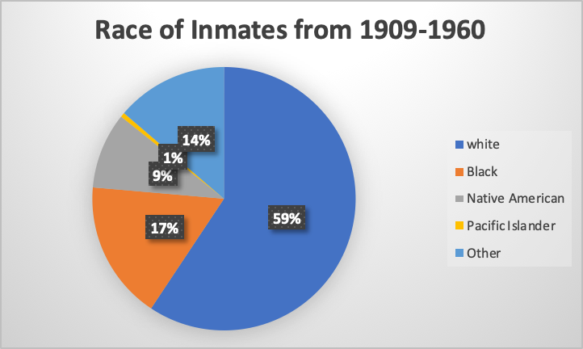
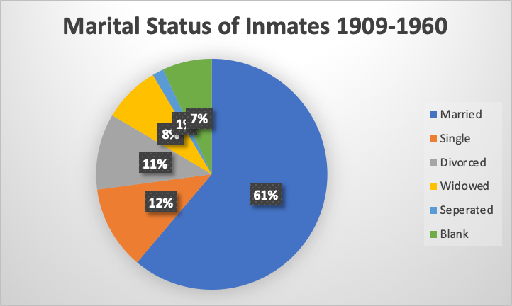
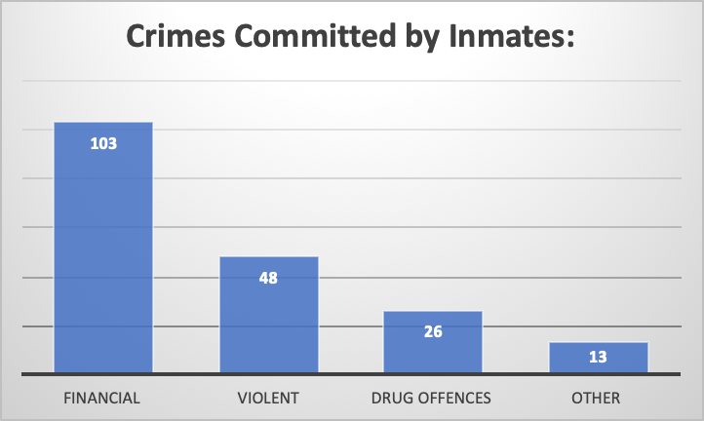
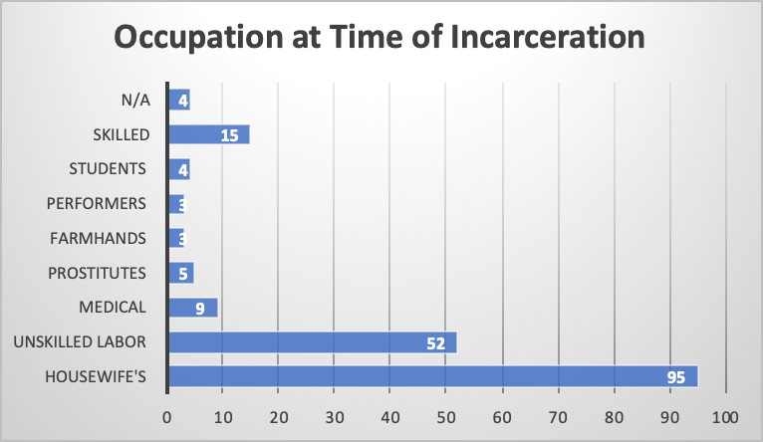
Demographics

Slide 5
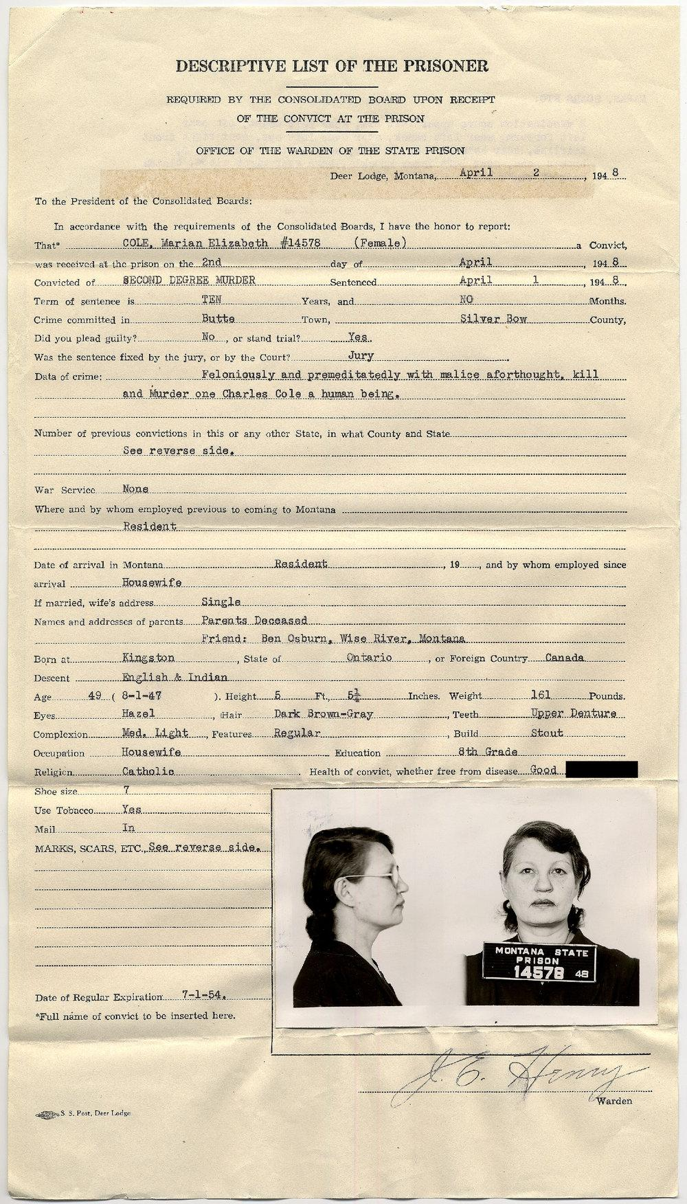
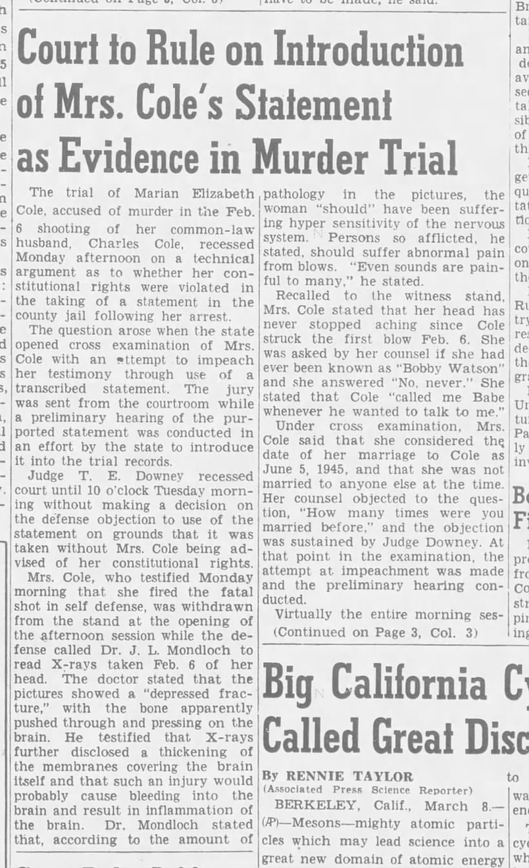
Marian Elizabeth Cole
49, Housewife, Ontario
2nd Degree Murder
Accused of Killings her
Common-law Husband

Slide 6
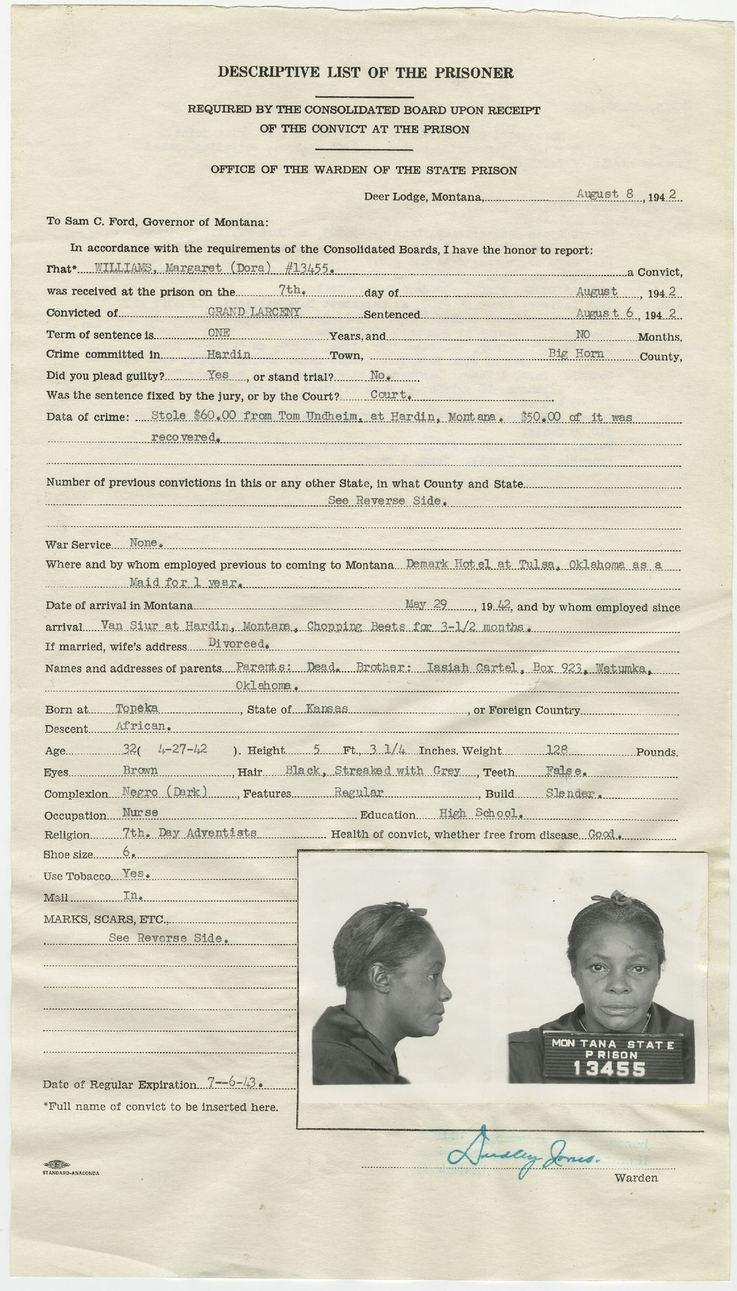
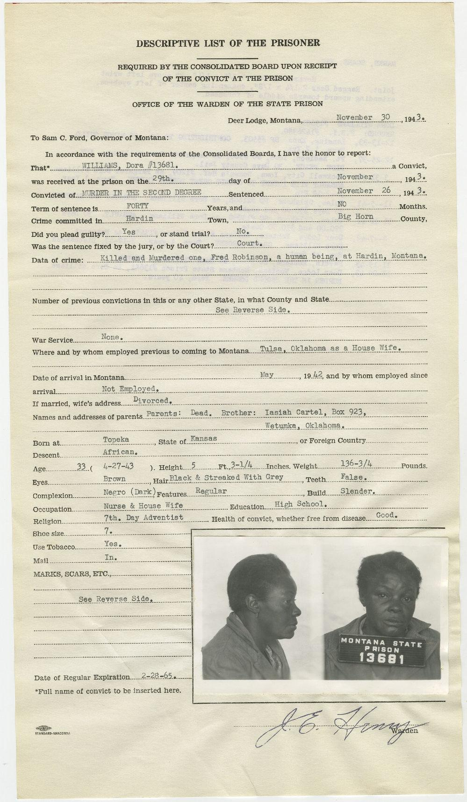
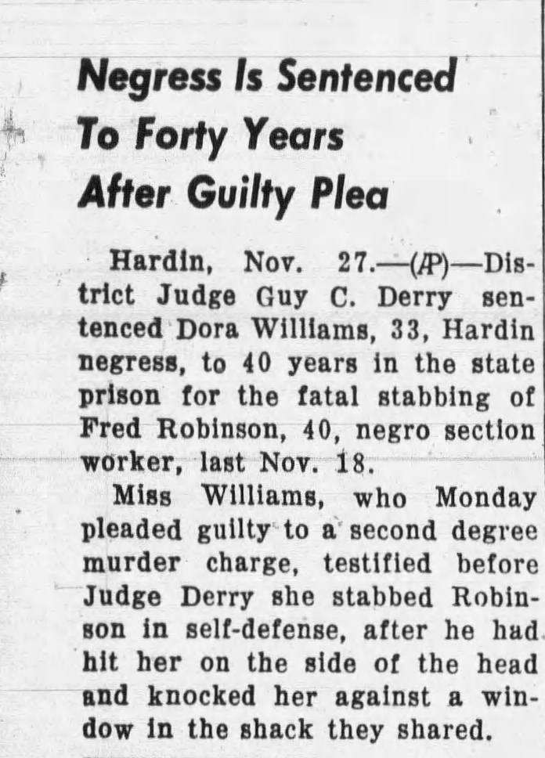
Dora Williams
33, Nurse/Housewife, Kansas
2nd Degree Murder
Accused of Killing
the man she was living with

