Slide 1
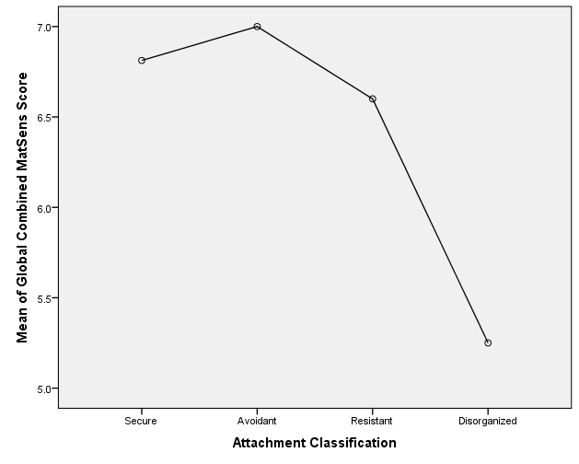
Introduction Children who do not form a secure attachment bond with their caregivers are more likely to develop cognitive and developmental problems, conductive disorders and even psychopathy. In 1969 Mary Ainsworth developed the Strange Situation Procedure (SSP) to measure mother-child attachment (Rosmalen, 2015). Ainsworth also established a scoring system to measure the mother’s sensitivity toward her infant called the Ainsworth Maternal Sensitivity Scale (AMSS). This construct includes the caregiver identifying a signal from the infant, interpreting it correctly, and responding promptly and appropriately (Kennedy, 2008). Measurement of maternal sensitivity during the SSP reflects the mother’s orientation toward the infant in that sensitivity predicts attachment (Muir, Koester, & Yorgason, 2012). The relationship between maternal sensitivity and attachment classification affects the child’s further development and psychopathy (Zilberstein, 2006). Consequently, prediction of mother-infant attachment would allow intervention before an insecure attachment to their caregiver forms. This study assessed two mother-infant interactions, in the home and the laboratory at two infant ages. By expanding the observations, this a more complete picture of the mother’s maternal sensitivity pattern emerges, which results in better prediction of infant attachment (Cassidy et all, 2005).
Using Global Maternal Sensitivity Score to Predict Infant Attachment
Jamie Pauley, Laurel Yorgason, and Lois Muir
University of Montana, USA
UMCUR, 2016
Participants
Sixty-six Caucasian moms and 68 infants (due to two sets of twins)
36 infant males (53%) and 32 infant females (47%)
Forty nine mothers were primiparous and 19 mothers were multiparous.
65% of the mothers achieved a college degree or beyond
All caregivers were the biological mother
Discussion
Attachment is an important building block in all aspects of a child’s life. Without healthy attachment a child has an increased chance of developing cognitive and developmental deficits as well as conduct disorders and even psychopathy. Assigning a global score to the mother-infant dyad based on multiple interactions from different infant ages provided more information on the dyad’s relationship compared to one single interaction score. Despite the overall results trending toward significance, the post hoc analysis revealed that there is a significant difference between maternal sensitivity ratings of secure and disorganized attachment. Being able to decipher the differences between secure and disorganized attachment will better prepare the mother and the clinician for an appropriate intervention.
Although results from this study were not statistically significant, the direction provided in this research could detect a statistical relationship between attachment and global sensitivity if the power was increased with a larger sample.
This study lends support to the idea that developing a measure to better identify the relationship between maternal sensitivity and infant attachment is important. Observing the mother–infant dyad in multiple settings and at multiple infant ages makes it possible to detect problems in a caregiver-infant relationship. Interventions can then be devised to promote a secure attachment to the caregiver.
Measurement
AMSS: The Ainsworth Maternal Sensitivity Scale is a nine point Likert Scale used to determine a mother’s level of sensitivity during interaction with her infant. The scale ranges from nine (highly sensitive) to one (highly insensitive). The scale offers detailed descriptions of the type of behavior a mother might exhibit.
SSP: The Strange Situation Procedure is used to classify infant attachment. The function of the SSP is to create a situation where the infant’s stress level is continually increased. The procedure takes place over a series of timed, consecutive episodes. The infant’s reactions to a stranger and to the mother are watched and coded by trained observers. The trained observers detect behaviors that are predictive of attachment categories (proximity-seeking, contact maintenance, resistance, and avoidance).
Procedure
At the infants’ age of 4 weeks mothers were videotaped in a 20 minute free play with the infant in the dyads’ home.
At the infants’ age of 16 months mothers and infants came to the laboratory and were videotaped in the SSP. Mothers were given instruction on the procedure and toys were available for the child to play with.
The videos were then coded for maternal sensitivity using the AMSS. The observer received training regarding the process and was required to match (plus or minus one on the Likert scale) 100 percent of the videos to show inter-rater reliability. Based on the interactions from both videotapes, the observer assigned a sensitivity score for the mother.
By observing the dyad in multiple locations and at multiple infant ages, a more complete picture of the mother’s maternal sensitivity pattern should result in a better prediction of infant attachment.
Results
An ANOVA was conducted with the global rating of maternal sensitivity and infant attachment classification but the results were not significant F(3, 64) = 2.32, p = .084. See figure on right.
A Tukey HSD post-hoc analysis revealed that there is a significant difference between mothers with securely attached infants and mothers with disorganized attached infants
(p < .05).
Notes:
3. Where do I even post all of my references? DON’T, JUST HAVE THEM WITH YOU. ALSO HAVE OTHER INFO SUCH AS THE PERCENTAGES OF CLASSIFICATIONS.

