Slide 1
Iran Nuclear Agreement:
Good Choice or Bad Deal?
Mikaela Koski

Slide 2
Betrayal

Slide 3
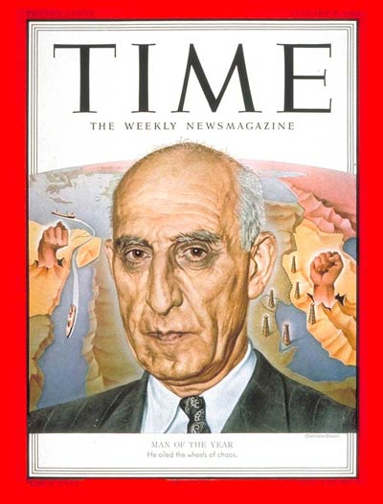
The Loss of Iranian Trust:
CIA Coup -- 1953
Anglo-Iranian Oil Company
Mohammad Mossadeq and Oil Nationalization
CIA-led Coup
http://myhero.com/images/guest/g278342/hero102940/1101520107_400.jpg

Slide 4
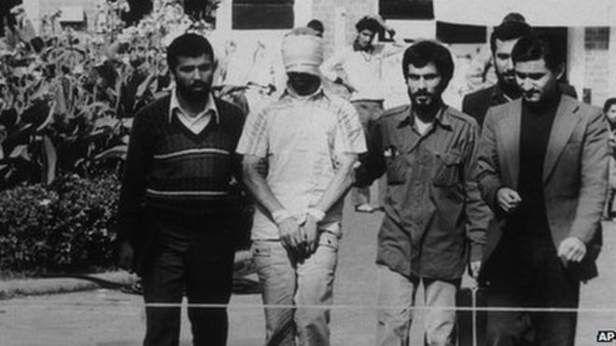
The Loss of American Trust:
Hostage Crisis -- 1979
444 days
One Event, Two Perceptions
http://ichef.bbci.co.uk/news/660/cpsprodpb/D653/production/_87376845_008125466-1.jpg

Slide 5
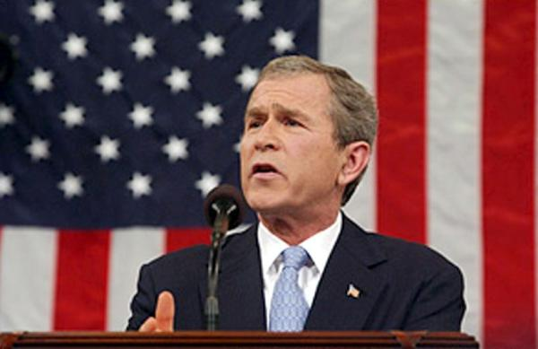
Bonding Over
A Common Enemy?
Iran as “Axis of Evil”
Mutual Enemy: Taliban
http://www-tc.pbs.org/wgbh/pages/frontline/tehranbureau/BushAxisOfEvil2002.jpg

Slide 6
The Road to Reconciliation:
JCPOA Provisions
Restrictions on Nuclear Capabilities
Limits enrichment level to 3.67%
Reduces stockpile 98%
Restricts Iran from obtaining certain elements
Breakout length: 1 year
Sanctions Relief
Nuclear Related Economic Sanctions
Terrorism and Human Rights Sanctions Remain
$100 billion of unfrozen assets

Slide 7
JCPOA Provisions (cont.)
Implementation
IAEA Monitoring
Joint Commission
No veto power
Cooperation
Modernization and Alteration Projects
Scientific Exchange
Nuclear Safety
Medical Research

Slide 8
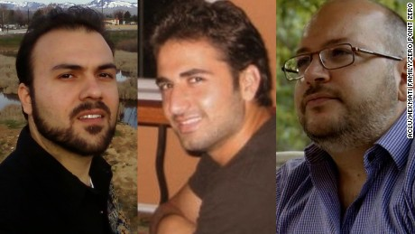
Baby Steps:
Recent Developments
US Navy members released: January 13, 2015
Implementation Day: January 16, 2015
Prisoner-Swap: January 16, 2015
http://i2.cdn.turner.com/cnnnext/dam/assets/160117130018-t1-iran-3-prisoner-swap-large-169.jpg

Slide 9
Iran Nuclear Agreement:
good Choice or bad Deal?

Slide 10
Helpful Links
Preamble and General Provisions
ANNEX I: Nuclear Related Commitments
ANNEX II: Sanctions Related Commitments
ANNEX III: Civil Nuclear Cooperation
ANNEX IV: Joint Commission
ANNEX V: Implementation Plan
Treasury Explanation of Sanctions Relief

