Slide 1
Ruskis in Hollywood
Historical Stereotypes and Clichés of Russians in American Cinema

Slide 2
JUSTIFICATION OF RESEARCH

Slide 3
Media Influence of Public Attitudes
Movies reflect general American attitudes
Movies influence those same American views
EXAMPLES FROM EXISTING BODY OF LITERATURE:
Depiction of masculinity and violence in relation to practices
Depiction of crime in Disney films and child attitudes
Depiction of interracial relationships in relation to social norms
Depiction of virginity loss and guidance tools for teenagers
Notes:
Overall body of research on the sociology of film suggests:
These are just a few of the examples, demonstrating how critical film is in both reflecting and shaping values
By analyzing the relationship between depiction of Russian villains and the current political attitudes, I hoped to find a correlation between the era-centric beliefs and the media representation. Ultimately, I think these relationships are critical in understanding how important film is in shaping the American public’s view of Russia.

Slide 4
METHODS SECTION
FILM SELECTION AND FILM BREAKDOWN

Slide 5
HISTORICL ERAS CHOSEN
1960s 1980s 2010s Beginning of Cold War Cold War Revival New Cold War
All three featured times of political & cultural strife

Slide 6
Film | Year Released | Country Produced
From Russia with Love | 1963 | UK
Fail Safe | 1964 | USA
The Russians are Coming | 1966 | USA
Ice Station Zebra | 1969 | USA
Octopussy | 1983 | UK
Red Dawn | 1984 | USA
Rocky IV | 1985 | USA
Invasion USA | 1985 | USA
Iron Man 2 | 2010 | USA
Salt | 2010 | USA
A Good Day to Die Hard | 2013 | USA
Jack Ryan: Shadow Recruit | 2014 | USA
Notes:
Three criteria:
1 – featured a Russian antagonist, which I found was actually somewhat varied in terms of how villainous they actually were.
2 – be contemporary for that time (ie – no Bridge of Spies)
3 – be produced in the US, with the James bond exception

Slide 7
ANALYSIS AND RESULTS
DECADE CENTRIC THEMES AND VARIANCES

Slide 8
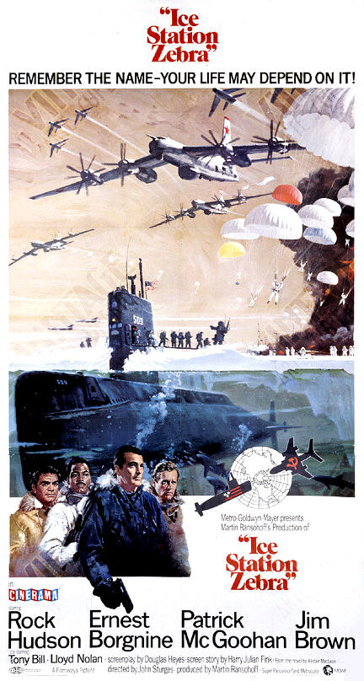
Film | Year Released
From Russia with Love | 1963
Fail Safe | 1964
The Russians are Coming | 1966
Ice Station Zebra | 1969
Notes:
1960s – ALL novel adaptations, not intentional

Slide 9
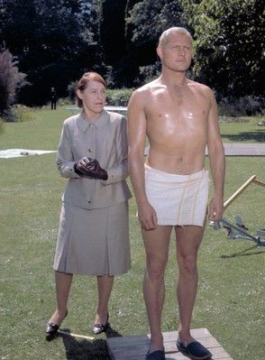
1960s Themes
Antagonistic Russian Presence
Survival of the US way of Life
Threat of Nuclear Armageddon

Slide 10
1960s – The Antagonistic Russian
An invisible Russian presence
Russians rarely seen, but always looming
Russian characters are typically traitors
Notes:
Russia official/Russians loyal to their country rarely seen
Rosa Klebb (From Russia) and Boris Vaslov (Ice Station) examples of traitors

Slide 11
1960s – Survival of the US Way of Life
Focus on survival of the US as a country
Sympathetic American characters overcome traitorous Russians
Russians occasionally work with US to preserve US life
Notes:
Sympathetic Russians in TRACTRAC examples, some extent in Zebra

Slide 12
1960s – Threat of Nuclear Armageddon
Nuclear war and mutually assured destruction is the real enemy
Constant fear of nuclear bombing
Notes:
All four films featured this fear of nuclear fallout

Slide 13
RELATION TO US ATTITUDES IN THE 1960s
Fear of Nuclear Destruction
Lack of desire to villainize Russians
Ian Fleming & the Russians are Coming

Slide 14
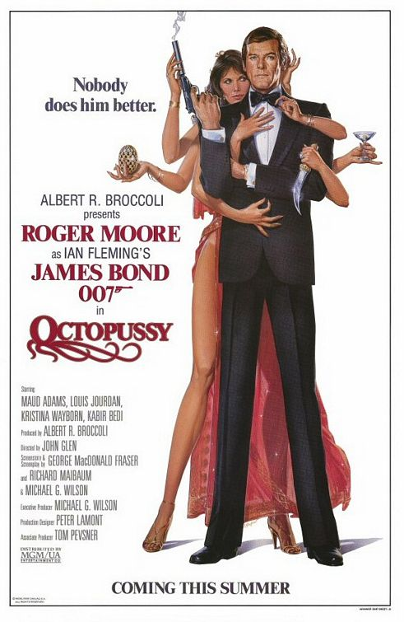
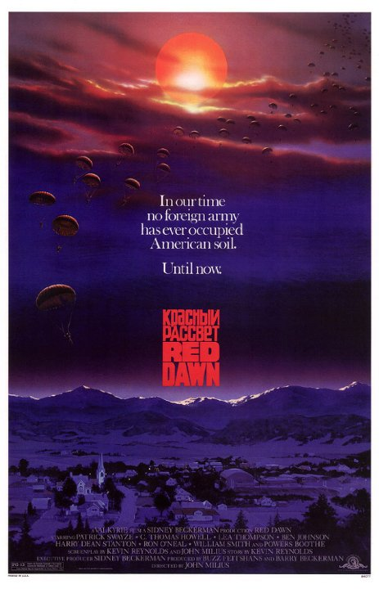
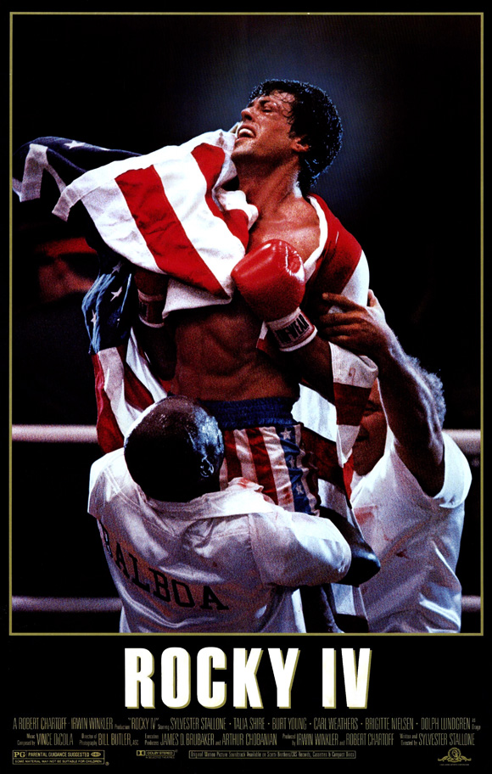
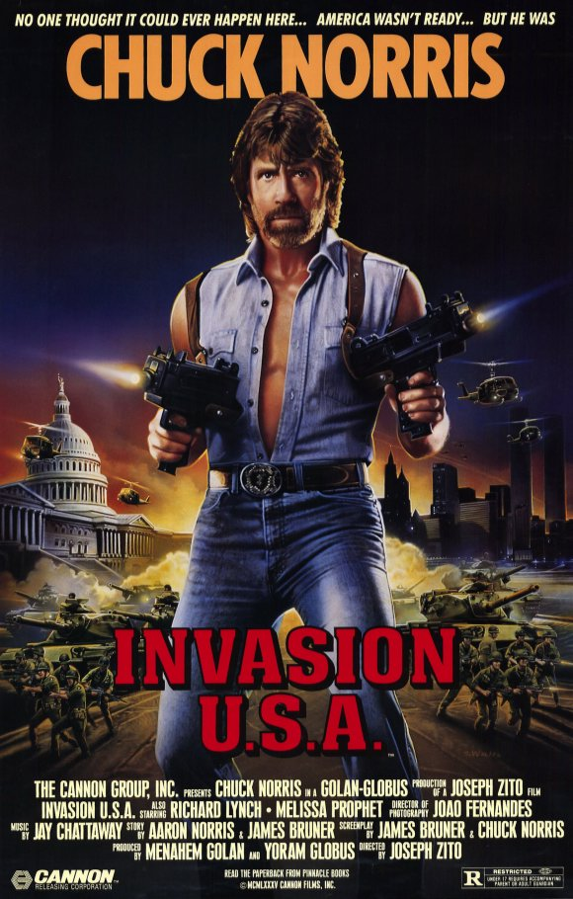
Film | Year Released
Octopussy | 1983
Red Dawn | 1984
Rocky IV | 1985
Invasion USA | 1985
Notes:
1980s

Slide 15
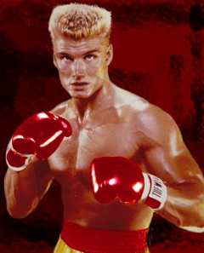
1980s Themes
The Aggressive Russian
Intent to destroy US Culture
Characters symbolic of USSR

Slide 16
1980s – The Aggressive, Destructive Russian
Soviet characters depicted killing/harming an (unnecessary) amount of people
Violence as the only means to an end
Aggressive without reason
Notes:
Red Dawn commies and destruction of Colorado
Mikhail Rostov (Invasion) example of USSR overkill
General Orlov (feat.) and intention to KILL

Slide 17
1980s – Intent to Destroy US
Focus of films are Russian intent to eliminate US as a country
Literal invasion of US (with goal of destruction)
Notes:
Invasion + Red Dawn w/ actual invasions, Octopussy + invasion to invade Western Europe

Slide 18
1980s – Characters Symbolic of USSR
Proxy examples of the Soviet Union
Symbolic of inevitable defeat of USSR
Plucky American heroes overcoming Soviets
Notes:
Colorado high schoolers, Chuck Norris, Rocky

Slide 19
RELATION TO US ATTITUDES IN THE 1980s
The Moscow Olympics Boycott
Miracle on Ice event
The Afghanistan War
Returned hatred of Communism and fear of spies
Notes:
Rising international aggression of USSR made them excellent villains on the global stage for Hollywood to then characterize.

Slide 20
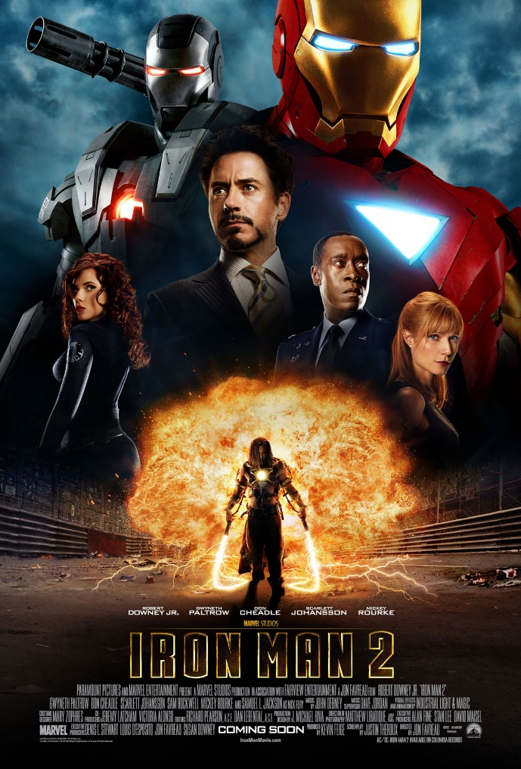
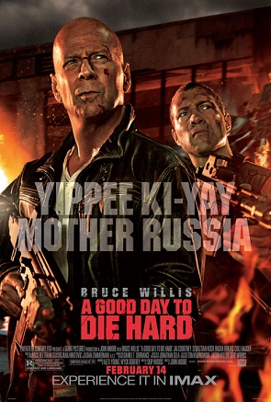
Film | Year Released
Iron Man 2 | 2010
Salt | 2010
A Good Day to Die Hard | 2013
Jack Ryan: Shadow Recruit | 2014
Notes:
2010s

Slide 21
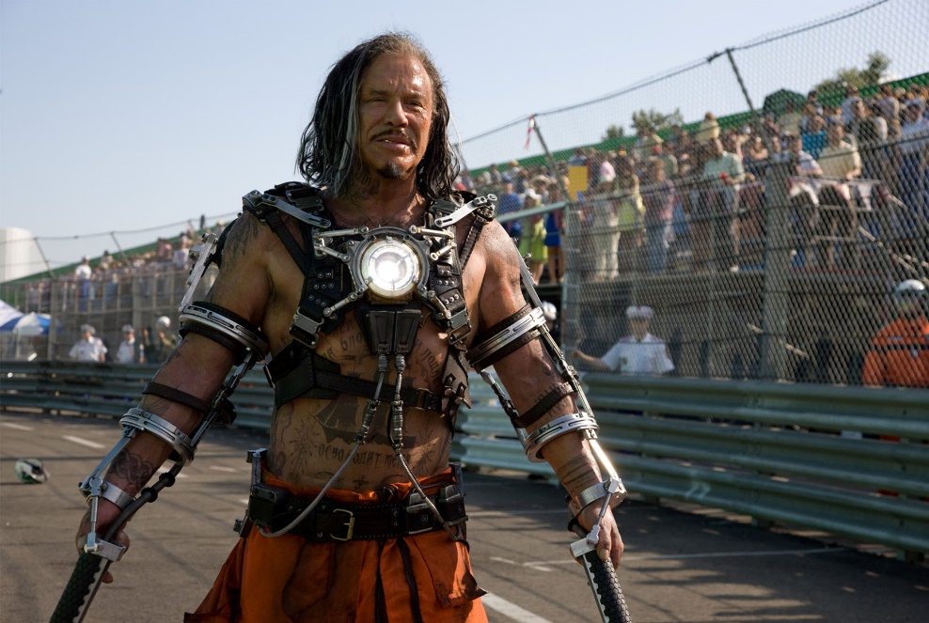
2010s Themes
The Evil, Plotting Russian
Destruction of US power
Putin-esque characters

Slide 22
2010s – Evil, Plotting Russian
Similar to Russians of the 1980s
More conniving, complex plans
Shows gradual devolution of villains
Notes:
Still aggressive, just with more developed plans

Slide 23
2010s – Destruction of US power structure
Eliminating US as a global superpower
Destroy specific part of US power
Economic
Political
USA technology

Slide 24
2010s – Putin-esque figures
Strong, macho men
Willing to bleed/die for “Mother Russia”
Similar backgrounds to Putin (military/police)

Slide 25
RELATION TO US ATTITUDES Modern Day
The Rise of Putin
Decreasing approval ratings of Russia (from US citizens)
Russia is not a major foreign media market
Notes:
Gallup polls – drastic decrease in US approval rating of Russia, in line w/ Putin’s rise
Again, return to aggressive Russian action posits them as an international villain
Lack of economic impact on US from villanization.

Slide 26
OVERALL TRENDS
Movement from sympathetic Russians to overtly evil Russians
Rise of plucky American heroes
Opposite results of what I expected to find
Why does this matter?

Slide 27
QUESTIONS?

