Slide 1
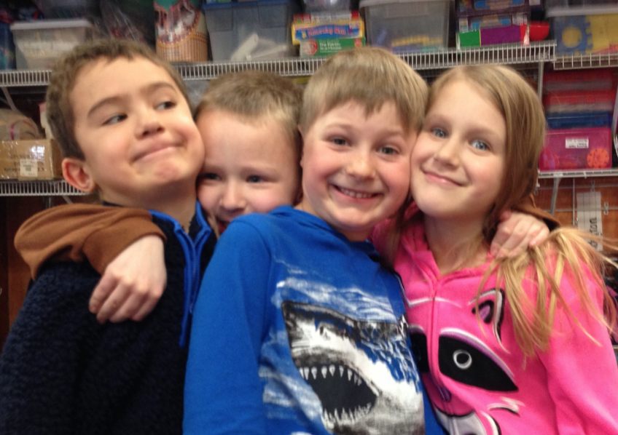
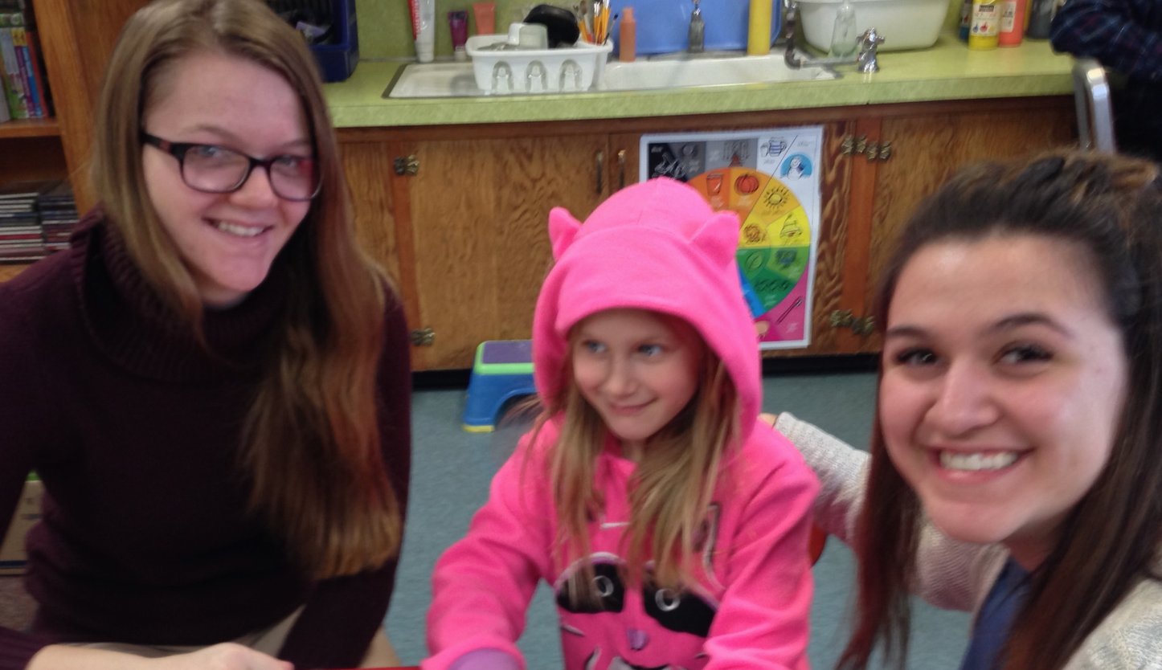
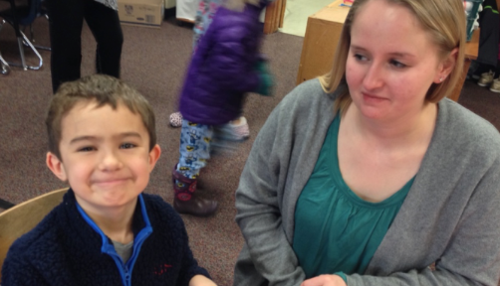
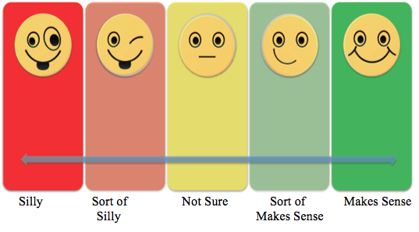
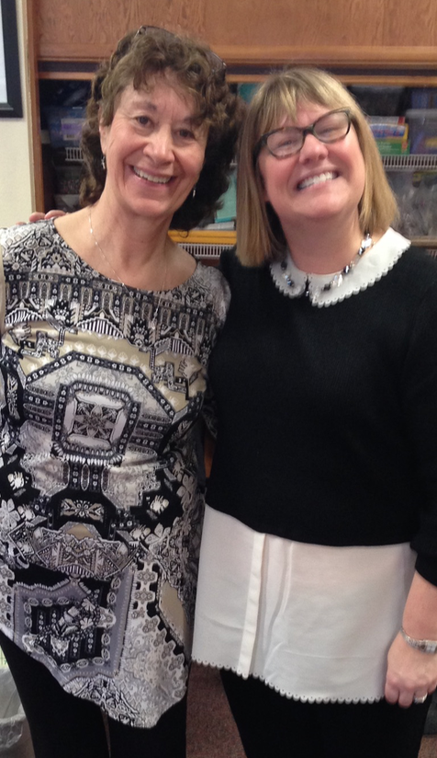
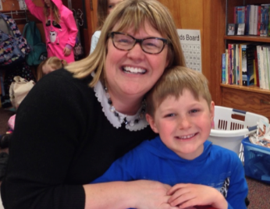
Vocabulary and Morphological Awareness Development in Young Children
Undergraduate Researchers: Maya Anger, Kelcie Cassidy, Morgan Williams
Graduate Researcher: Cheska Dietsch, BA Mentor: Julie A. Wolter PhD, CCC-SLP
Introduction
.
Results
Morphological Awareness (MA) is “The ability to reflect upon and manipulate morphemes and employ word formation rules in one’s language” (Kuo & Anderson, 2006, p. 161).
MA is important because it aids in
learning new vocabulary
Reading and pronouncing words
And can predict future literacy success
(Apel & Lawrence, 2011; Carlisle, 2005; Nagy et al., 2006; Wolter & Pike 2015; Wolter, Wood, D’Zatko, 2009).
Researchers do not know as much about how MA develops.
Significant differences found between all vocabulary awareness levels(p < .01, except moderate and high morphological relatedness (p = .06) .
Methods
Related in Meaning only
MA Related/Mod Vocab Relatedness
MA Related/Low Vocab Relatedness
Related in Letter Form only
MA Related/High Vocab Relatedness
Participants*:
Typically developing kindergarteners
(N = 16; M age = 6:2)
Native English speakers with typical hearing abilities
(*Part of larger International study in Canada and France)
Discussion & Future Directions
Developed and administered the: Morphological Awareness Semantics Task (MAST) (adapted from Carlisle,1995; Wolter & Pike, 2015)
40 sentences w/ word pairs on vocabulary relatedness scale
Vocabulary relatedness appears to affect children’s understanding and processing of morphology
Needs to be further studied to determine
If predicts later literacy success
Can be harnessed to help children develop morphology in children with and without language and literacy deficits.
Is different between languages
This was a pilot study and research to investigate these questions is ongoing and part of larger study with partners in the U.S.A., Canada, and France.
The purpose of this small feasibility study was to examine how vocabulary conceptualizations influence MA development.
Related in Meaning only
MA Related/Mod Vocab Relatedness
MA Related/Low Vocab Relatedness
Related in Letter Form only
MA Related/High Vocab Relatedness
Bake - Cook
Late - Lately
Hard –Hardly
Teach-Teacher
Spin - Spinach
Children determined sentence silliness by pointing on a scale.
Acknowledgements
You use spin to make spinach
If you teach you are a teacher
Special THANKS to Mrs. Newman, Mrs. Tucker, Mr. Hyland and all the participating kindergarteners at Saint Joseph’s school!
Portions of this research were supported by a grant from the: National Institute on Deafness and Other Communication Disorders of the National Institute of Health
When it is late it is lately

