Slide 1
CLIMATE CHANGE: OUR ADAPTIVE FUTURE IN THE COLUMBIA AND MEKONG RIVER BASINS
By: Thiago Cardoso, Brandon Lowry, Lauren Swett, Hannah Tibke, and Cassidy White
Notes:
The five of us bonded right away last year at the GLI capstone brainstorming events. We immediately found we were all passionate about water! We all cherish the Clark Fork that we call home here in Missoula and the greater Columbia River Basin it is a part of. But we also all understand that climate change, the greatest threat humanity has ever faced, is a threat to this precious water resource. We agreed even then that we cannot rely on the federal government to take action on climate change. If we want to see the river systems, traditional ways of life, fish and wildlife, cultures, and economies we love and rely on protected, we need to take action. If we want to see social, environmental, and generational justice achieved, action needs to come from the people. And with that understanding and our shared passion, we went on to explore the issue of global water resources in a changing climate.
we care. Why it’s important. Administration is doing nothing, so we must.

Slide 2
Overview
Research Question
Methods/Analysis
Findings
Recommendations
Conclusion
Notes:
In pursuing this issue, we embarked on a year long journey that we will now share with you today. I’ll begin by introducing our research question and explaining the necessity of taking a global approach in addressing our question. Lauren will then take you through the methods and analysis used in conducting our research. She will describe how we used interviews as a means for data collection in both the Mekong and Columbia River basins as well as the qualitative approach we used for quantifying our interview results in the analysis. Lauren will also describe major findings in the Columbia River Basin, followed by Brandon continuing with findings in the Mekong River Basin. From there, Thiago and Hannah will describe our primary recommendations for addressing our findings and conclude with a few next steps.

Slide 3
How has climate change impacted the ecological & social components of our river systems?
Notes:
With that, I give you our research question:

Slide 4
International Collaboration
Alex Braun
Phuc Ho Nguyễn (Jen) and the Delta Youth Alliance
Notes:
This question, however, cannot be answered through a single lens. Climate change isn’t only influencing Montana nor are its effects in Vietnam confined to only Vietnam. It is a global crisis and will require large-scale, international collaboration to be averted. And so, to answer our question, we needed to delve deeper into how climate change is influencing water resources in communities around the world in order to provide a holistic analysis of climate impacts and provide effective solutions for addressing change on both a local and global scale. For this reason, the Columbia River Basin and Mekong River Basins were chosen as case studies due to their transboundary nature and similarities in their sizes, economic uses, and roles in the livelihoods of their respective communities. We utilized international connections made by a few of our members' previous study abroad experiences with a student group called the Delta Youth Alliance in Indochina. Jen, one of the students from the Delta Youth Alliance, was our primary correspondent and through her help we were able to hire a translator and organize for one of our own group members, Alex Braun, to travel to Vietnam’s Mekong Delta. Jen, Alex, and our translator worked with several other students to arrange and facilitate meetings between Alex and farmers across the Mekong Delta in an effort to understand the effects of climate change in the lives of the Vietnamese people and identify similarities between changes and concerns in the Mekong and Columbia River Basin. The methods for and analysis of the interview process and results will be explained in greater depth by Lauren.

Slide 5
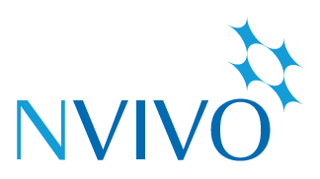
Methods & Analysis
19 Interviews
NVivo coding program
Economy, environment, pollution, Invasive Species, etc.
Commonalities within each basin
Commonalities between the basins
Notes:
Just as Cassidy has said, we determined that the best way to go about educating ourselves of the issues surrounding climate change in these river basins was to get in contact with the people who interact with our river resources on a day to day basis.
While Alex was conducting interviews in the Mekong River Basin, the rest of us interacted with stakeholders here in the Columbia River Basin. Together, we did nineteen total interviews-- 13 in the Columbia, and 6 in the Mekong-- from January through March. To ensure our analysis of interview data was rigorous and generalizable, we uploaded all of our interview responses into NVivo. NVivo is a qualitative software program that allowed us to break down our data in order to detect themes across stakeholder interviews from both river basins.
With NVivo, we were able to develop coding nodes to highlight, compare, and contrast themes, such as economy, environment, and pollution. We used these nodes to analyze commonalities and variances both within and across basins. This word cloud is just one example of how we were able to bring our data to life through NVivo – the size of the word represents the amount of times a statement or word was used by interviewees, informing us about what is really happening on the ground. For the sake of time, today our group will just report the top three themes from across the basins. First, I will guide you through the themes that played out within the Columbia river basin interviews; Brandon will then tell us about the Mekong river basin themes, and later Thiago will delve deeper into the commonalities across both basins.
BE MORE INTERACTIVE with words and pointing to photos

Slide 6
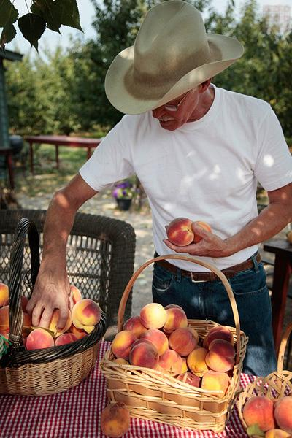
On the Home Front: Interviews in the Columbia River Basin
Thirteen Interviews
Montana
Professors, Tribal members, farmers, businessmen
Findings included...
Notes:
I’m going to start with our findings from the Columbia River Basin. Again, we did 13 interviews which ranged from professors, tribal members, farmers, to businenssmen. The major themes from our Columbia River Basin findings included policy; economy; and environment and ecosystems.

Slide 7
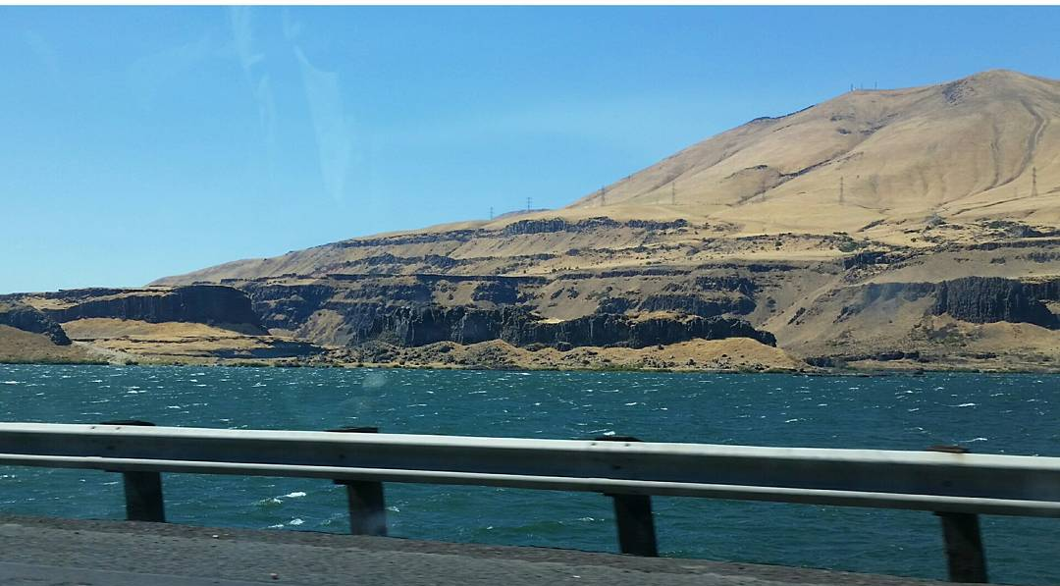
Policy &
Collaborative Management
“I want to see more use of environmentally friendly pesticides. Pesticides and fertilizers get in the water and we all depend on clean, good quality water. I want to see the USDA and EPA have more strict regulations.”
Notes:
our first theme was an emphasis on policy and collaborative management. As this quote indicates, stakeholders are concerned about the lack of regulations for pesticides, development, and best practices for water management.
Our second theme is

Slide 8
Economy
Notes:
economy, which takes place on the ground for our stakeholders in the form of agriculture, hydropower, recreation and tourism. The common thread across these topics? Clean and plentiful water.
One of the main economic drivers for this region is the flathead cherries. because of changes in precipitation and temperature, these and other crops are ripening earlier. Such changes have also made way for a more intense and catastrophic fire regime. All of these results of climate change heavily impact the costs of production and management of lands in Western Montana and beyond.

Slide 9
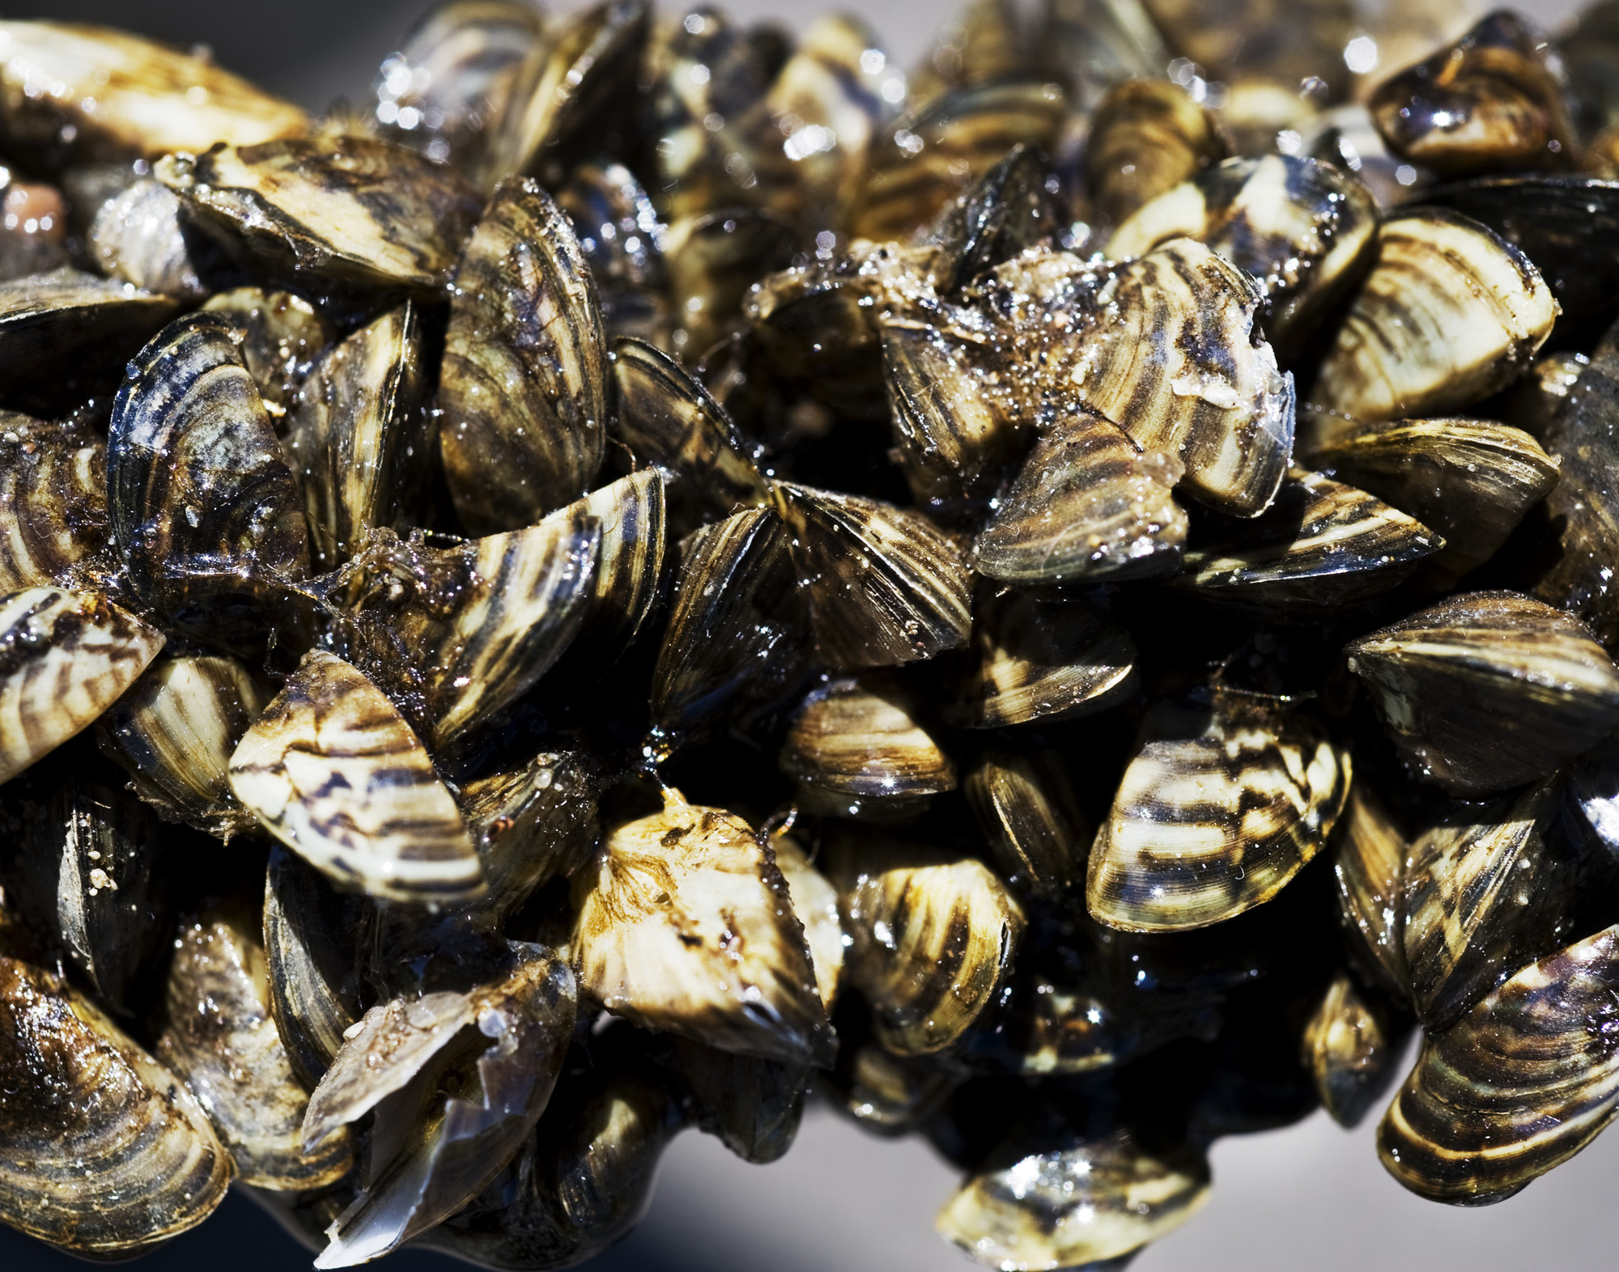
Environmental & Ecologic
Notes:
Finally, the most frequently occurring theme within the Columbia River Basin interviews is “Environmental and Ecologic.” This includes all of the afformentioned issues, both as protections for wildlife and natural processes, as well as the benefits and ecological services they provide for all of the people who call this basin home. Most often, this theme included the destruction of water quality through land use and development. There is also worry over invasive species and, combined with the effects of climate change, their capacity to alter native ecosystems. Pictured are the Zebra mussels, mentioned by a number of Columbia River Basin stakeholders. this species is constantly making their way closer to the region. As you will see, these themes aren’t so different than those in the Mekong River Basin, which Brandon will now share with you.
The third and final theme for the Columbia RB is environmental and ecologic. We’ve already talked a lot about the environmental impacts, but

Slide 10
Deep in the Delta: Interviews in the Mekong River Basin
Six interviews
Five Vietnamese Provinces
Rice, Fish, Shrimp, and Fruit Farmers
Findings included:
Notes:
Thanks Lauren, as said earlier our member Alex Braun, went to Vietnam this past winter break and conducted six interviews with the l people who rely on the Mekong River Basin as a food and income source. The interviewees consisted of a wide range of farmers such as rice, fish, shrimp and fruit farmers. Though they all have one common necessity for their everyday lives: the Mekong river.

Slide 11
Rice Farms & Profits
Notes:
One of the general sources of income for farmers in Vietnam are rice farms as shown in the photo above. Unfortunately dams are reducing freshwater input and the revitalizing soil rich in nutrients that was historically deposited by annual floods. Climate change is also worsening the effects of reduced freshwater inputs. The Mekong river is at a very low sea level, and this leading to increased saltwater moving up the channel of the Mekong River. High salinity levels in water used for agriculture are making rice paddies less profitable. Forcing farmers to change their agricultural practices and shift to part-time shrimp farming.

Slide 12
Water Contamination
Notes:
Though farmers aren’t catching a break with shrimp farms along the Mekong Basin as they are also being affected by climate change. Along with the rise in diseases in shrimp and fish due to contaminated waters. More intense agricultural activity and population growth have made the river more contaminated, particularly along the estuaries. There are minimal waste removal services or infrastructure in the Mekong basin and most domestic trash is burned or dumped into waterways. Not only are waterways being affected by water waste and climate change but so are the crops and fruits surrounding the Mekong basin. Making farmers to adapt to new farming practices along the basin.

Slide 13
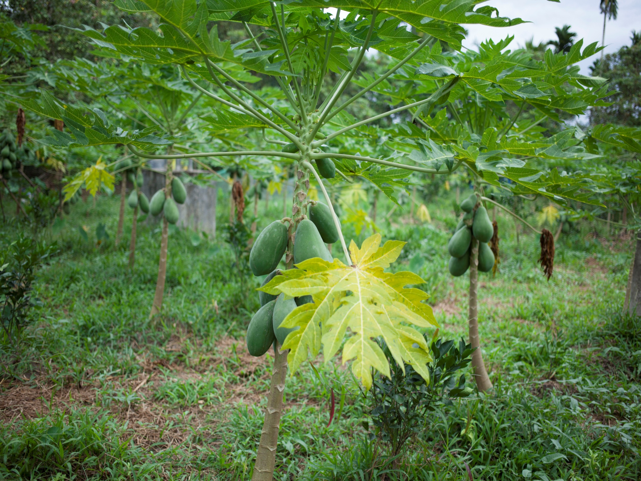
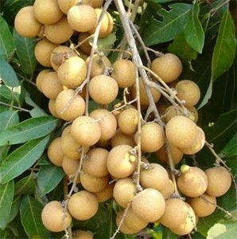
Struggling Agriculture
Notes:
For example here we have a papaya tree flourishing in the changing weather patterns in Vietnam. While papaya is thriving, fruits like longan showed in the photo above are failing to flower. Rising temperatures due to climate change are causing more batches of diseased fruit leading to a loss in profits for farmers. There is also an increasing fear of pesticides and degrading water quality within the Mekong river . As you can see Lauren and I have now discussed the different and similar challenges the Mekong and Columbia basin face from the cause of climate change. Now Thiago will talk about the overlapping commonalities between the Mekong and Columbia river.

Slide 14
Commonalities
Climate Change
Water Resources
Adaptation to Changes
Notes:
Thanks Brandon. The top three recurring themes across both CRB and MRB were climate change, water resources, and adaptations to change. We found that these themes are very interconnected to one another.
The climate change theme plays a very different, yet omnipresent role in these two watersheds; one in the form of rapidly encroaching sea-levels and salination of freshwater sources, the other with vastly different harvest dates and snowpacks. Both have already begun to seriously impact the work of farmers and have brought attention to adaptive, solutions-based resource management plans. In conjunction with adaptations to climate change across farming practices, our interviews indicated that all stakeholders who mentioned climate change are also concerned about pollution, most often in the form of chemical pesticides, and the impact that human developments– such as housing or wastewater– have on the health of our waters.
The word cloud here symbolizes the top thirty most often used words for both CRB and MRB interviews combined. This may seem like a simply fun representation of our findings, but take a moment to consider what you see here. Our analysis revealed that these words are vital to these stakeholder’s stories and their livelihoods.

Slide 15
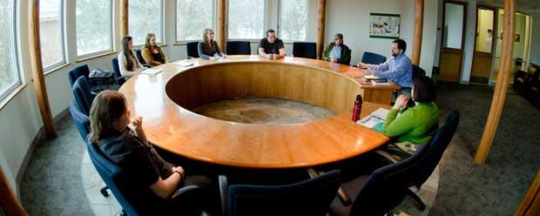
Recommendations
Roundtable Discussion
Local Action
Incentives
3. Education
Story map
http://arcg.is/2lFLdu5
Notes:
To address these challenges, we have developed three main suggested solutions to be executed on local levels with the understanding that local action is a laboratory for larger scale action and that these actions will have a global impact when implemented by many localities. First, I will elaborate on the ideas of having a roundtable discussion and creating incentive for implementing local action, then Hannah will talk more about education of the public.
First, the roundtable discussion. As our research developed, an interest in mitigation for climate change through changes in water policy grew. This helped us formulate questions we could pose to stakeholders interested in participating in a roundtable discussion regarding watershed policy and management. For example, two themes that were of major importance to professors were the recommendations to begin better incorporating groundwater management and instream flow rights for environmental and fisheries protections with our existing water policy and land development measures. The latter was also important to many members of the Confederated Salish-Kootenai Tribes within the Flathead Valley. By having a roundtable discussion we could let stakeholders discuss their main values and objectives and manage the basin more effectively.
Another option are local grassroots actions. The vietnamese government, for example, pays a monthly stipend to farmers who monitor and maintain mangroves on their properties. This sort of model where an economic incentive is offered in exchange for local actions, can greatly benefit the environment by expanding the net of people taking action. The combined effort of multiple local actions could act as a climate buffer and greatly increase the effectiveness of water management.
and now Hannah will address education.

Slide 16
Conclusion
Water is a powerful resource.
We can use education to bring communities together to protect our waters and adapt to our changing climate.
How is our ESRI story map being used now?
Notes:
Thanks Thiago. It is crucial to get people thinking about the importance of water. To do so we created our 3rd solution, the ESRI story map, which is a visual display of the Colombia and Mekong River Basins which you can see in the bottom photo. Our story map also offers information about both of the basins and some solutions to problems in both waterways.
After finishing our ESRI story map we sent them to our interviewees and got feedback on how they plan to implement the story map in the classroom. University of Montana Professor says “I would likely use this to get students thinking about the comparative aspects of the two river systems and also ask them to analyze how indigenous peoples and tribes may be impacted by climate change in ways different from other groups and what legal rights those peoples may be able to exercise to address those impacts.“ In Vietnam, our collaborator Jen presented our ESRI story map to in class to Can Tho University students.
In conclusion, we have three viable solutions, but we believe that the most viable world-wide is our ESRI story map. Our story map is already being used in classrooms here and in Vietnam. , We ultimately think that education is a powerful tool. It is an essential starting point for bringing communities together from around the world to improve water management.
In our changing political climate it is more important now then ever to educate fellow citizens and to work together to address our changing climate and protect our waters. Water is undeniably a resource that we cannot live without.

Slide 17
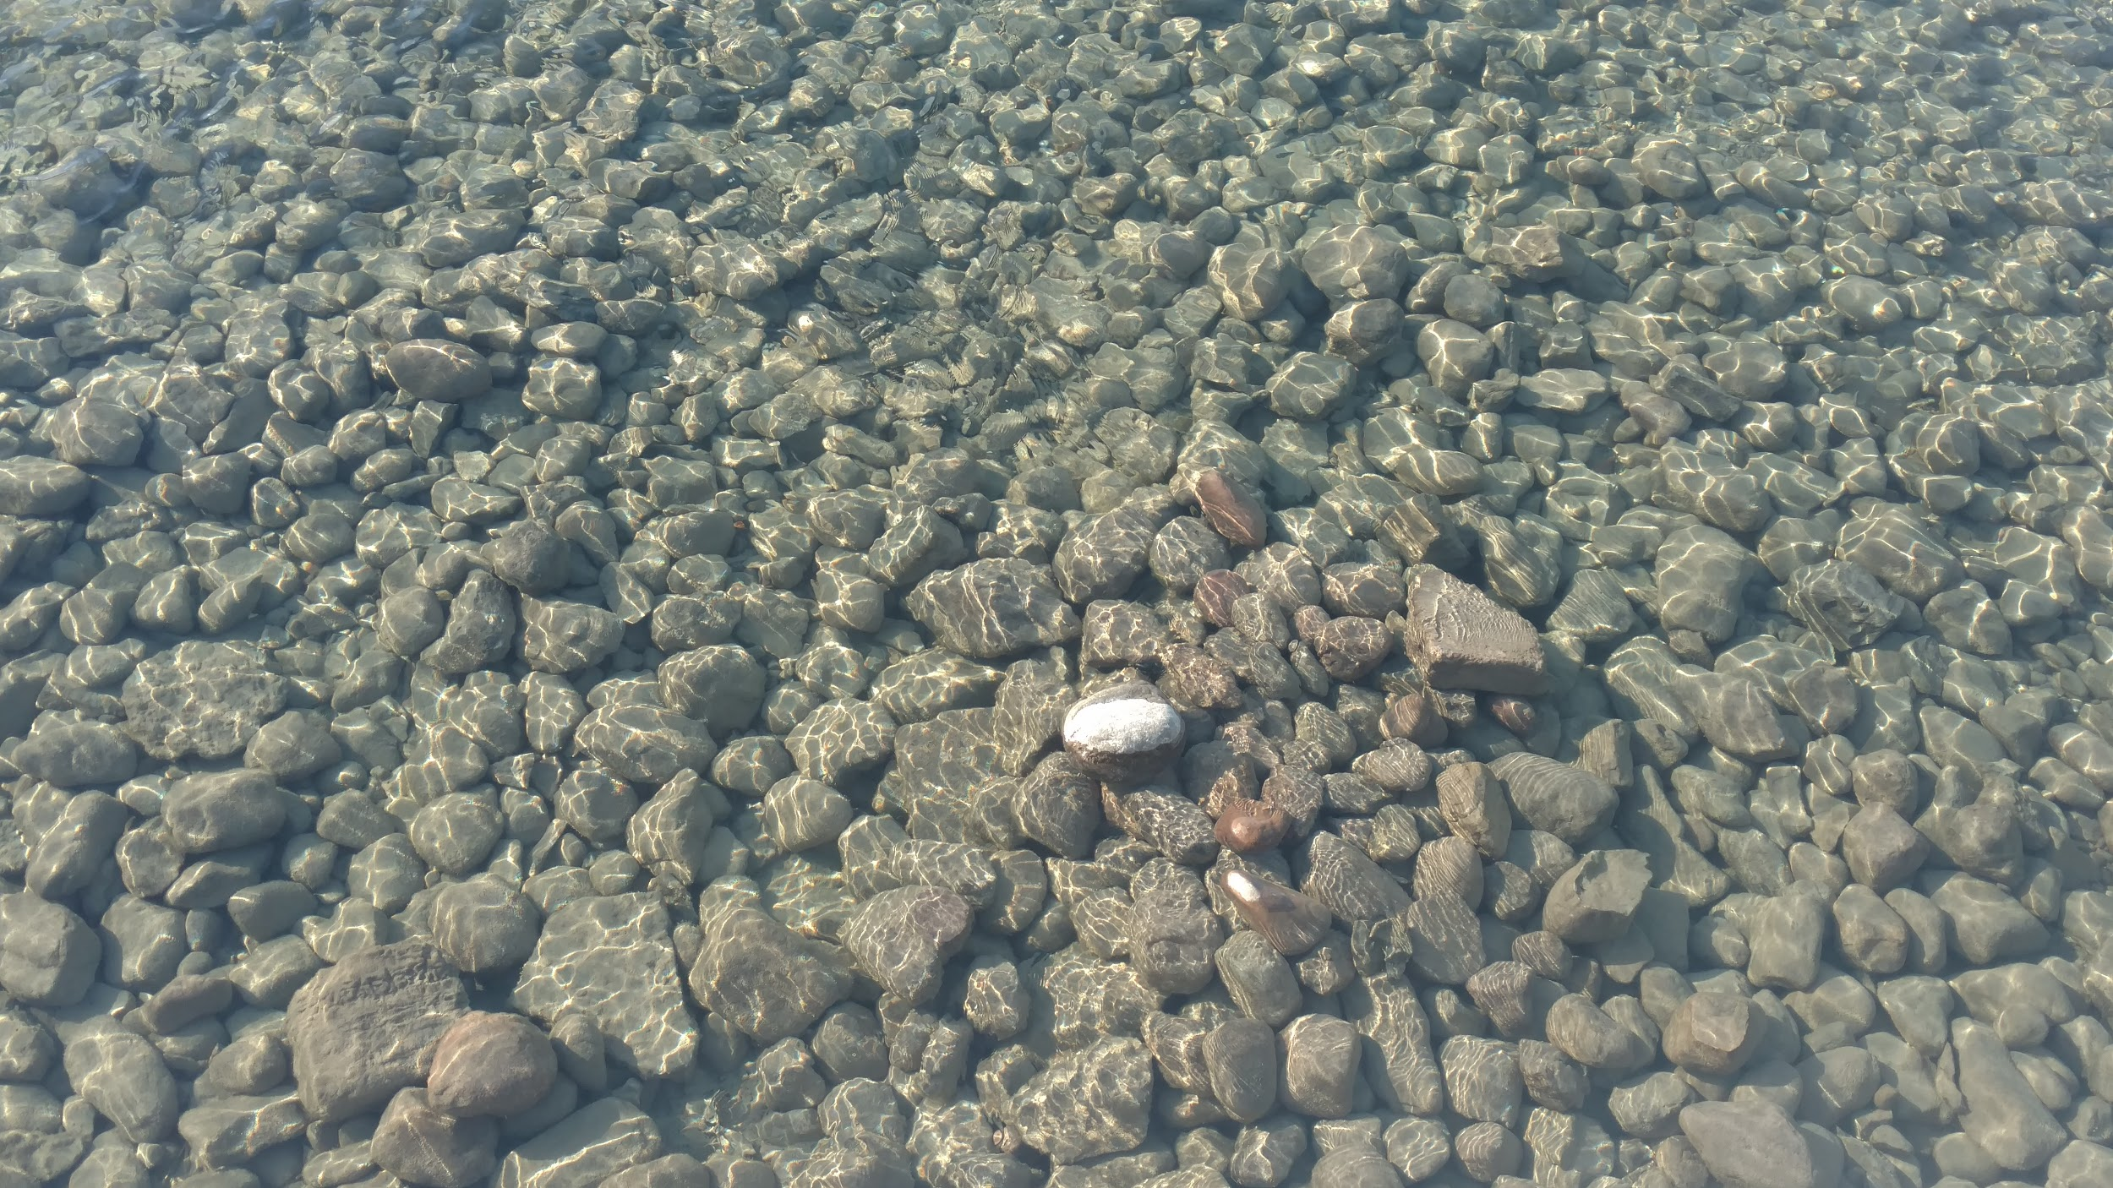
Questions?

