Slide 1
A Generation of Katnisses
The New Power of Female Protagonists in Young Adult Dystopian Literature
By: McKenzie Watterson
Notes:
Introduction screen
My thesis

Slide 2
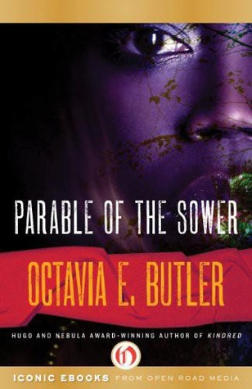
Katniss Everdeen
Tris Prior
Lauren Olamina
Notes:
How I chose the books

Slide 3
Recipe for a Katniss:
Dystopia
Position in Society
Feminist Ethics

Slide 4
Dystopia:
“An imagined place or state in which everything is unpleasant or bad, typically a totalitarian or environmentally degraded one”
Opposite of Utopia
Katniss
Lauren
Notes:
From Oxford living dictionary
Understanding what is wrong in these societies is key to recognizing how characters operate within them.

Slide 5
Recipe for a Katniss:
✔
Dystopia
Position in Society
Feminist Ethics

Slide 6
Societal Outsiders, Community Insiders
Katniss
Rejects Panem’s rules
Hunting
Manipulation of Panem’s expectations
Lauren
Survivalist
Earthseed
“God is Change”
“God exists to be shaped”
Notes:
Dystopias are failing by definition! Protagonists’ full participation in the dystopias would indicate stagnancy, if not failure.
Agency because they operate outside flawed society without alienating themselves from their communities!
Katniss, Hunting = feed community, benefit in games
Literally does not fit into one faction, but many
Imagines the world more complexly = rejection of faction’s rigid world
Earthseed= fundemental belief in one’s agency
Prepares for tumbling wal

Slide 7
Recipe for a Katniss:
✔
Dystopia
✔
Societal Outsiders, Community Insiders
Position in Society
Feminist Ethics
Notes:
We know more about this now, we can be more specfic

Slide 8
Traditional Ethics Devalue Women
Value:
Independence
Autonomy
Hierarchy
Rules
Domination
Devalue:
Interdependence
Relationships
Community
Connection
Partiality
Moral issues of the private realm.
**Stereotypically masculine attributes**
**Stereotypically feminine attributes**
Traditional Ethics
Notes:
*****Western Ethics******

Slide 9
Feminist Ethics:
Stanford Encyclopedia of Philosophy:
Feminist ethics are “an attempt to revise, reformulate, or rethink traditional ethics to the extent it depreciates or devalues women's moral experience.”
Response to the failings of traditional ethics
“aim to eliminate or at least ameliorate the oppression of any group of people”
Traditional Ethics
Feminist Ethics
Reaction
Notes:
Feminist ethics best serve to understand our protagonists because they are all women who are oppressed in some way

Slide 10
NO need to choose
Carol Gilligan:
“women […] can speak the moral language of justice and rights nearly as fluently as the moral language of care and responsibilities”
Lawrence Blum
Traditional Ethical Value: protect one’s children
Feminist Ethics of Care: allows for the care necessary to do so
Traditional Ethics
Feminist Ethics
Notes:
Traditional Ethics laud universality and absolute truth, can’t incorporate other systems.
Feminist ethics has room because of its more open, fluid foundation

Slide 11
Care-Focused Feminist ethics
Carol Gilligan and Nell Noddings:
Question the notion that “universal, abstract, impartial, and rational knowledge” is necessarily closest to reality.
Instead, suggest, “that the more connected the self is to others, the better the self is.”
Traditional Ethics
Feminist Ethics
Care-Focused Feminist Ethics
Notes:
In contrast with traditional ethics, feminist ethics of care values connection and the power of emotional relationships.

Slide 12
Gilligan’s Three Levels of Morality
Level 1: “women overemphasize the interests of their selves.”
Level 2: “women overemphasize others' interests.”
Level 3: “women weave their own interests together with those of others.”
Traditional Ethics
Feminist Ethics
Care-Focused Feminist Ethics
Gilligan’s Levels
Notes:
One way to evaluate someone’s adhesion to FEC
“this makes sense to us”

Slide 13
Feminist Ethics of Care
Katniss
Prim
Rue
Her caring actions spark rebellious communities
Notes:
Her actions create rebellious communities
Prim- makes her most popular for HG
Rue- Alliances within hunger games
Thresh
-rebellious unity in Panem

Slide 14
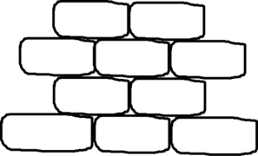
Feminist Ethics of Care
Lauren
Care on the Road
In a world fueled by self interest, where communities are crumbling, she creates a strong, caring community because of her feminist ethics.
Notes:
Her actions create rebellious communities
Prim- makes her most popular for HG
Rue- Alliances within hunger games
Thresh
-rebellious unity in Panem

Slide 15
Recipe for a Katniss:
✔
Dystopia
✔
Societal Outsiders, Community Insiders
Feminist Ethics
✔
Level Three Care Warriors
*
Notes:
Powerful not because they climb society’s ladder, but because they invent a whole new path, bringing others with them as they rise. This is the recipe for the newly powerful female dystopian protagonist, and she is revolutionary.

Slide 16
Thank you
Erin Saldin
Dean Tessman
UMCUR Organizers
Davidson Honors College at the University of Montana: Robin Parent and Karen Kaley
And you- the people who are also excited about this work!

Slide 17
Sources
Butler, Octavia. Parable of the Sower. New York, NY: Warner Books, 1993. Print.
Collins, Suzanne. The Hunger Games. New York: Scholastic, 2008. Print.
Roth, Veronica. Divergent. New York: Katherine Tegen Books (Harper Collins Imprint), 2011.
Tong, Rosemarie and Williams, Nancy, "Feminist Ethics", The Stanford Encyclopedia of Philosophy (Winter 2016 Edition), Edward N. Zalta (ed.), URL = <https:// plato.stanford.edu/archives/win2016/entries/feminism-ethics/>.

