Slide 1
Analysis of Montana Snowpack
By: Ben Uhlenbruck

Slide 2
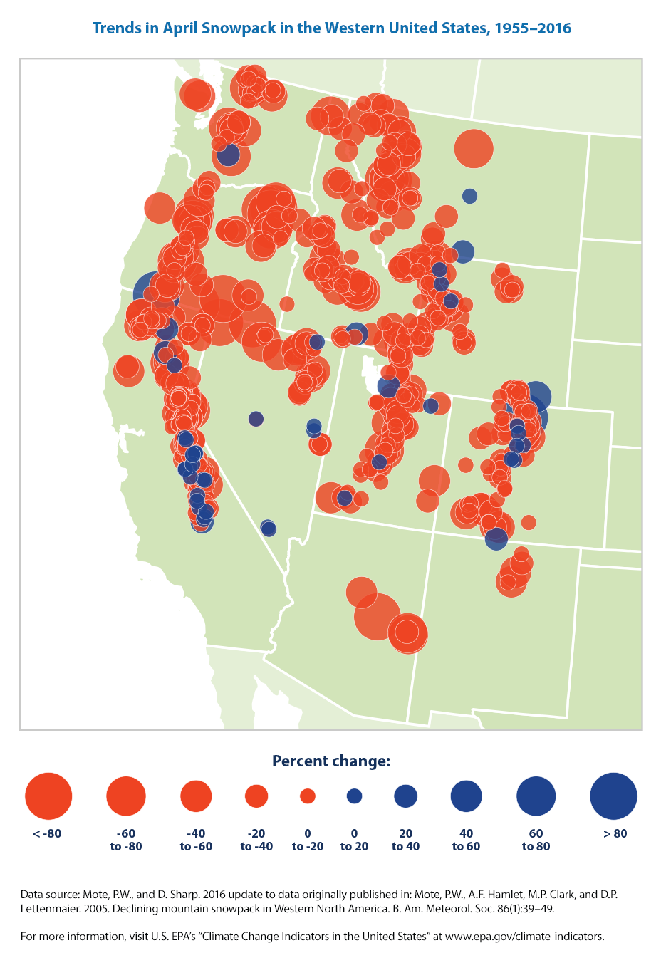
Introduction
Research done has found strong reductions in snowpack since 1950
Reductions in response to increased temperature in the Pacific Northwest
These studies focus broader than Montana, and are largely out of date
This map shows trends in April snowpack in the western United States, measured in terms of snow water equivalent. Blue circles represent increased snowpack; red circles represent a decrease.
Data source: Mote and Sharp, 2016²

Slide 3
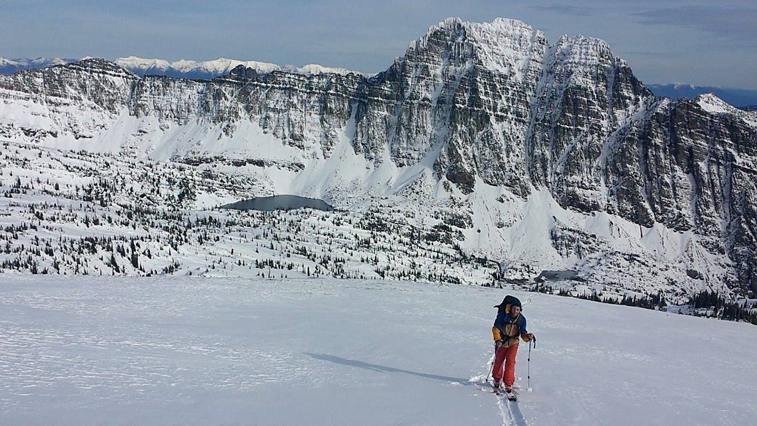
My Research
Motivation for research
Literature review
Acquire data
Learn to program with R
Analyze data using R
Write paper with findings

Slide 4
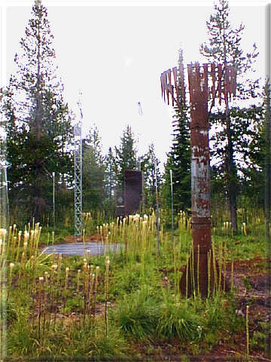
Terminology
Snow Water Equivalent (SWE)
Snow Course Data
SNOTEL (Snow Telemetry) Data
Stuart Mountain SNOTEL, 7,400’.
Photo courtesy of NRCS SNOTEL webpage.

Slide 5
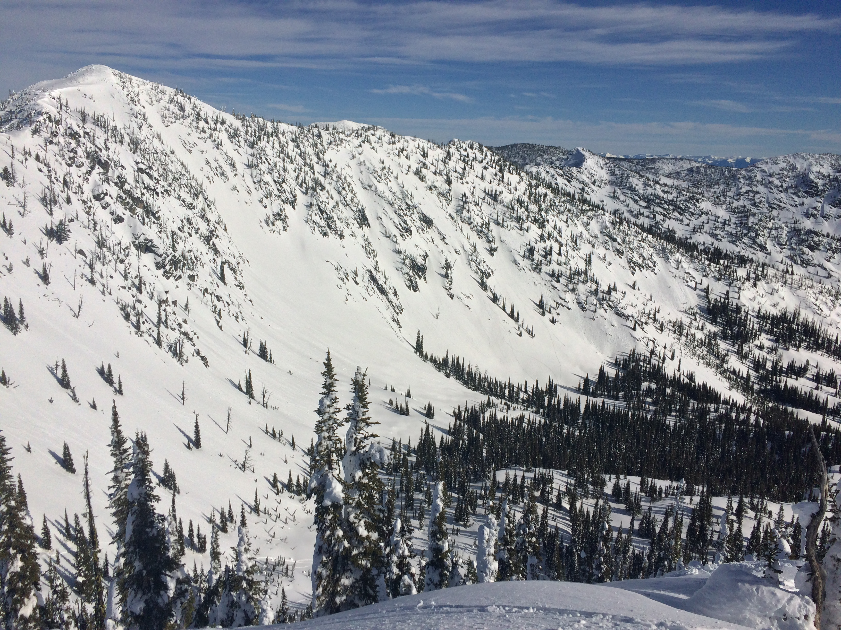
Previous Research
Major differences:
April 1st vs. maximum SWE
Data range (1980-2015)
Focus on Montana alone
My Research
Analysis of trends in SWE
Spatial comparison
Comparison with trends in precipitation and temperature.

Slide 6
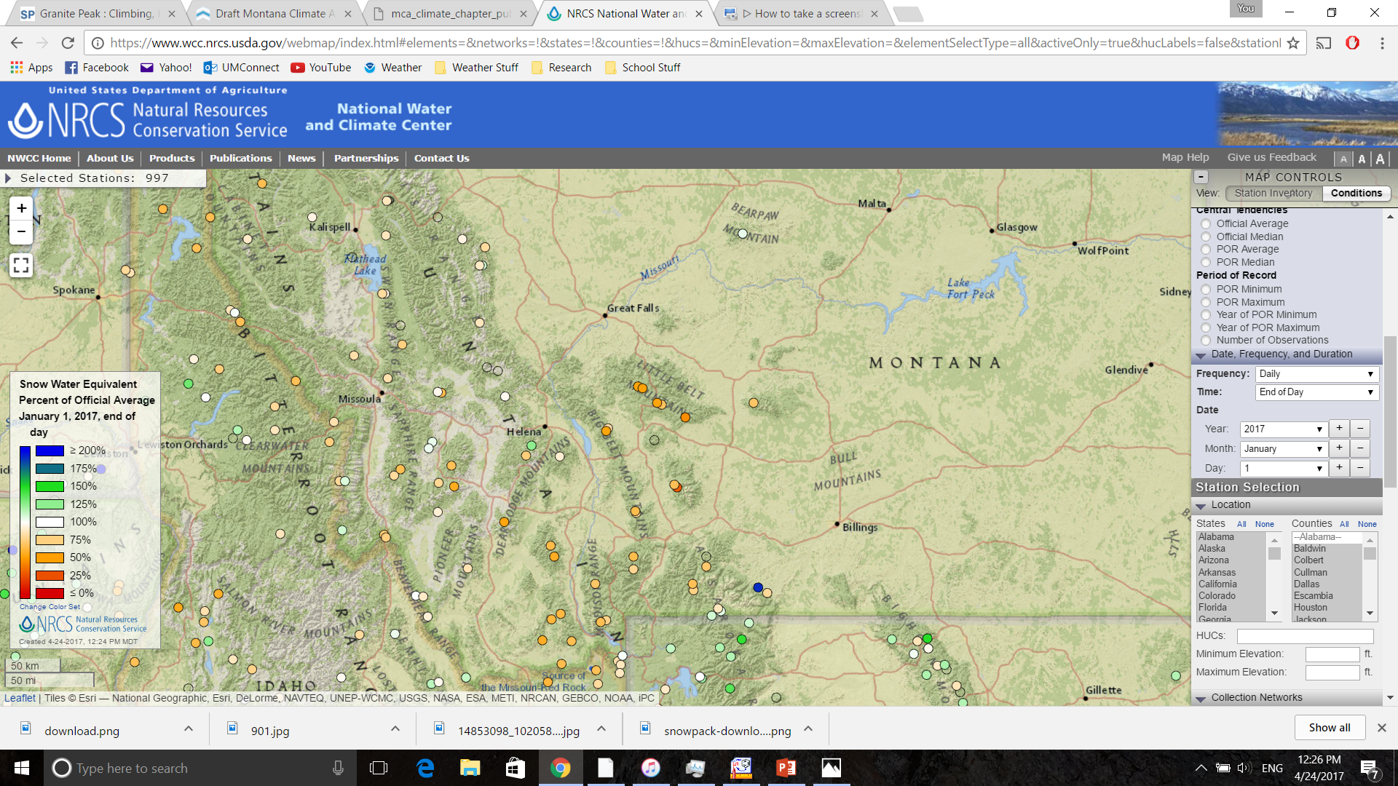
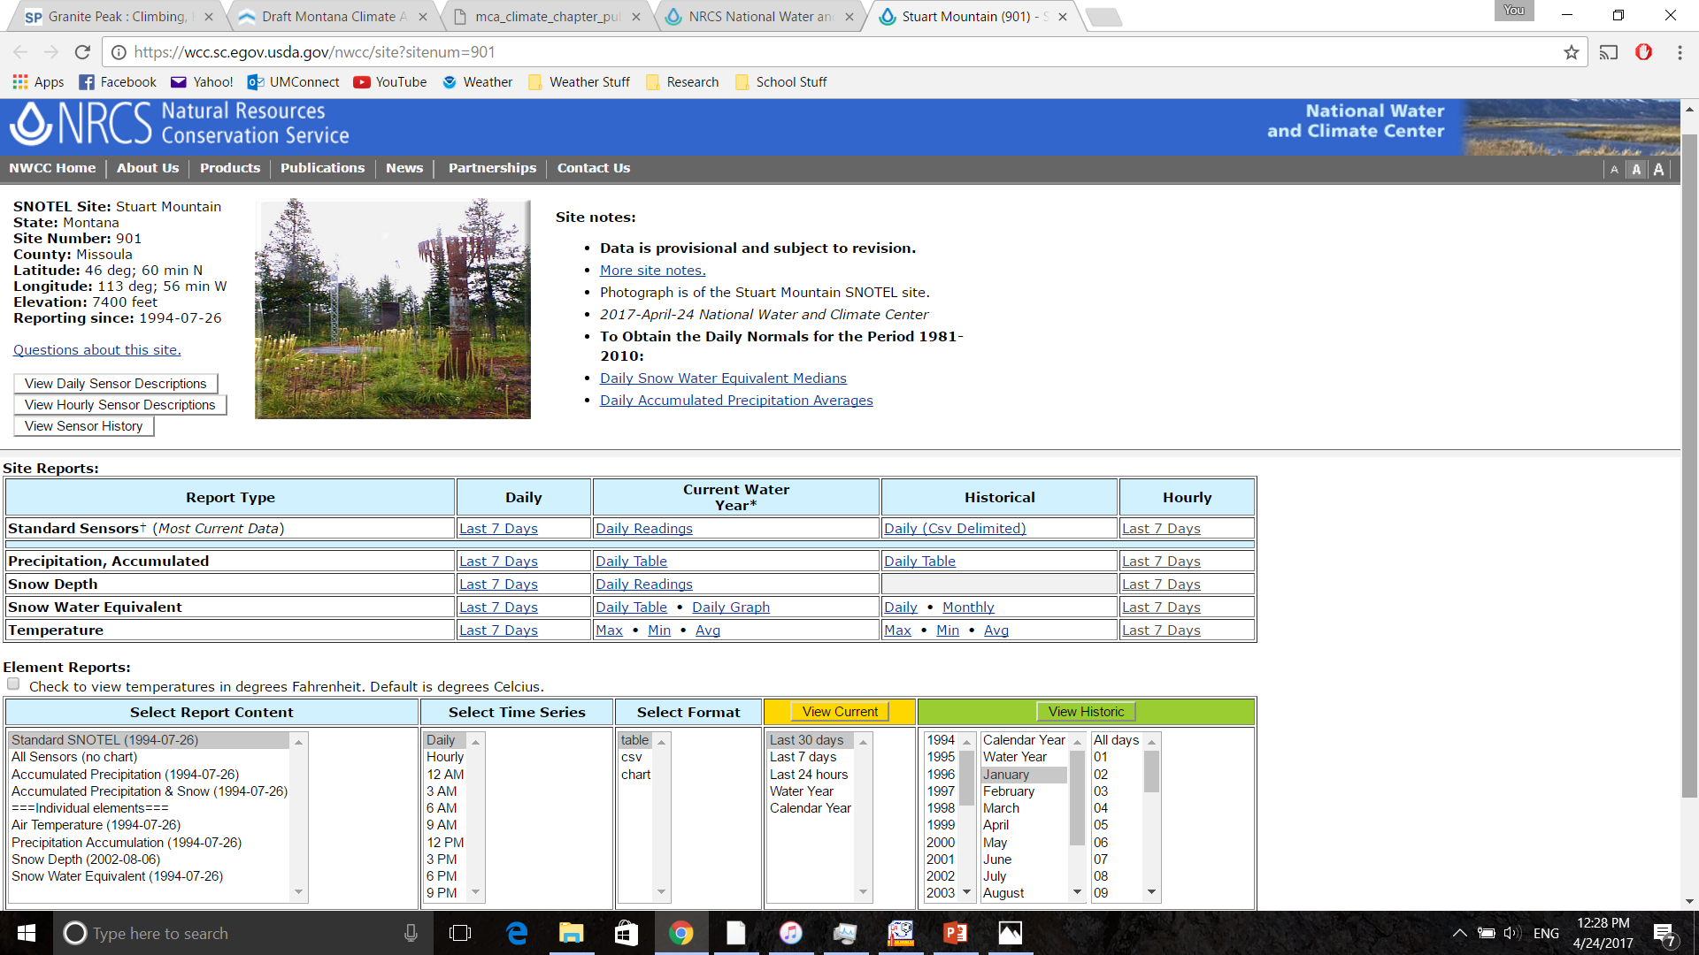
Data Acquisition
National Resource Conservation Service

Slide 7
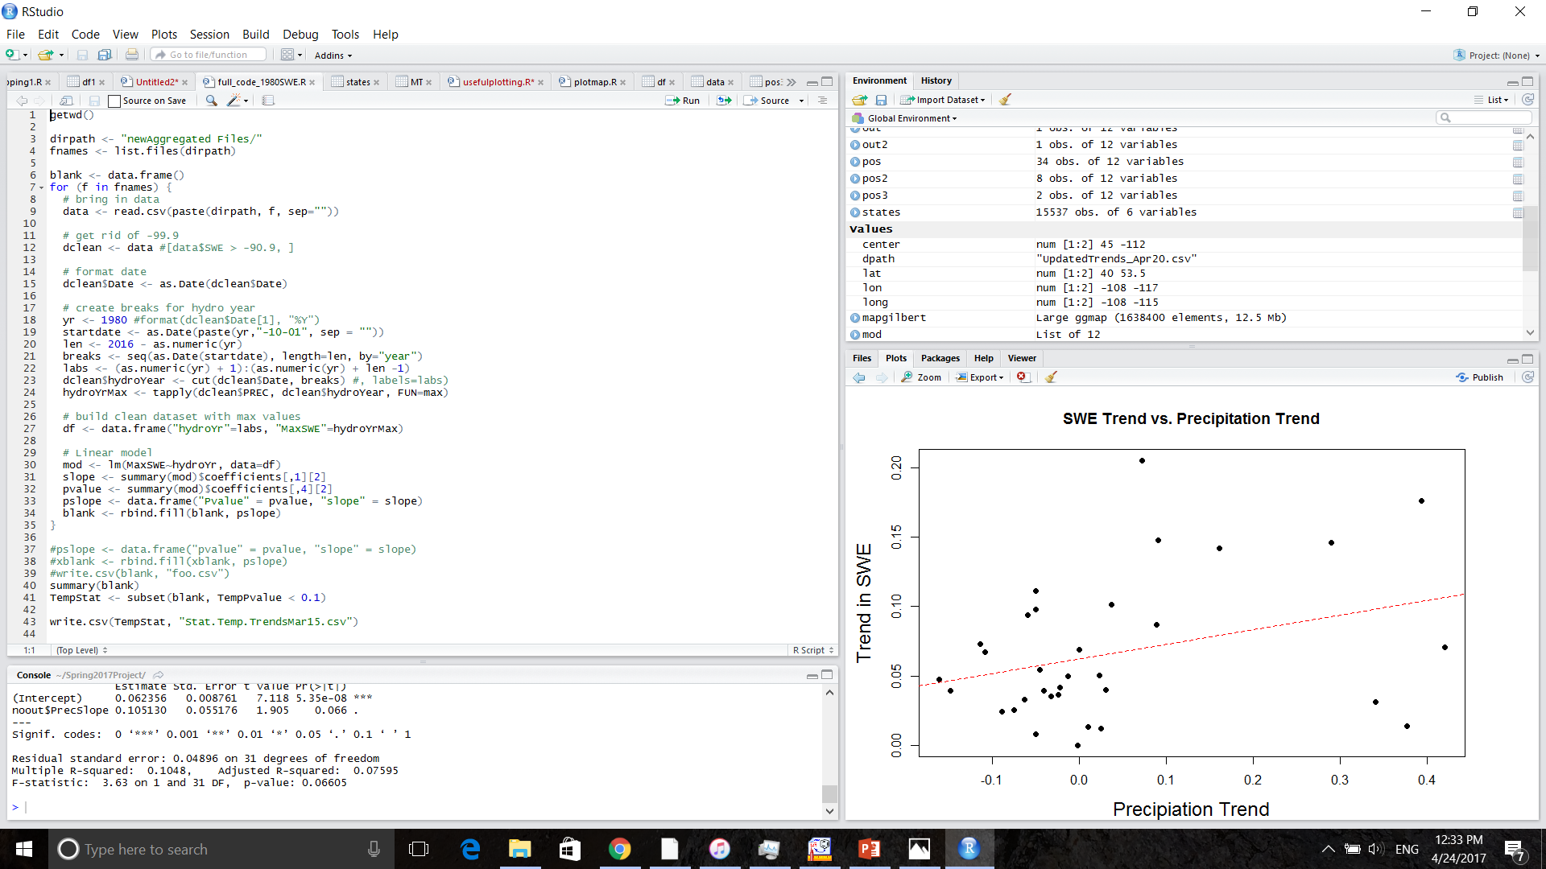
Coding
Analysis done using programming software R
Big thanks to Nick Silverman for helping me with code!

Slide 8
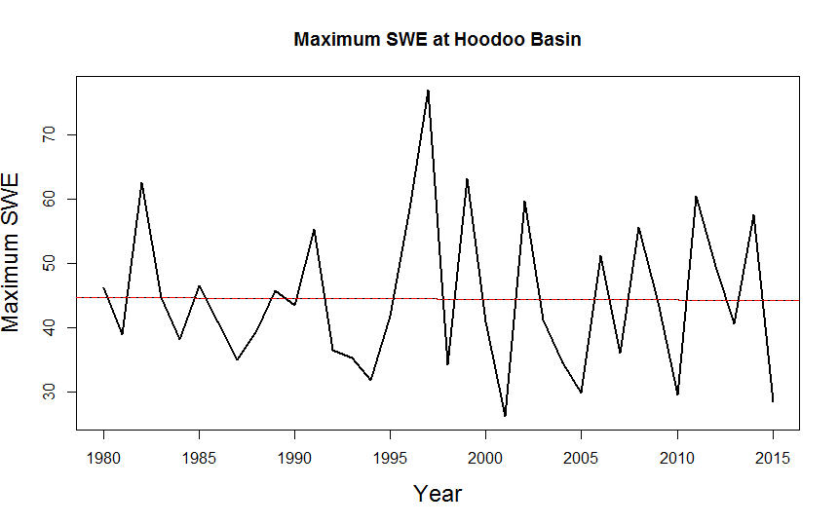
Findings – Typical Snow
Maximum values for SWE plotted against year for the period 1980-2015. Trend-line included.
Trend line slope = -0.015 in/yr, p-value = 0.939
SWE vs. Time for a typical snow year. In 2016, April 1st SWE at Hoodoo Basin was 90% of average.

Slide 9
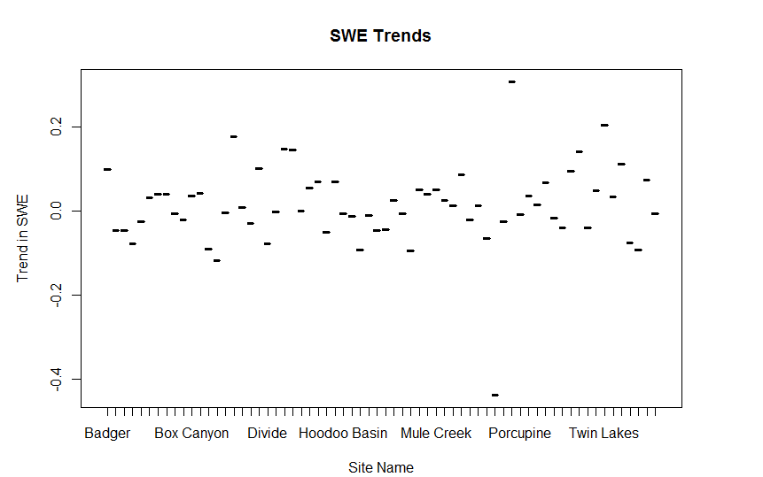
SWE Trends
66 Sites Analyzed
Average Trend = +0.011 inches/yr
Average P-Value = 0.54

Slide 10
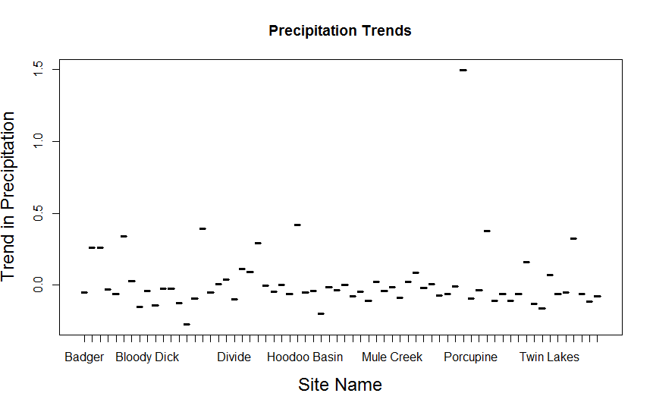
Precipitation Trends
Total accumulated Precip.
Average trend = +0.0239 in/yr
Median trend = -0.0386 in/yr
Average p-value = 0.49

Slide 11
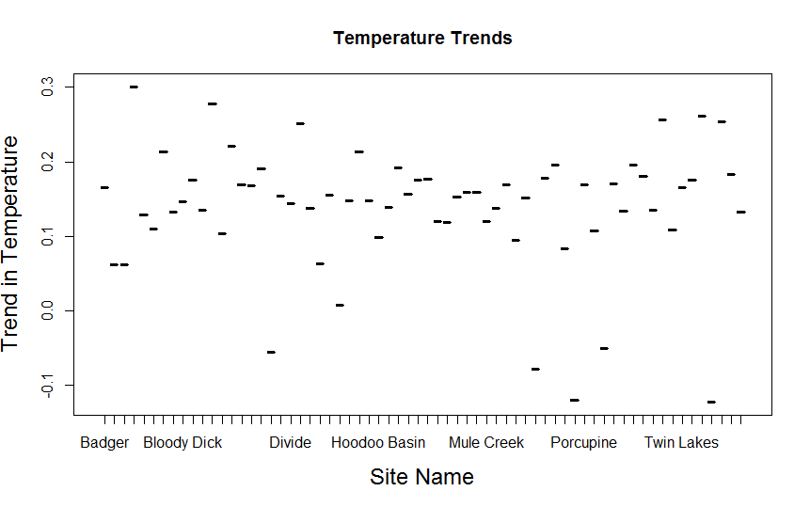
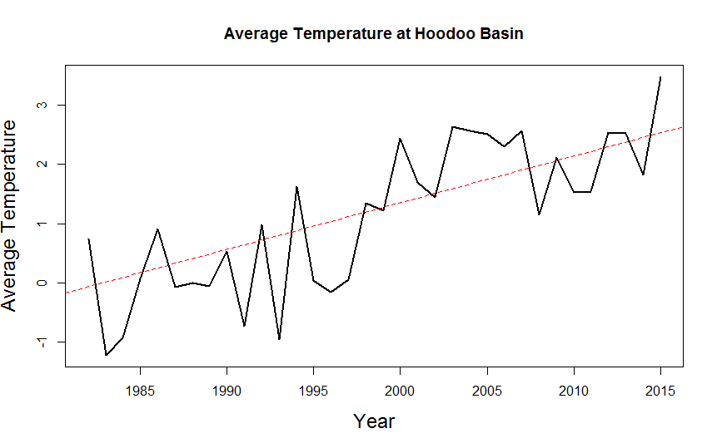
Temperature Trends
Average of temperature recorded at midnight over the entire year
Average trend = $+0.139 ℉/yr$
Average p-value = 0.049
Only 5 out of 66 sites had negative temperature trends.

Slide 12
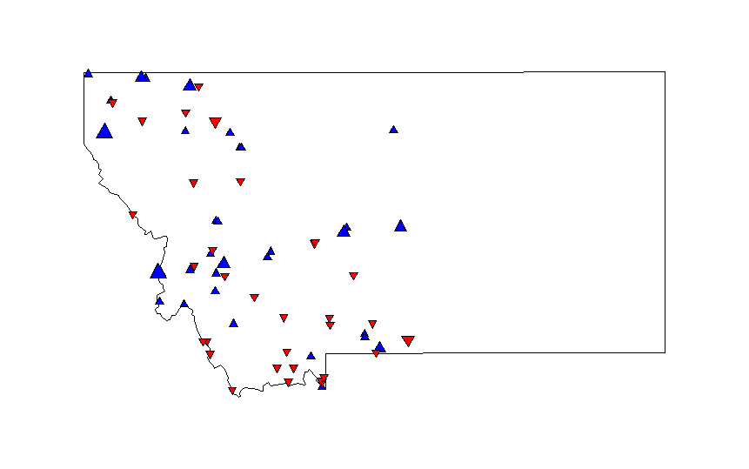
Spatial Trends
No obvious trends
Some concentration of reductions or increases
Gravelly/Beaverhead ranges
Bitterroot

Slide 13
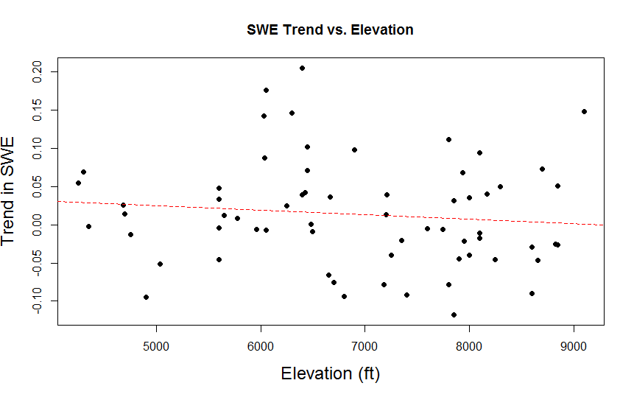
Elevation Trends
Small negative correlation
Slope = -0.5x10⁻³ $\frac{SWE (in.)}{1,000 ft ∙yr}$
P-value = 0.399

Slide 14
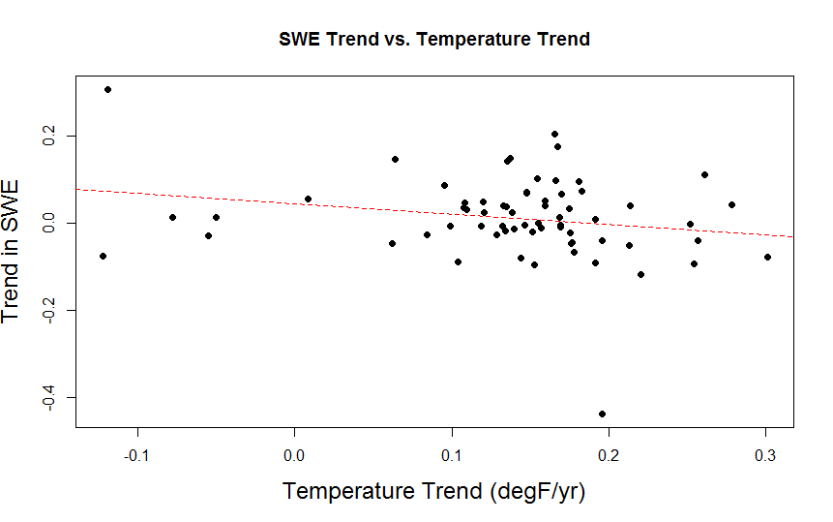
Temperature and SWE
Negative correlation: Sites that warmed the most had the greatest reductions in maximum SWE
Good trend: p-value = 0.097

Slide 15
Conclusions
No consistent trends in maximum SWE
This disagrees with the majority of literature surrounding Pacific Northwest snowpack
No obvious spatial or elevation correlation
Clear dependency on trends with temperature and precipitation

Slide 16
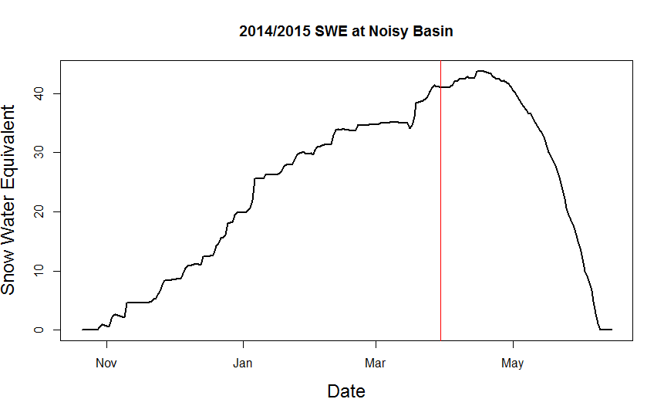
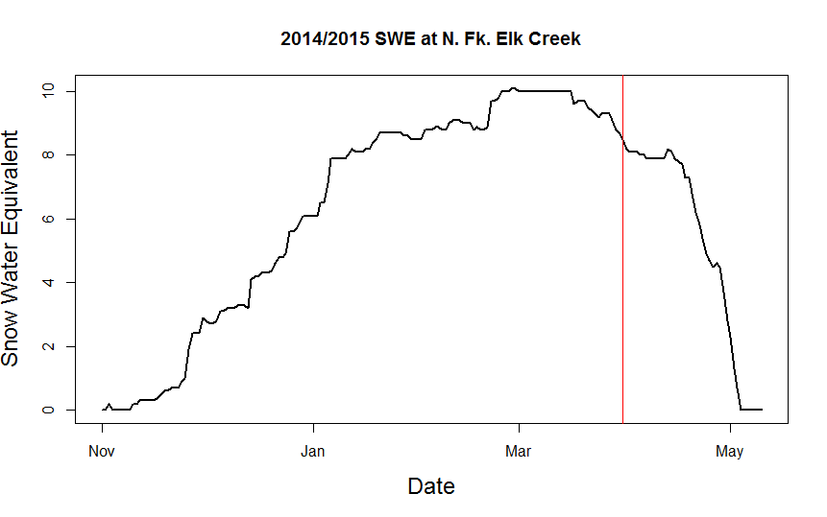
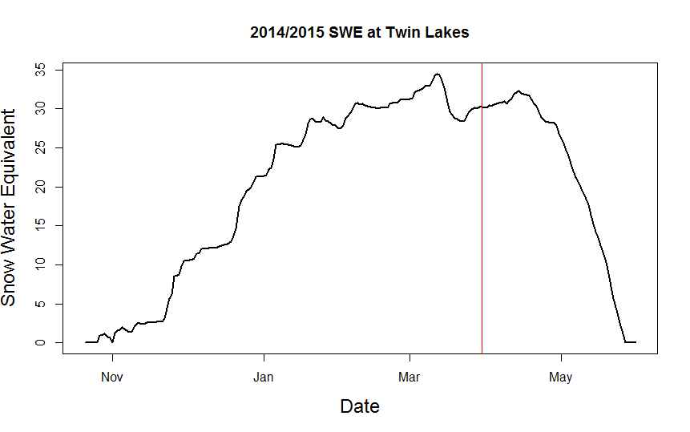
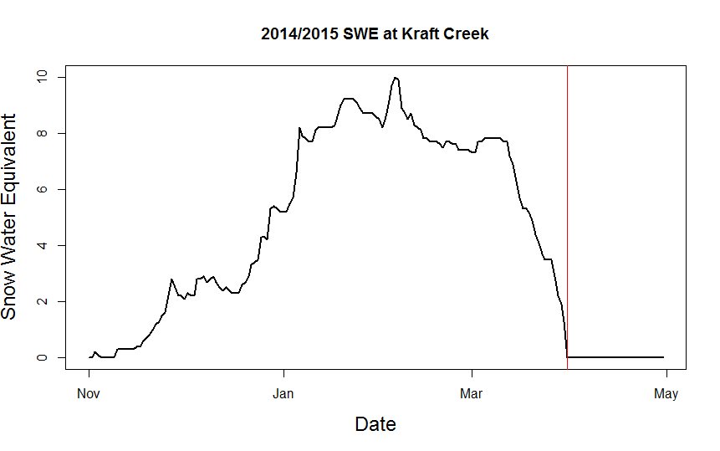
Why are my findings different?
April 1st vs. maximum
SWE more responsive to annual changes than temperature trend

