Slide 1
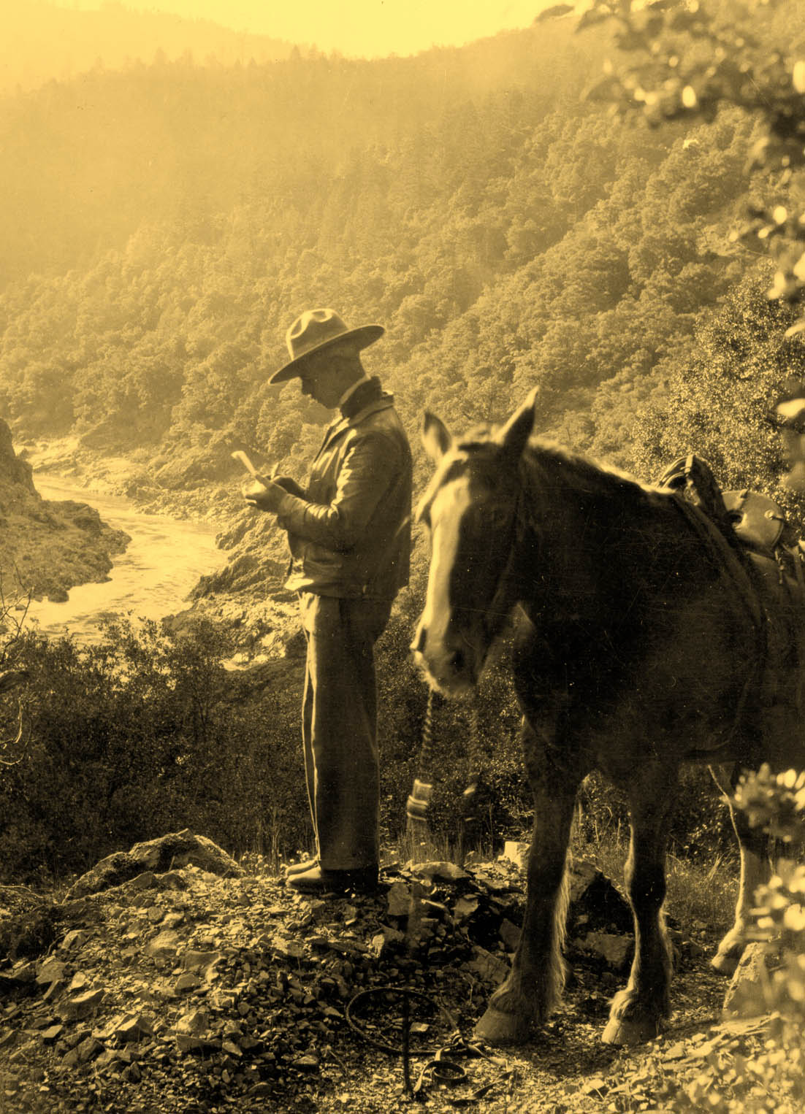
Defining an Agency: Animals, Fire, and the U.S. Forest Service
By Ellen Ipsen

Slide 2
My Argument
First 50 years of the USFS – the role of animals shifted from active fighting role to engaging prevention advertisement strategy
Mules, horses, pigeons, and bears increased efficiency and visibility of the Forest Service.
Animals defined the agency by increasing professionalization of USFS rangers, engaging the public, and augmenting respect
Helped create a lasting, reputable agency

Slide 3
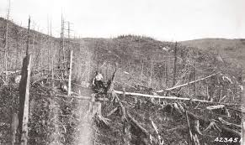
Establishing USFS
USFS created in 1905 - unprecedented expansion of federal power
“lawless” region
Loggers, miners, and farmers self-regulated natural resources

Slide 4
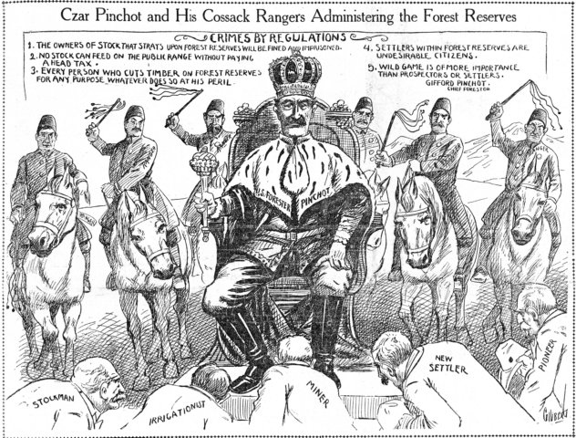
Early reception
Conservation = off-putting to some

Slide 5
Lack of Public Confidence
One early ranger described:
“In the Little North Fork, Marble Creek and Big Creek, we were extremely unpopular as rangers and had to use discretion and diplomacy. We never knew when a bullet might meet us in a thicket or on the trail.”
UDSA Forest Service

Slide 6
Forest Fires Affect Everyone
Fighting Fires Prior to USFS
No precedent for management of large forests
Disorganized & relied on volunteers
Wrap-up and scouting failures

Slide 7
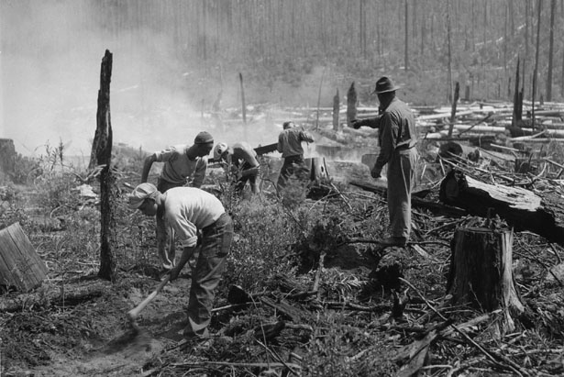
Rallying Issue
1910 Great Fire
Success and reliability needed

Slide 8
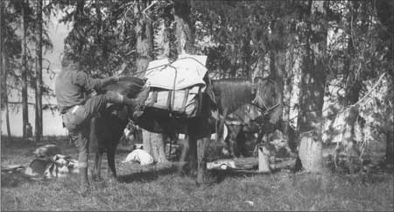
Animals Used to Fight Fires
Transportation, communication, scouting, fire-line
Alleviated manpower shortage
One horse and plow combo = 150 men
Rangers required to provide horse

Slide 9
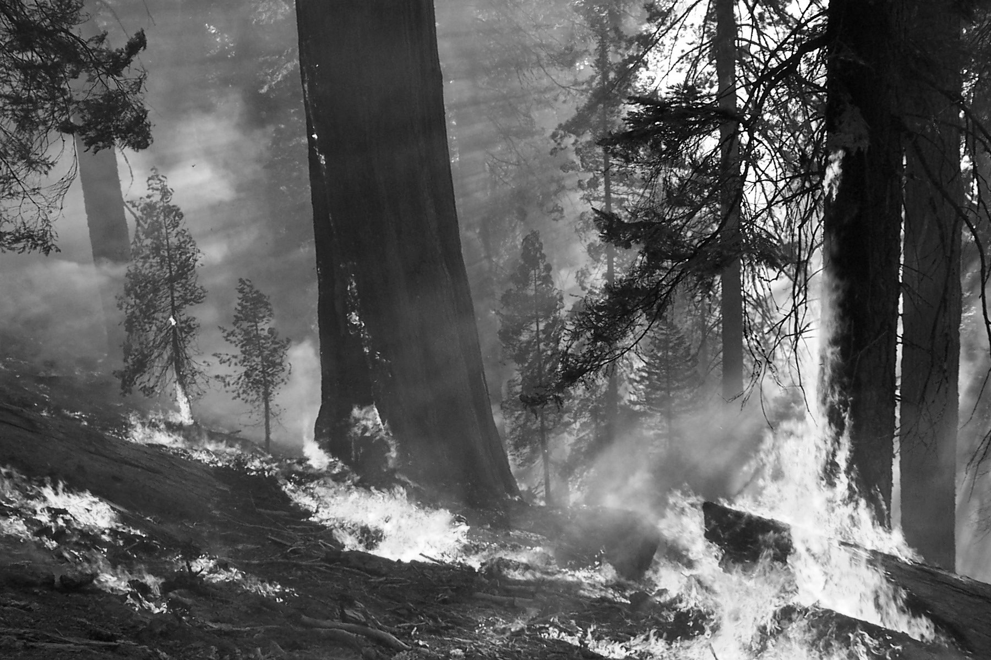
“For country of this degree of roughness, up to the present time, no power tool has been found which surpasses the horse and plow, or even competes with it.”
- Journal of Forestry, 1932

Slide 10
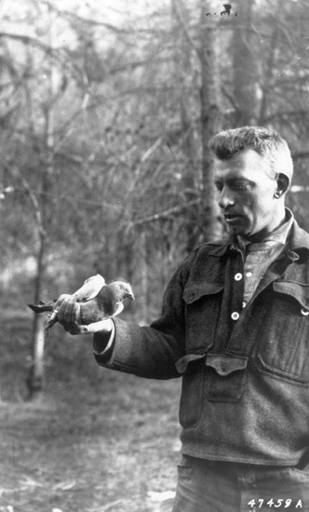
Animals fighting fires
Pigeons - WWI technology borrowed by USFS
USFS use started in 1919
Established coops throughout West

Slide 11
Timely Communication
1922 Forestry Kaimin - the carrier pigeon outpaced any other form of communication at the time
Could travel 150-200 miles in a few hours
Most USFS trips under 50 miles

Slide 12
Impact
Rangers with horses — uniformity and comfort to rangers
Companionship and confidence for rangers
Knowledge of horses and success in forest fires — public confidence

Slide 13
“…a ranger and his horse out in the deep grass and spends and hour lying on his back” -- The Youth’s Companion (1910)

Slide 14
Impact
Prior to 1905: estimated 30 million acres of forest burned every year.
Post-1905, reduced dramatically, eventually as low as 1.9 million acres per year.
Improvement duly noted by public - profession gaining respect

Slide 15
Transition - Technology
New technologies: crawler tractor, smoke jumping, radio, telephone
More roads and automobiles
Shift from animals as workforce, to individual animals advertised as a personality

Slide 16
Changed World View
World War II — protect natural resources
Animals in popular culture
True Life Adventures, photography
world more receptive to animal-based engagement

Slide 17
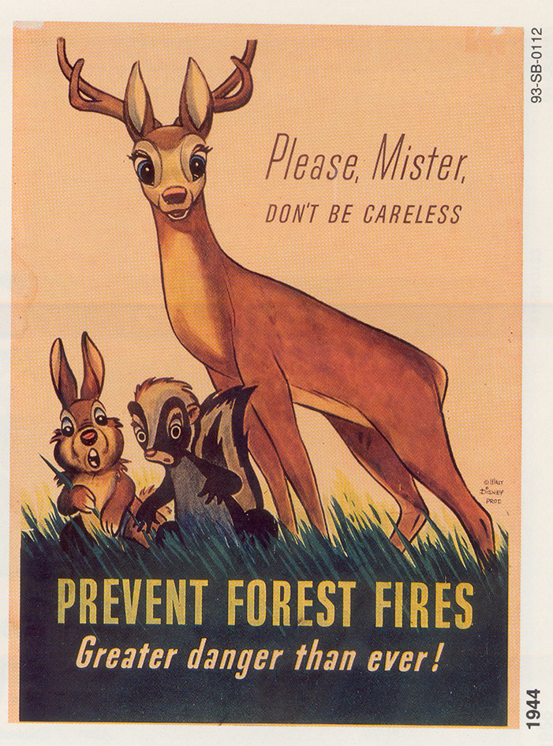
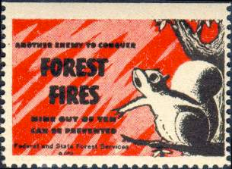
Early Engagement
Bambi leased to USFS
Animals evoke action
Children targeted

Slide 18
Smokey Bear
Advertising campaign launched in 1944 - placed emphasis on personal responsibility
Human attributes
Campaigns in most states, not just West
posters, window cards, bookmarks, blotters, radio programs

Slide 19
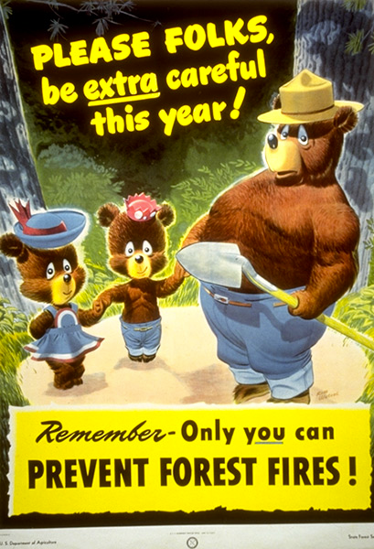
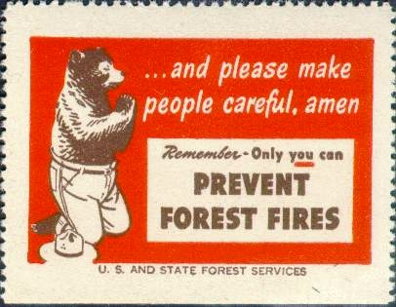

Slide 20
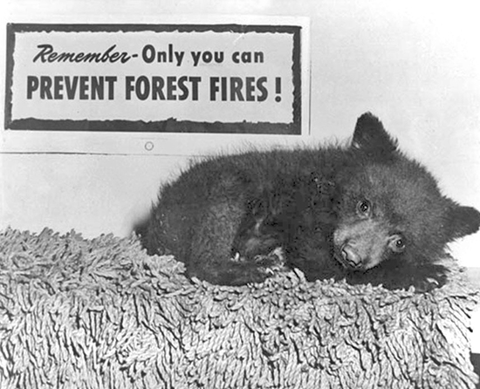
Propel to Success
Bear cub rescued – Captain Gun Fire 1950
Media heyday
Hotfoot Teddy → Smokey Bear
National Zoo’s most visited attraction
95% adult household recognition
Smokey II

Slide 21
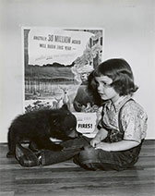
Smokey Bear 20252
Kid’s letters: “Dear Smokey: I think your story was awesome. I want to prevent forest fires. I am with you forest fires stink. I am so sorry that your mother past away. Some day I want to be like you. Reed.”
1000/day
Own zip code

Slide 22
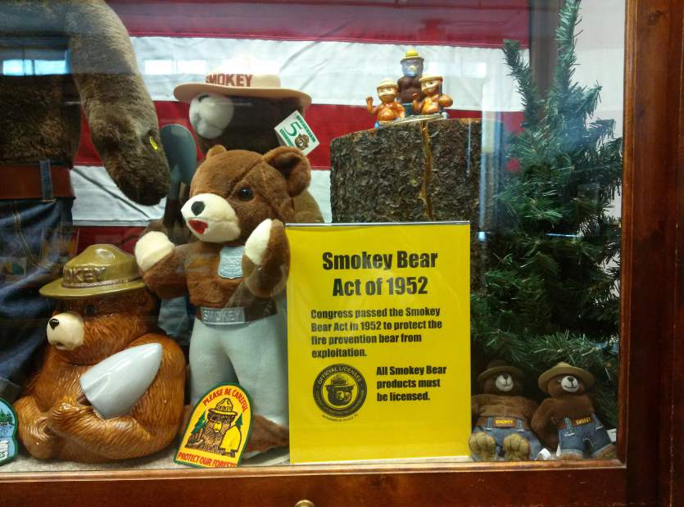
Smokey Bear Act of 1952
Act of Congress: Removed from public domain
Required license to use image of Smokey
Raised funds for forest fire prevention

Slide 23
Smokey’s Message
9 out of 10 human caused
Tobacco use, matches, campfires targeted
Junior Rangers program
Success example: forest fires were down 20,000 acres per year from the pre-war average in Arkansas

Slide 24
Impact
Fewer forest fires
Kid’s wanted to become foresters
Public awareness & engagement
Nationwide recognition and respect of USFS

Slide 25
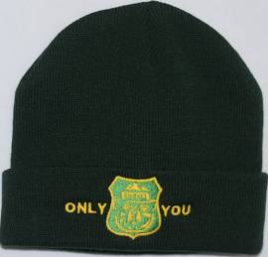
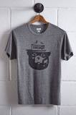
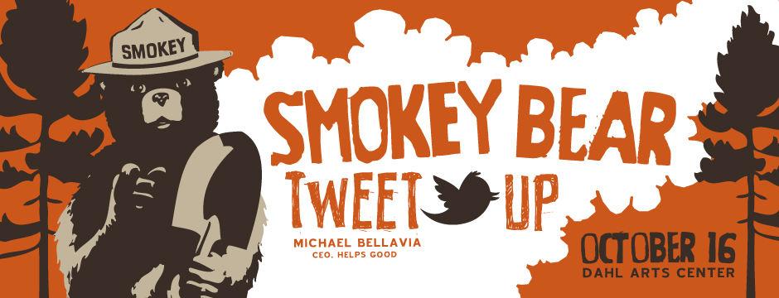
Most Successful Campaign
Still relevant
80 years
Consumer culture

Slide 26
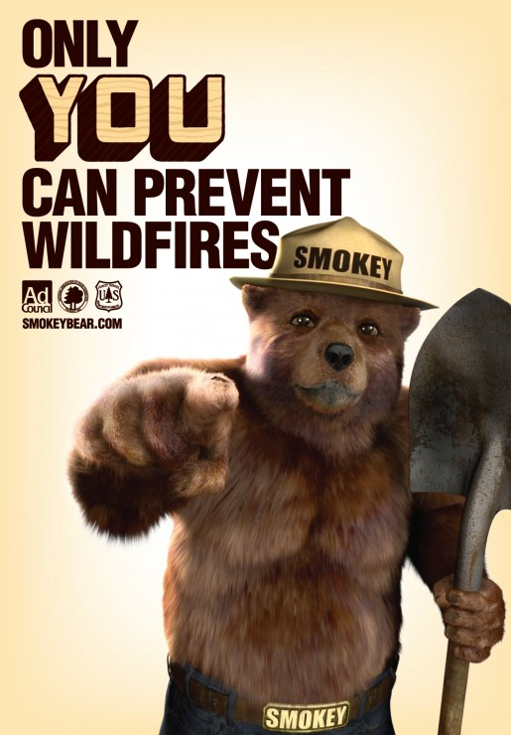
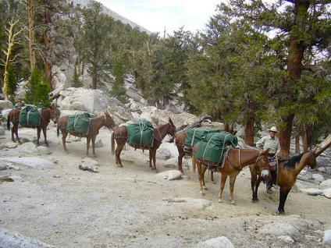
Wrap Up
Animals still used today!
USFS still a functioning agency

Slide 27
Thank you!
Questions?

Slide 28
Primary:
“Amazing Bear Does Much to Prevent Forest Fires.” Admore Daily Ardmoreite. August 30, 1953.
Barnes, Will C. “The Forest Ranger: In Two Part One What a Ranger Must Be. Trials of a Candidate. More Amusing Answers. Winter Duty and Adventure.” The Youth’s Companion (1827-1929), November 3, 1910.
Carlson, Cheri. “Mules, Horses Help Crews Fighting Los Padres Fire.” Ventura County Star, July 2, 2016.
http://www.vcstar.com/news/special/outdoors/mules-horses-help-crews-fighting-los-padres-fire-36eca82a-b1b7-4501- e053-0100007f4e01-386085371.html.
“Carrier Pigeons Aid Foresters." American Forestry 25, No. 11. November 1919.
Chapman, Arthur. “A Day With A Forest Ranger.” Outlook. October 28, 1905.
Clar, C. Raymond and L.R. Chatten. Principles of Forest Fire Management. Sacramento Dept. of Natural Resources Division of Forestry: 1954.
Dahl, Arthur. “How Forest Rangers Protect Uncle Sam’s Forests.” Overland Monthly and Out West Magazine (1868-1935), April 1910.
Eiselien, A. W. “Work for Working Men.” The Roundup Record. August 12, 1910.
“Forest Fire Prevention Work.” Camden News. March 4, 1948.
Headley, Roy. “Recent Mechanical and Other Innovations in National Forest Fire Control.” Journal of Forestry 30, no. 2 (February 1, 1932).
Holmes, John Simcox. “Forest Fires in North Carolina During 1913 and State Forest Fire Prevention in the United States.” North Carolina Geological and Economic Survey, 1914.
Huey, B. M. "The First U.S. Forest Ranger." Journal of Forestry 45, No. 10. October 1927.
Overland Monthly and Out West Magazine Vol. LXXXI No. 3. July 1923.
"Pigeons for Forest Fire Fighting." American Forestry 26, No. 2. February 1920.
“Pigeons in Fire Fighting – Forest Service Uses Them as Messengers – Feathered Heroes on View.” The Starry Cross Vol. 19. Philadelphia, PA, March 1920.
"Rangers Use Carrier Pigeons.” Forestry Kaiman 4. 1922.
Smith, Glen A. Interview with Glen Smith. University of Montana Oral History Collection. Missoula, Montana, 1956.
“Smokey Enlists Kids Against Forest Fires.” Alamogordo News. October 17, 1956.
“Smokey Bear Toy Is Fire Prevention Envoy.” Beckley Post Herald. November 13, 1953.
“The Fire Fiend.” The San Francisco Call. September 25, 1898.
The Western Fire Fighter’s Manual ... Portland, Ore., 1924 http://hdl.handle.net/2027/mdp.39015063724952.
“The Handling of Sheep on the National Forests.” Washington, 19 http://hdl.handle.net/2027/loc.ark:/13960/t39z9tc0b.
US Congress, Smokey Bear Act. May 23, 1952.
Van Tassel, Alfred J. Mechanization in the Lumber Industry; a Study of Technology in Relation to Resources and Employment Opportunity. Philadelphia, Pa., 1940. //catalog.hathitrust.org/Record/010832820.
Walker, Hazel Austin. “Protection for the Tahoe Forest.” Overland Monthly and Out
West Magazine (1868-1935), May 1913.
Wilsonian, H. K. “Control of Noxious Plants.” Botanical Review 10, no. 5 (1944): 279–326.

Slide 29
Secondary:
Brown, Nelson Courtlandt. Logging: Principles and Practices in the United States and Canada. New York: J. Wiley, 1934. //catalog.hathitrust.org/Record/001508319.
Cochrane, Timothy. “Trial by Fire: Early Forest Service Rangers’ Fire Stories.” Forest &
Conservation History 35 (1991): 16–22.
Egan, Timothy. The Big Burn: Teddy Roosevelt and the Fire That Saved America. Reprint edition. Mariner Books, 2010.
LaBau, Vernon J., and United States. A History of the Forest Survey in the United States: 1830-2004. Washington, DC: U. S. Dept. of Agriculture, Forest Service, 2007. //catalog.hathitrust.org/Record/007425838.
Larson, Rolf. “Firestorm! The Story of the Heaven’s Peak Fire of 1936.” Glacier Park
Foundation. Accessed September 29, 2016. http://www.glacierparkfoundation.org/History/firestorm.html.
Miller, Char. “Crisis Management: Challenge and Controversy in Forest Service History.” Rangelands, 2005.
Mitman, Gregg. Reel Nature: America’s Romance with Wildlife on Film. Cambridge MA: Harvard University Press, 1999.
“Smokey’s History.” Smokeybear.com. https://smokeybear.com/en/smokeys-history?decade=1940 (accessed November 23, 2016).
Sobse, Kathryn. “Letters to Smokey Bear Reveal Promise of Hope for the Future.” Office of Communication, U.S. Forest Service, 2014.
Steen, Harold. The Forest Service — A History. Seattle: University of Washington Press, 1976.
Williams, Gerald. The USDA Forest Service - The First Century. Washington D.C.:
USDA Forest Service, 2005.

