Slide 1
EAAT This: How EAAT1 Knockdown in Astrocytes Alters Aggression in Drosophila melanogaster
Haley Shepard
Sarah Certel, Faculty mentor
University of Montana, Missoula
UMCUR 2017
4/28/17

Slide 2
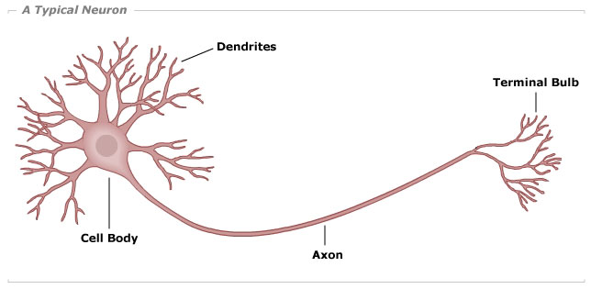
Introducing: The Neuron
100 BILLION neurons in the human brain
Axon terminal
Image by Pennsylvania State University Eberly College of Science

Slide 3
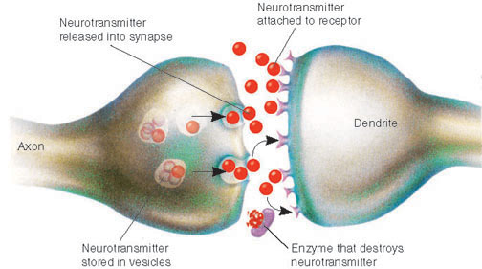
How Neurons Communicate
Neurons communicate electrically and chemically
Communication occurs at Synapses
Many neurons can form circuits related to biological responses or behaviors

Slide 4
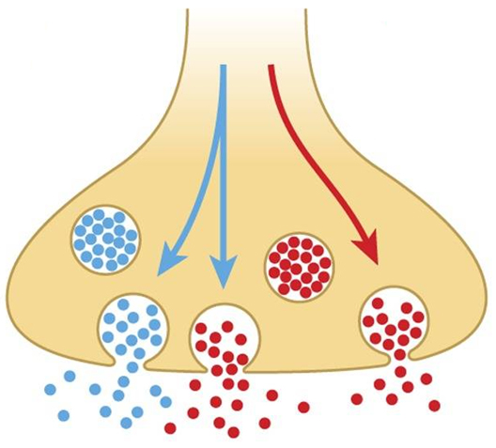
Neurotransmitters
Neurotransmitter
Neurotransmitters are chemicals that carry signals between neurons at the synapses
Glutamate is the most abundant neurotransmitter
Glutamate is an “excitatory neurotransmitter”
Octopamine is similar to adrenaline
Neurons can release more than one neurotransmitter (Co-transmission)
Axon Terminal
Octopamine
Glutamate

Slide 5
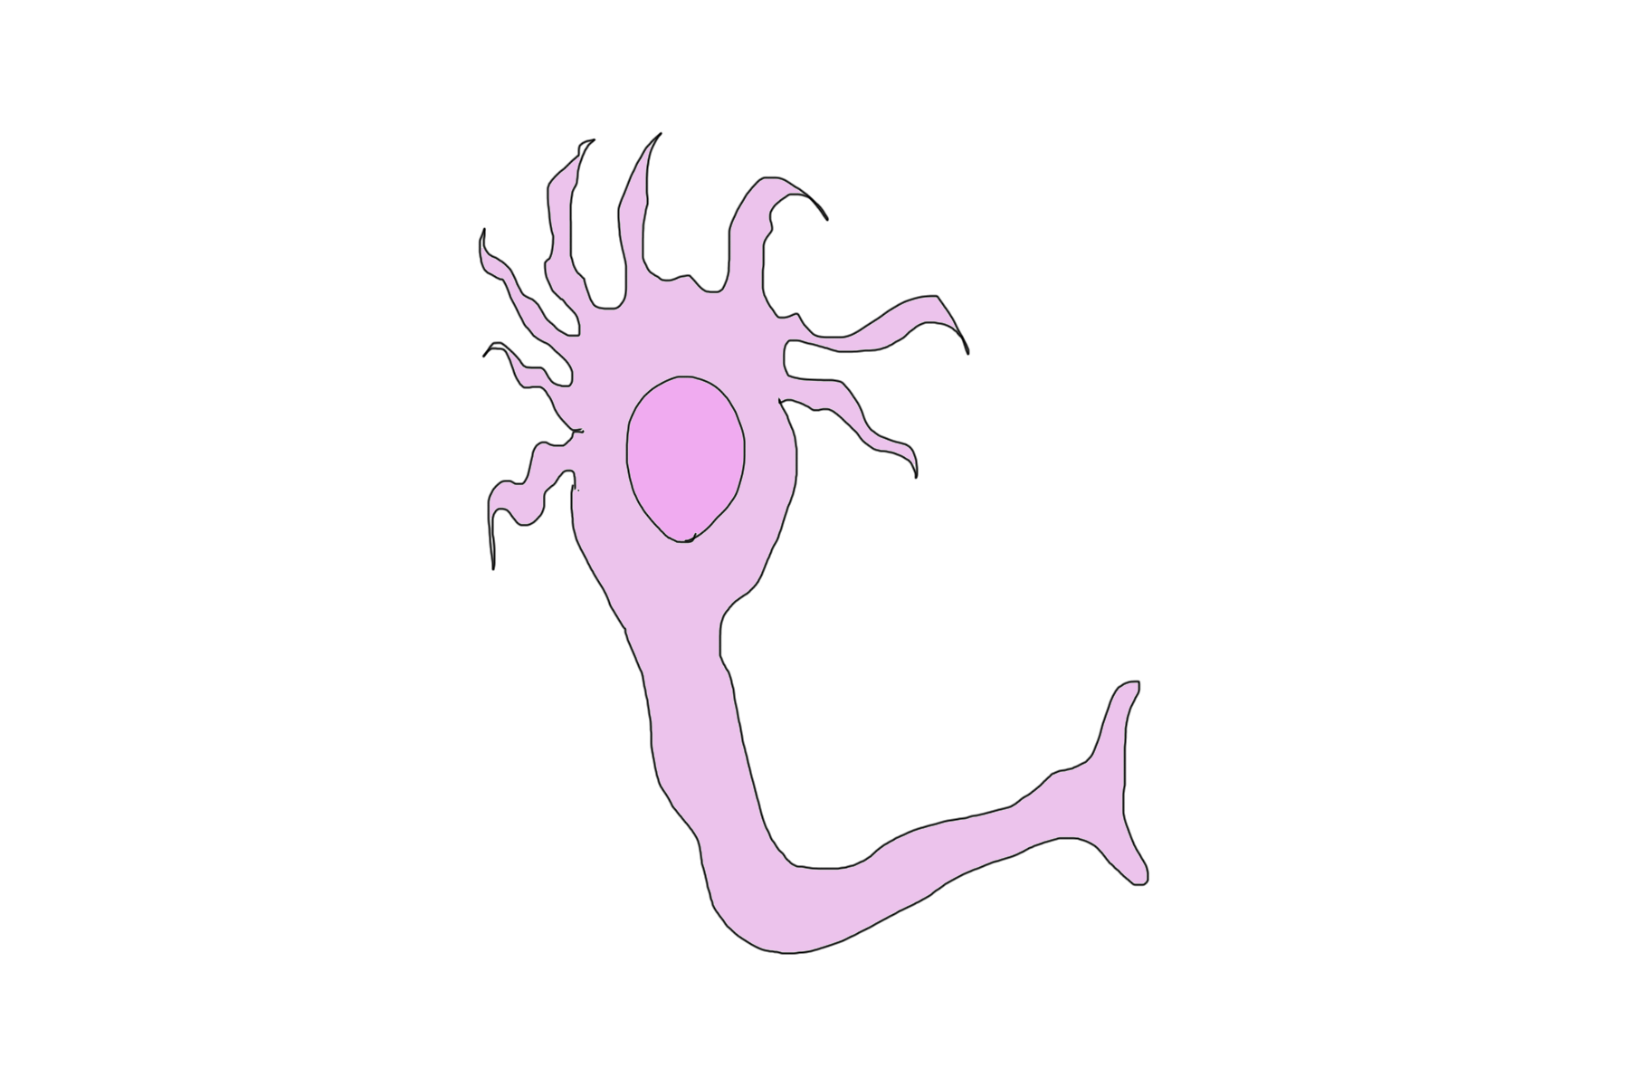
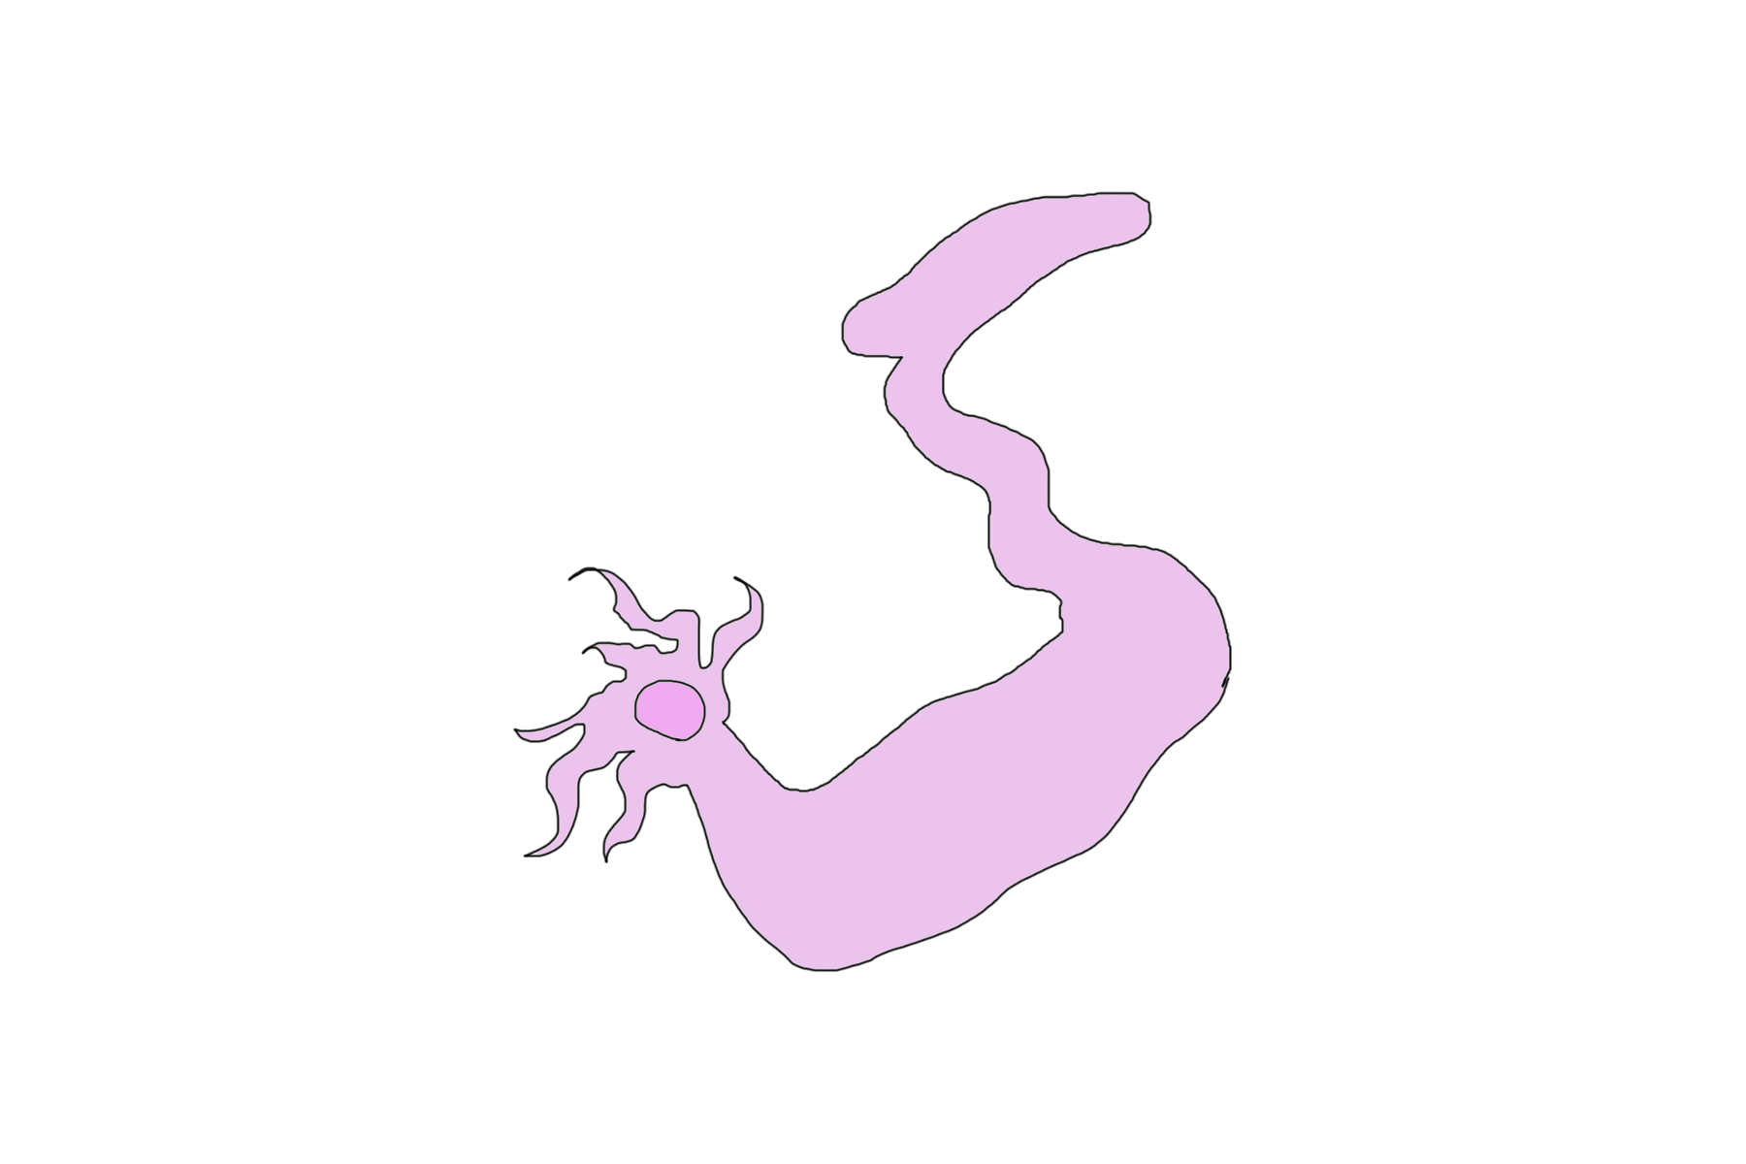

Slide 6
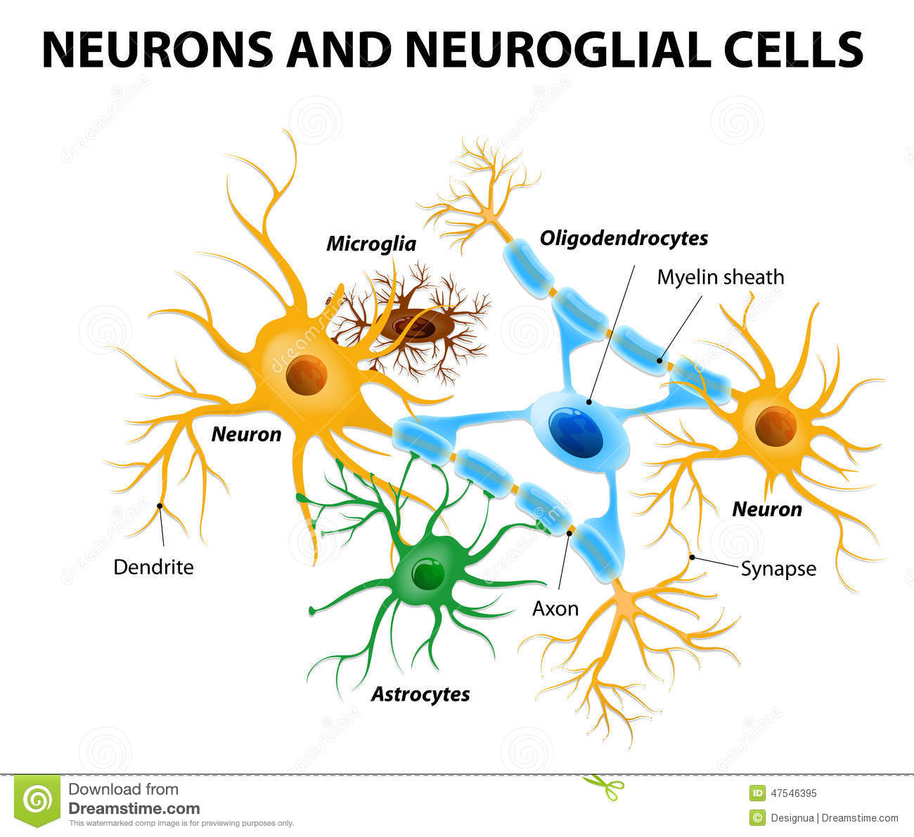
Glial Cells
Support cells of the brain
Astrocytes
Oligodendrocytes
Microglia
Picture by Dreamstime.com

Slide 7
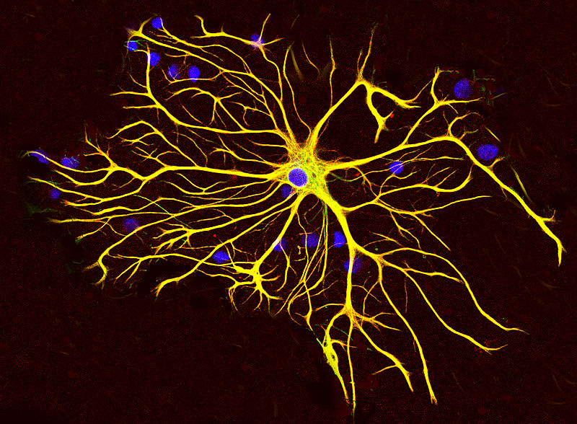
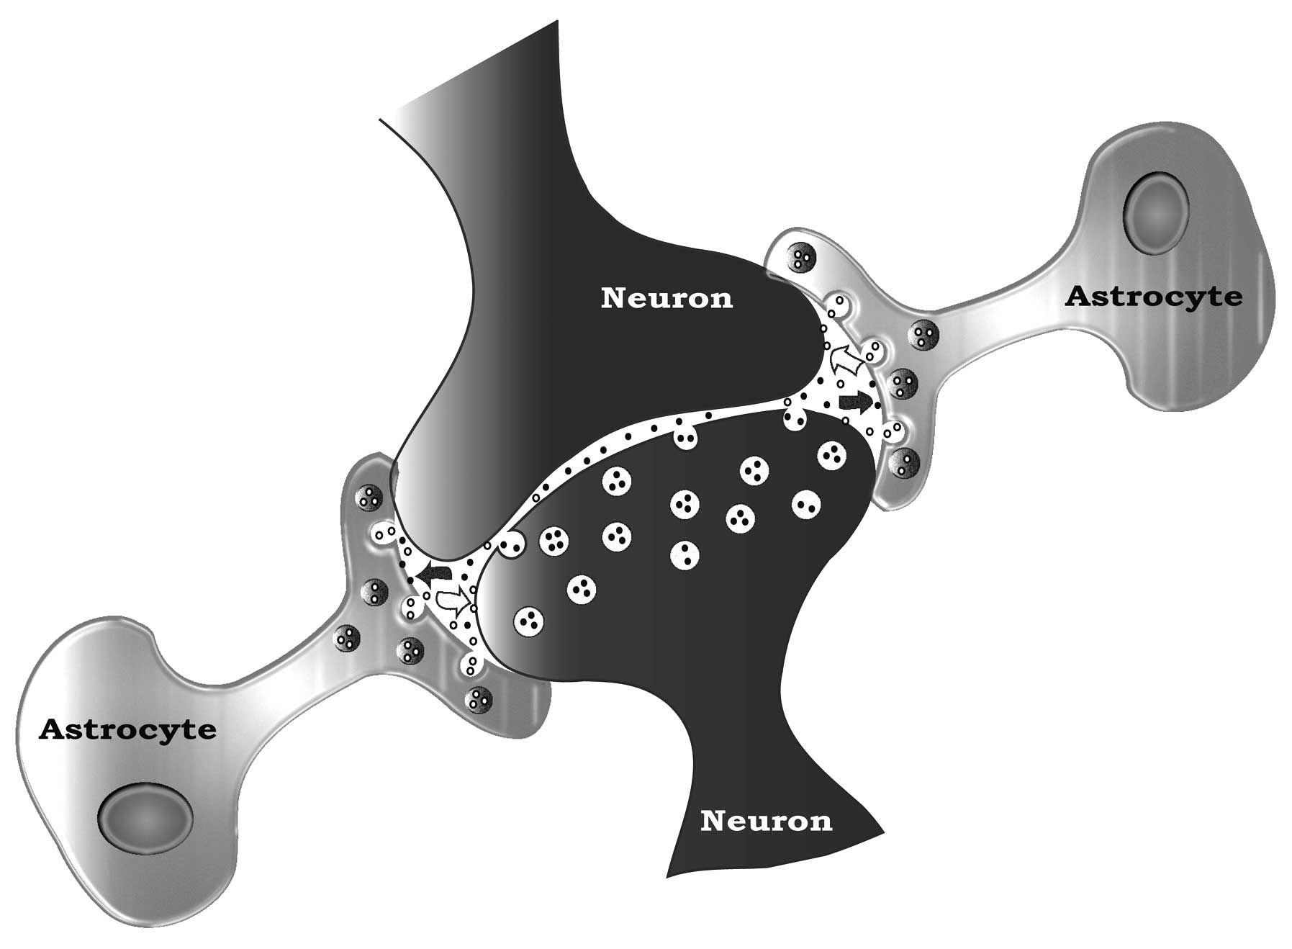
Astrocytes
Named for their star shaped appearance
Outnumber neurons 5 to 1
Remove excess neurotransmitter from synapse
Images (top) by EnCor Biotechnology (bottom) by Armato, U., B. Chakravarthy, R. Pacchiana, and J.F. Whitfield. 2013. Alzheimer’s disease: An update of the roles of receptors, astrocytes and primary cilia (Review). Int. J. Mol. Med.

Slide 8
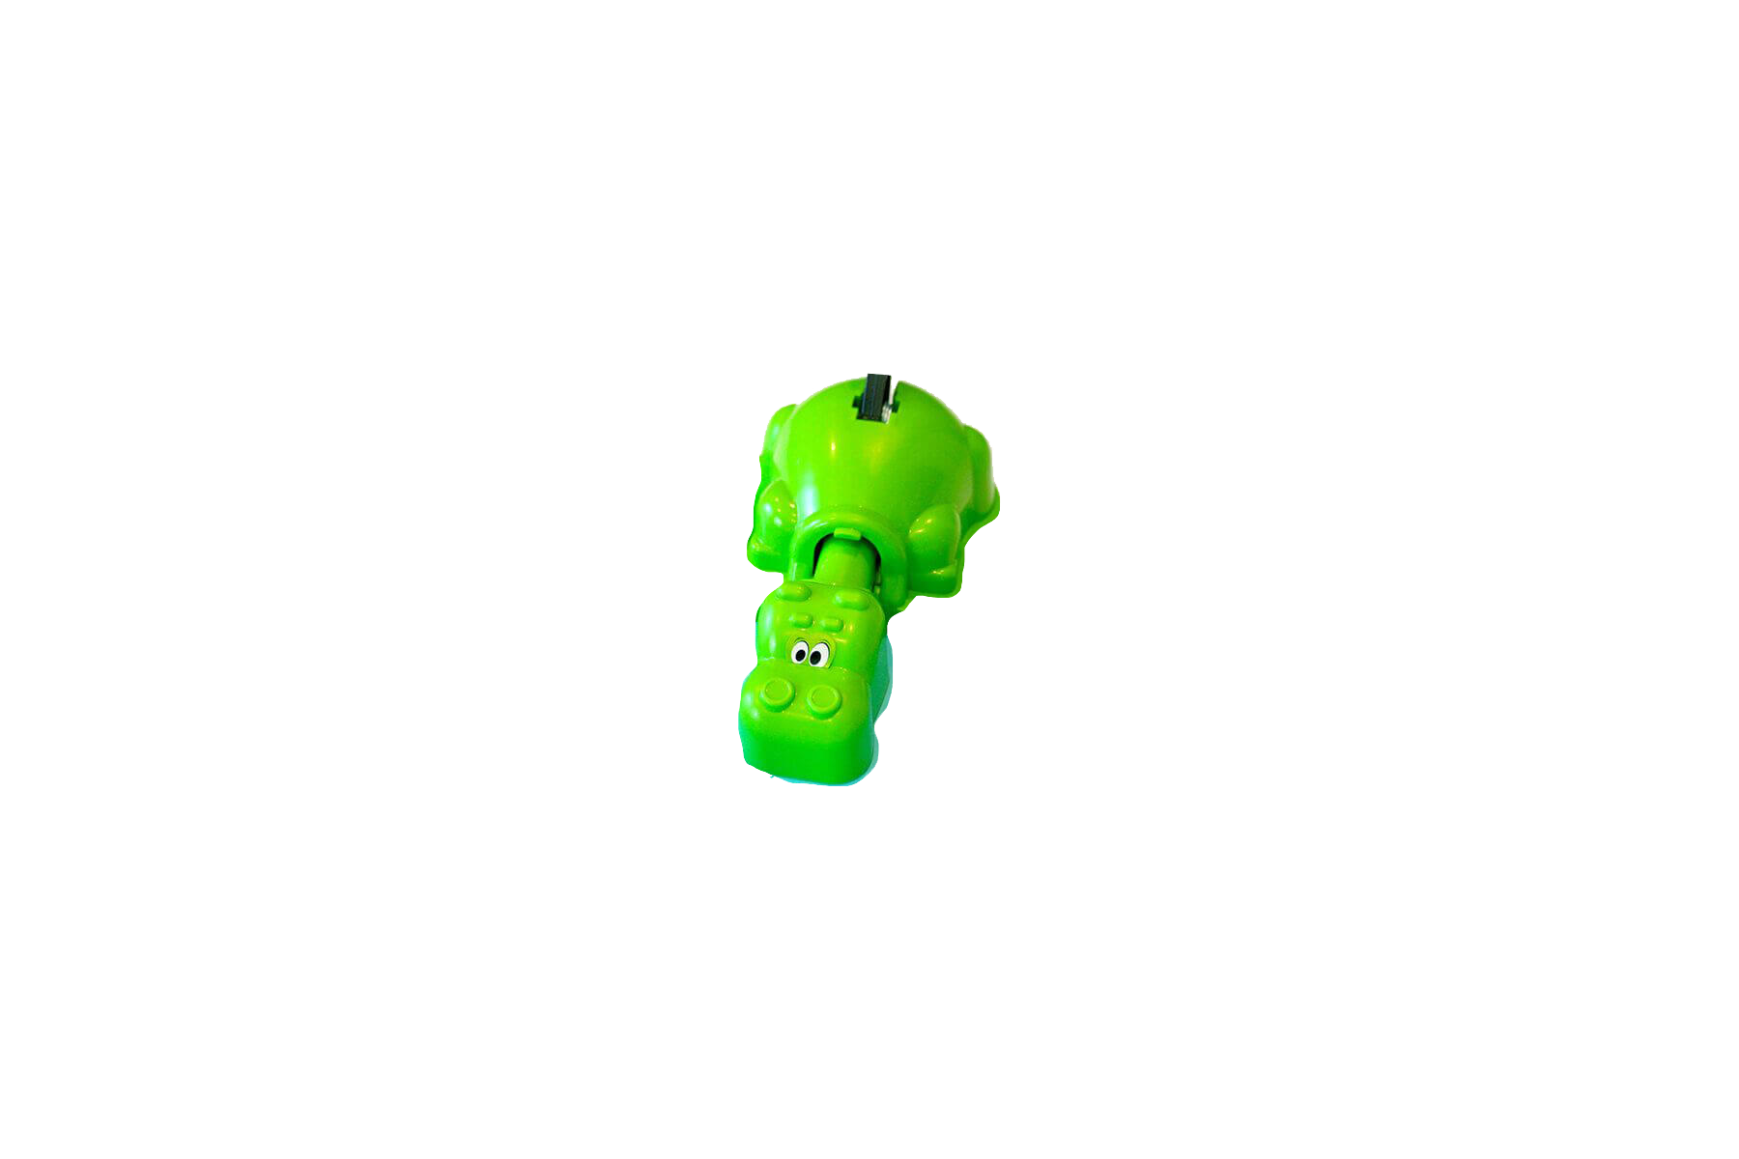
Excitatory Amino Acid Transporter 1 (EAAT1)
Astrocyte
Glutamate released from neurons enters the synapse
Too much glutamate over a long period may over-excite neurons and have toxic effects
EAAT1 removes glutamate from the synapse
Astrocyte
EAAT1

Slide 9
Hypothesis
An increased amount of glutamate at synapses within the aggression circuit as a result of reduced amounts of EAAT1 would result in enhanced aggression
Significance:
Glutamate may be the most abundant neurotransmitter in the CNS
Understand role of glutamate in disorders that show enhanced aggression such as dementia, schizophrenia, and traumatic brain injury

Slide 10
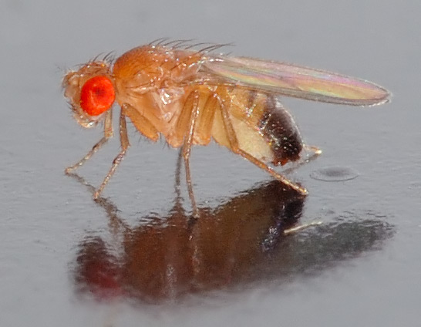
Drosophila melanogaster
AKA “Fruit Fly”
Model organism with vast genetic tools
Shares ~50-60% genetic similarity with humans
Well-studied behaviors aid in analyzing aggression
Photo by Andre Karwath

Slide 11
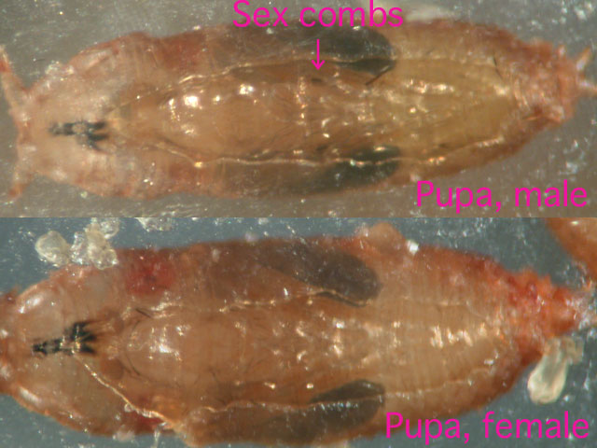
Methods
Obtain mutant stock animals
Cross stock animals to generate animals that have reduced expression of EAAT1 on their astrocytes
Isolate male pupa
Compare behavior of experimental males to normal males (Wild Type) at 3-5 days after they emerge from pupa

Slide 12
Behavior Assay
Two male flies are placed in closed chamber with resource or territory to compete for
Yeast was used as the ‘prize’
Interactions are recorded using a digital camera and analyzed
Certel, S.J., and E.A. Kravitz. 2012. Scoring and analyzing aggression in Drosophila. Cold Spring Harb. Protoc.

Slide 13
Lunges
Video courtesy of Sarah Certel , University of Montana, 2017

Slide 14
Wing Threats
Photo by Eric Hoopfer

Slide 15
Results
Figure. 1 Latency to Lunge (min) between Control Males and Experimental Males.
All values were generated via analysis using the Mann-Whitney U-test
Experimental
n=13
Control n=7

Slide 16
Figure. 2 The Average Number of Lunges between Control Males and Experimental Males.
Control n=6
All values were generated via analysis using the Mann-Whitney U-test
Experimental n=15

Slide 17
Figure. 3 The Total number of Wing Threats between Control Males and Experimental Males.
All values were generated via analysis using the Mann-Whitney U-test
Control n=6
Experimental n=12

Slide 18
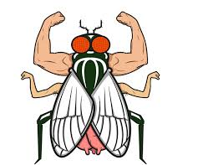
Conclusions
Preliminary data indicate that increased glutamate does not make male Drosophila more aggressive, instead reduces aggression
Why?
No glutamate removal = Death

Slide 19
Conclusions continued…
First time reducing EAAT1 in Drosophila
Future experiments: Larger sample sizes, exclude males with light-colored eyes
Refine: Target specific neurons in aggression circuit that release both octopamine and glutamate

Slide 20
Acknowledgements
Dr. Sarah Certel, without whom this project would not have been possible
Hannah Morgan, Lizzie Catudio-Garrett, John, Lewis Sherer, and the other members of the Certel Lab for their invaluable assistance and feedback
My parents: Chuck and Becky Shepard
This project was completed as part of BIOH 458 : Neuroscience Research

Slide 21
References
Certel SJ, Kravitz EA (2012) Scoring and analyzing aggression in Drosophila. Cold Spring Harbor Protocols 2012:pdb.prot068130.
Dankert H, Wang L, Hoopfer ED, Anderson DJ, Perona P (2009) Automated monitoring and analysis of social behavior in Drosophila. Nature Methods 6:297-303.
Grosjean Y, Grillet M, Augustin H, Ferveur J, Featherstone DE (2008) A glial amino-acid transporter controls synapse strength and courtship in Drosophila. Nat Neurosci 11:54-61.
Hoptman MJ (2015) Impulsivity and aggression in schizophrenia: A neural circuitry perspective with implications for treatment. CNS Spectrums 20:280-286.
Hoyer SC, Eckart A, Herrel A, Zars T, Fischer SA, Hardie SL, Heisenberg M (2008) Octopamine in male aggression of Drosophila. Current Biology 18:159-167.
Kravitz EA, Fernandez, Maria de la Paz (2015) Aggression in Drosophila. Behavioral Neuroscience 129:549-563.
Liu WW, Wilson RI (2013) Glutamate is an inhibitory neurotransmitter in the Drosophila olfactory system. Proc Natl Acad Sci 110:10294-10299.
Martin CA, Krantz DE (2014) Drosophila melanogaster as a genetic model system to study neurotransmitter transporters. Neurochemistry International 73:71-88.
Rao V, Rosenberg P, Bertrand M, Salehinia S, Spiro J, Vaishnavi S, Rastogi P, Noll K, Schretlen DJ, Brandt J, Cornwell E, Makley M, Miles QS (2009) Aggression after traumatic brain injury: Prevalence & correlates. J Neuropsychiatry Clin Neurosci 21:420-429.
Vaaga CE, Borisovska M, Westbrook GL (2014) Dual-transmitter neurons: Functional implications of co-release and co-transmission. Curr Opin Neurobiol 0:25-32.
Wharton T, Ford BK (2014) What is known about dementia care recipient violence & aggression against caregivers? Journal of Gerontological Social Work 57:460-477.

Slide 22
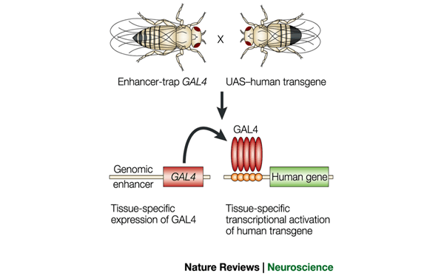
Gal4-UAS System
Images from genius.com (left) and The art and design of genetic screens: Drosophila melanogaster
Daniel St Johnston
Nature Reviews Genetics 3, 176-188 (March 2002)

