Slide 1
Editing: The value of quality content in an online-first industry
By Meg Giddings
UMCUR April 28, 2017
Notes:
Good morning, and welcome. My name is Meg Giddings, and today I will be presenting on the changing role of editing within the journalism industry and the value of quality content as the Internet becomes the standard platform for news consumers.

Slide 2
A changing industry model
Circulation
Revenue
Consolidation
Notes:
To start with the big picture, it’s no secret the journalism industry has been struggling.
Print newspaper circulation is down, and accordingly, so is the revenue that used to come from print subscriptions and print advertising.
Many traditional newspapers across the country have even stopped printing and closed their doors for good.
The news organizations that fight to remain relevant are being forced to change their strategy and develop online-first publication models, in which news is broken online and directed toward digital consumers.
With this changing model comes innovative leadership and often, consolidation of staff.
So, what positions are being cut? At many publications, it’s not as often reporters and supervisors as it is editors.
As a student of the journalism school here at the University of Montana and an editor at the Montana Kaimin, our university’s student newspaper, I became particularly interested in examining the overall importance and sustainability of the role of editors in the publication process, and how that role is changing within the shifting news media industry.

Slide 3
What makes a good editor?
Notes:
My first question was: What makes someone a “good” editor?
In 2014, the New York Times actually asked its staff the same question. One reporter responded, “The best editor is the person who can take a modest story and make it big, broad, and powerful.”
Another columnist said, “A great editor has a deft touch, the ability to hack and slice and make it seem like minor surgery.”
For a copy editor, being good means knowing your style guide inside and out, and having an eye for grammar mistakes. It’s about being detail-oriented, checking every fact and making sure every line of a story is clean, logical, and accurate. As job duties get combined, copy editors are taking on even more responsibilities, such as writing headlines and composing social media posts.
Good or not, let’s take a look at how copy editors are faring in the job market.

Slide 4
Newsroom census
Copy editors 47%
Reporting positions 26%
Supervisory positions 24%
Overall journalism jobs 26%
From 2002 to 2012
Notes:
This data is from the American Society of News Editors’ annual survey, which tallies journalism jobs by category.
As you can see, from 2002 to 2012, unsurprisingly, the number of journalism jobs in the U.S. declined 26%. Reporting positions and supervisory roles were consistent with this decline, dropping about the same percentage. Copy editor jobs, on the other hand, are disproportionately disappearing by nearly twice as much, at 47%.
From 2012 to 2015, copy editor positions dropped even further, and there are now half as many jobs in this field as there were at the start of the millennium.
I had the chance to speak with Henry Fuhrmann, a former assistant managing editor at the LA Times, and he said that when he started at the Times in the early 2000s, there were nearly 120 copy editor positions throughout various departments. When he took over responsibility of the consolidated copy desk in 2009, it was down to 75. And as of 2016, there were 44 people on what is now called the multiplatform/copy desk. That’s a 63 percent decrease in copy editing staff over 15 years at the LA Times, one of the country’s most renowned papers.
The copy desk is seeing cuts across the board, and many papers have eliminated it all together. Some of these include the Denver Post, the Salt Lake Tribune, the Baltimore Sun, and the Cincinnati Enquirer.
What’s interesting, according to Fuhrmann, is that while there are fewer people, there certainly isn’t less work. If anything, there’s more, because the online-first model demands constant production of content, even more so than a daily print edition. Fuhrmann said editors are harder worked and more stressed than they used to be.
So, what solutions are organizations turning to in order to fill the void as they cut copy staff?

Slide 5
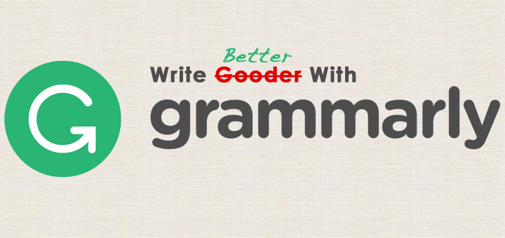
Software: Copy editor of the future?
Uses algorithms
Paid subscriptions
Can’t catch the facts
Another tool in the belt
Notes:
One option is the use of editing software.
I’m sure many of you have seen an ad at some point, probably from Grammarly, trying to convince you that, if you pay for their editing services, your writing will be spotless.
Grammarly is probably the most well-known of these software companies, but there are many others, such as PerfectIt, Tansa, StyleGuard, and Lingofy.
They all use algorithms to catch and flag grammar mistakes in your writing. I like to think of them as spellcheck on steroids.
But, they’re not just for college students or aspiring novelists. News publications can also use them.
Pretty much all of the services require a paid subscription, and paying for a subscription is significantly cheaper than paying a salary for a human copy editor.
BUT the problem is that these programs can’t yet catch factual errors, which is one of the most important aspects of a copy editor’s job, making them not quite as good as the real thing.
In an article in the American Journalism Review, Michael King suggests these software programs have the potential to be another tool for editors, just like a dictionary or a style guide. And actually, they can perhaps lighten the increased work load that comes with a smaller staff, but it’s not likely they will be replacing people any time soon.

Slide 6
Outsourcing
Toronto Star
Hartford Courant
Raleigh News & Observer
Winston-Salem Journal
Newport News Daily Press
To parent companies and
editing “hubs”
Notes:
Another option many organizations are considering is outsourcing.
Right now, this mostly means sending editorial tasks to parent companies or editing “hubs” in centralized locations, however, it could eventually mean outsourcing to other countries altogether.
The politically correct term many organizations use is “consolidated editing operations,” but in effect, it is editing work outsourced to another location.
In a study published in May 2016, an assistant journalism professor at Northwestern University in Qatar examined 5 publications that have outsourced copy editing. The study analyzed the number of corrections the papers issued one year before and one year after they began outsourcing.
The results were pretty mixed. The number of corrections at the Daily Press went down, but they increased at the News and Observer. Essentially, the study was inconclusive, which could have been due to a number of extraneous factors.
One significant problem with this study is that it doesn’t measure all the actual errors that may have been in the papers, just the errors for which corrections were issued.
One of the concerns with outsourced editing is that an editor in a distant hub can’t contribute the same level of knowledge and experience to a story as someone who lives and works in the area where it was written and will ultimately be distributed.
As this editorial strategy is still relatively new, it may take some time before there is clear evidence for whether it is more productive or a disadvantage to news organizations.

Slide 7
Does editing matter?
Notes:
So, this look at the state of the industry and different approaches that media organizations are taking to adapt brought me to my overall research question: Does editing matter? Do readers notice quality, edited content? Do they care, and does it affect what they choose to read?

Slide 8
Grammar errors
Earned credibility
Career success
Romantic interests
Brand reputation
Who cares?
Notes:
To take a step back, even outside journalism, do grammar errors matter?
Behavior scientist B.J. Fogg outlines 4 types of credibility: presumed, reputed, surface, and earned credibility.
Typos and grammar errors fall under the category of earned credibility, as they are part of a user’s personal experience with a website, publication, or newspaper.
These types of errors can be glaringly obvious and immediately put off readers or they can be more subtle and gradually undermine the credibility of a publication in the mind of the reader.
A study by Grammarly reviewed a sample of 100 LinkedIn profiles and found that fewer grammar errors correlated with more promotions and frequent job changes. Overall, those who had fewer errors in their profiles achieved higher positions in their industry.
Marketing company Colour Works examined 1,700 online dates and found that 43% of users consider bad grammar “decidedly unattractive” and 35% think good grammar is appealing.
A digital communications agency surveyed over 1,000 Internet users in the United Kingdom and found that 43 percent cited poor spelling or grammar as most likely to damage their opinion of a brand on social media.
The evidence suggests that grammar errors do influence a consumer’s perception of whatever it is they are reading. So, in the case of news content, what does this mean?

Slide 9
Audience perceptions of editing quality
Professionalism
Organization
Writing
Value
Fred Vultee, Wayne State University
Notes:
In 2015, Professor Fred Vultee of Wayne State University conducted an experiment to analyze audience perceptions of editing quality. He took 8 articles published by various news organizations that he did not think were edited well, and he edited the articles himself, based on years of experience. He fixed errors in style, grammar, word usage, and overall organization. Then, with a sample of 119 students, he presented each with 4 of the edited articles, and 4 that were not edited. The students were asked to rate each article on 4 different scales: professionalism, organization, writing, and value.

Slide 10
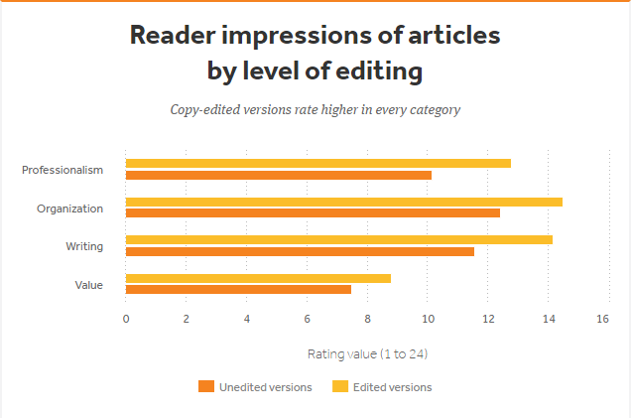
Notes:
The results showed students rating each of the edited articles higher in all four categories.
According to Natalie Stroud in an American Press Institute summary of the study, it is noteworthy that “digitally savvy young people picked up on editing differences and reacted negatively to unedited content.” She said “this research confirms the importance of copy-editing” for news organizations and, “As newsroom job titles and duties have shifted in response to increasingly digital audiences, attention to the basic of news editing continues to play a valuable role.”
What is particularly notable about Vultee’s study is the value rating. To measure this, participants were asked to indicate their level of agreement with statements such as, “This article is worth paying for.”
Image from: https://www.americanpressinstitute.org/publications/research-review/the-value-of-copy-editing/
Data from: http://www.tandfonline.com/doi/full/10.1080/21670811.2014.995938?scroll=top&needAccess=true

Slide 11
Quality correlates with value.
Notes:
These results are significant because they suggest that consumers are more willing to pay for higher quality, edited content.
This is a crucial realization in a time when news organizations are struggling to generate revenue and stay relevant.

Slide 12
Why editing matters
“Editing isn’t threatened; quality is threatened, and thus the trust that the reader has in the product, be it electronic or dead-tree. A newspaper that would not save money by printing press releases verbatim on the back of used wallpaper nevertheless might think it can clip off a few pennies by eliminating that extra set of eyes, that extra level of judgement, experience and common sense. Like the farmer feeding his horse on sawdust, that’ll save a fortune — till the horse starves to death.”
American Copy Editors Society
Notes:
In 2008, as a response to the increasingly threatened role of copy editors within news organizations, the American Copy Editors Society launched a website to collect comments about why editing matters. Hundreds of comments were submitted, and this is just one of my favorites, as it really illustrates this concept of quality being intimately linked with the value readers place on content. And I’ll just read it for you now.
Read it.

Slide 13
THANK YOU
Denise Dowling, Faculty Mentor
Davidson Honors College
Henry Fuhrmann, LA Times
For the dedication and support
Notes:
Thank you.

