Slide 1
World War I and the New Negro Movement
Madison Renaldo
UMCUR
April 27, 2018

Slide 2
What do you think about when I say Civil Rights?

Slide 3
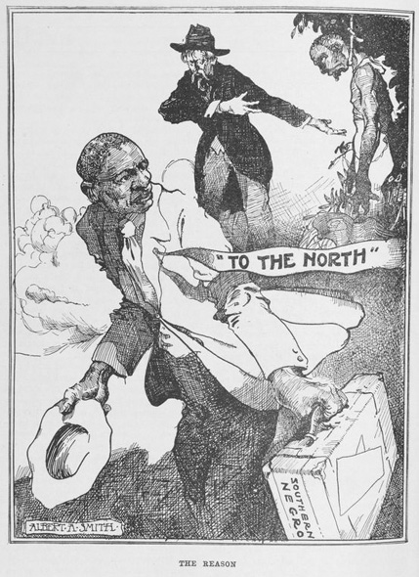
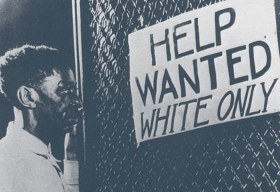
The Question of Enlistment
Jim Crow
Lynchings
The Great Migration
War in Europe
Enlist or Not?
W.E.B. Du Bois
Death Threats

Slide 4
Being African American in the Military
Training
92nd and 93rd Regiment
Labor
France v. U.S.
Pershing Letter
Linard Note
“We must not eat with them, must not shake hands or seek to talk or meet with them outside the requirements of military service. We must not commend too highly the black American troops, particularly in the presence of Americans.”- Pershing

Slide 5
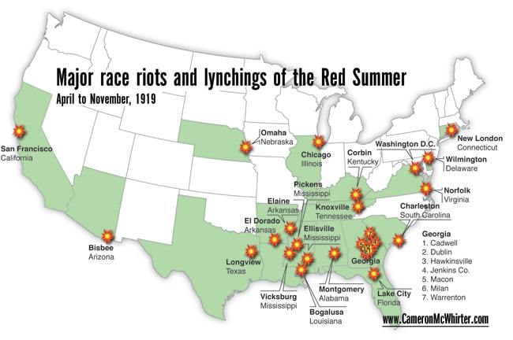
After the War
Awards
Radicalized
Bloody Summer
Lynchings
Rise of the KKK
African American Leaders
Marcus Garvey
W.E.B. DuBois
Asa Philp Randolph and Chandler Owen

Slide 6
Effects of the New Negro Movement

