Slide 1
A Bacteriophage Integrase Regulates Virulence Factor Production in Pseudomonas aeruginosa
Jake Cohen April 27, 2018

Slide 2
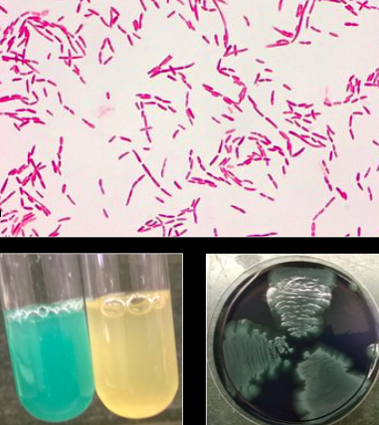
Pseudomonas aeruginosa is an opportunistic bacterial pathogen
-P. aeruginosa causes millions of infections worldwide each year
-P. aeruginosa infections can be difficult to treat, as they are often resistant to antibiotics

Slide 3
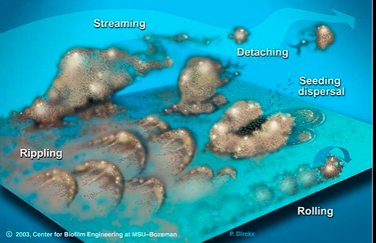
Pseudomonas aeruginosa forms protective biofilms
-A biofilm is a colony of bacteria growing in a protective matrix (slime)
-Biofilms are ubiquitous in the environment and at sites of chronic infection
Notes:
Talk about medical device biofilms, etc.

Slide 4
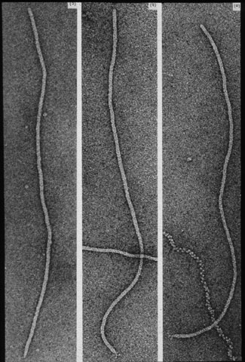
Pf phage increase P. aeruginosa virulence
-A bacteriophage is a virus that infects bacteria
-The majority of clinical P. aeruginosa isolates are already infected with Pf phage. Knezevic et al., Virology, 2015
-The presence of Pf phage in biofilms promotes resistance to antibiotics and desiccation. Secor et. al., Cell H&M 2015
-Pf phage increase the virulence of P. aeruginosa in vivo. Rice et al., ISME, 2009
Notes:
Presence of phage in biofilms correlated with resistance to desiccation and antibiotics- found in clinical isolates

Slide 5
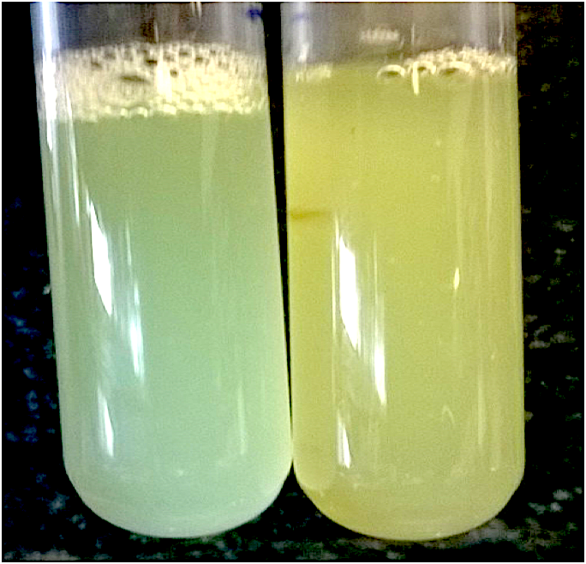
The integrase gene intP regulates pyocyanin production
-IntP integrates phage DNA into the P. aeruginosa chromosome
  IntP is required for Pf phage replication
Wild type
ΔintP
-When intP is deleted, production of the green pigment pyocyanin is reduced
Notes:
The gene is intP always italicised, protein is not

Slide 6
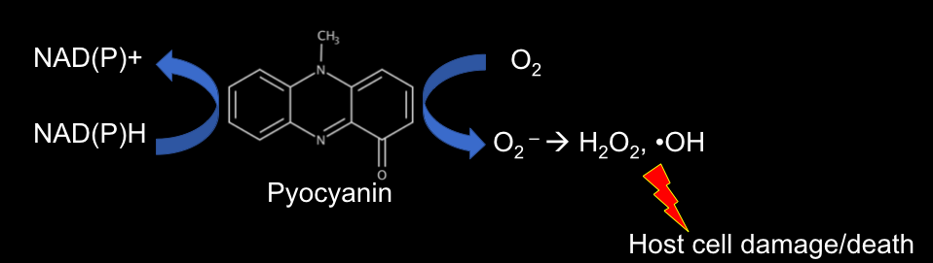
Pyocyanin is a redox-active virulence factor
Observation:
Pyocyanin production is reduced when intP is deleted
Question:
Does overexpression of intP enhance pyocyanin production?
Notes:
Pyocyanin is quorum regulated- definitely have a quorum in a biofilm and will definitely be produced

Slide 7
Construction of an inducible intP
IPTG
pTac
intP
IPTG inducible promoter
Castang and Dove, JBac, 2012

Slide 8
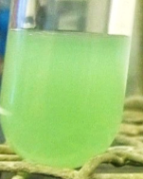
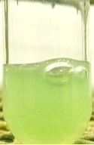
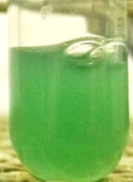
intP regulates pyocyanin production
Hypothesis:
The integrase activity of IntP is required for pyocyanin production.

Slide 9
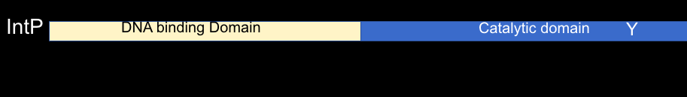
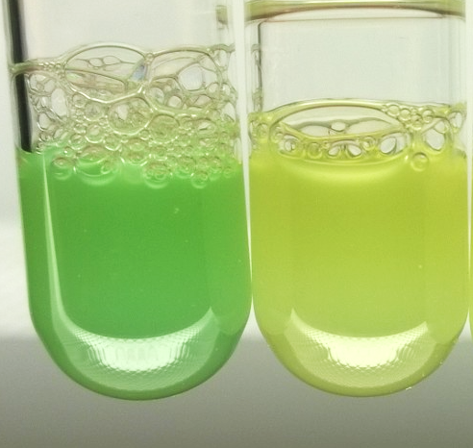
The integrase activity of IntP is required for pyocyanin production
-We introduced a point mutation to the catalytic tyrosine of intP (intP*)
intP+++
intP*+++
-We then extracted and quantified pyocyanin
Notes:
Show picture of point mutation- show where they are
Point mutation is A base pair change on a primer - primer binds to sequence and replicates- up, down, and SOE
Mutation in catalytic region means that there is no longer ability to break the bonds in DNA molecule and insert phage DNA.

Slide 10
Future Directions
-Does IntP integrate phage DNA into chromosomal locations that control pyocyanin production?
-Can intP be targeted therapeutically to treat or prevent P. aeruginosa infections?
-Can Pf phage be targeted therapeutically in other ways?

Slide 11
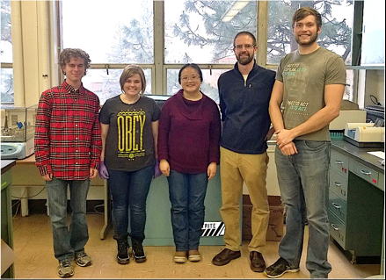
Acknowledgments
The Secor Lab:
Pat Secor
Lia Michaels
Autumn Robinson
Caleb Schwartzkopf
Zi Xie
Devin Hunt
Bradie Strauch
PHOTO

