Slide 1
What do you want to be when you grow up?
Melanie Gagen, Martha Krebill, Anna Peterson, Nikia Reynolds, & Melisande Slater
University of Montana
Franke Global Leadership Initiative
Notes:
Intro: Melanie
My name is ______ and when I was a kid, I wanted to be a ________

Slide 2
How can we encourage children to be open to career exploration?
Notes:
Melanie: Research Question and Topic

Slide 3
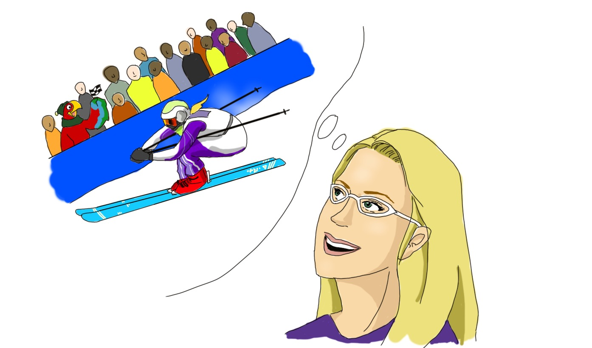
Deciding on a Topic
Inspire children to broaden their horizons
Think about the future and their interests
Positive outlook on success
Applying variety of interests and skills
Not all success stems from similar pathways
Notes:
Melanie: How can we help children to_____________

Slide 4
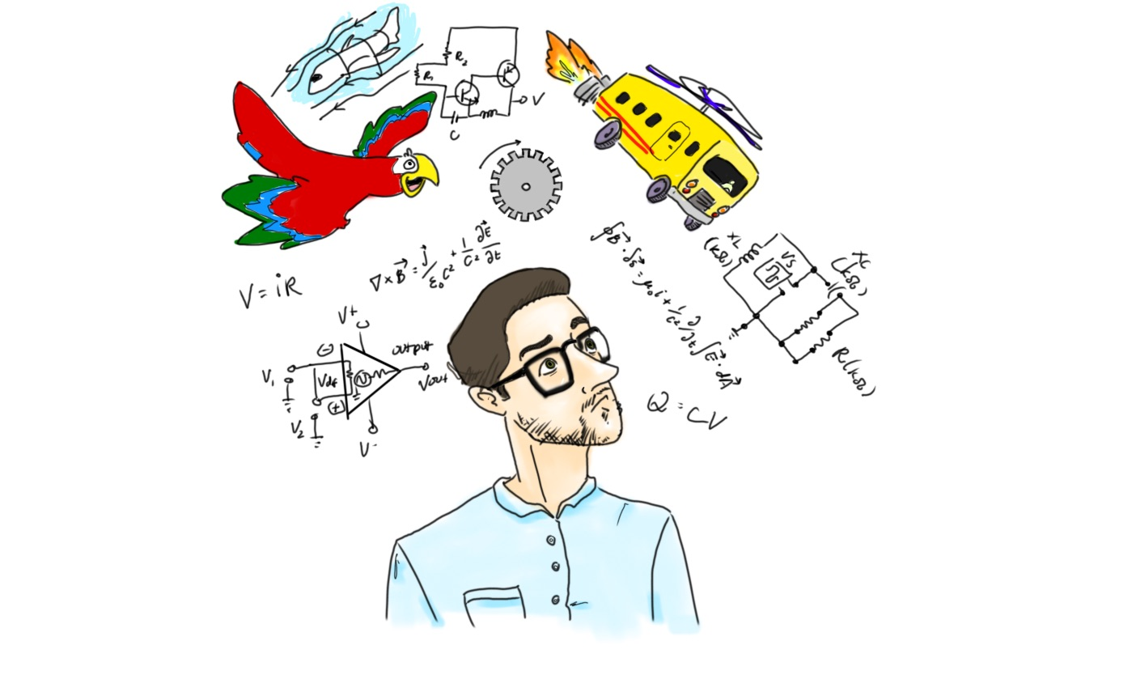
Summary of Current Research
What influences children’s career choice?
Gender stereotypes (Perasso, 2017)
Socioeconomic status (Tough, 2014)
Professions of parents and role models (Morrow, 1995)
Community industries (Godsey, 2015)
Notes:
Martha: Mostly influenced by our literature review

Slide 5
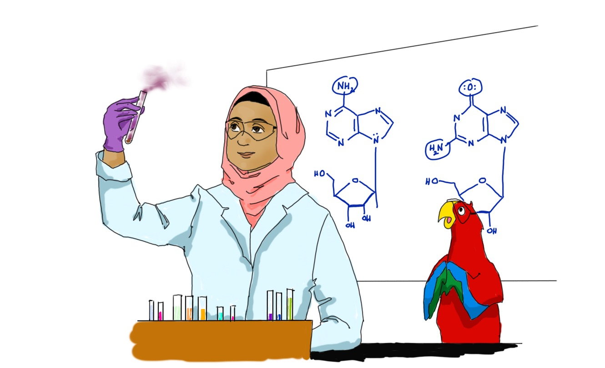
Summary of Current Research
Career development can:
Combat gender role stereotyping (Perasso, 2017)
Allow children to see more opportunities (Crettaz & Jacot, 2017)
Help children move beyond socioeconomic status (Tough, 2014)
Notes:
Martha: More on our literature review

Slide 6
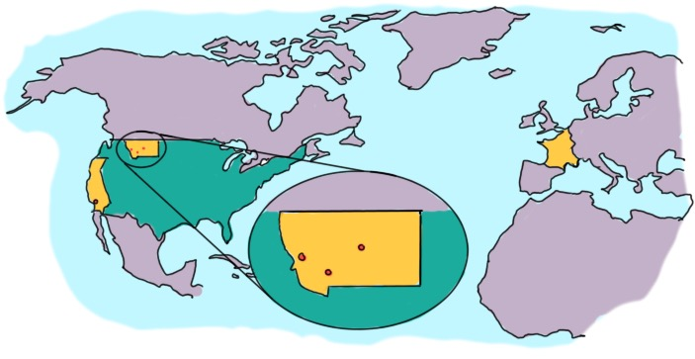
Storybook
Interviews of community members
Story of their career paths
Influences in their life
How they chose their career
Advice
Narrator: Sam the Bird
Notes:
Anna: Implementation of our product and the creation of the storybook
-mention release forms (to use name and likeness)

Slide 7
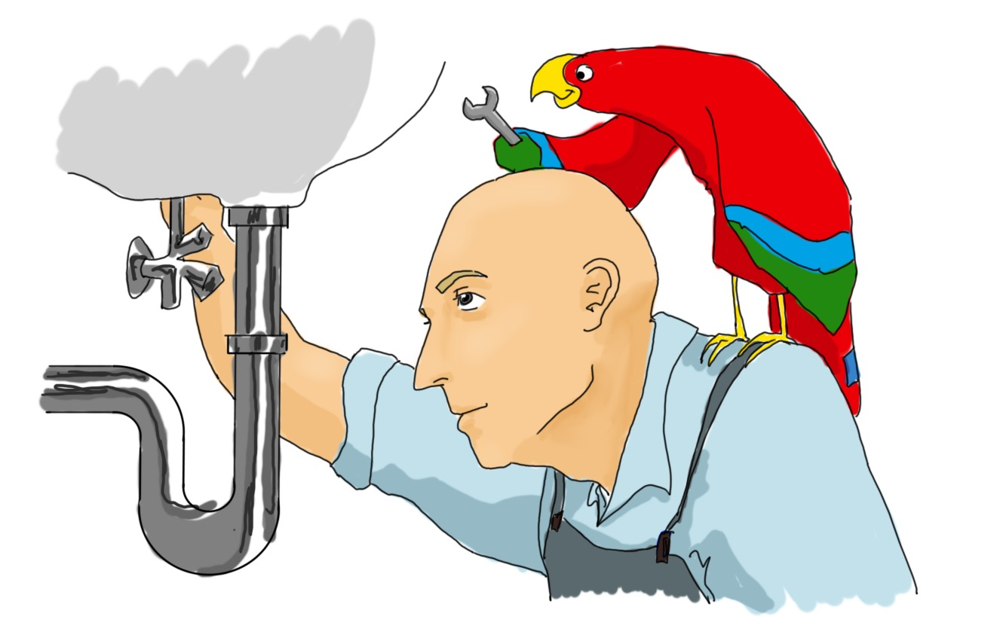
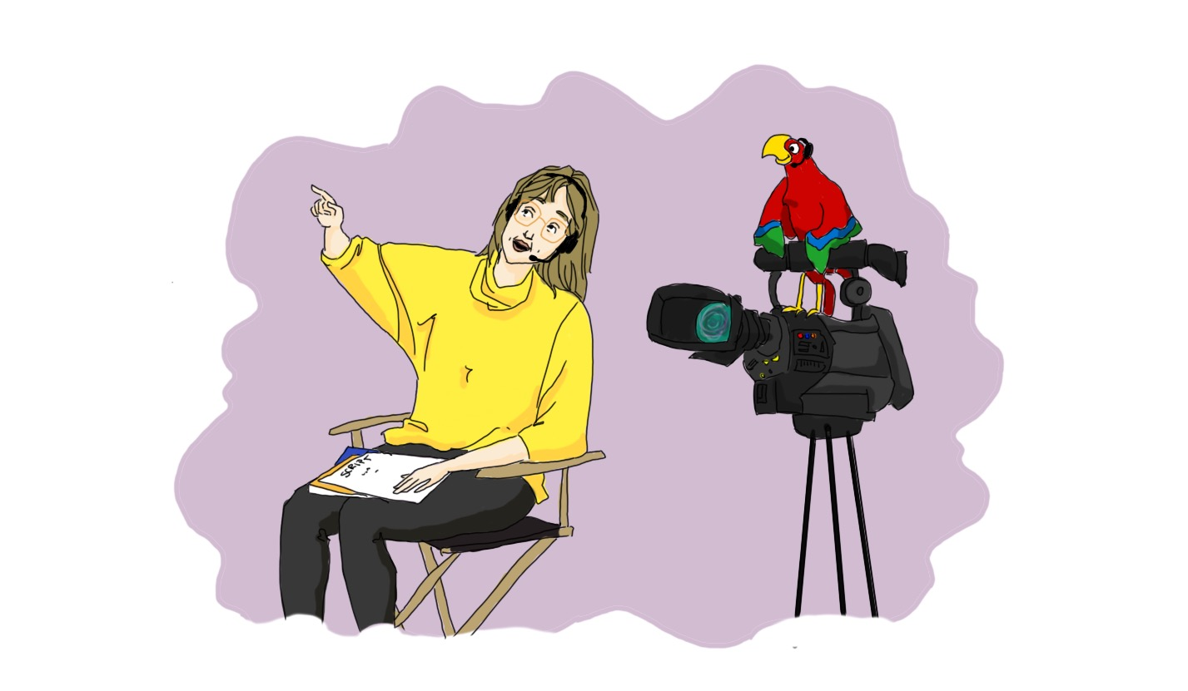
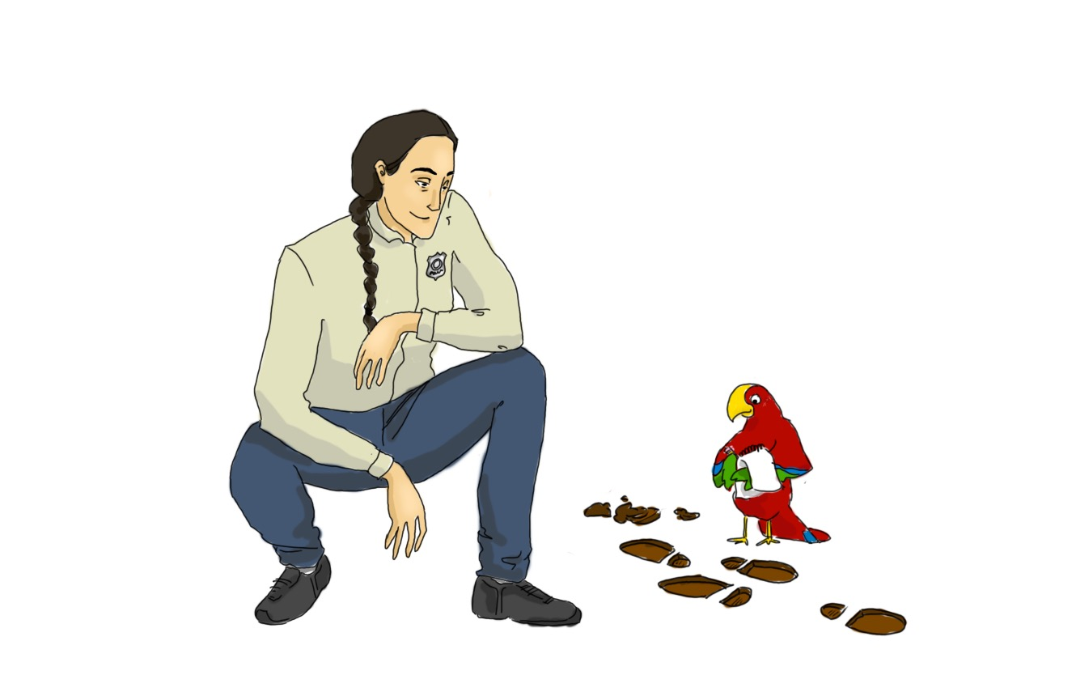
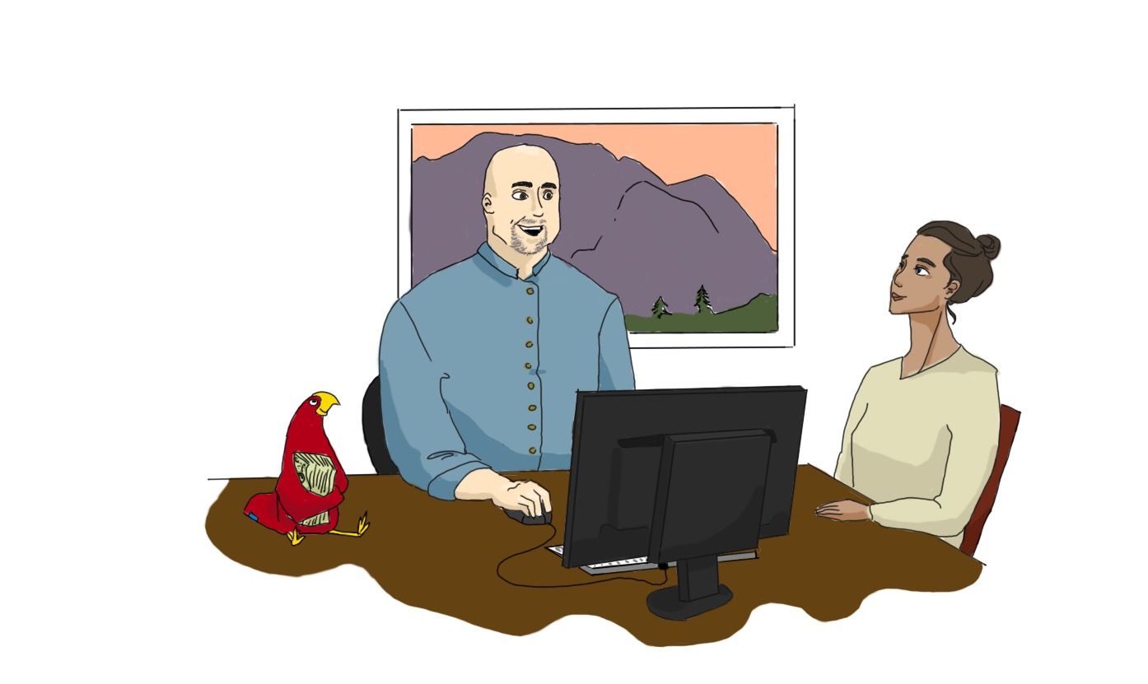
Shannon: Police Officer
Shadmani: Chemist
Cheryl: Freelance Producer
Gloria: TV Network Executive
Jason: Mechanical Engineer
Erin: English Professor
Jason: Plumber
Lisa: Executive Director
Tom: Bank President
Notes:
Anna: What was included in the book and the story of each interviewee

Slide 8
“The Boys and Girls Club of Missoula County aims to provide youth with quality out-of-school time programming with the expressed purpose of inspiring and guiding all young people to develop positive values and realize their full potential as productive, responsible, and caring citizens.”
(The Boys and Girls Club of Missoula, 2018)
Notes:
Meli: Reading the book to the children-their reaction and the impact it may have had, telling to story of implementation

Slide 9
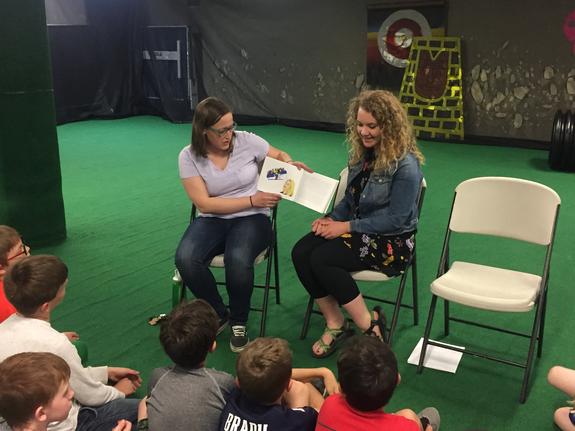
Our Visit to the Boys and Girls Club
Notes:
Meli: Reading the book to the children-their reaction and the impact it may have had, telling to story of implementation

Slide 10
Conclusions
Impact
Trend
Lessons Learned
Response
Donation
Notes:
Nikia: The impact of our project on the students, GLI, our group, and what we learned; the book and how to find it for the future; how we plan to continue our implementation of the project

Slide 11
Bibliography
Auger, Richard W., Anne E. Blackhurst, and Kay Herting. "The Development of Elementary- Aged Children's Career Aspirations and Expectations." Professional School Counseling 8 (2005): 322-9. Web. 25 Oct 2017.
Breen, Richard, et al. "Long-Term Trends in Educational Inequality in Europe: Class Inequalities and Gender Differences." European Sociological Review 26.1 (2010): 31-48. Web. 20 Nov 2017.
Brogdon, Richard E., and Douglas L. Nielson. "Career and Vocational Exploration in the Middle School." Middle School Journal 12 (1981): 10-4. Web. 25 Oct 2017.
Crettaz, Eric, and Cédric Jacot. "Do Family Policies Matter for Educational Outcomes?" European Societies 16.5 (2014): 645-65. Sociological Abstracts. Web. 20 Nov 2017.
Curry, Jennifer R., Christopher T. Belser, and Ian C. Binns. "Integrating Postsecondary College and Career Options in the Middle Level Curriculum." Middle School Journal 44 (2013): 26-32. Web. 25 Oct 2017.
Földvári, Péter, and Bas Leeuwen. "Educational and Income Inequality in Europe, Ca. 1870 - 2000." Cliometrica 8.3 (2014): 271-3000. Web. 20 Nov 2017
Godsey, Michael. "The Inequality in Public Schools." The Atlantic. 15 Jun. 2015. Web. 12 Oct2017 <https://www.theatlantic.com/education/archive/2015/06/inequality-public-schools/395876/>
Hageman, Mary Bowe, and Samuel T. Gladding. "The Art of Career Exploration: Occupational Sex-Role Stereotyping among Elementary School Children." Elementary School Guidance & Counseling 17 (1983): 280-7. Web. 25 Oct 2017.
Hanson, Amy B. "Washington Foundation Grant to Help Montana Students Graduate, Find Careers." The Missoulian. 9 Oct 2017. Web. 20 Nov 2017. <http://missoulian.com/news/state-and-regional/washington-foundation-grant-to-help-montana-students-graduate-find-careers/article_557a2802-620b-5c66-9137-86c3886c95ec.html>
Jensen, Audrey. "Construction Career Days Event Educates Students about Career Options." The Colorado Springs Business Journal (2017) Web. 20 Nov 2017.
Kekelis, Linda S., Rebecca Wepsic Ancheta, and Etta Heber. "Hurdles in the Pipeline: Girls and Technology Careers." Frontiers: A Journal of Women Studies 26 (2005): 99-109. Web. 25 Oct 2017.
Members' Research Service. "Women and Education in the EU." -03-04T13:00:12+00:00 2015. Web. Nov 20, 2017 <https://epthinktank.eu/2015/03/04/women-and-education-in-the-eu/>
Montimurro, Thomas. "A Career Day for Elementary School Students?" Elementary School Guidance & Counseling 14.4 (1980): 263-5. Web.
Morrow, Michael R. "The Influence of Dysfunctional Family Behaviors on Adolescent Career Exploration." The School Counselor 42 (1995): 311-6. Web. 25 Oct 2017.
(p. 229).
Newman, Katherine S., and Hella Winston. "Opinion | Straight from High School to a Career." The New York Times. 15 Apr. 2016. Web. 20 Nov 2017 <https://www.nytimes.com/2016/04/15/opinion/straight-from-high-school-to-a-career.html>
Parks, Beverly J. "Career Development-how Early?." The Elementary School Journal 76 (1976): 469-74. Web. 25 Oct 2017.
Perasso, Valeria. "We Can't Teach Girls of the Future with Books of the Past'." BBC News. Web. 12 Oct 2017 <http://www.bbc.com/news/world-41421406>
Tough, Paul. "Who Gets to Graduate?" The New York Times. 15 May 2014. Web. 20 Nov 2017 <https://www.nytimes.com/2014/05/18/magazine/who-gets-to-graduate.html>
Notes:
Nikia: The impact of our project on the students, GLI, our group, and what we learned; the book and how to find it for the future; how we plan to continue our implementation of the project

Slide 12
Thank You!
University of Montana
Franke Global Leadership Initiative
Notes:
Nikia: The impact of our project on the students, GLI, our group, and what we learned; the book and how to find it for the future; how we plan to continue our implementation of the project

