Slide 1
WHERE DO ALL THE BATS GO IN THE WINTER? DO BATS HIBERNATE IN TALUS SLOPES?
Sarah M Gaulke*, University of Montana Wildlife Biology
UMCUR- 4/27/2018
Dan A Bachen, Montana Natural Heritage Program
Erick P Greene, University of Montana Wildlife Biology
Alexis L McEwan, Montana Natural Heritage Program

Slide 2
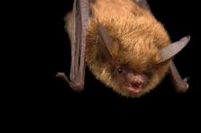
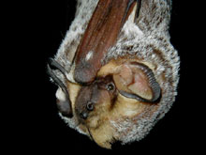
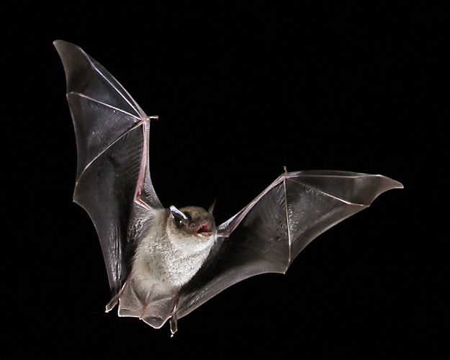
Significance of bats
Pest control & nutrient dispersal
Use echolocation for navigation & food
15 bat species in Montana
At risk from White Nose Syndrome
Notes:
single little brown bat can consume 1200 mosquitoes in one hour
15 bat species – 9 thought to hibernate

Slide 3
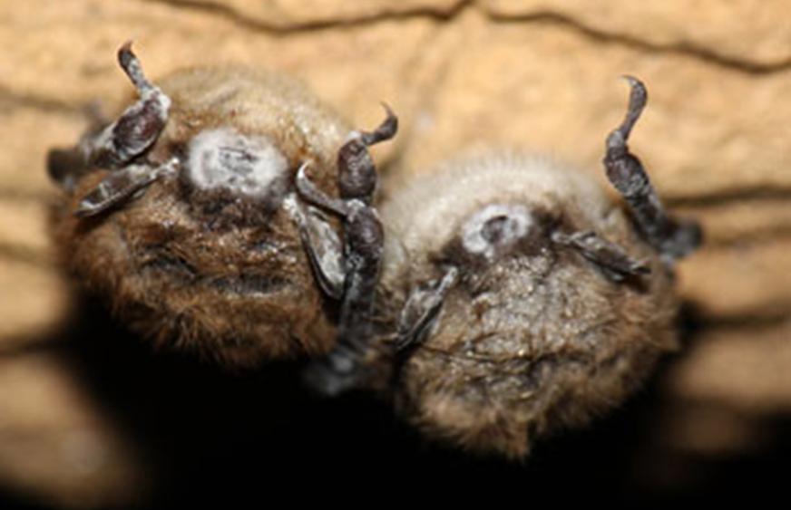
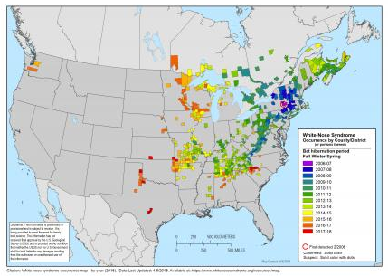
White Nose Syndrome
Fungus: Pseudogymnoascus destructans
Reduces fat stores during winter until death
Found 650km away in Washington
Need to record a baseline of activity before the disease hits
Notes:
5.7-6.7 million bats killed on the East Coast
2026, Little Brown is estimated to be extinct
Easily spread from either side of the US

Slide 4
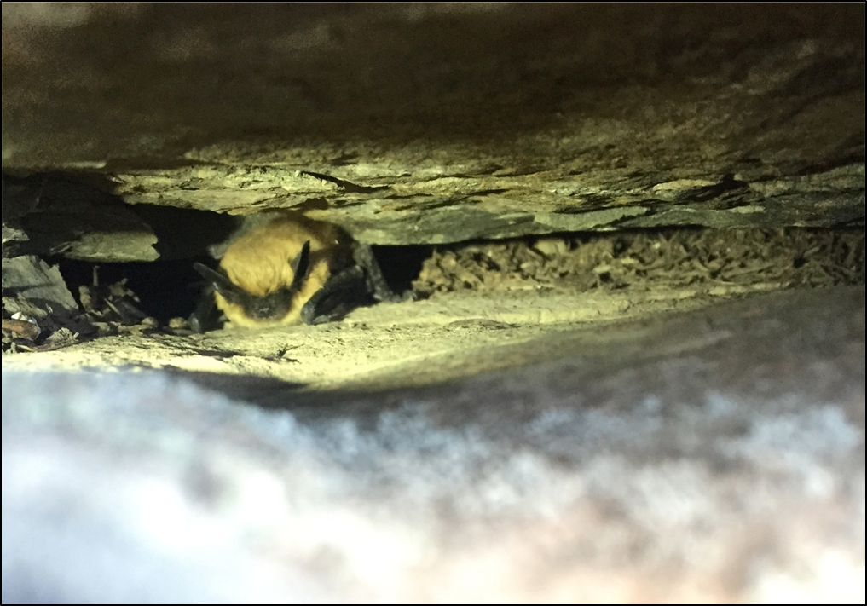
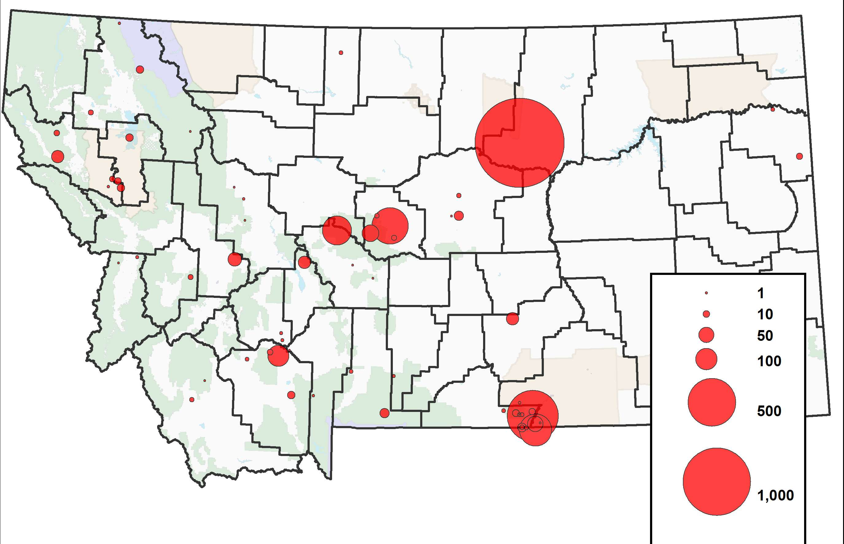
BAT Roosting & hibernation
Roost communally in East Coast
Roost individually or small communities in West Coast
Only know where 4,000 bats hibernate in MT
Notes:
Half a million bats in this one cave
Not many red dots because not many caves or mines in the bitterroot valley

Slide 5
Notes:
All the bats of Montana
10 we think hibernate in Montana – found via cave surveys or acoustic detections
Stars indicated ones affected by White Nose Syndrome- either vectors are affected by symptoms - over one third of MT bats

Slide 6
Objectives
Identify if bats are active near talus slopes during the winter
Record activity to use as a baseline to assess future impacts of White Nose Syndrome
Assess microclimate variables of talus slopes to identify preferred microclimates

Slide 7
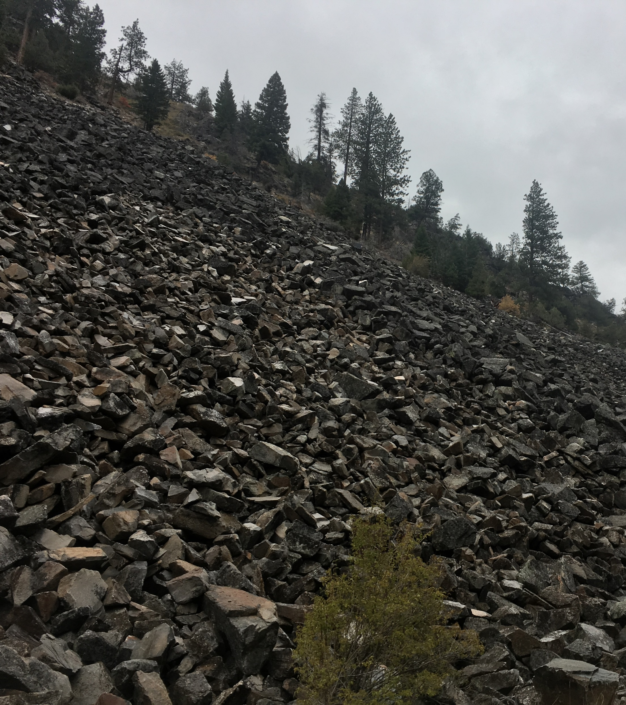
Talus Slopes
Detections have occurred near talus slopes
Similar climates & features to caves
Summer Roost Surveys found 42 bats and 39 guano samples
Talus can provide suitable summer roosting habitat
Notes:
We are answering this question by looking at if bats present at talus slopes preceding and during the hibernation period?
Pressure differential
Nothing else really over talus slopes – no insects or water

Slide 8
Methods
10 long-term acoustic detectors/recorders from Oct – May
Record 30-min before sun down to 30-min after sun-up
Talus Variables:
Rock Size
Rock Depth (estimate)
Aspect
Air Flow
Temperature & Humidity
HOBO climate monitors inside the talus slopes
Notes:
Detecting acoustic passes where bats would otherwise not be

Slide 9
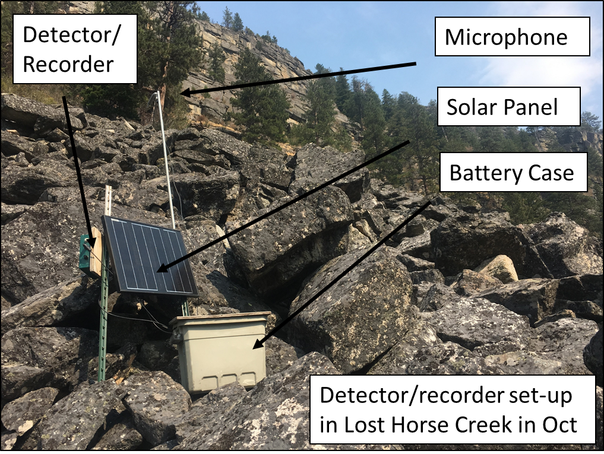

Slide 10
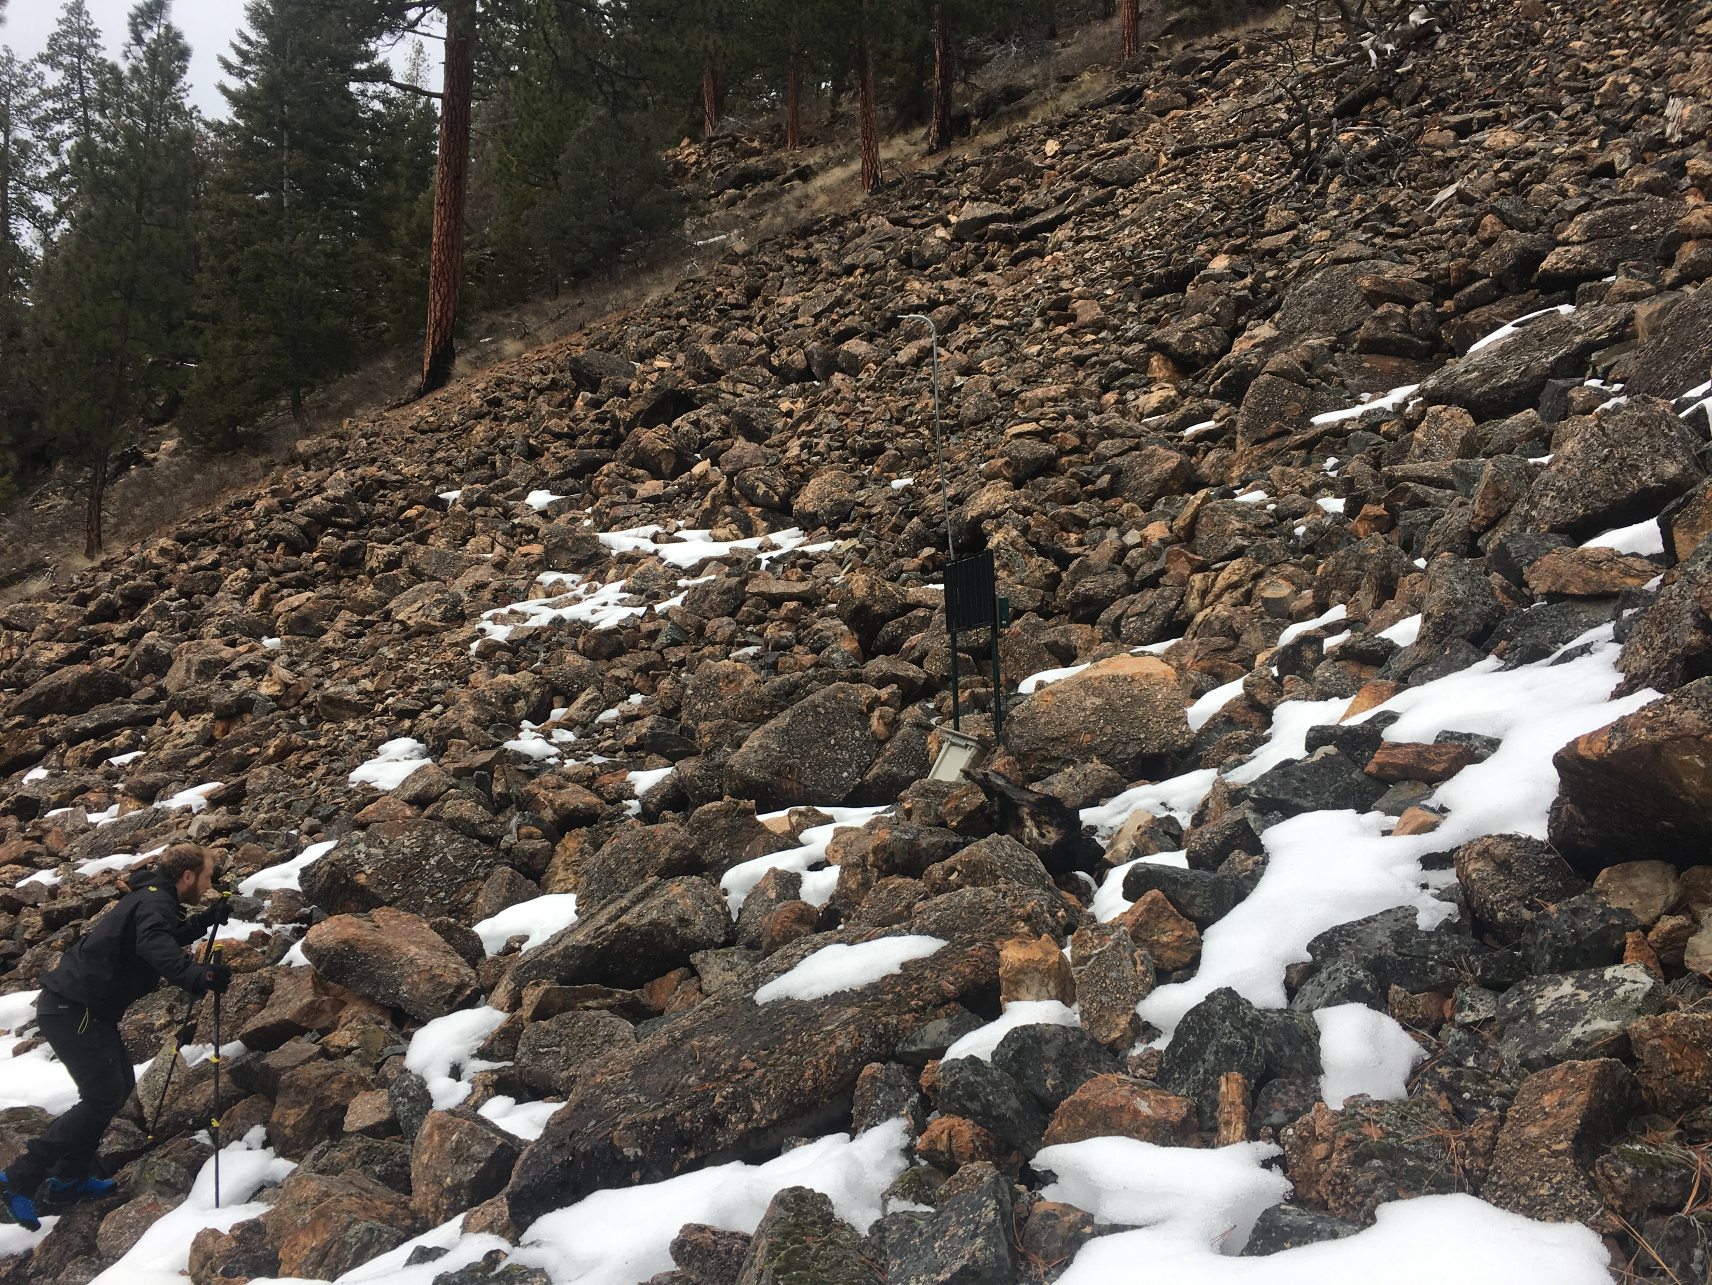
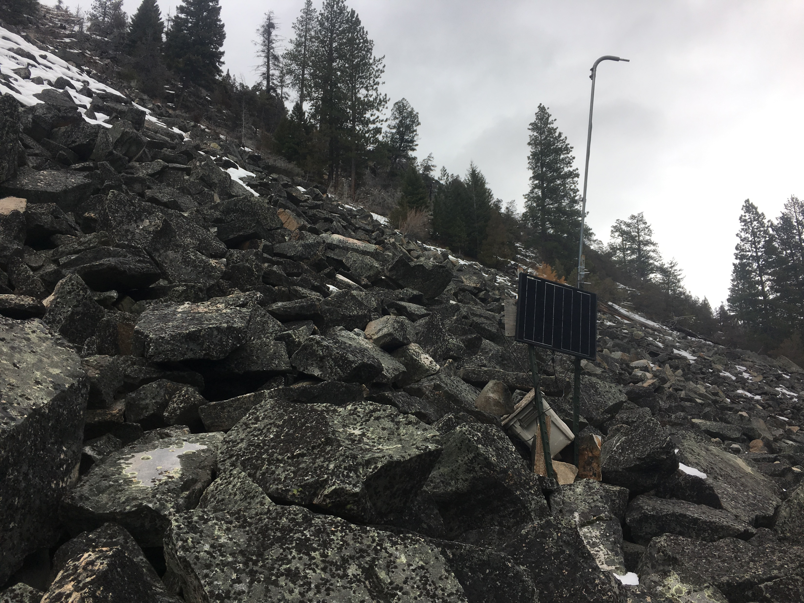
Winter data collection – Feb 7

Slide 11
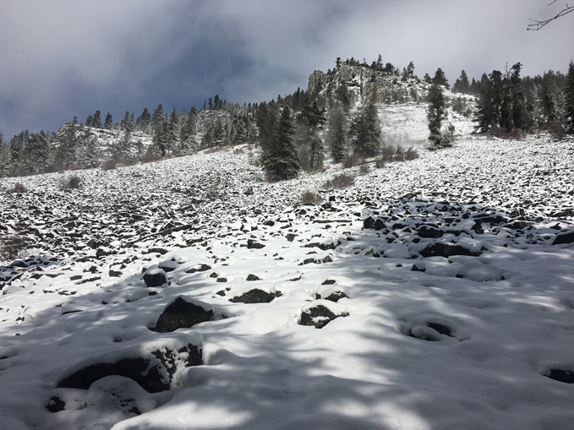
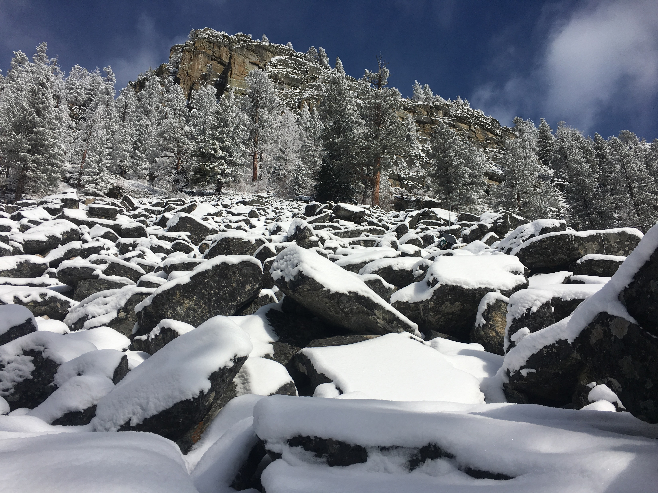
Winter Data Collection – Feb 10

Slide 12
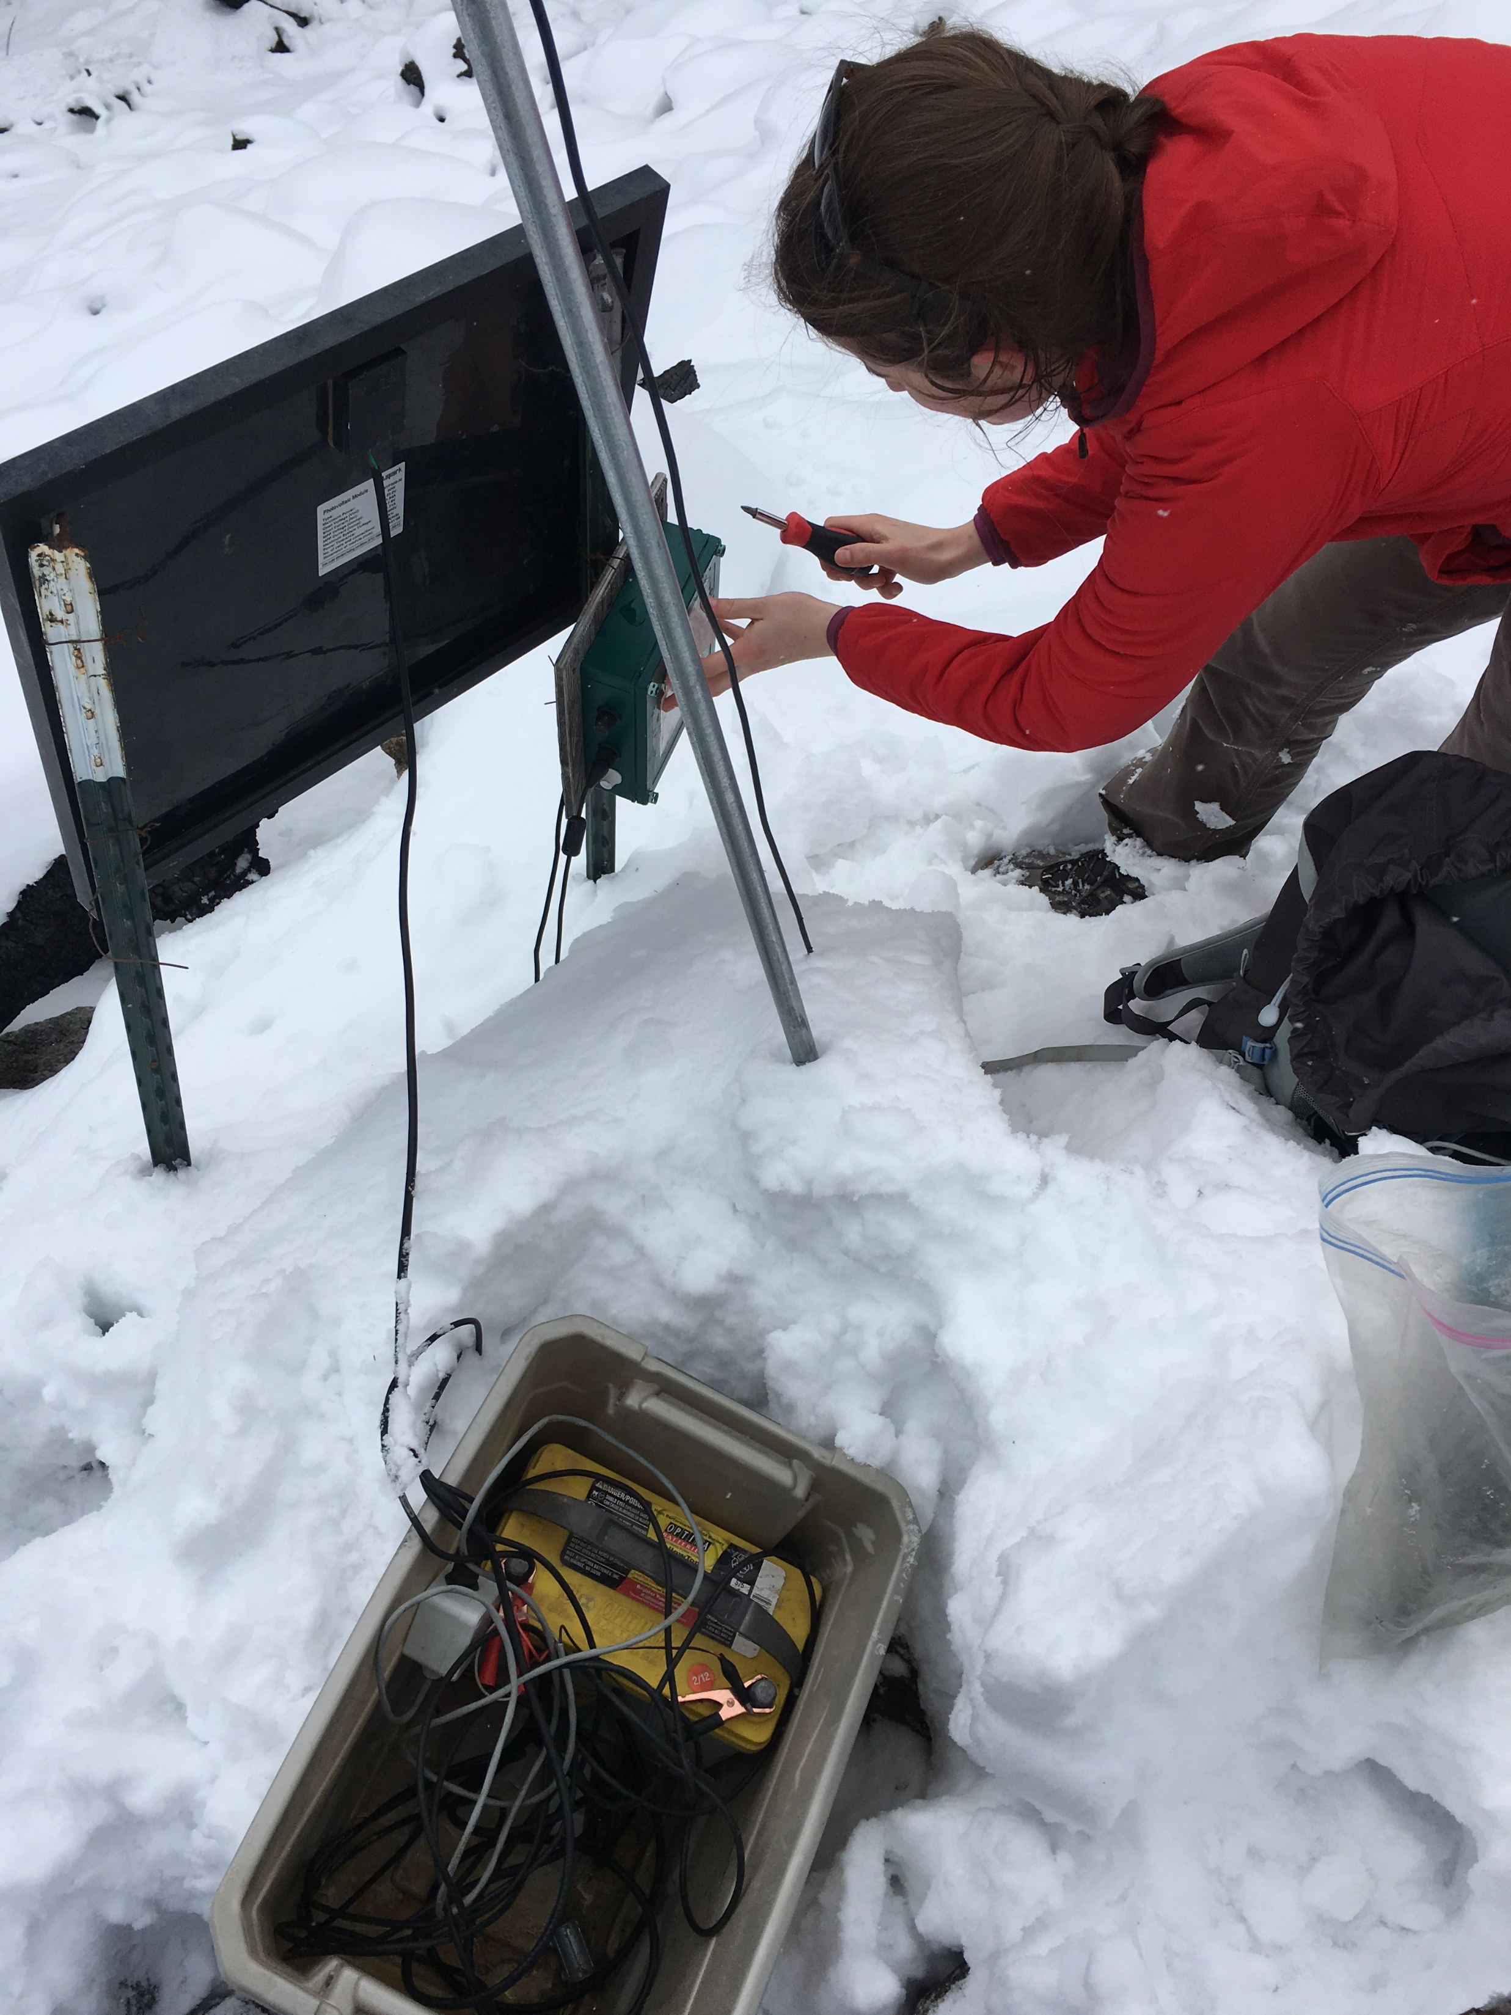
Winter Data Collection – Feb 19

Slide 13
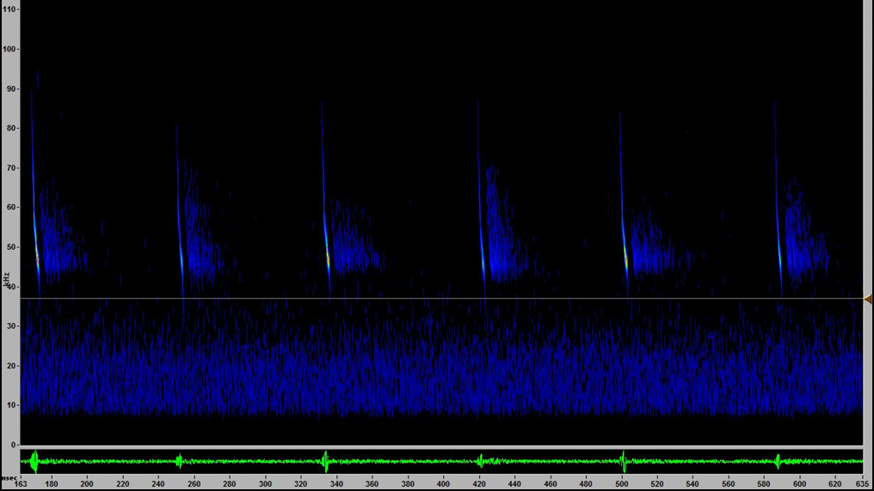
Echolocation Call Data
1. Number of Calls
2. Timing of Calls
3. Frequency of Calls
Notes:
Data Analysis
Number of Calls – type of calls
Timing of Calls
Frequency of Calls

Slide 14
Results: Detectors are finicky

Slide 15
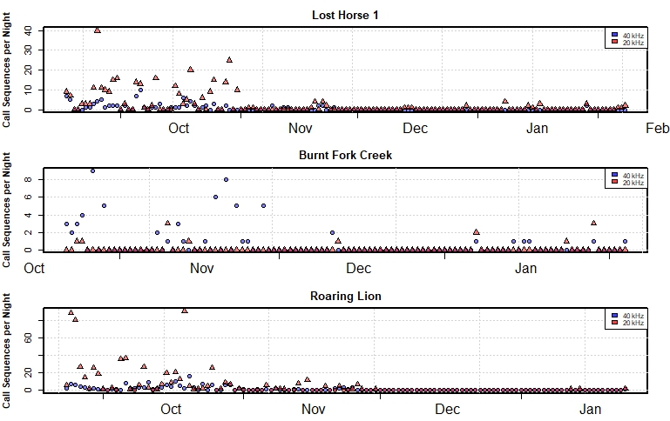
Results
Bats are active over talus slopes!
Shows fall swarming behavior
Notes:
Calls recorded in the middle of the night
One 30 ft radius extrapolated across 600m field
Many large and frequent talus slopes across landscape

Slide 16
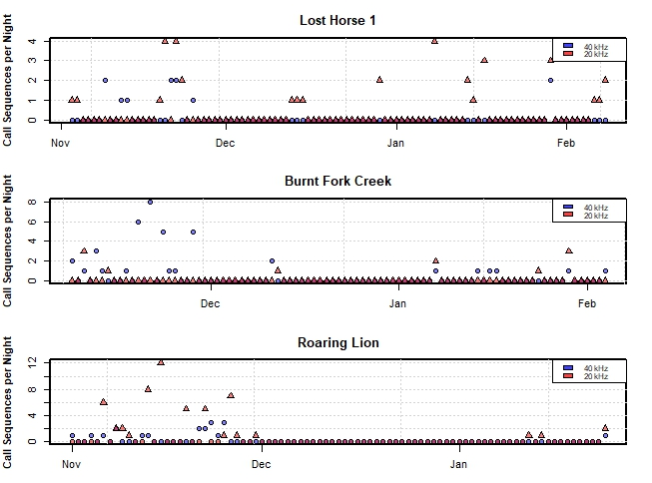
Winter Months
Bats are active over talus in the winter!
Both 20 and 40 kHz bats
Predominantly at dusk, but also in the middle of the night

Slide 17
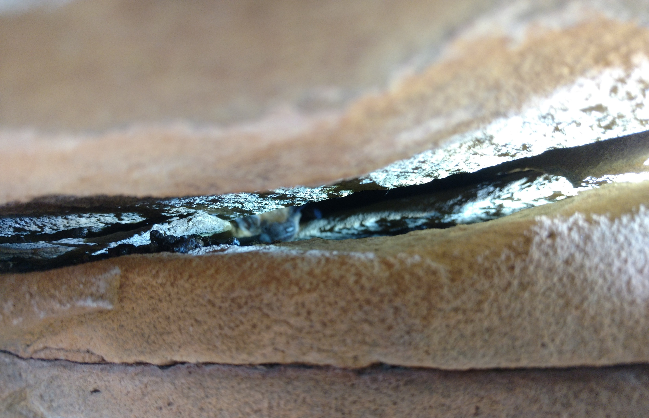
implications
Better bat management in Western states and Canada
Base line understanding of Montana’s bats
Assess and mitigate White Nose Syndrome
Notes:
Establishing a baseline understanding of bat hibernation leads to better management decisions and provides data to inform better White-Nose Syndrome mitigation efforts if P. destructans is found
Prevent roost disturbance
Also applicable to most Western States and Canada
Emphasize new habitat

Slide 18
Acknowledgements
Dan Bachen
Erick Greene
Alexis McEwan

Slide 19
Questions?

