Slide 1
"White Folks Has Everything They Need":
Diversity and Inclusivity at the University of Montana
Emily Gillispie

Slide 2
How the University has been both successful and unsuccessful in reflecting a specific stance toward, responsibility for, and engagement with issues of diversity?

Slide 3
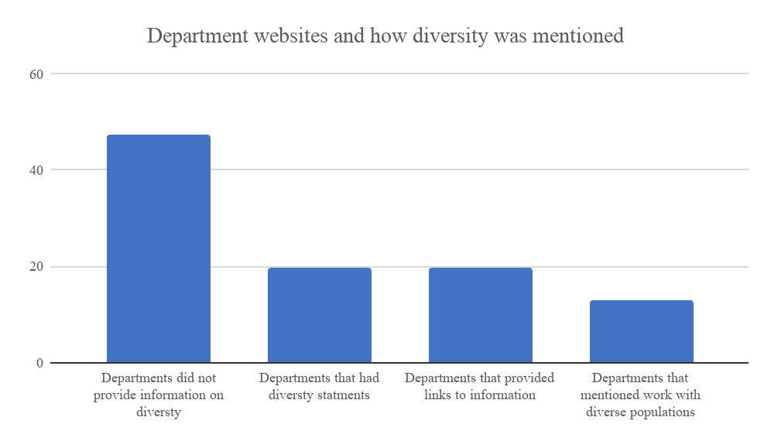
How diversity was mentioned on department websites

Slide 4
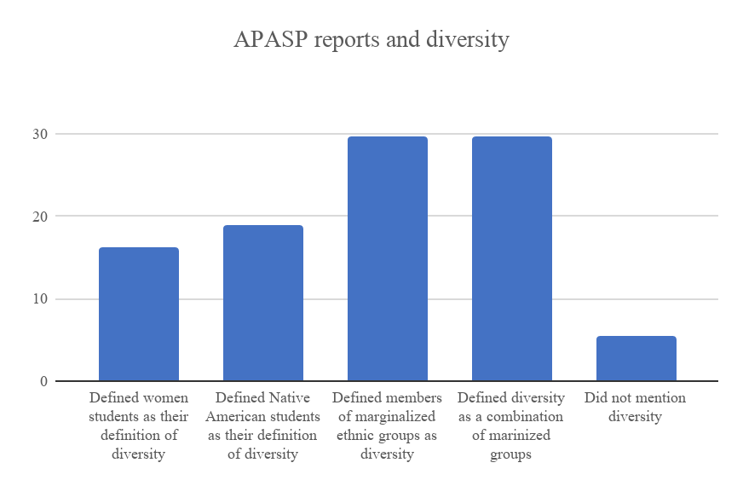
APASP reports and diversity

Slide 5
President lecture series demographics

Slide 6
“We are a community committed to seeking and celebrating diversity and to supporting the growth and development of people from all backgrounds and all walks of life.”

Slide 7
Tokenism : the policy or practice of making only a symbolic effort (as to desegregate)
Harassment : aggressive pressure or intimidation.
Stereotypes : a widely held but fixed and oversimplified image or idea of a particular type of person or thing.

Slide 8
Experiences of marginalized students
“Being talked at as if you know my kind, and being isolated and alienated when I don't fit that mold of what you think I am. I am crimazed as if I am going to steal something.”
“It’s tough being on the asexual spectrum.. I had a nurse practitioner at Curry tell me my asexuality will pass.”
“My fiance has gotten a couple of Nazis come up to him on campus while he was wearing his keffiyeh… One guy went as far as to find out where we lived and threatened to murder and rape me.”

Slide 9
What changes should be made: In the words of margenzled students
“There should a be well balanced way to encourage students to perform the type of critical thinking that allows you to talk to others outside of your own religion and ethnicity.”
“The university does try but, they don't do it in a manner that works, they need to change their strategy to something more successful… Maybe they should have something where there are more talks on different types of minorities.”
“I think it would be good to along with alcohol education that students would have to take an Ally Training.”

