Slide 1
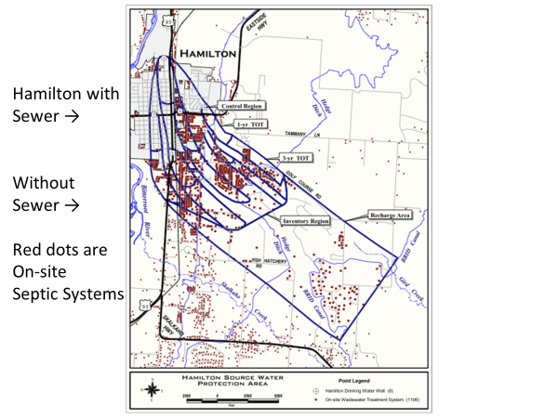
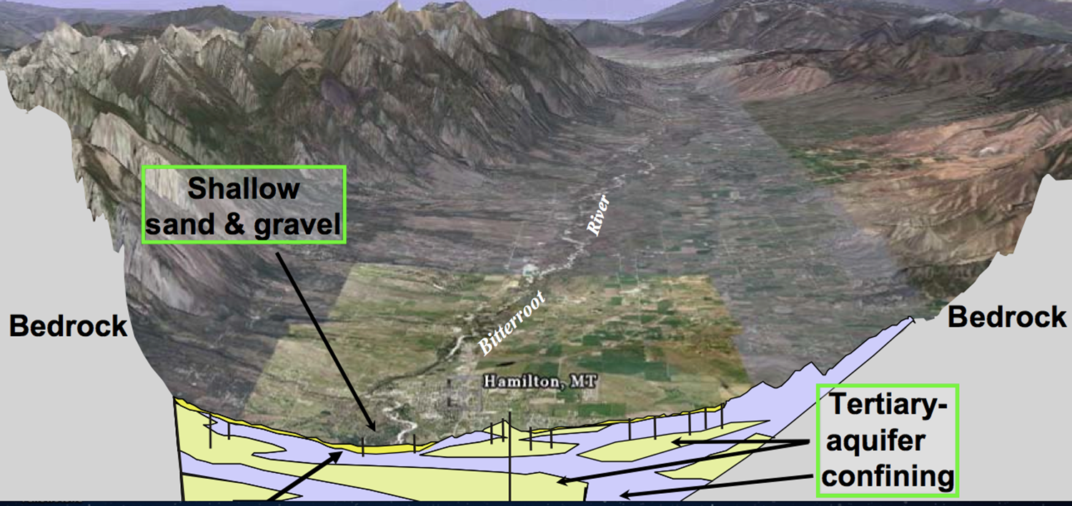
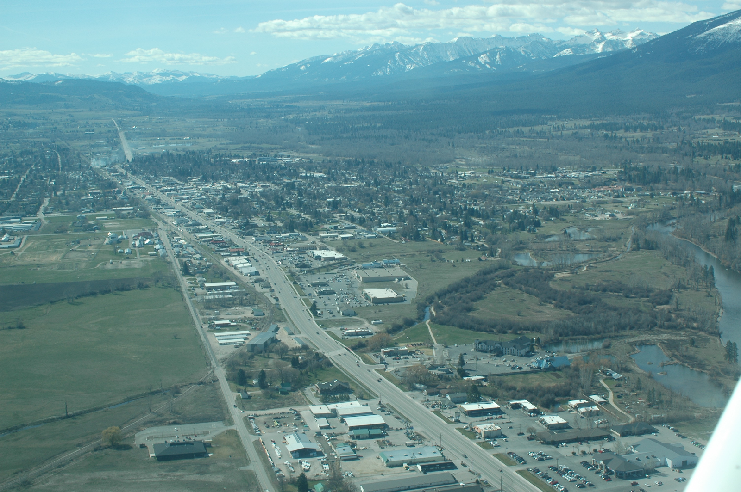
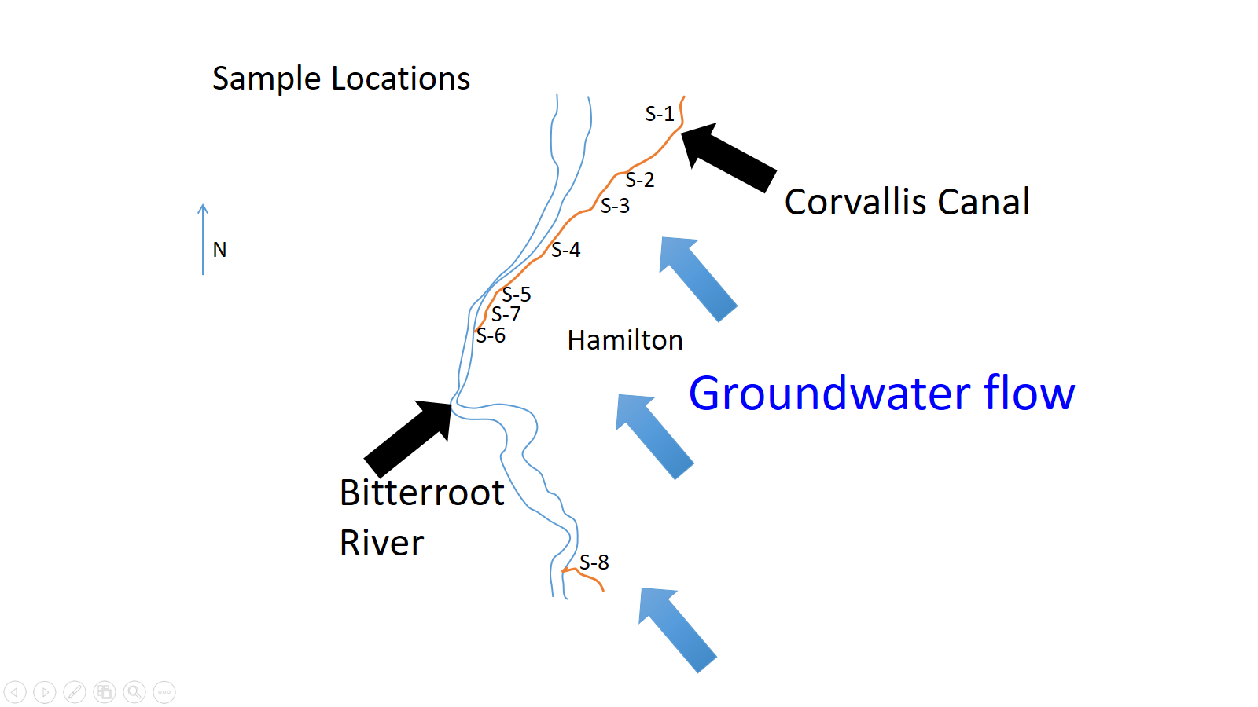
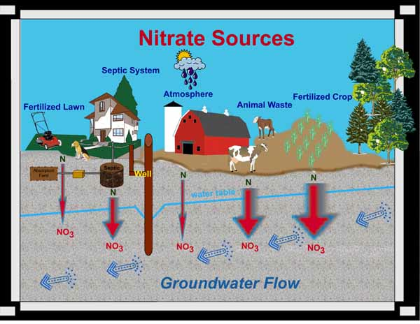
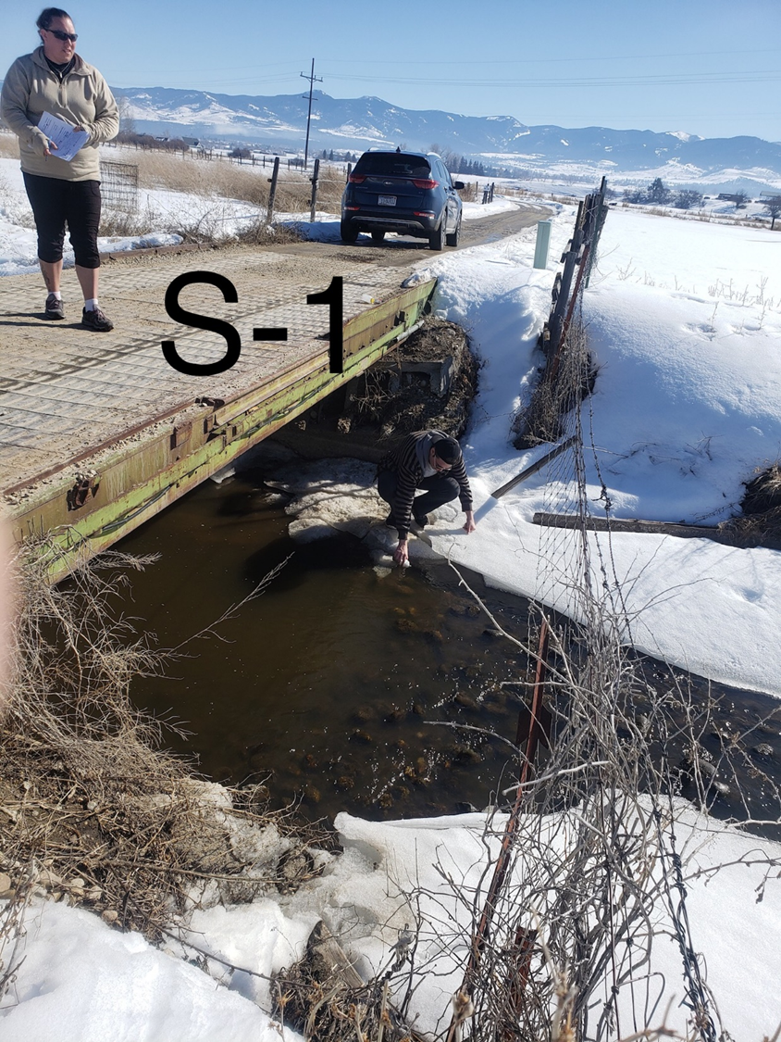
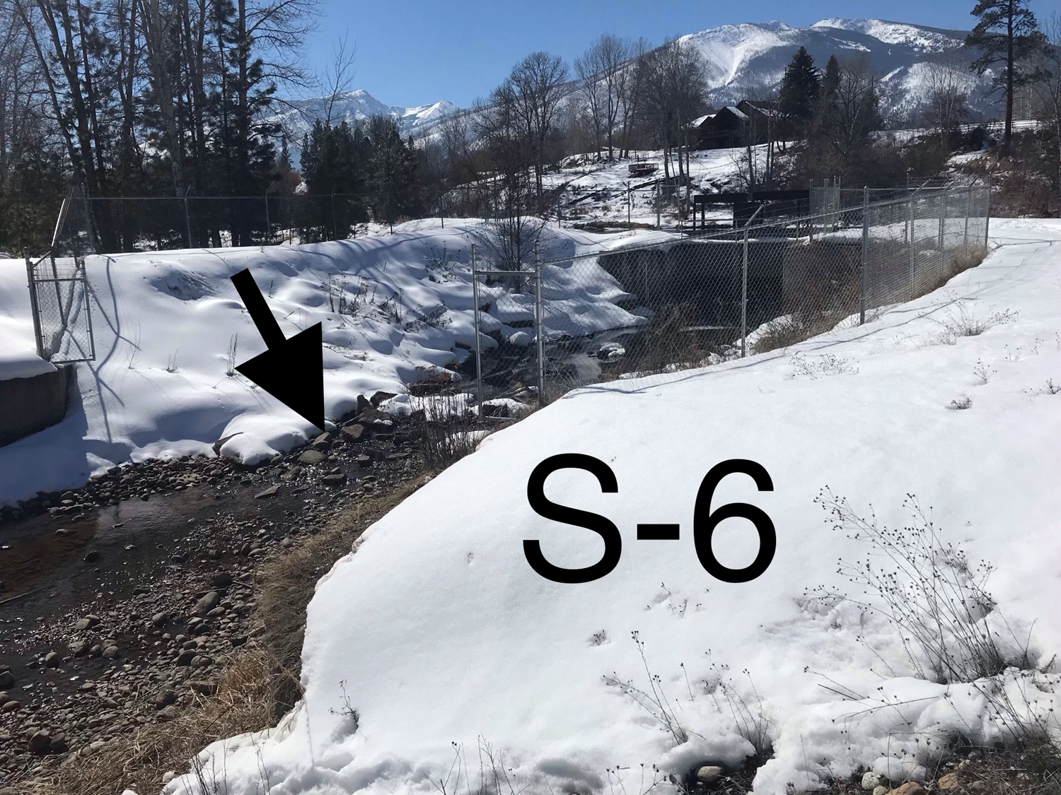
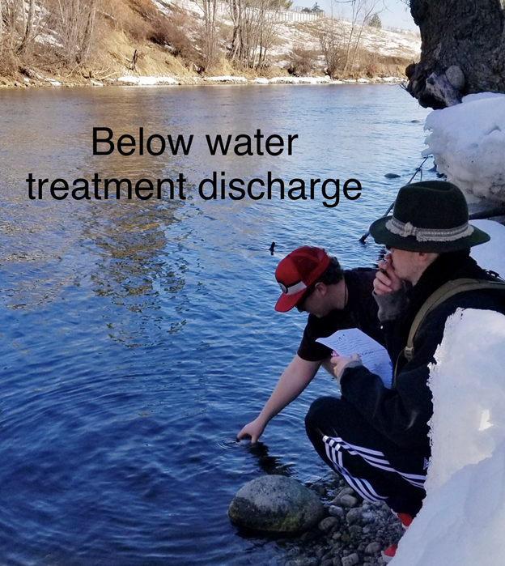
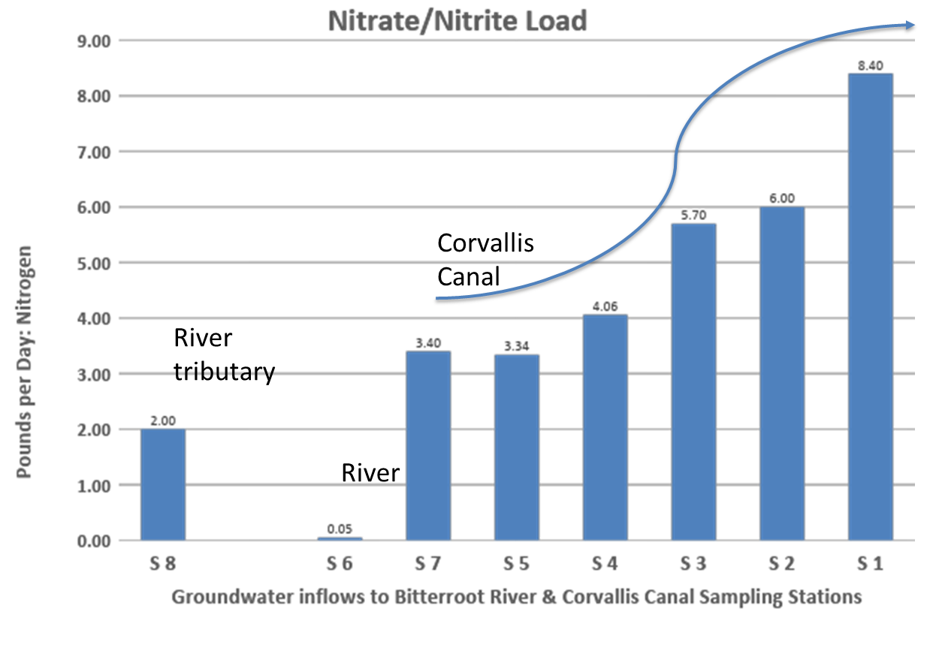
Establishing groundwater Nitrate/Nitrite levels In Hamilton, Montana & local area March 2019
Qwinn Lulis, Amber Harbin, Maria Goman, Steven Christensen, Alis Auch, April Anglea, Paul Gabriel, India Hite, Rosalie Carter, Riley Clairmont, Barbara McCrorey, Alec Brown, Kendall Moody, Austin Hicks, Aldo Rodriguez, Makayla Gandara, Andrea Poulin, Desi Zeto, Ryan Mott, Arthur Reyes, Kade Hudgins, Ali Borgen
Mentor: George Furniss
ABSTRACT
Water resources are often impacted by nitrate (NO₃) and nitrite (NO₂) from agricultural feed lots, over fertilized soils, septic leach fields, leaky sewer lines, and municipal wastewater treatment plants. Bitterroot College has been investigating nitrogen in groundwater the past five years. We discovered (1) that inflowing surface water from wilderness areas, public lands, and the Bitterroot River is pristine with respect to nitrogen but that, (2) some wells used for drinking water in our valley test above the standard of 10 parts per million (ppm) and can be dangerous. The health concern of high nitrate/nitrite levels in drinking water is methemoglobinemia. As a community awareness project we sampled 18 randomly selected wells and 8 springflow surface water sites in the Hamilton area, and the Bitterroot River and had the water samples analyzed for nitrate/nitrite at Energy Labs, Helena, Montana. All of our springflow samples and the river samples were collected on March 20, 2019 and all of the wells were sampled the following two days. We used standardized collection methodology. Three of our samples (ten percent) were duplicates or blank distilled water for quality assurance and quality control.
Our 8 springflow samples were repeat locations situated on the down-gradient, west and north edge of Hamilton that indicated a nitrate/nitrite load of about 8 pounds per day in March 2018. Results indicate we successfully verified the nitrate/nitrite loading discovered in 2018. Trends this year are neither increasing nor decreasing in concentration. Nitrate (NO₃) and nitrite (NO₂) background levels in natural groundwater systems should be less than 10 ppm (U.S. Geological Survey). Seventeen of our well water samples were under 2 ppm and safe. One well was 23.8 ppm, far above the standard for human health. We notified the landowner.
Hamilton, MT
(view south)
Corvallis Canal
Health Effects of Nitrates in Water
The most commonly known health concern of high nitrate levels is methemoglobinemia, or better known as blue baby syndrome. The name blue baby syndrome is used because the baby actually starts to turn blue from not having enough oxygenated blood in circulation. Babies under six months of age are sensitive to nitrates and therefor cannot deal with them as older humans do. As the nitrites circulate in the babies body it produces methemoglobin. Hemoglobin is what carries oxygen through our body via our blood stream. Methemoglobin as well as hemoglobin both contain iron, however unlike hemoglobin methemoglobin contains the Fe3+ state of iron. Hemoglobin contains the Fe2+ state. This difference in charge is what makes oxygen unable to bond with methemoglobin, and when methemoglobin is produced in excess this can lead to poorly oxygenated blood. Nitrates could also be considered as carcinogens to humans.
What can we do? Community-based water well testing!
Economy
Nitrates/nitrites are also an environmental threat because they
cause eutrophication damage to surface water aquatic
environments in the Bitterroot River. The Bitterroot River
is a valuable fishery with an annual contribution to the economy.
What can we do? Community-based nutrient monitoring!
2019 | Well at lower Sleeping Child Creek | N=0.85 mg/L
2019 | Well at near Pinedale | N=23.8 mg/L
2019 | Well at Shoshone Rd, Hamilton | N=0.15 mg/L
2019 | Well at Wood Ln | N=1.02 mg/L
2019 | Well at Little Joe Ln, south of Hamilton | N=0.02 mg/L
2019 | Well north of Hamilton on Corvallis Rd | N=1.15, 1.14 mg/L
2019 | Well at Blue Lupine Ln, Victor | N=0.18 mg/L
2019 | Well at Riverside Gas Station, Hamilton | N=1.69 mg/L
2019 | Well at Hamilton | N=0.38 mg/L
2019 | Well at 101 7th street, Hamilton | N=1.68 mg/L
2019 | Well at 121 West Hills way, Hamilton | N=0.27 mg/L
2019 | Well at Blue Lupine Ln, Victor | N=0.09 mg/L
2019 | Well at Hamilton | N=1.48 mg/L
2019 | Well at Christian Academy, Grantsdale | N=0.83 mg/L
2019 | Well at Honeyhouse Ln, Corvallis | N=1.68 mg/L
2019 | Well at Market St, Corvallis | N=1.67 mg/L
2019 | Well at Westside Rd near Roaring Lion | N=non-detectable mg/L
2019 | Well on ridge above Ricketts Rd | N=0.53 mg/L
 | QAQC
2019 | Distilled Water Blank | N=0.05 mg/L
2019 | S-1 and S-1 duplicate | N=0.43, 0.42 mg/L
2019 | Well north of Hamilton above | N=1.15, 1.14 mg/L
Research Methods:
We followed best practices and protocols for water quality sampling
We collected all of our water samples within a short amount of time within the second week of march 2019.
For quality assurance and quality control we collected duplicates and blanks and sent these blindly to Energy Labs.
All of our duplicates were closely identical and all of our blanks were less than 0.05mg/L; these were ten percent of our samples.
This project was supported by: Dr. Jay Johnson
Patti Furniss Education Memorial Fund
Energy Labs institutional discount
2018
Conclusions:
All the nitrate/nitrite in wells that we have tested so far
are at safe levels, except for two wells that are dangerously unsafe.
We notified the homeowners.
Given the pristine quality of the water flowing into the
Bitterroot Valley from the wilderness (nitrates non-detectable)
and the quality of the Bitterroot River (nitrates equal to distilled
water), we believe that nitrates in groundwater that we have
studied should be at lower concentrations than we found.
(The graphs show that the nitrogen loading is increasing as we travel down the canal. This means that, gradually, nitrogen filled water is percolating out from the aquifer under Hamilton)

