Slide 1
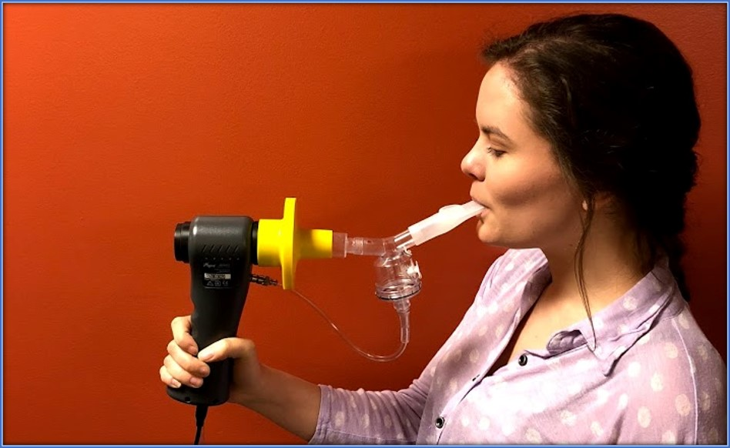
By: Emma Bozarth B.A, Sarah Campbell, Serena Haller B.A., Claire Malany, Sarah Popp, Jane Reynolds, M.S., CCC-SLP Sarjubhal Patel, Ph.D., & Laurie Slovarp, Ph.D., CCC-SLP, BCS-S
Use of Capsaicin for Desensitization of the Cough Reflex
VOICES (Voice Outcomes and Inquiry of Cough and Essentials in Swallowing) Lab
Introduction
Up to 20% of patients who suffer from chronic cough do not respond to medical treatment⁴. They are said to have refractory chronic cough (RCC). Research has shown the underlying cause of RCC in many patients is hypersensitivity in the airway leading this subset of cough termed cough hypersensitivity syndrome (CHS) ³. Many patients with CHS are successfully treated with behavioral cough therapy (BCT). BCT primarily consists of suppressing the cough. Within 2-4 weeks the sensitivity returns to normal. Experts theorize the change is due to the use-it or lose-it principle of neuroplasticity¹. Although BCT is an effective treatment in up to 88% of patients with RCC⁴, some patients have such significant CHS they cannot suppress at all. We hypothesize these patients would benefit from BCT if they could be presented with a cough stimulant strong enough to elicit an urge-to-cough but weak enough for cough suppression.
Purpose
The purpose of this study is to determine efficacy of decreasing cough sensitivity through use of cough suppression strategies following inhalation of capsaicin in gradually increasing doses, across repeated treatment sessions.
Research Question
Is it possible to decrease cough sensitivity by exposing patients with chronic refractory cough to increasing doses of aerosolized capsaicin (a known cough stimulant) combined with active cough suppression?
Healthy Patient Feasibility Trial
Single cohort design (N=5) of healthy participants
Results
Four out of five subjects (N=5) were able to successfully suppress their cough at the highest capsaicin dose (1000 uM) by the final treatment session. Cough sensitivity for all 5 participants significantly reduced at 1 and 3 weeks post treatment.
Study Design
Single blinded (assessors) randomized control trial
Experimental group (capsaicin)
Placebo group (saline)
The Koko Digidoser nebulizer is used to deliver a standard amount of capsaicin on a single inhale
C5 at baseline, 1 week, 3 weeks post-treatment
Baseline Measures
Leicester Cough Questionnaire
Treatment Sessions
2x/week for three weeks
Practice cough suppression following inhalation of capsaicin or placebo at increasing doses
Outcome Measures (1 and 3 weeks post)
cough sensitivity
Cough sensitivity: concentration of capsaicin that causes two coughs (C2) and five coughs (C5)
Leicester cough questionnaire
Discussion
High impact potential for patients and health care system
Desirable treatment option (non-invasive, safe, inexpensive, not a medication)
Could be standardized and provided by a variety of practitioners (e.g., medical practitioners, respiratory, speech, and occupational therapists, etc.)
Cough Suppression Strategies
Cough control breathing
sip water
hard swallow
Non-medicated lozenge
Funding
References
1. Gibson, P. G., & Vertigan, A. E. (2015). Management of chronic refractory cough. BMJ (Clinical Research Ed.), 351, h5590. doi:10.1136/bmj.h5590 [doi]
2. Morice, A. H., Faruqi, S., Wright, C. E., Thompson, R., & Bland, J. M. (2011). Cough hypersensitivity syndrome: A distinct clinical entity. Lung, 189(1), 73-79. doi:10.1007/s00408-010-9272-1 [doi]
3. Ryan, N. M., Vertigan, A. E., Bone, S., & Gibson, P. G. (2010). Cough reflex sensitivity improves with speech language pathology management of refractory chronic cough. Cough (London, England), 6, 5. doi:10.1186/1745-9974-6-5 [doi]
4. Slovarp, L., Loomis, B. K., & Glaspey, A. (2018). Assessing referral and practice patterns of patients with chronic cough referred for behavioral cough suppression therapy. Chronic Respiratory Disease, 15(3), 296-305. doi:10.1177/1479972318755722 [doi]
5. Vertigan, A. E., Theodoros, D. G., Gibson, P. G., & Winkworth, A. L. (2007a). Review series: Chronic cough: Behaviour modification therapies
for chronic cough. Chronic Respiratory Disease,4 (2), 89-97. doi:10.1177/1479972307078099
Participants
Patients with RCC who have received BCT without full resolution of their cough

