Slide 1
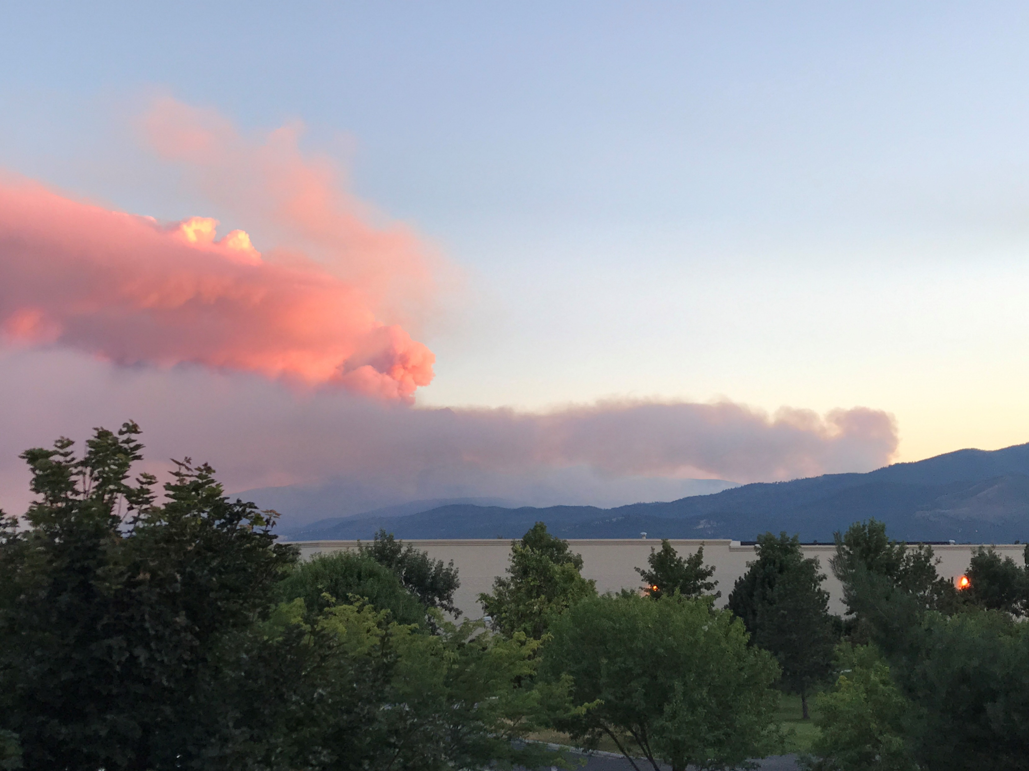
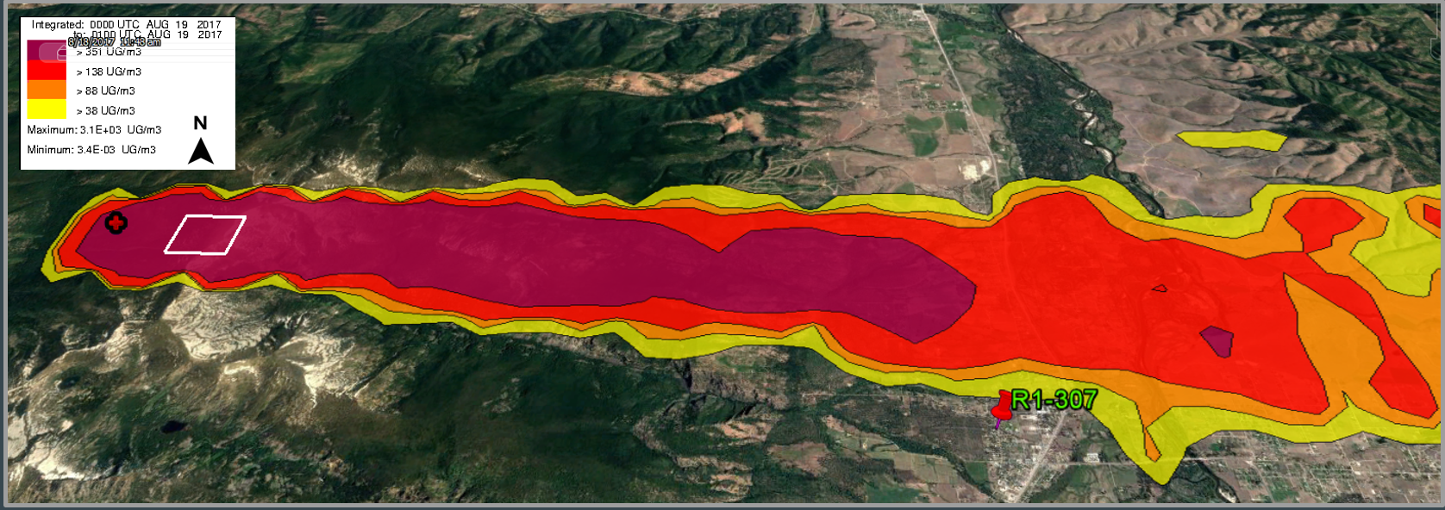
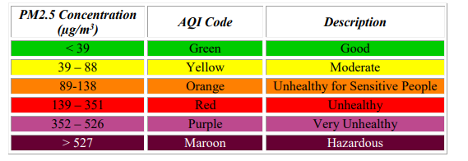
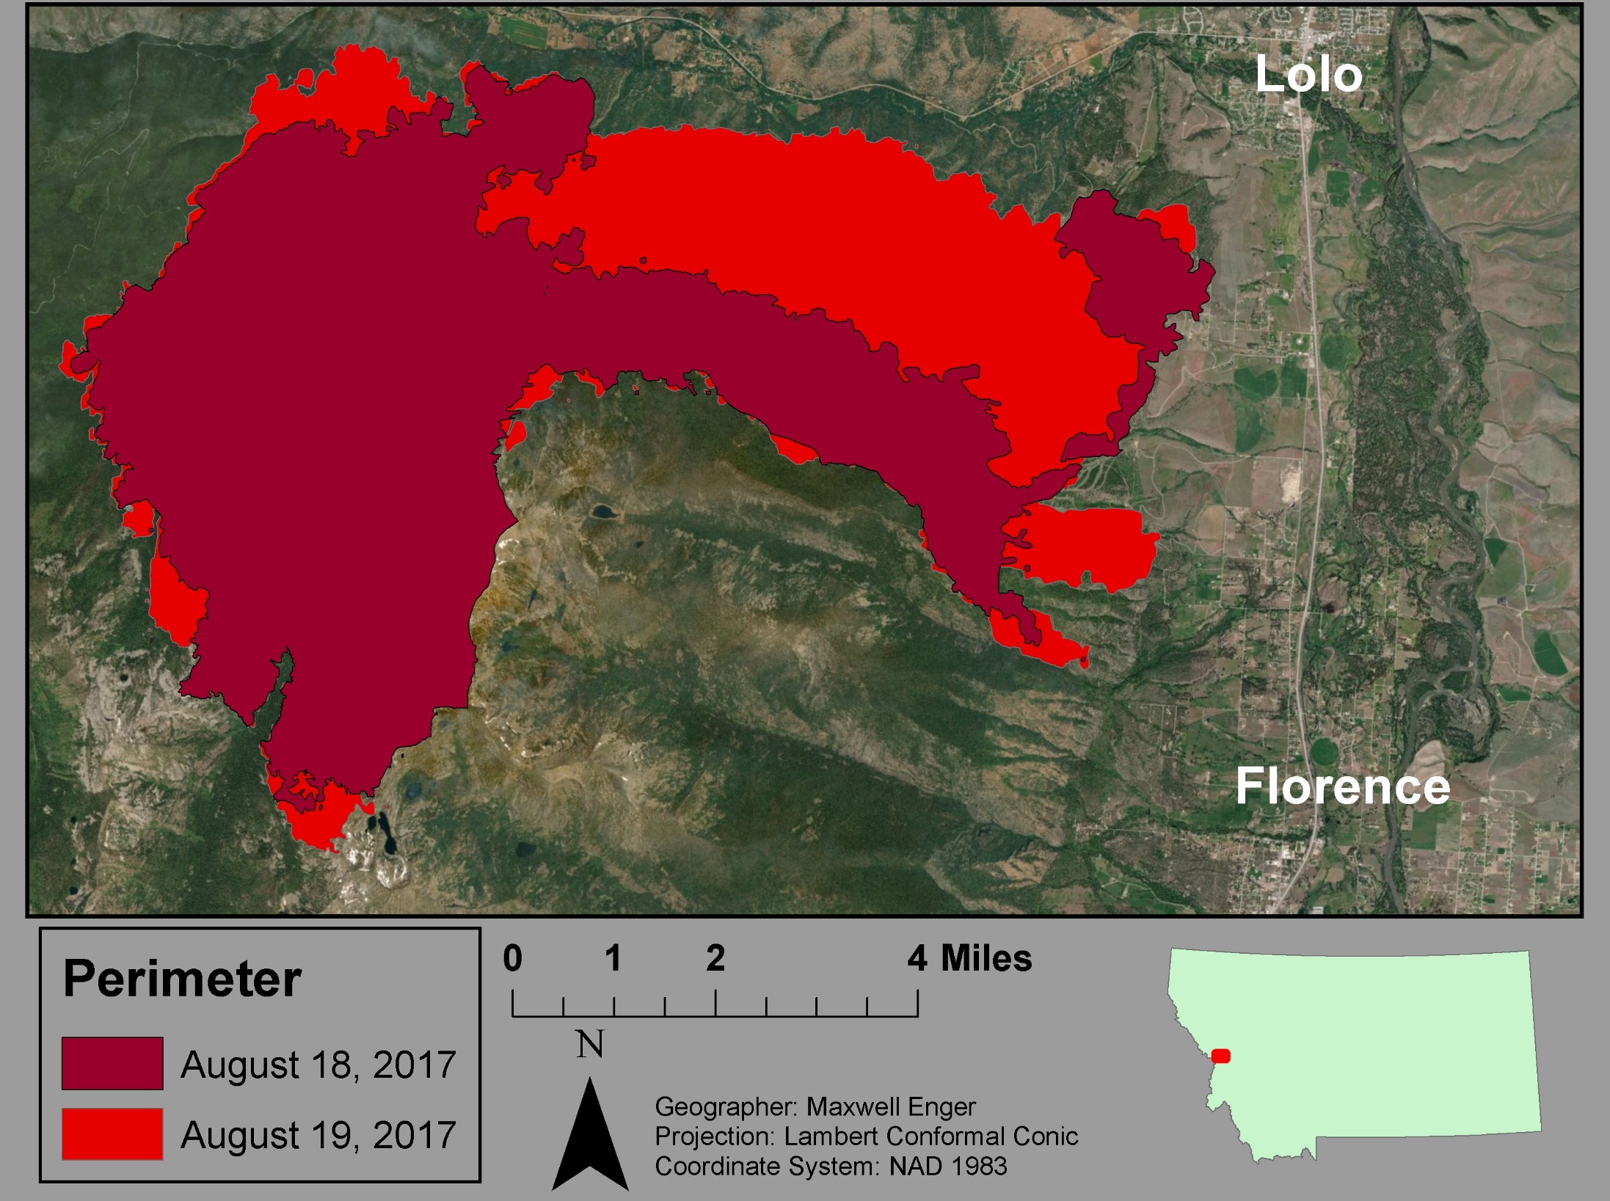
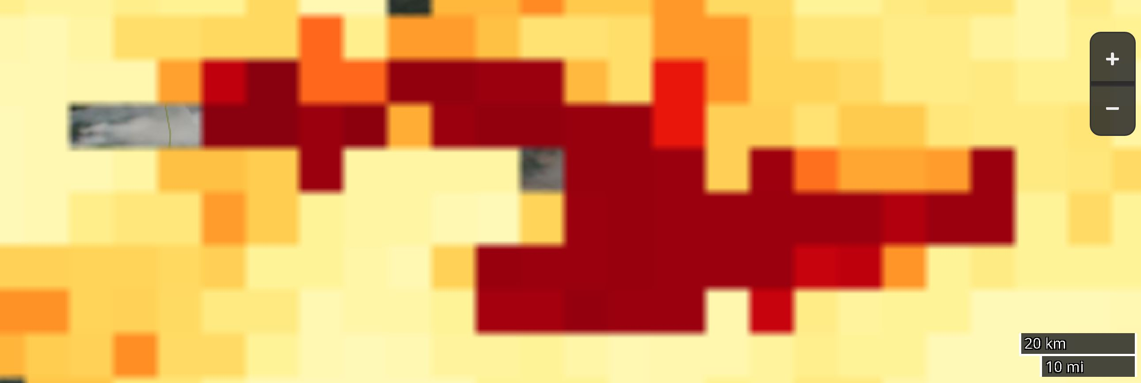
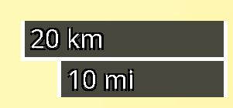
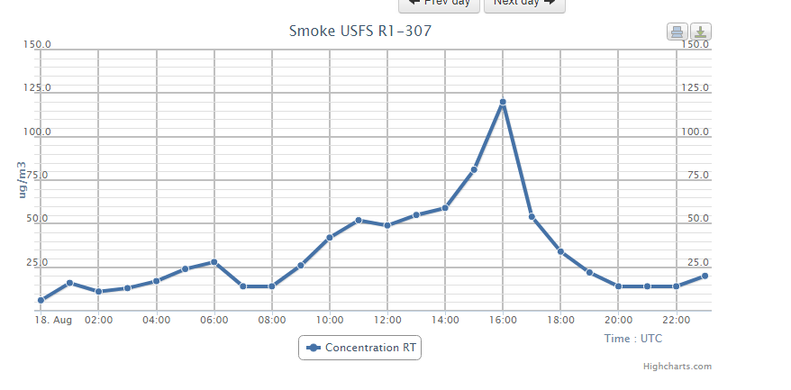
A Comparative Analysis of HYSPLIT and AIRPACT to Estimate
Wildland Fire Smoke Emissions for Public Health Applications
Maxwell Enger¹, Anna Klene¹, Deborah Ross², & Carl Spangrude³
¹Department of Geography, University of Montana, Missoula MT; ² Montana Space Grant Consortium, Montana State University, Bozeman MT ;
³ Franke College of Forestry and Conservation, University of Montana, Missoula MT
Introduction
Results & Conclusions
The burning of biomass releases a variety of pollutants, but the most commonly monitored in terms of public health is PM_{2.5.} Examining how wildfire specific PM_{2.5} is transported through the atmosphere is important because these particulates pose serious health risks. Many types of models exist to simulate the dispersal of wildfire smoke, but the Hybrid Single-Particle Lagrangian Integrated Trajectory (HYSPLIT) model and the Air Indicator Report for Public Awareness and Community Tracking (AIRPACT) system can produce spatially explicit pollution transport simulations. This analysis will utilize PM_{2.5} as the species to compare the outputs of HYSPLIT and AIRPACT along with a readily available satellite dataset, and on-site measurements. Outputs will be assessed with respect to useful outputs for city and county managers concerned with the public health effects of wildfire smoke.
The Lolo Peak fire (Figure 1) was first detected on July 15, 2017 in a section of the Selway-Bitterroot Wilderness, southwest of Lolo, Montana, ignited by a lightning strike. The fire was managed from its ignition, but due high temperatures, low relative humidity, high pre-existing tree mortality, gusty winds, and steep terrain the fire was able to spread rapidly and burn over 53,000 acres (InciWeb, 2017). Data from August 18, 2017 (Figure 2) will be examined for this comparison.
Data & Methods
HYSPLIT Results
Category | AIRPACT | HYSPLIT | MODIS AOD
Inputs | WRF-ARW V3.7.1 4 km CMAQ MCIP 4.3 SMOKE V3.5.1 | FEPS, Meteorology | Layers: Air Quality, Meteorology, Vegetation, Land use
Timing | Daily output December 2015- Present data available | 12-48 hr output | Daily (2x) 2002 - Present data available
Region | Northwest United States | United States | Global
Spatial Output | NCL, ARWpost, RIP4,WPP, MET Vapor | KML, GIS shapefile | NASA Worldview
Image Cell Sizes | 12 km | Google Earth vector file | 2 km
PM2.5 Concentration | Hourly | Hourly | 3 July 2002 - Present
~Hours until output | <10 hours | 12-15 hours | <10 hours
Comments | Limited to NW US | Gaps in meteorological data | Coarse imagery
HYSPLIT
Installed and run by the end user.
Uses Fire Emissions Production Simulator (FEPS) to set site-specific fuel and consumption data to get emissions and heat release rates.
Hourly 12 km North American Mesoscale Forecast System (NAM12) meteorological data were obtained from the systems archives to drive the model.
HYSPLIT’s concentration data was configured by importing the FEPS data and displayed in a GIS environment.
AIRPACT
Run for the Northwest US by University of Washington.
Utilizes CMAQ, MCIP, and SMOKE for chemistry, emissions, and concentrations.
Utilizes WRF-ARW V3.7.1 for meteorological inputs.
Output is primarily an interactive map on a website.
USFS Hourly Air Quality Measurements
Hourly air quality and meteorological data obtained from the Western Regional Climate Center’s Fire Cache Smoke Monitor Archive, Region 1-307 station.
Must be set up by USFS, in this case temporarily installed adjacent to the Legion Baseball Field in Florence. Hourly meteorological data, wind speed, and air quality data were available from website.
MODIS’s Deep Blue Aerosol Optical Depth (MODIS AOD)
AQUA satellite’s MODIS imagery acquired daily at mid-day.
Downloaded from NASA’s Worldview webviewer.
1600-1700 Mean, August 18, 2017
Lolo
Florence
Figures 3. HYSPLIT output in Google Earth for mean conditions for 1600-1700, August 18, 2017.
Table 1. Site land-cover classification, physiographic province, bioclimatic subzone, trend in temperature difference (air-soil) 1995 to 2014, and trend in maximum NDVI 1982 to 2011.
Lolo Peak Fire
AIRPACT Results
1600, August 18, 2017
Table 4. Comparison of AIRPACT, HYSPLIT, and MODIS AOD implementation and results.
Comparison between HYSPLIT, AIRPACT, MODIS AOD, and the USFS observed air quality data reveal:
Similar forecasts, with high concentrations of PM2.5 located over the city of Florence, MT,
HYSPLIT is similar in pattern to the MODIS image (Figure 2), but only produces results with a single source of emission (near the Lolo Peak summit),
AIRPACT is also similar in pattern to the MODIS image (Figure 2) the closest, but is only produced for the NW U.S.,
AIRPACT and HYSPLIT produce outputs that show the USFS observations as being north of the smoke plume (which it was for a portion of the afternoon but not at the time compared),
MODIS AOD is a globally available product, but is very coarse compared to the other outputs, and had missing data (Figure 5),
None of these is a real-time product except the mobile USFS observational data which must be set up for each location, however HYSPLIT, AIRPACT, and AOD could be available within a day.
These results illustrate the availability and types of information that are available within the region to assist and predict wildfire smoke concentrations spatially.
FEPS Configuration | Settings
Fire Intensity | Severe
Fire Shape | Free Spreading Oval
Fuel Loading | 2 categories: Fuels above 2,134m and below
Fuel Moisture | Very Dry, Severe
Fire Profile | Acres Burned per hour at each category
Meteorology | Trans Wind, Wind@Flame, Pasquill Stability, Temperature, RH
Figure 4. AIRPACT output for 1600, August 18, 2017.
MODIS AOD Imagery
Figure 1. Map of the Lolo Peak fire perimeter.
HYSPLIT Configuration | Settings
Emission Configuration | SETUP-FEPS
Meteorology/Transport | CONTROL-FEPS, NAM12 (1HR)
Spatial Output | KML, Google Earth
Missoula
Florence
Figure 5. MODIS AOD output for August 17, 2017.
AIRPACT Configuration | Settings
Overlay | AIRPACT-5 Domain Boundary Country & State Boundaries
Species | PM2.5
Opacity for all overlays | 70%
Map Display | Terrain
USFS Hourly Measurements
References
Figure 2. MODIS Satellite Imagery for August 18, 2017.
“AIRPACT.” AIRPACT Air-Quality Forecasting for the PNW, lar.wsu.edu/airpact/index.html.
Stein, A. F., R. R. Draxler, G. D. Rolph, B. J. B. Stunder, M. D. Cohen, and F. Ngan. "NOAA’s HYSPLIT Atmospheric Transport and Dispersion Modeling System." Bulletin of the American Meteorological Society 96, no. 12 (12 2015): 2059-077. doi:10.1175/bams-d-14-00110.1.
“Lolo Peak Fire.” Mendocino Complex Information - InciWeb the Incident Information System. (2017). inciweb.nwcg.gov/incident/5375/.
Potter, Brian, et al. “Understanding Smoke Dynamics.” Understanding Smoke Dynamics, U.S Forest Service, 14 Sept. 2015, www.fs.fed.us/pnw/research/fire/smoke.shtml.
RedZone Analyst Team. “Regional Wildfire Forecasts: July - August 2017.” RedZone, RedZone Analyst Team, 14 July 2017, www.redzone.co/2017/07/18/wildfire-forecasts-july-august-2017/.
"Worldview: Explore Your Dynamic Planet." NASA. (2018)
Acknowledgements
Tables 1, 2, and 3 showing settings selections made for FEPS, HYSPLIT, and AIRPACT, respectively.
Thank you to Bob Yokelson, Bill Jackson, Tony Ward, Carolyn Hester, Emily Weiler, Brian Gullet, Jennifer Fowler, David Shively, John Harbor, Shawn Urbanski, Faith Ann Heinsch, the University of Montana Geography Department, and the US Forest Service for aiding in this research. This research was supported by Montana Space Grant Consortium funding to ME & CS.
Figure 6. R1-307 PM2.5 Sensor data, August 17, 2017.

