Slide 1
The Consolidation of corn
A Case Study to Inspire Design for the Wicked Problems of our Time by Sophie Moon

Slide 2
Road map
Explore the consolidation of U.S. corn production as a case study of wicked problems
Consider the roots of consolidation and other wicked problems
Inspire complex, interconnected solutions for wicked problems

Slide 3
But first…

Slide 4
Defining Consolidation

Slide 5
Inputs of U.S. Corn Production

Slide 6
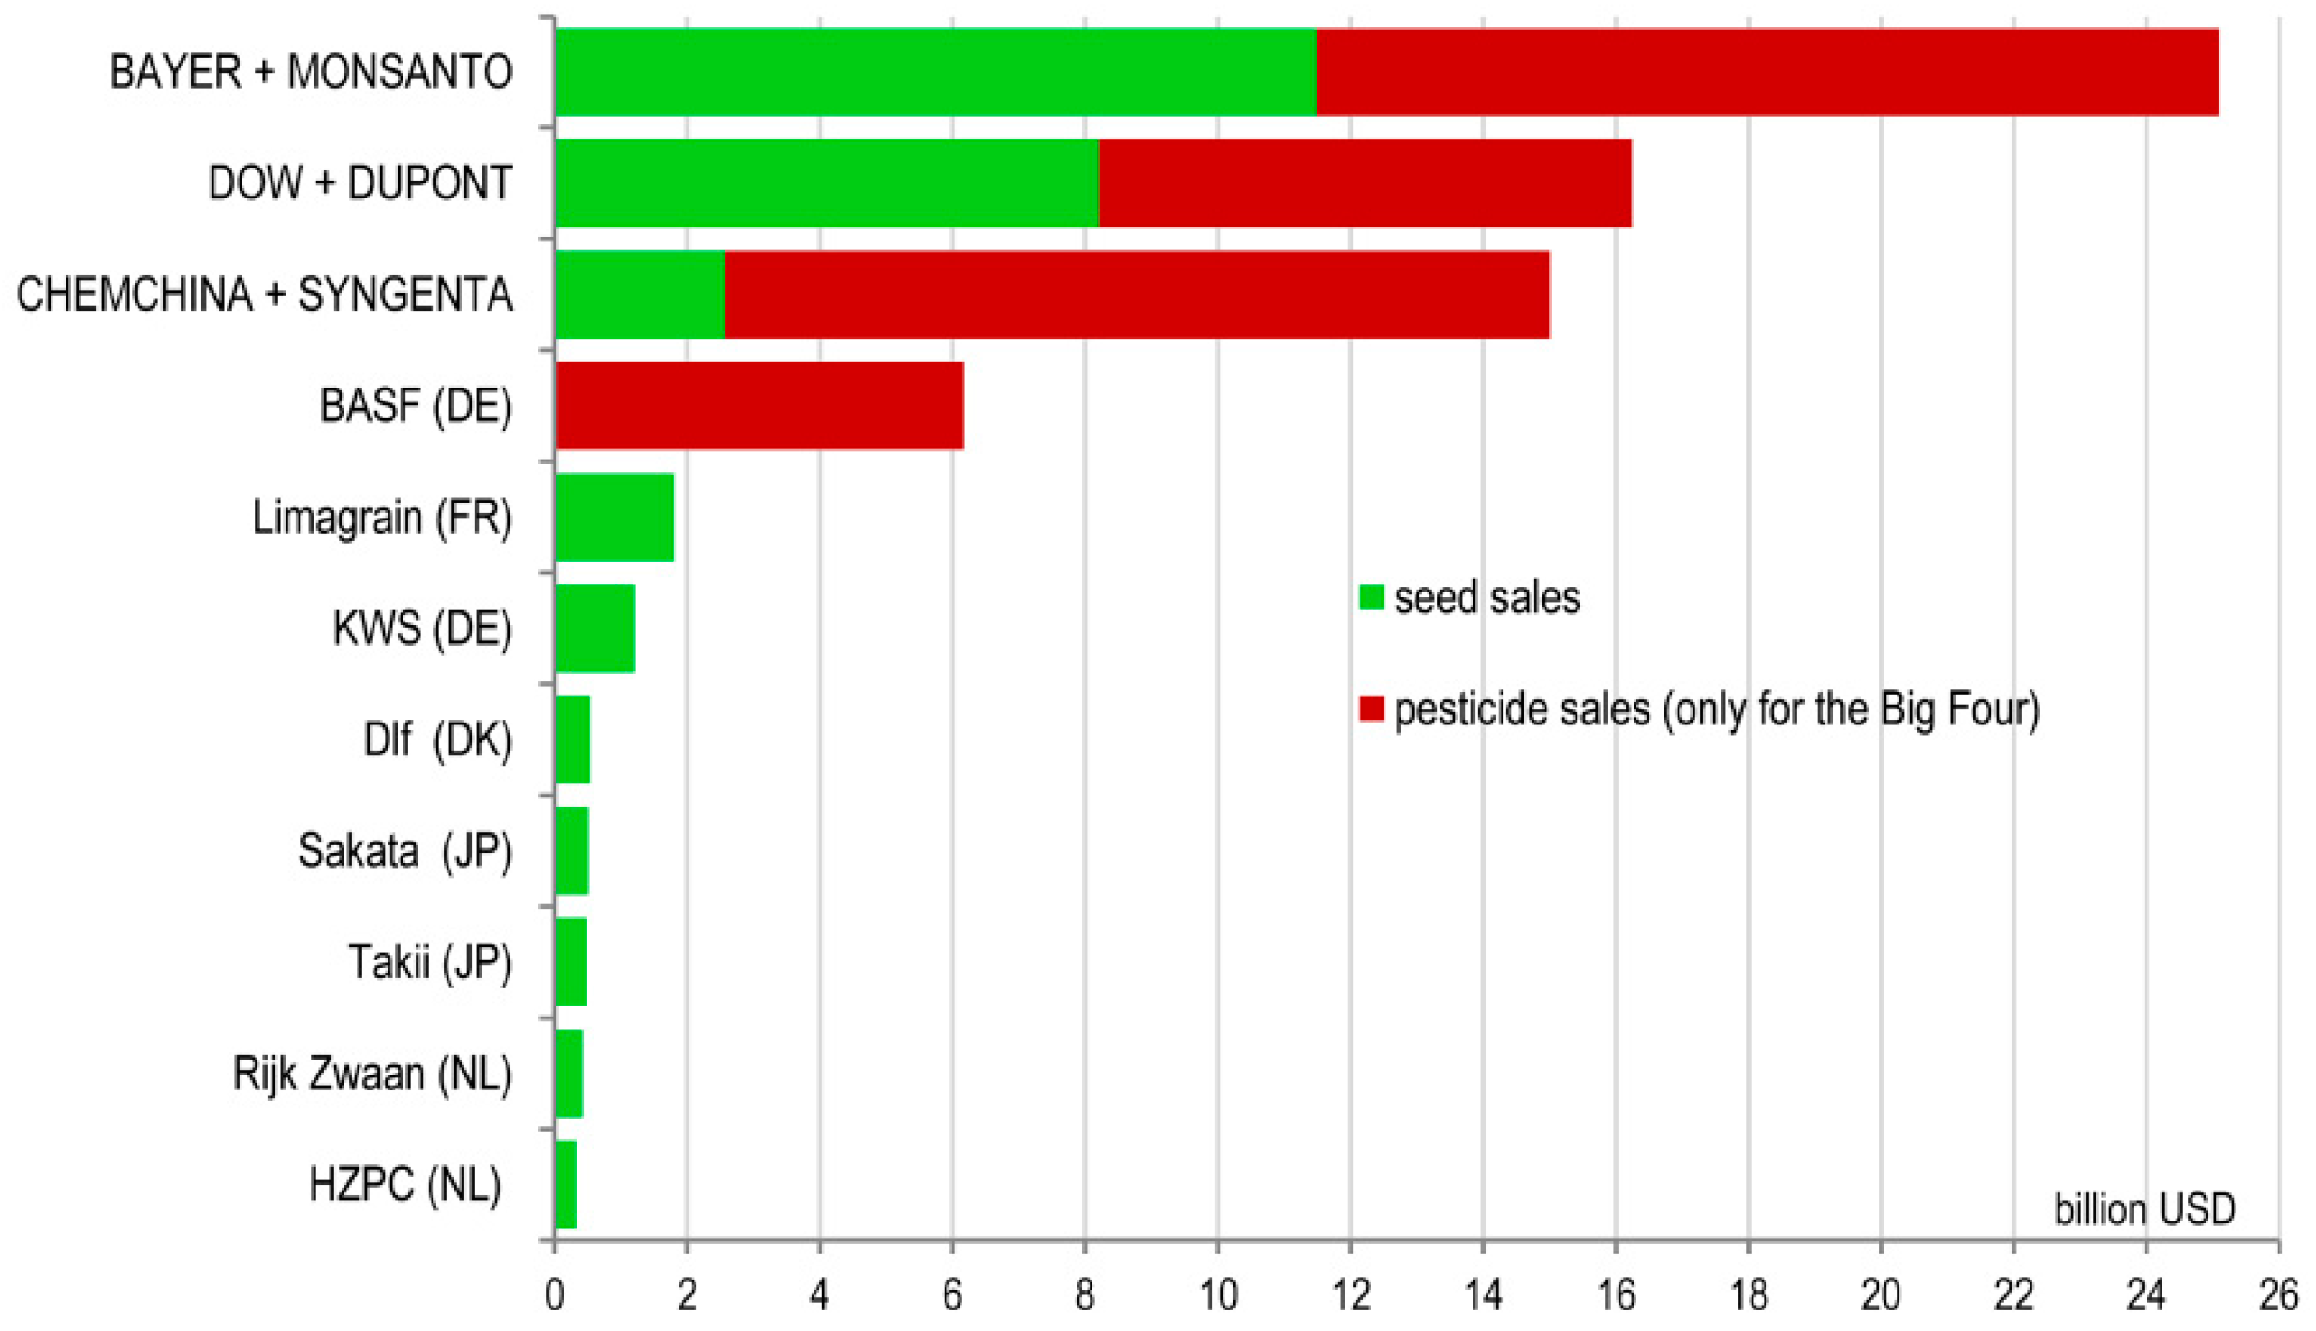
Consolidation of Seed, Pesticide, and fertilizer
The leading 12 companies in the seed industry after the 2015-2016 consolidation wave (sales in billion USD.) Bonny 2017.

Slide 7
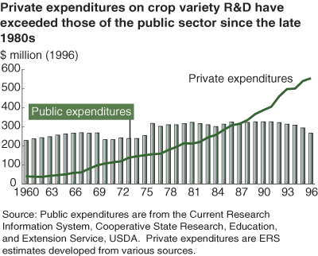
Consolidation of Research and development

Slide 8
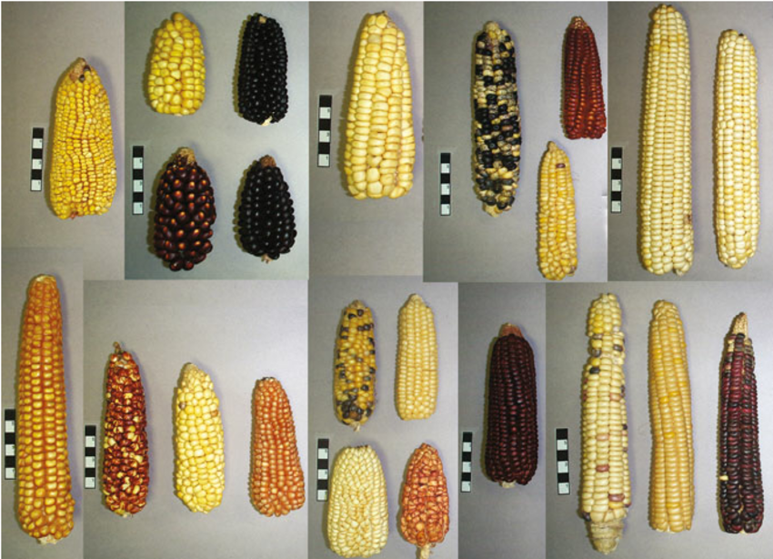
Impacts of consolidation on seed diversity

Slide 9
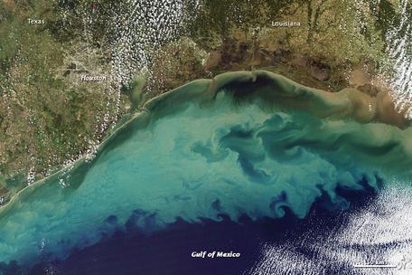
Impacts of consolidation on Human and Environmental heath
Louisiana
Houston
Gulf of Mexico

Slide 10
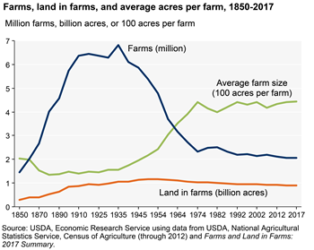
Consolidation of Land, labor, and machinery

Slide 11
Early impacts of large scale industrial agriculture
USDA Anthropologist Walter Goldschmidt found…
smaller middle class
lower incomes
higher poverty rates
poorer quality schools
fewer community institutions
less control over public decisions
significant influence on local politics from agribusinesses

Slide 12
Racial disparities in land ownership (Value and Acres)

Slide 13
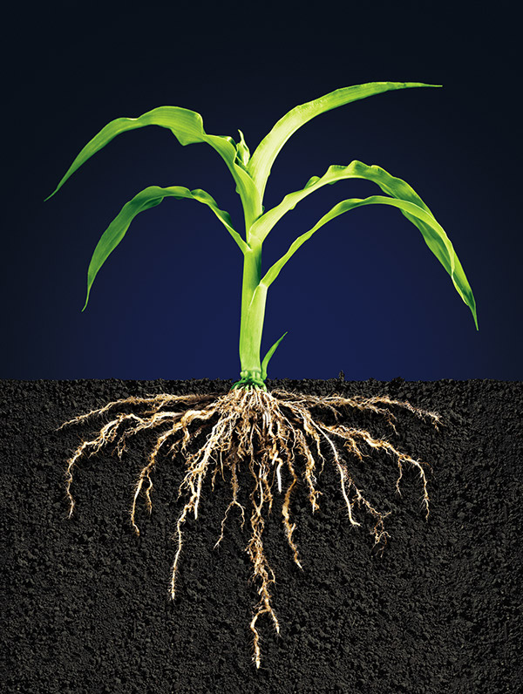
The roots of consolidation

Slide 14
Efforts to address consolidation

Slide 15
Wicked Problem tool kit

Slide 16
Leadership qualities
Question the paradigm
Think and act collaboratively
Experiment to understand the problem and emergent solutions
Mobilize creative responses
Do continual high level reflection

Slide 17
Emerging opportunities

Slide 18
Thank you
Professor William McLauchlan, Political Science
Professor Neva Hassanein, Environmental Studies
Laure Pengelly Drake, Advisor

Slide 19
References
Barrett, Christopher B. N.D. “Lecture 10: Competition: trader behavior.” Lecture, Cornell University, Ithaca, N.D.
Bonny, Sylvie. 2017. ”Corporate Concentration and Technological Change in the Global Seed Industry.” Sustainability, no. 9. Accessed April 14, 2019. doi:10.3390/su9091632
Boudreau, Catherine and Helena Bottemiller-Evich. 2017. “Strange bedfellows unite to push for subsidy reform in farm bill.” Politico. Accessed April 14, 2019. https://www.politico.com/story/2017/11/15/farm-bill-subsidy-reform-244928
Elia, Gianluca and Alessandro Margherita. 2018. “Can we solve wicked problems? A conceptual framework and a collective intelligence system to support problem analysis and solution design for complex social issues.” Technological Forecasting & Social Change, no. 133: 279-286. Accessed April 14, 2019. https://doi.org/10.1016/j.techfore.2018.03.010
Eller, Donnelle and Kevin Hardy. 2017. “Dow-DuPont merger closes Thursday. How will Pioneer, Iowa fare?” Des Moines Register. Accessed April 14, 2019. https://www.desmoinesregister. com/story/money/agriculture/2017/08/31/dow-dupont-merger-closes-thursday-how-pioneer-iowa-fare/611784001/
Elsheikh, Elsadig. 2016. “Race and Corporate Power in the US Food System: Examining the Farm Bill.” Food First. Accessed April 14, 2019. https://foodfirst.org/wp-content/uploads/2016/06/DRnumber2_VF.pdf
Haas Institute. 2018. The Era of Corporate Consolidation and the End of Competition. Berkeley: Haas Institute of Berkeley.
Holt-Giménez, Eric. 2017. A Foodie’s Guide to Capitalism: Understanding the Political Economy of What we Eat. New York: Monthly Review Press.
Horst, Megan. 2019. “How Racism has Shaped the American Farming Landscape.” Eater. Accessed April 14, 2019. https://www.eater.com/2019/1/25/18197352/american-farming-racism-us-agriculture-history

Slide 20
Pollan, Michael. 2016. The Omnivore’s Dilemma: A Natural History of Four Meals. New York, NY: Penguin Press.
Quinn, Bob and Liz Carlisle. 2019. Grain by Grain: A Quest to Revive Ancient Wheat, Rural Jobs, and Healthy Food. Washington, D.C.: Island Press.
Reibel, Jennifer. 2018. “Manufacturer Consolidation Reshaping the Farm Equipment Marketplace.” Farm Equipment. Accessed April 14, 2019. https://www.farm-equipment.com/articles/15962-manufacturer-consolidation-reshaping-the-farm-equipment-marketplace
Seed World Videos. 2016. “An Effort to Bring Biodiversity Back to U.S. Corn.” Seed World, September 15. Accessed April 14, 2019. https://seedworld.com/dr-jim-holland-usda-ars-ncsu-corn-genetic-diversity-dna-sequencing-fusarium-resistance/
Smith, Vincent H., Joseph W. Glauber, and Barry K. Goodwin. 2018. Agricultural Policy in Disarray: Volume I. Washington, D.C.: American Enterprise Institute.
Texas A&M University. 2016. Effects of Proposed Mergers and Acquisitions Among Biotechnology Firms on Seed Prices. Texas: Agricultural and Food Policy Center.
U.S. Department of Agriculture. 2013. Farm Size and the Organization of U.S. Crop Farming, Economic Research Service. Washington D.C.
U.S. Department of Agriculture. 2015. Factsheet: USDA Coexistance Fact Sheets Corn, Office of Communications. Washington, D.C.
U.S. Department of Agriculture. 2017. Large Family Farms Continue to Dominate U.S. Agricultural Production, Economic Research Service. Washington, D.C.
University of Iowa, University of Northern Iowa, Drake University, Iowa Public Health Association. 2017. Nitrate in Your Drinking Water: What You Need to Know. Iowa Water Quality and Public Health Consortium.
Yukawa, Joyce. 2015. “Preparing for Complexity and Wicked Problems through Transformational Learning Approaches.” Journal of Education for Library and Information Science 56, no. 2 (Spring): 158-168. Accessed April 14, 2019. https://www.jstor.org/stable/10.2307/90015180

