Slide 1
Effects of Climate Change on Rocky Mountain Spotted Fever and Public Health Implications in Western Montana
Ella Baumgarten, Max Enger, Benjamin Hickey, Ronan Kennedy, Tiffany Matthews, Sydney Qualls

Slide 2
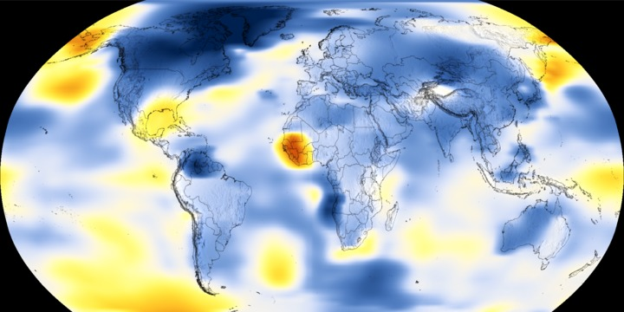
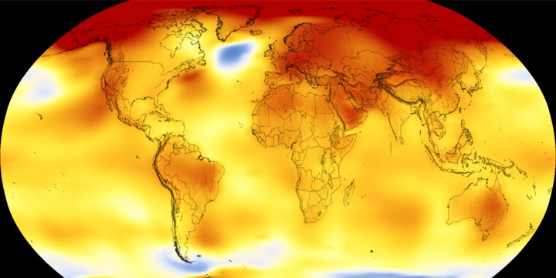
Climate Change and Vector Borne Diseases
1884
2018
Temperature Difference in Fahrenheit

Slide 3
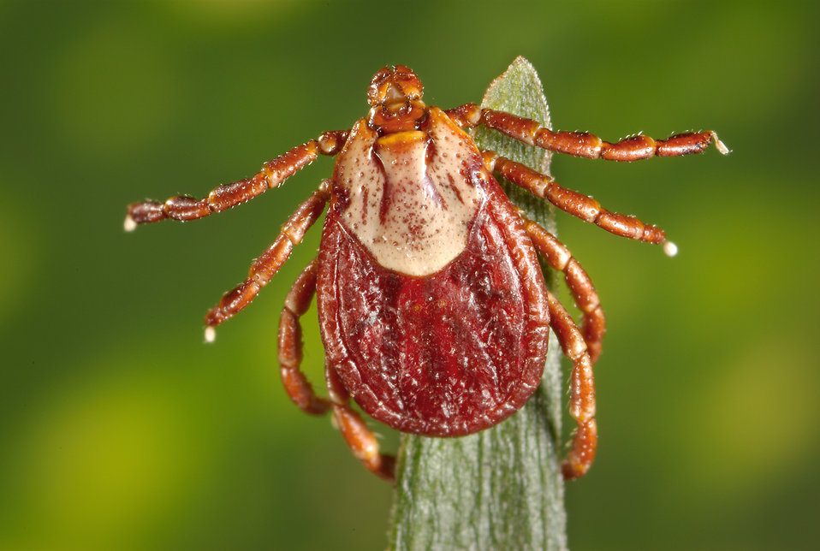
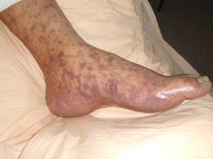
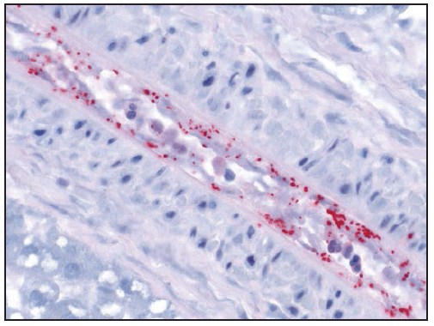
Rocky Mountain Spotted Fever (RMSF)
Tick-borne disease (TBD) caused by Rickettsia rickettsii
Carried by the Rocky Mountain Wood Tick (Dermacentor andersoni)
Symptoms begin as flu-like symptoms with rash and progress to coma and necrosis
Rarity of disease and commonality of symptoms increase misdiagnosis
Deadly if left untreated
Dermacentor andersoni “Spotted Fever” Rash Rickettsia rickettsii
cdc.gov cdc.gov cdc.gov

Slide 4
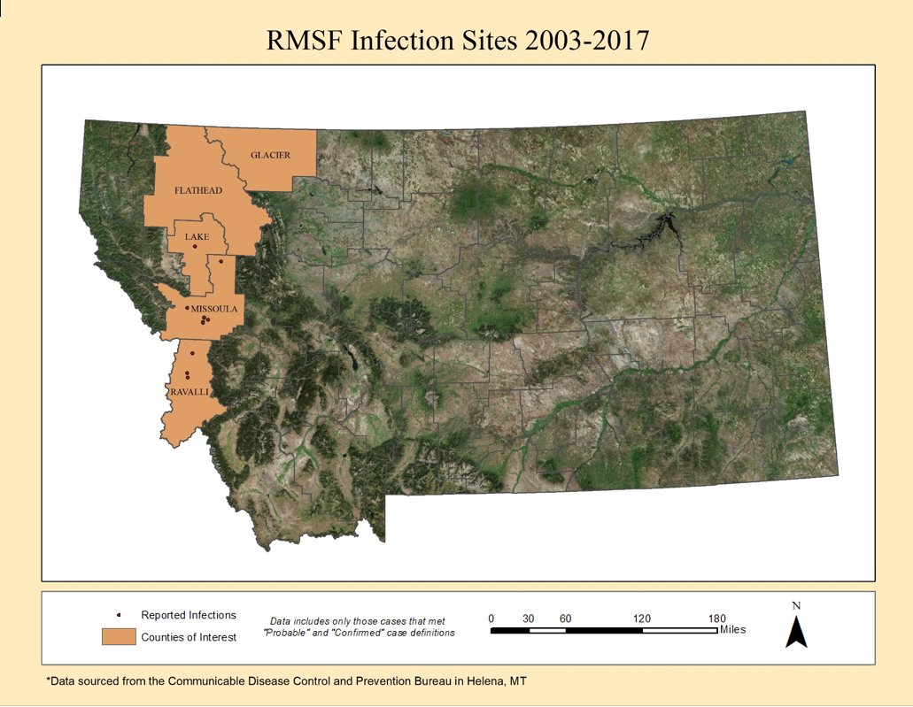
Notes:
Speaker Notes:
1. RMSF infection sites map:
This is our study area. We chose the counties from the bitterroot corridor up to the glacier park counties. These counties are going to experience the most climate change affects (temp increases in the warmer valleys and glaciated/former glaciated areas up north)
The highlighted counties are our Region of interest. We overlayed the counties with coordinate presence data. Presence data here is the infection sites…aka where people claimed they were infected with the disease. To model this we used a random point generator to place presence data among vegetated areas in the corresponding areas.

Slide 5
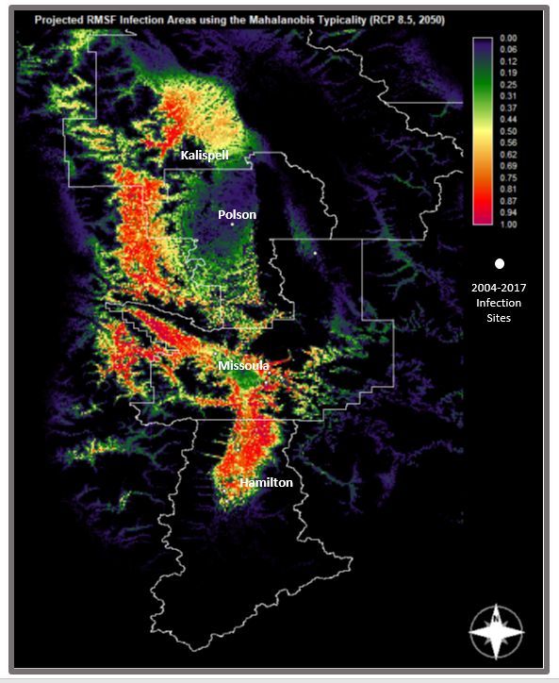
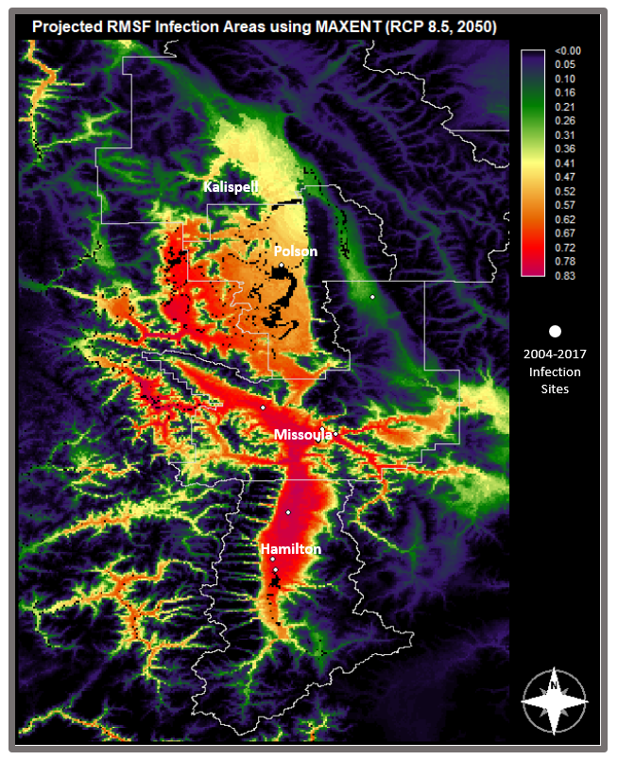
Projected Infection Areas (RCP 8.5, 2050)
Mahalanobis Typicality, IDRISI
MAXENT, IDRISI
Notes:
Speaker Notes:
2. Projected infection sites:
RCP8.5 = Representative Concentration Pathway. This corresponds to the IPCC Greenhouse gas concentration pathways. There are 4 different pathways, but we chose RCP8.5 because this pathway shows business as usual or rather where we are headed without making major changes. RCP 8.5 models that we will experience around 640 ppm of co2 in our atmosphere. Right now, we sit at just under 450 ppm.
Warmer values show a suitable environment for someone to come in contact with RMSF… Colder values yield the opposite
Left Image: Ran the first model using only 5 bioclimatic variables, uses Normal distribution ideals in its algorithm to produce species distribution probability per pixel
Right image: Ran using all 19 bioclimatic variables: Uses maximum entropy modeling algorithm that creates probability distribution
MAXENT variables (chosen through algorithm)
18: precip of warmest quarter
8: mean temperature of wettest quarter
13: precip of wettest month
10: mean temp of warmest quarter
15: precipitation seasonality (coefficient of variation)
3: isothermality (Mean diurnal range/temperature annual range)
Mahalanobis typicallity
1
2
4
7
12

Slide 6
Local Public Health
Increase public awareness of RMSF transmission, symptoms, and treatments
3 tactics:
Brochures
Informational media
Educational programs
Articles in statewide articles
Outside Bozeman
Big Sky Journal
Montana Quarterly
Mountain Outlaw
Notes:
Purpose of these measures is to reduce the prevalence of RMSF in Western Montana through increasing awareness of RMSF throughout the general public and medical/health professionals.
We designed these measures off of lyme disease preventative measures that have been put in place, such the Maine CDC lyme disease educational programs…
The goal is to prevent RMSF spread before more people are at risk in the future due to climate change.

Slide 7
RMSF Brochure

Slide 8
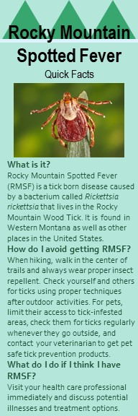
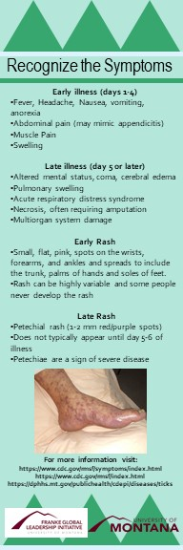
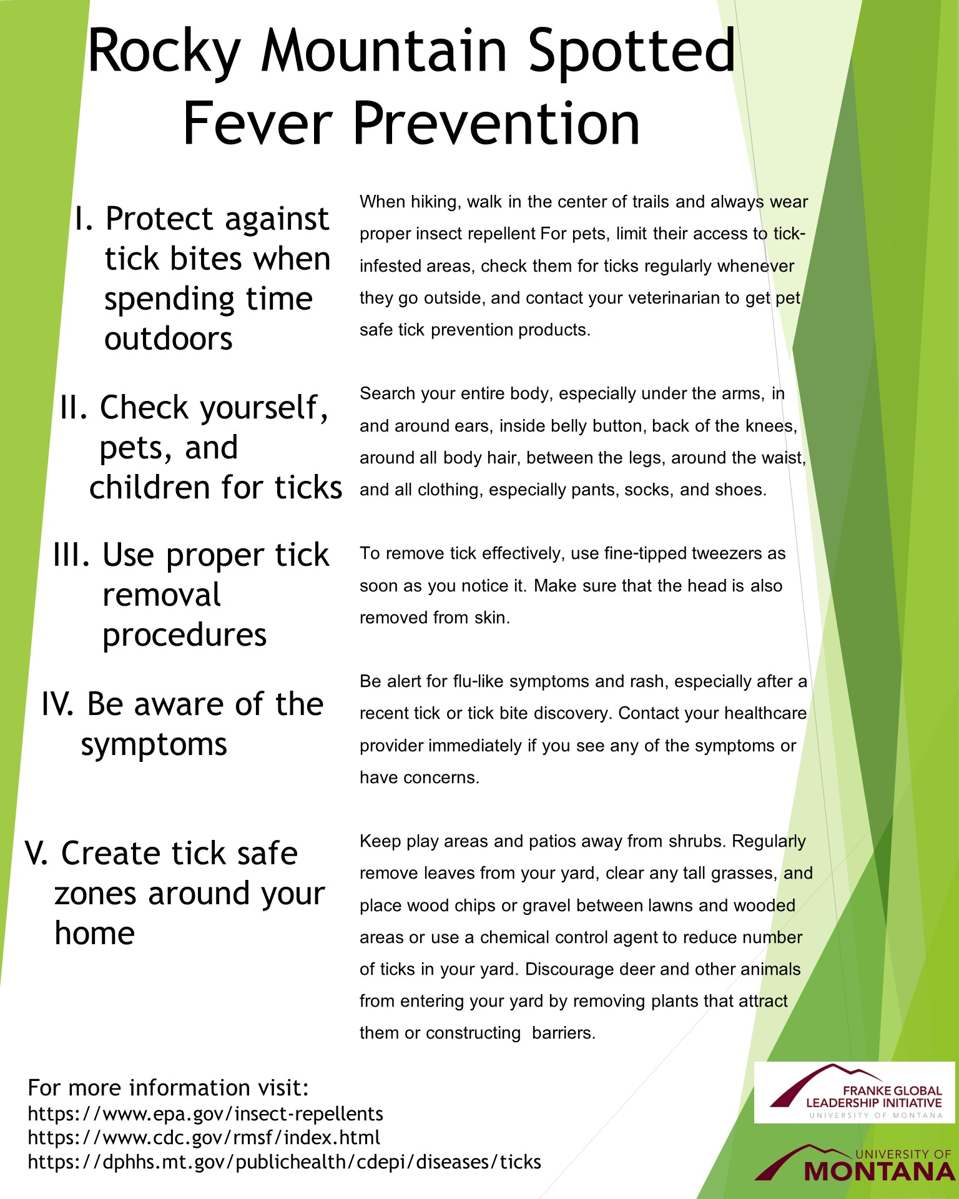
2. Informational Media

Slide 9
3. Educational Program
This program is designed for children in elementary school. It covers:
General information about ticks
Tick life cycle
RMSF prevention
These topics will be integrated into PowerPoint presentations, games, and teacher demonstrations.

Slide 10
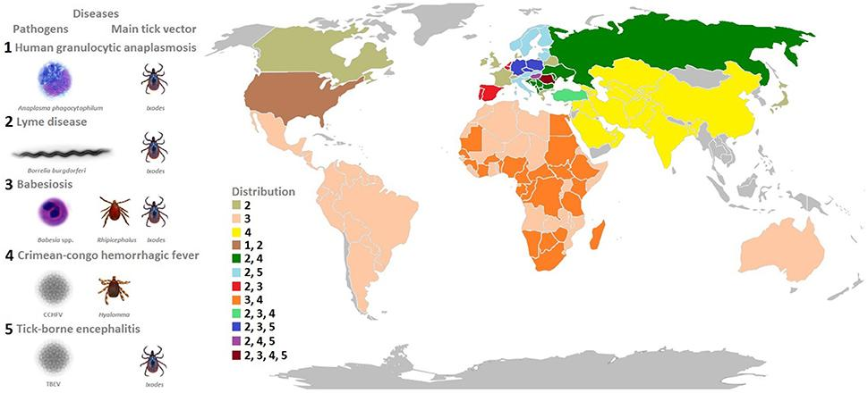
Implications in Global Public Health
Demonstrates the broad implications of climate change on the human experience
Allows healthcare professionals and their communities to prepare for novel and exacerbated epidemics
Democratizing public health planning and action

Slide 11
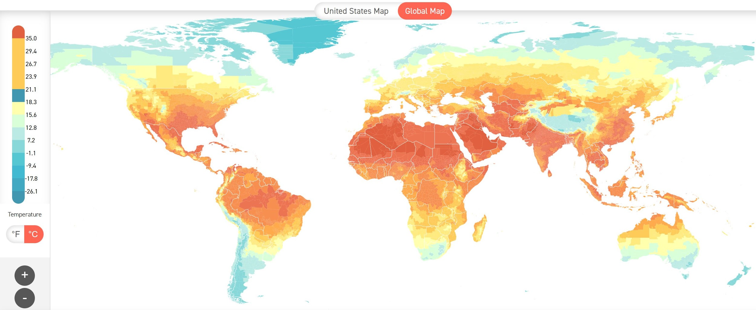
Future Directions
Connect with governmental organizations in orders
Utilize this methodology to model and prepare for vector-borne diseases that will spread as the climate changes
Dengue Fever
Yellow Fever
Malaria
Relapsing Fevers
Zika Virus
Chagas Disease
African Sleeping Sickness

Slide 12
References
CDC.gov
Estrada-Peña, A., Ayllón, N., & de la Fuente, J. (2012). Impact of climate trends on tick-borne pathogen transmission. Frontiers in Physiology, 3, 64. doi:10.3389/fphys.2012.00064
Gottlieb, M., Long, B., & Koyfman, A. (2018). The evaluation and management of rocky mountain spotted fever in the emergency department: A review of the literature. The Journal of Emergency Medicine, 55(1), 42-50. doi:S0736-4679(18)30230-0 [pii]
Hijmans, R.J., S.E. Cameron, J.L. Parra, P.G. Jones and A. Jarvis, 2005. Very high resolution interpolated climate surfaces for global land areas. International Journal of Climatology 25: 1965-1978
Li, Zhe, and Jefferson M. Fox. "Integrating Mahalanobis Typicalities with a Neural Network for Rubber Distribution Mapping." Remote Sensing Letters 2, no. 2 (06 2011): 157-66. doi:10.1080/01431161.2010.505589.
Wilkinson, P. R. (1967). The distribution of dermacentor ticks in canada in relation to bioclimatic zones. Canadian Journal of Zoology, 45(4), 517-537. doi:10.1139/z67-066

Slide 13
Special Thanks
Peter McDonough, GLI Capstone Mentor, Hero, Tea Aficionado
Jeanne Loftus, GLI Director
Jim Battisti, University of Montana Division of Biological Sciences Research
Anna Klene, University of Montana Geography Department
Erika Baldry, Communicable Disease Control and Prevention Bureau
Outside Bozeman, Editing Team
Montana Quarterly, Editing Team
Mountain Outlaw, Editing Team
Big Sky Journal, Editing Team
Distinctly Montana, Editing Team
The University of Montana
The Franke Family
Missoula County Health Department

Slide 14
Questions?

