Slide 1
Evidence of Arthritis in a 92-year-old Female Cadaveric Specimen
Sydney Ladas
Department of Biological Sciences at the University of Montana
April 17, 2019

Slide 2
Arthritis
100 different diseases
54.4 million adults in the US diagnosed with arthritis between 2013 and 2015
78 million by 2040
Osteoarthritis, gout, and rheumatoid arthritis are most prevalent
https://www.cdc.gov/arthritis/data_statistics/arthritis-related-stats.htm

Slide 3
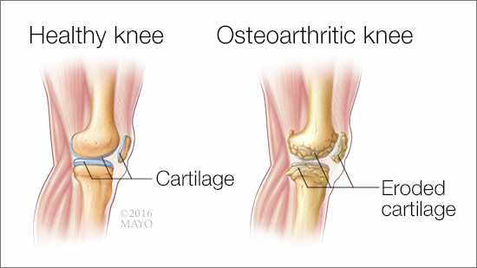
Osteoarthritis
Most common form of arthritis; affects 30 million adults in the US
Affects all structures of a synovial joint including cartilage, bone, and surrounding anatomy
Can cause destruction of cartilage, eventual remodeling of bone, and formation of osteophytes (bone spurs)
https://newsnetwork.mayoclinic.org/discussion/mayo-clinic-q-and-a-treatment-of-osteoarthritis/

Slide 4
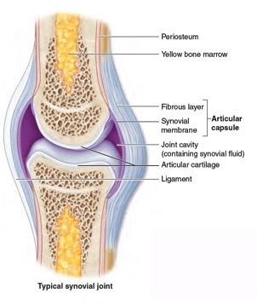
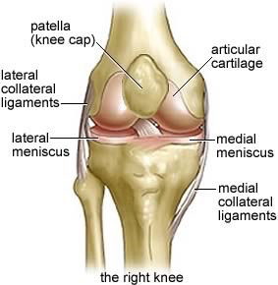
Osteoarthritis Affects Synovial Joints
All structures aim to reduce friction between articulating bones
Cartilage protects bony surfaces and absorbs shock
Synovial fluid within joint cavity lubricates joint
Dense connective tissue provides tensile strength to joint
Anatomy and Physiology: An Integrative Approach (McGraw Hill); https://www.nzihf.co.nz/media-resources-1/articles/personal-training-the-knee-joint-explained

Slide 5
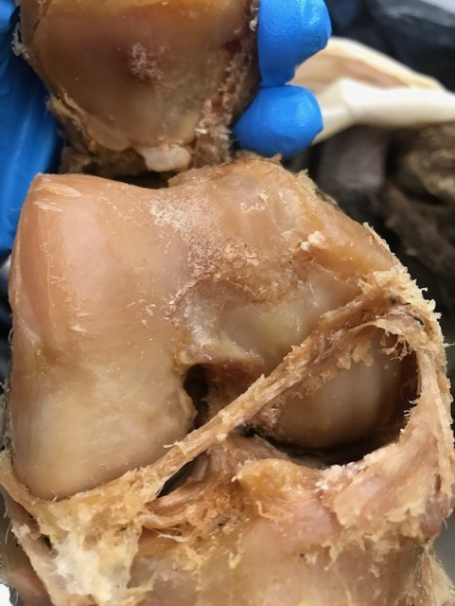
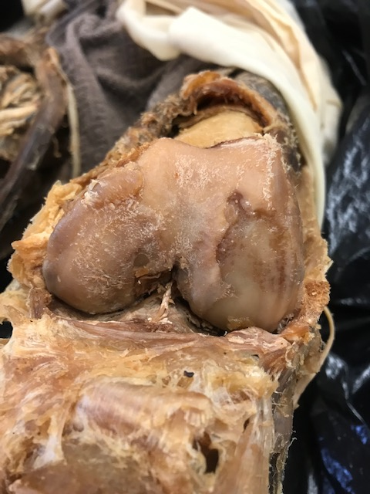
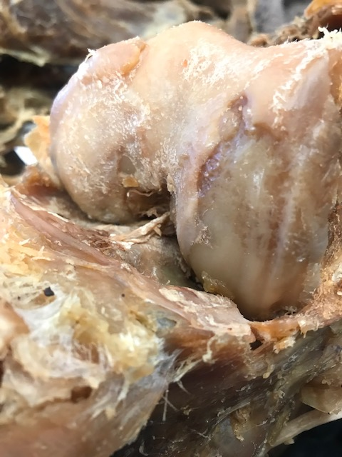
Background Observations: Female Cadaver on Campus
Right female knee
Left female knee
Left female knee
92 years old → prior dissection of knees revealed extreme arthritic pathology
Can evidence of arthritis in one joint have body-wide implications about arthritis?
Joints of female cadaver dissected, examined, and compared to joints of male cadaver

Slide 6
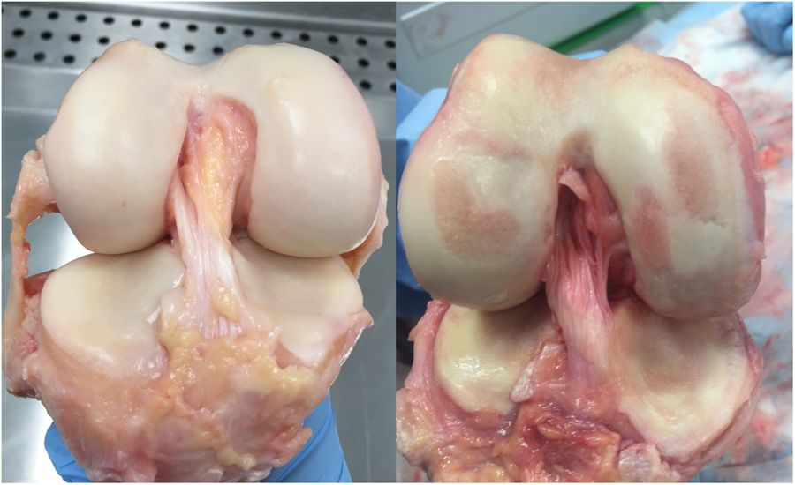
ICRS Grading System
Peters et al. 2018
Knees shown are from two different cadavers; knee on left assigned a grade of 0, while knee on right had structures ranging from 1 to 3
Peters et al. 2018

Slide 7
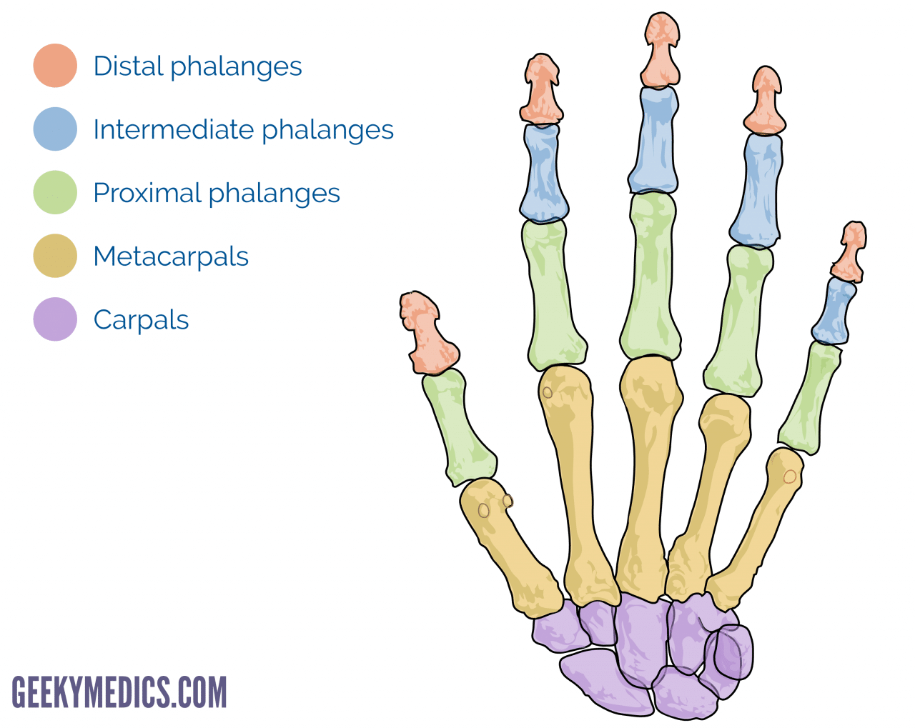
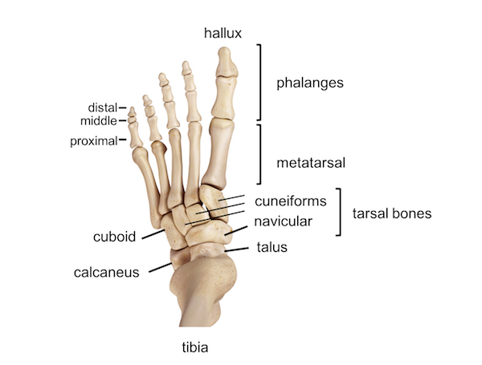
Methodology
https://geekymedics.com/bones-of-the-hand/
Joints dissected using a scalpel, probes, forceps
Joint cavities opened and examined for arthritic pathology
Metacarpophalangeal joints (knuckles) of digits 1 and 2
Proximal interphalangeal joint (first finger joint) of digit 2

Slide 8
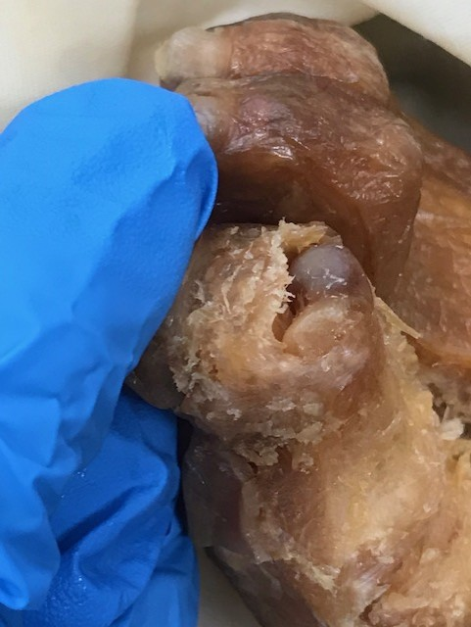
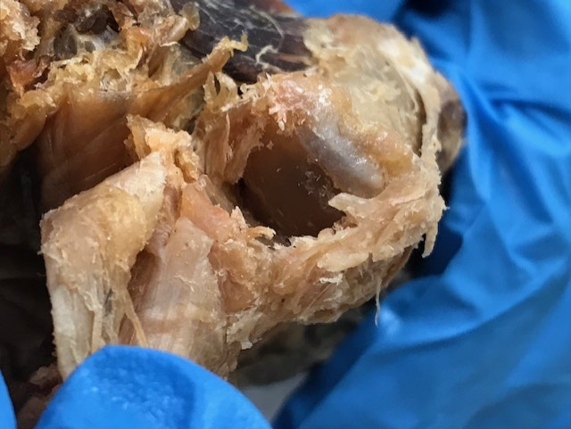
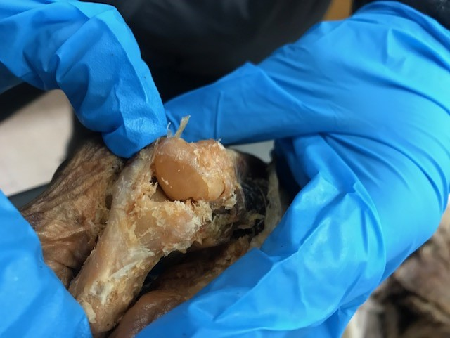
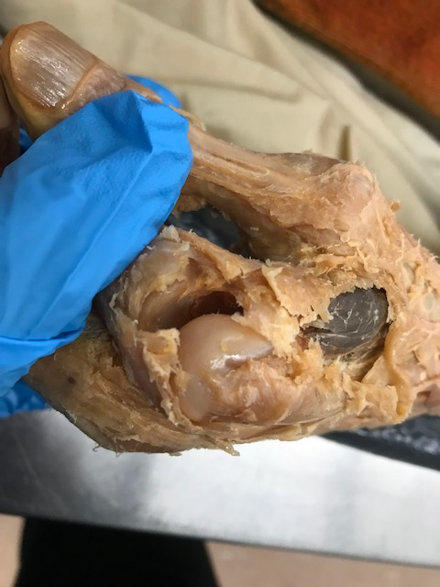
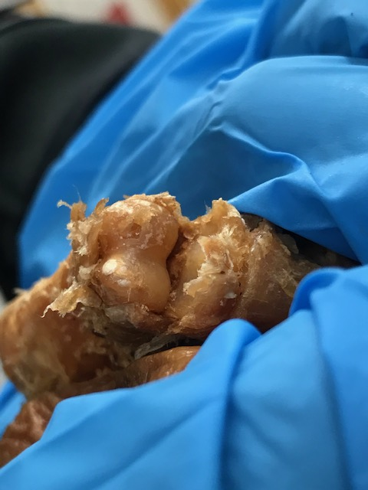
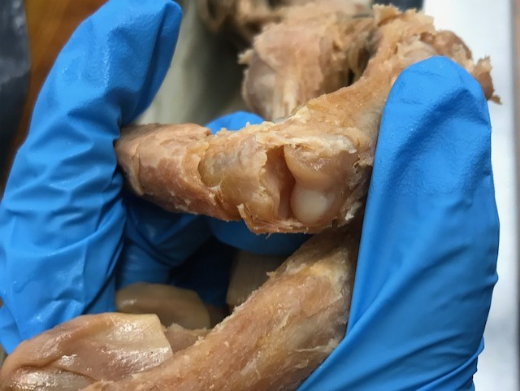
Metacarpophalangeal joint of digit one (female right hand)
Score: 2 – 3
Interphalangeal joint of great toe (female right foot)
Score: 0
Metacarpophalangeal joint of digit two (female right hand)
Score: 3 – 4
Metacarpophalangeal joint of digit two (male left hand)
Score: 0
Proximal interphalangeal joint of digit two (female right hand)
Score: 2
Proximal interphalangeal joint of digit two (Male left hand)
Score: 0

Slide 9
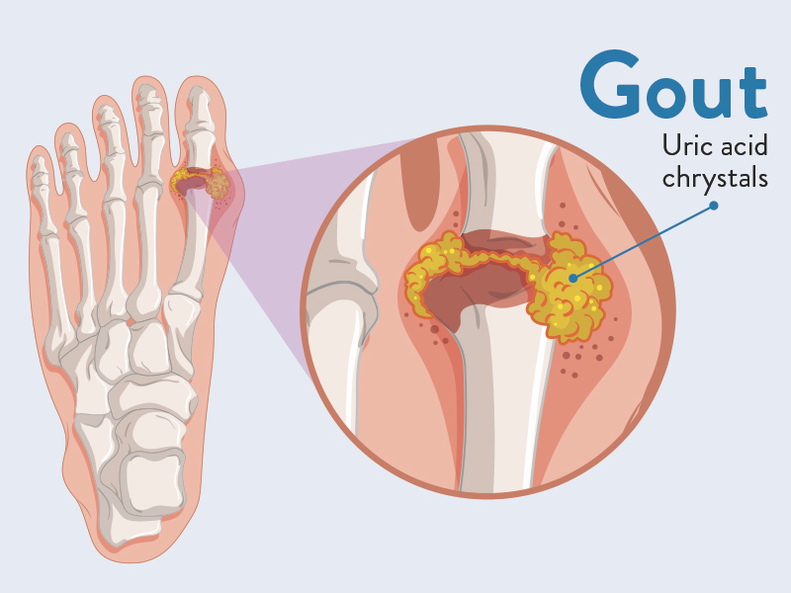
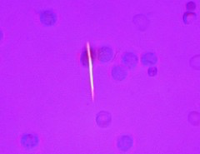
Gout
https://www.bouldermedicalcenter.com/about-gout-causes-symptoms-and-treatment/
Affects between 5 and 6 million Americans (2011)
Hyperuricema results in uric acid crystal deposition in and around joint tissue
Most commonly found in joints of great toe, foot, and ankle
Proximal interphalangeal joint of great toe revealed healthy tissue
Spiky yellow crystals found around several joints of female foot
https://www.flickr.com/photos/euthman/501152643/in/photostream/

Slide 10
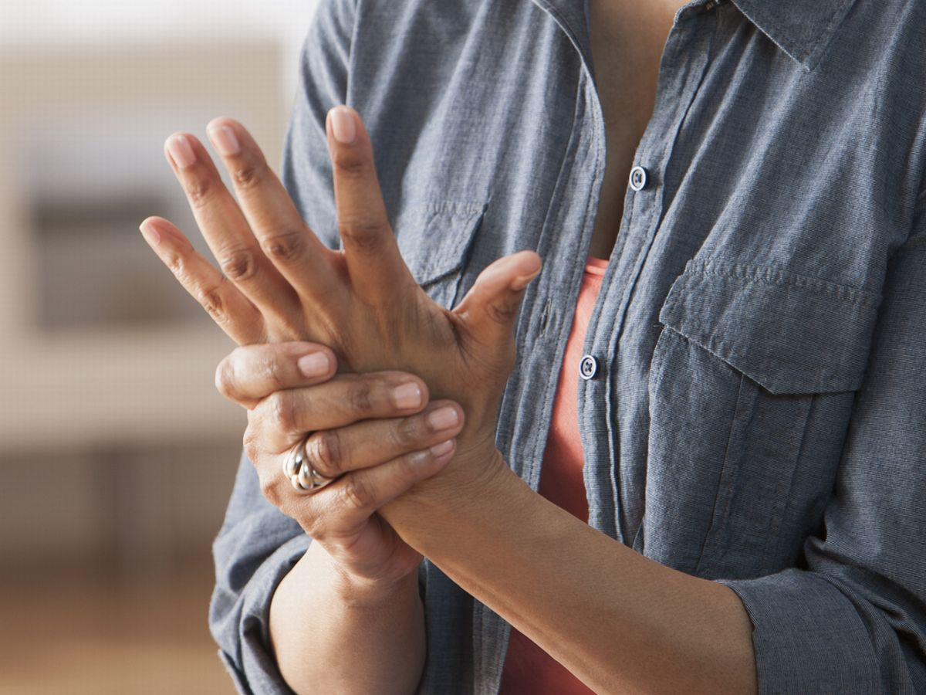
Conclusions and Moving Forward
Arthritic pathology noted in all joints of female hand
Evidence of gout suspected in the foot
Perhaps arthritis in one joint CAN have body-wide implications
Important to understand the pathology of this disease for future aging populations
https://www.mirror.co.uk/lifestyle/health/facts-arthritis-how-you-can-6416990

Slide 11
References
1. U.S. Department of Health & Human Services. Arthritis Basics | Arthritis | CDC. https://www.cdc.gov/arthritis/basics/index.html. Accessed October 20, 2018.
2. McKinley M, O’Laughlin V, Bidle T. Anatomy and Physiology: An Integrative Approach. 2nd ed. McGraw Hill; 2012.
3. Mora JC, Przkora R, Cruz-Almeida Y. Knee osteoarthritis: pathophysiology and current treatment modalities. J Pain Res. 2018;11:2189-2196. doi:10.2147/JPR.S154002
4. Gonzalez EB. An update on the pathology and clinical management of gouty arthritis. Clin Rheumatol. 2012;31(1):13-21. doi:10.1007/s10067-011-1877-0
5. Choy E. Understanding the dynamics: pathways involved in the pathogenesis of rheumatoid arthritis. Rheumatology. 2012;51(suppl 5):v3-v11. doi:10.1093/rheumatology/kes113
6. Peters AE, Akhtar R, Comerford EJ, Bates KT. The effect of ageing and osteoarthritis on the mechanical properties of cartilage and bone in the human knee joint. Sci Rep. 2018;8(1):5931. doi:10.1038/s41598-018-24258-6
7. Burr DB, Gallant MA. Bone remodelling in osteoarthritis. Nat Rev Rheumatol. 2012;8(11):665-673. doi:10.1038/nrrheum.2012.130
8. Resnick D, Broderick T. Lntraosseous Calcifications in Tophaceous Gout.; 1981. www.ajronline.org. Accessed November 7, 2018.
9. Ostrowska M, Maśliński W, Prochorec-Sobieszek M, Nieciecki M, Sudoł-Szopińska I. Cartilage and bone damage in rheumatoid arthritis. Reumatologia. 2018;56(2):111-120. doi:10.5114/reum.2018.75523

Slide 12
Acknowledgments
Montana Body Donation Program at Montana State University for permission to take pictures of cadaver
Dr. Laurie Minns

Slide 13
QUESTIONS?

