Slide 1
Using Data and Technology in Social Work as Catalysts for Effective Community Change
Haley Eakin

Slide 2
Research Question
How can data and technology be leveraged to make providers, policy-makers and everyday Montanans more knowledgeable about their own communities and more equipped to create effective change?
Ý
START
TIME
DESIGN
DEVELOP
TEAM
END
RESEARCH

Slide 3
Montana Data Dashboard
Improving outcomes through data-driven decision making
Policy Makers
Providers
Everyday Montanans

Slide 4
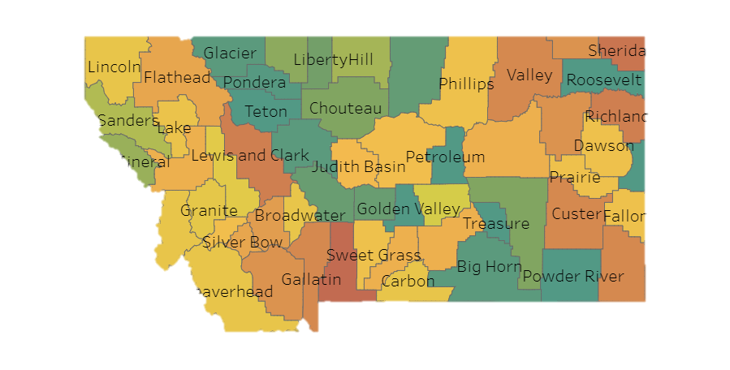
Community Mapping
Mapping Montana’s assets, opportunities, and threats
Over 120 community health indicators available including:
Foster Care
Teen substance abuse
Homelessness
ACES
And more!

Slide 5
Creating a Data-Driven Culture
Make data easily accessible and digestible to the public
Demand for data and research increases
Use media to generate enthusiasm and knowledge about data
Policy makers and other decision-makers use data to inform choices

Slide 6
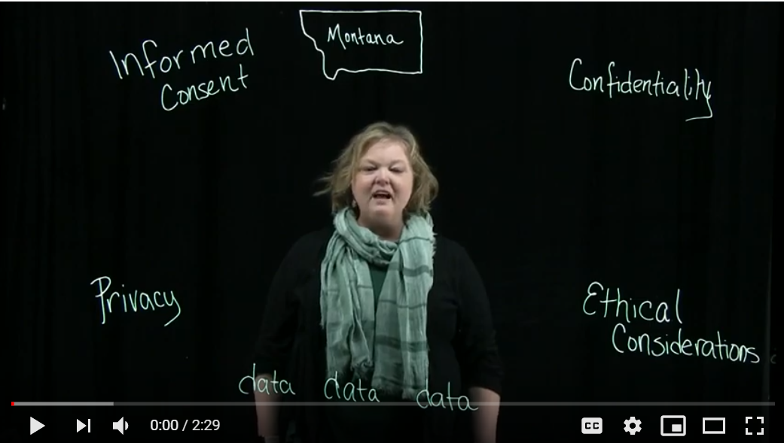
Data Education Portal
2-4 minute educational videos on subjects related to data and research

Slide 7
Thank You
for caring about data-driven community change in Montana
Contact Information
Haley Eakin
haley.eakin@umontana.edu
Montana Data Dashboard
health.umt.edu/ccfwd/
youtube/ccfwd

Slide 8
Data Sources
Annie E. Casey Foundation, Kids Count Data Center.
Center for Disease Control and Prevention, National Immunization Survey.
Center for Disease Control and Prevention, Stats on the State of Montana.
Center for Disease Control and Prevention, Vital Statistics.
Center for Health Workforce Studies, University of Washington.
Children’s Bureau, Adoption in Foster Care Analysis Reporting System.
Data Resource Center for Child and Adolescent Health, National Survey of Children’s Health.
Feeding America, Map the Meal Gap 2017.
Montana Kids Count Data Book.
Montana Board of Crime Control, Montana Incident Based Reporting System.
Montana Bureau of Labor Statistics.
Montana Office of Public Instruction, GEMS.
Montana Department of Public Health and Human Services, Annual Statistics Reports.
Montana Department of Health and Human Services, Montana Mortality Review Team
Montana Department of Public Health and Human Services, Office of Epidemiology and Scientific Support.
Montana Department of Public Health and Human Services, Office of Vital Statistics.
Montana Department of Public Health and Human Services, Statistical Bulletin.
Montana Department of Health and Human Services, WIC Office.
Montana Department of Labor and Industry, Research & Analysis Bureau.
Montana Needs Prevention Survey.
Montana Office of Public Instruction, Youth Risk Behavioral Survey.
Montana Public Health Data Resource, BRFSS.
Montana University System, First Time Freshman Enrollment and Retention.
National Archive on Abuse and Neglect, Child Maltreatment, 2015.
National Center for Education Statistics, National Assessment of Educational Progress.
National Children’s Health Survey.
Pew Center on the States, State of Recidivism 2011.
United States Census Bureau, American Community Fact Finder.
United States Census Bureau, Current Population Estimates.

