Slide 1
How Epidemiological Transitions Affect Mortuary Ritual: A study of infant burials in the Missoula City Cemetery.
Hannah W. Pepprock, B.A. Anthropology

Slide 2
Research Questions
Does the mortuary ritual afforded to infants display lower levels of investment in times of epidemiological transition in which mortality rates among this age group are high?
Are there higher levels of investment in mortuary ritual in times when life expectancy of young infants in raised, and mortality rates are lowered?
How does age impact mortuary ritual?

Slide 3
The Spanish Flu (1918-1919)
Arrived in Missoula, MT in October 1918 and lasted until March 1919₁
25% of the population was infected₁
860 cases and 38 deaths in Missoula₃
High risk age groups₂
0-5 years
65+ years
20-40 years
Memorial Row, 2. "1918 Pandemic (H1N1 virus) | Pandemic Influenza (Flu) | CDC.", 3. Mullen, Pierce C., and Michael L. Nelson. "Montanans and "the most Peculiar Disease": The Influenza Epidemic and Public Health, 1918-1919."

Slide 4
Mortuary Ritual
The dead do not bury themselves…
Infants are often interred by close family members
Little to no social connectedness
Largely reflect individual choice but may also follow culturally established norms
Photo I: “Baby Andrew”

Slide 5
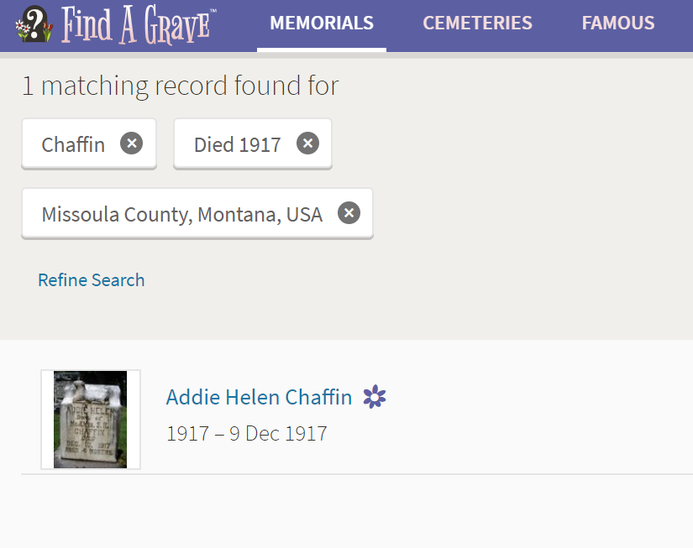
Methods
November, 2018- ground survey of the Missoula City Cemetery
A second ground survey was attempted in January, 2019.
The remaining burials were collected by cross referencing the cemetery’s online interment records with online gravesite databases in order to obtain photographs.
Cause of death data was obtained through collaboration with a cemetery employee.
Photo II: Find A Grave

Slide 6
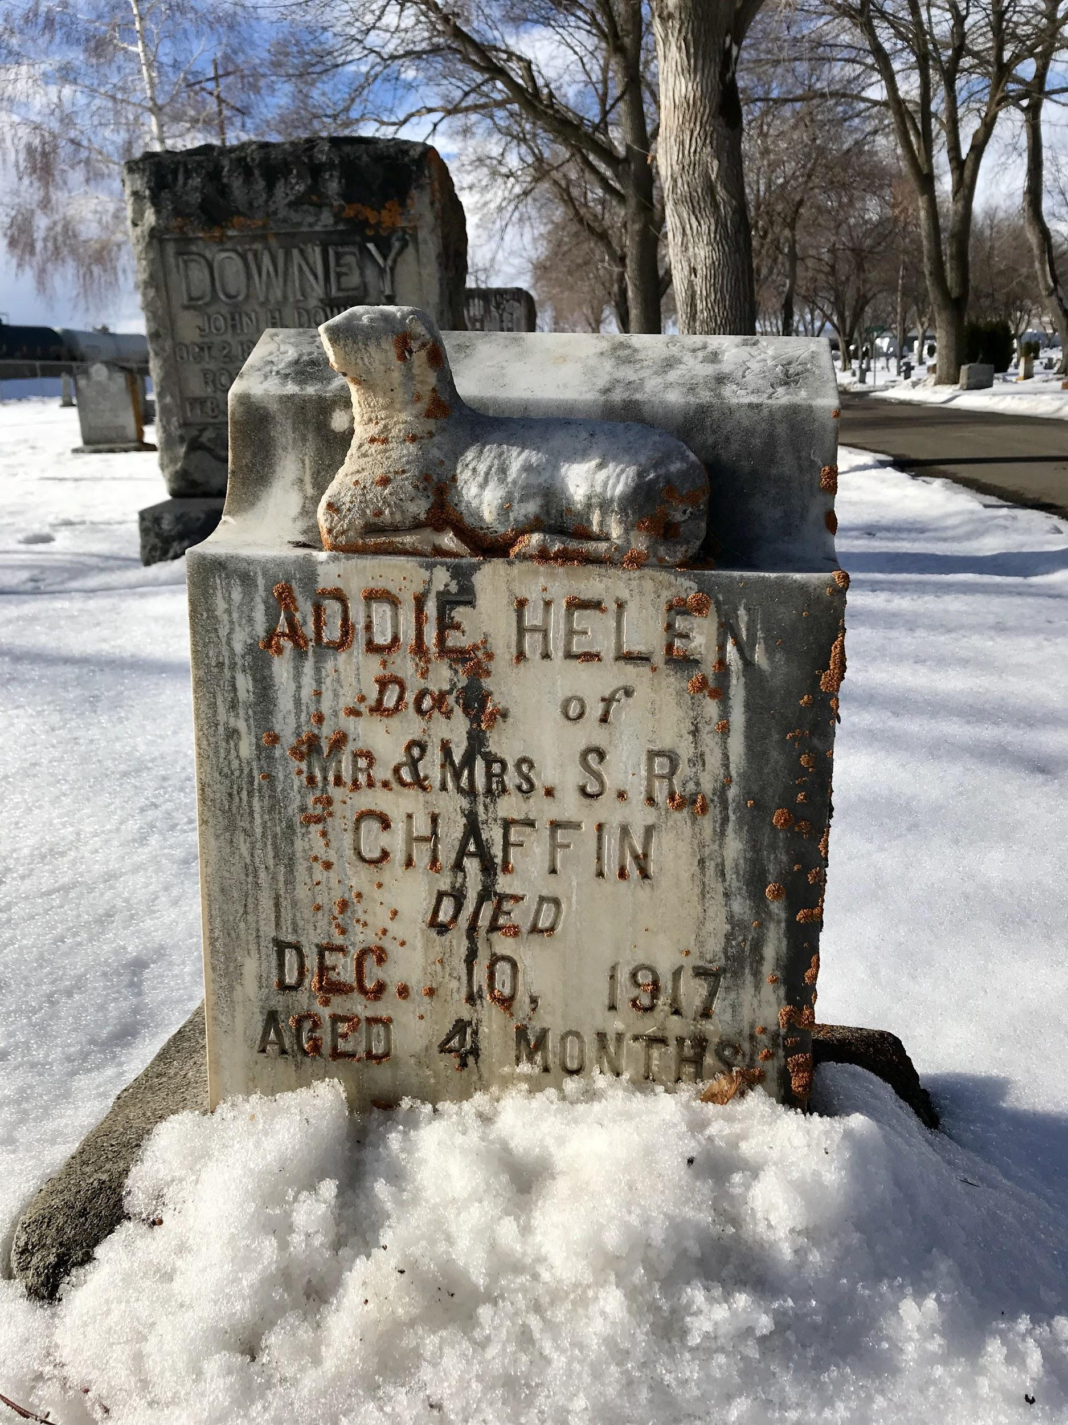
Methods
Temporal range: 1914-1930
Burials of individuals aged zero to five years old
I made no attempt to control for the variables of sex, ancestry, socioeconomic status, or cause of death.
Photo III: “Addie Helen”

Slide 7
Methods
The final data set includes 72 burials, 24 of which are female, 32 are male, and 16 of unknown sex.
Each burial was analyzed for three variables: symbolism, size and dimension of headstone, and location in cemetery.

Slide 8
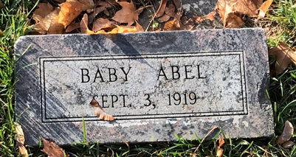
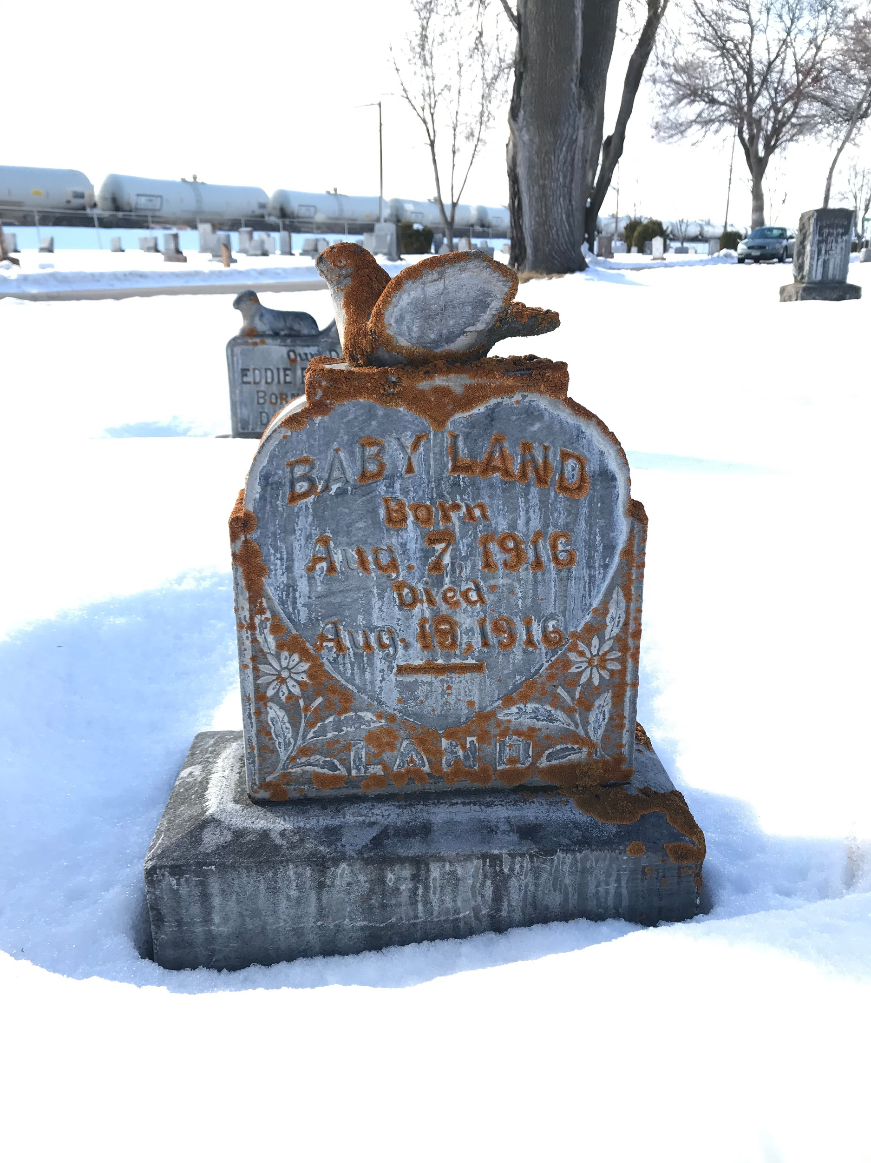
Photo IV: Unnamed burial, “Baby Abel”
Photo V: Unnamed burial, “Baby Land”

Slide 9
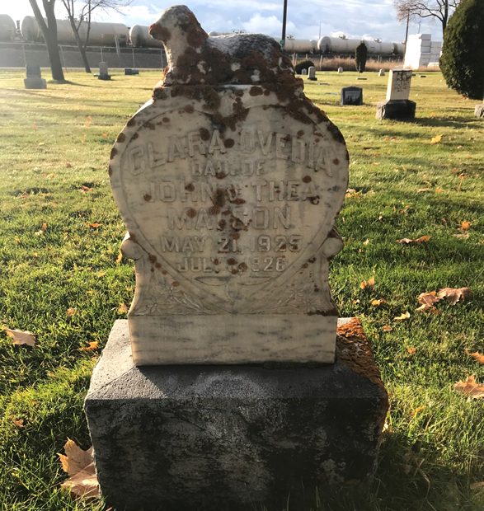
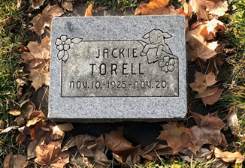
Photo VI: Example of Symbolism,Clara Matson
Photo VII: Example of Symbolism, Jackie Torell

Slide 10
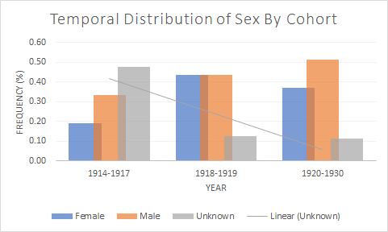
Results

Slide 11
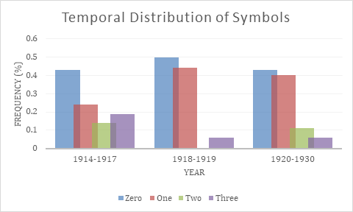
Results

Slide 12
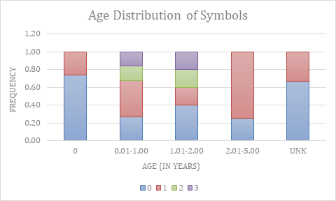
Results

Slide 13
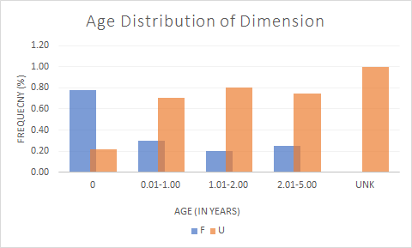
Results

Slide 14
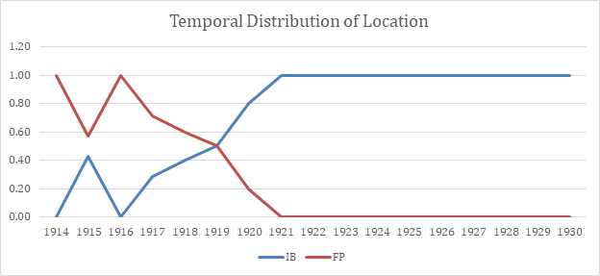
Results

Slide 15
Photo VIII: Map of Missoula City Cemetery

Slide 16
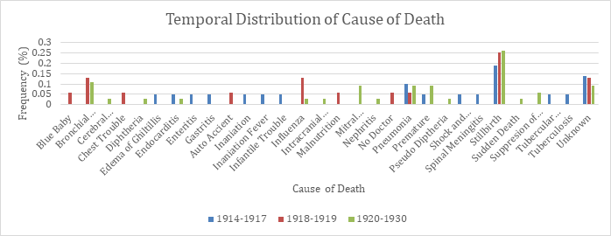
Results

Slide 17
Discussion
“While there is no doubt that the burial ritual, as a ritual, must reflect in some way the society that did the burying, the place of children within that society is obscure and little studied, to the extent that even defining children for comparison with adults within the archaeological record is beset by problems at the data dissemination stage.” (Crawford 169-179).

Slide 18
Discussion
The highest percentage of burials from a single year in the sample was from 1918, at 14%
16 individuals in the sample size were not given a first name.
All 16 individuals were aged less than one month, the oldest having aged 16 days, 11 were stillborn.
The variation in number of symbols prior to the pandemic suggests a highly individualized choice in headstone symbolism, regardless of social distinction.
Those born with the least amount of agency (.01-2) are the only ones with 3 symbols
Lack of symbolism may simply represent a lack of monetary investment in the infant’s headstone. It may also represent a lack of emotional, social, or religious connectedness

Slide 19
Discussion
It is possible that the “infant block” in the cemetery was established as a result of, or separately from, the 1918 pandemic. Regardless, it appears that in the decade following the pandemic, the majority of children aged under five years were interred in block 55A.
A temporal distribution of cause of death showed peak frequencies for bronchial pneumonia, influenza, stillbirth, and unknown causes of death in 1918 and 1919. Stillbirth and unknown causes of death remained the most prevalent across all time periods.

Slide 20
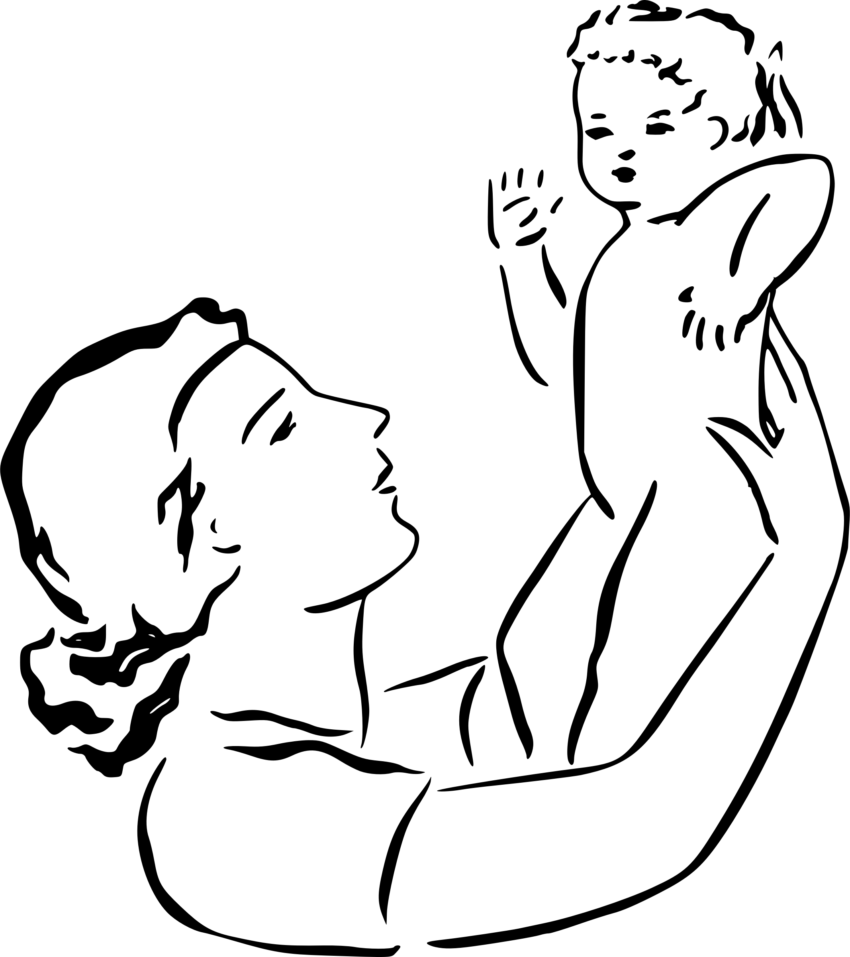
Conclusion
The results of this study are inconclusive.
There is a noticeable difference in the mortuary ritual surrounding a stillborn than that of a five-year old. This may be connected to social identity, both within and outside of the immediate family.

Slide 21
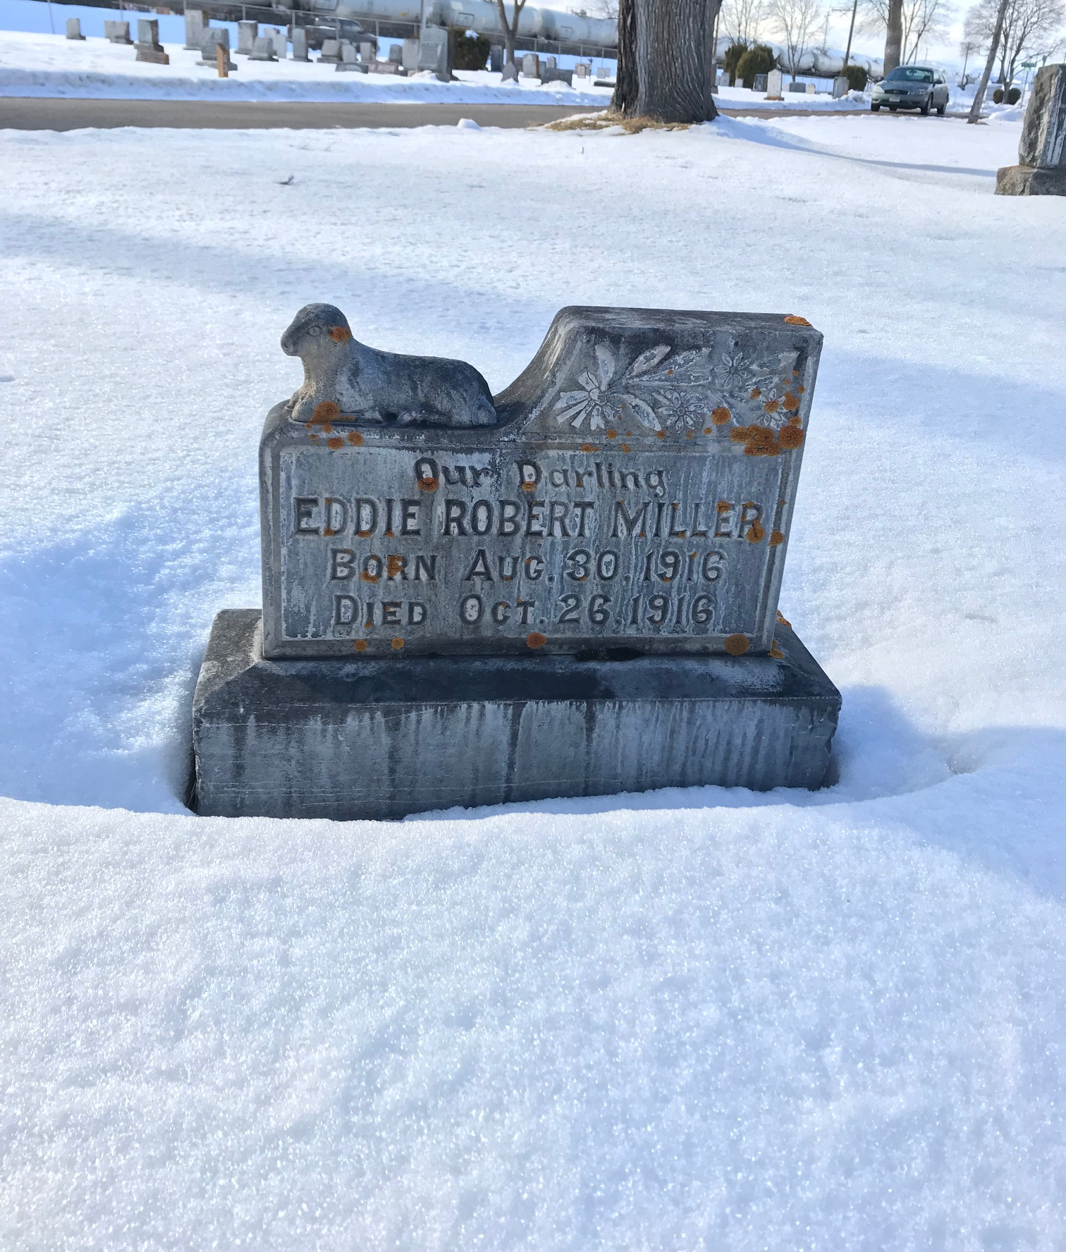
Limitations
Excavation
Weather
Frame of Reference
Little information is available surrounding the effects of pandemic on mortuary ritual, and even less so available detailing these effects on juvenile mortuary populations.
Photo IX: Eddie Robert Miller

Slide 22
Questions?

