Slide 1
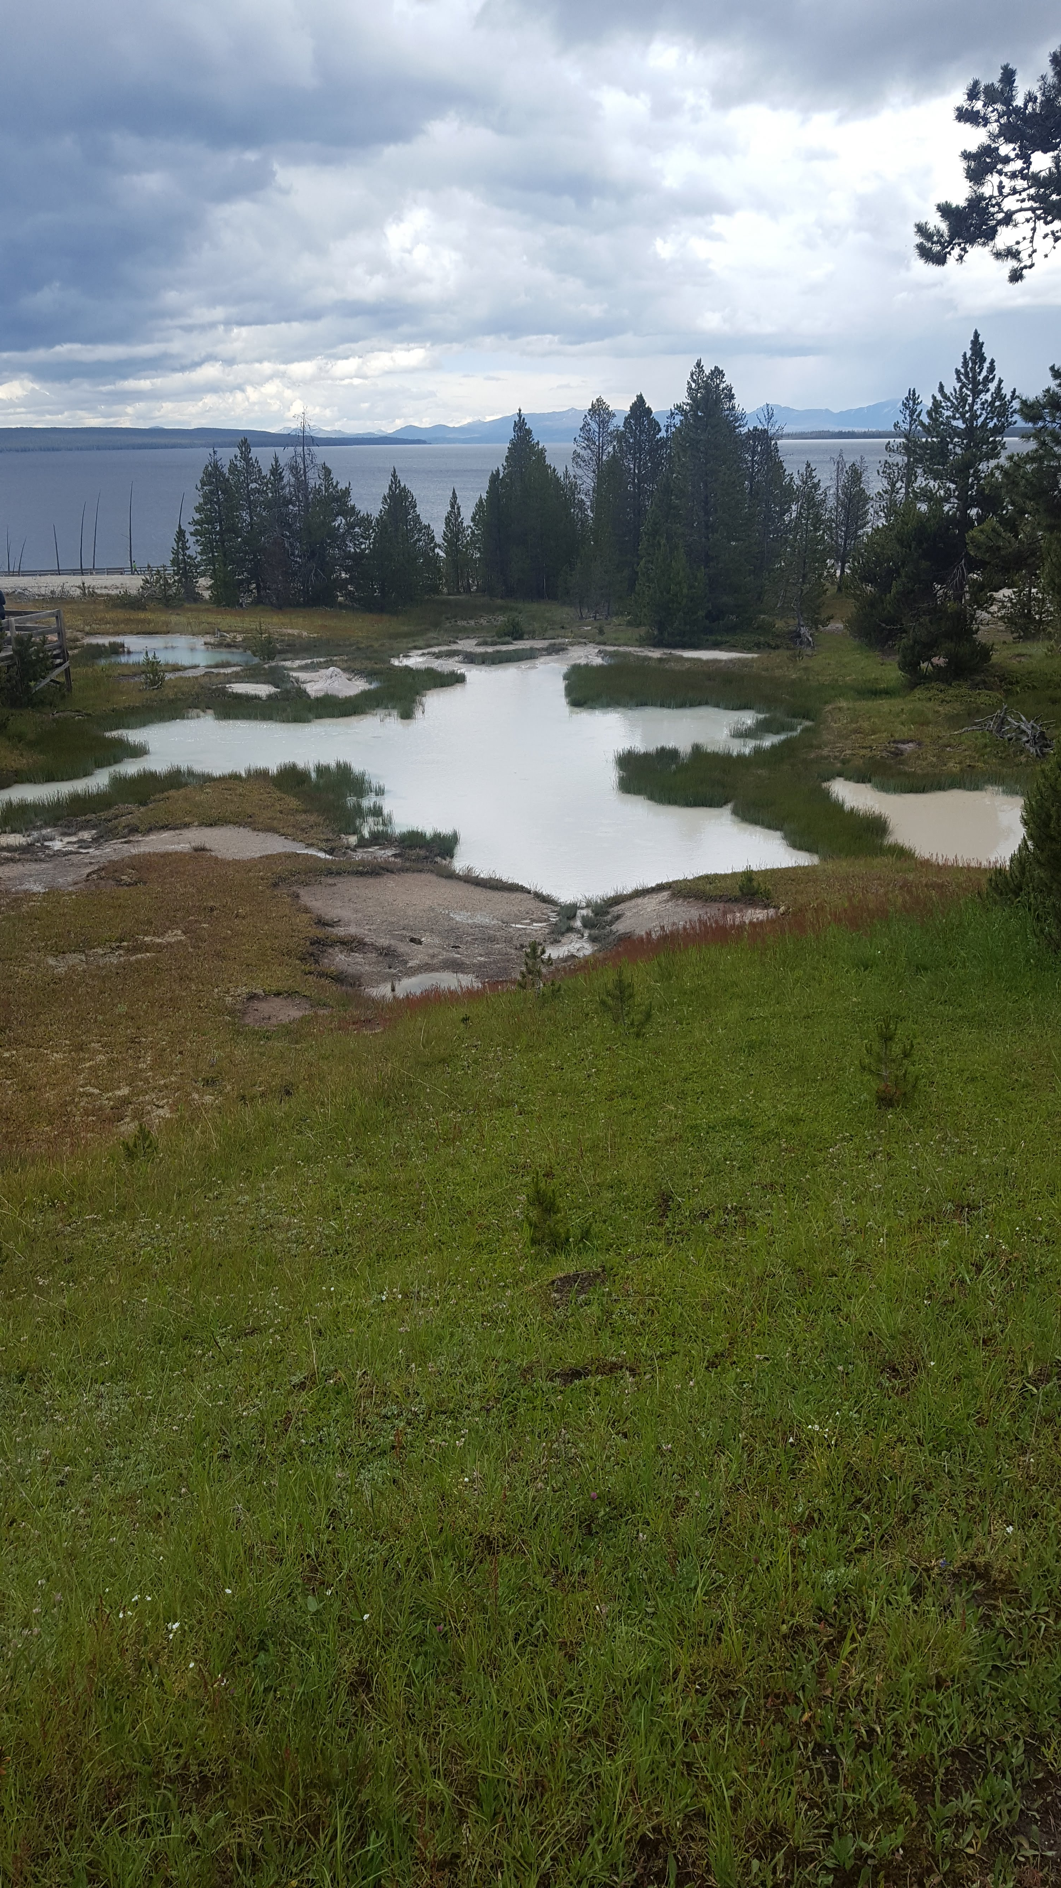
Rachel Blumhardt UMCUR 2019
Looking Past, Looking Forward: America’s National Parks, Archaeology and Climate Change
Yellowstone National Park

Slide 2
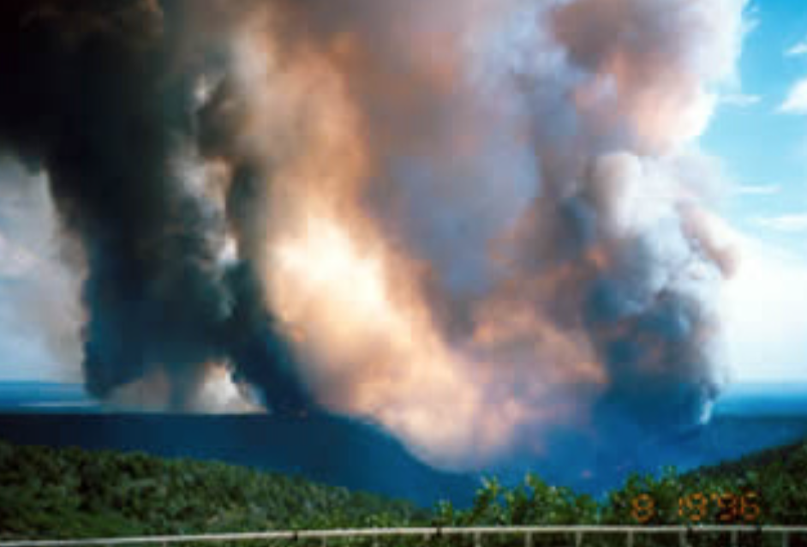
Yellowstone: Ice Patch Archaeology
Glacier Bay: Huna Tlinglet People/Tidewater Glaciers
NPS Photo. Ice Patch in YNP
NPS Photo. Margerie Glacier
American Samoa: Ancestral Polynesian People/Oceans & Coral Reefs
Mesa Verde: Ancestral Puebloan People/Drought & Wildfire
NPS Photo. Chapin 5 Fire 1996
NPS Photo. Orange Fin Anemone Fish

Slide 3
Climate Change Throughout Earth’s History
Climate has changed (usually gradually) over the entire course of earth’s 4+ billion-year history
Climate Proxy Data: Ice Cores and Tree Rings
Over the past 100 years, rapid temperature increases

Slide 4
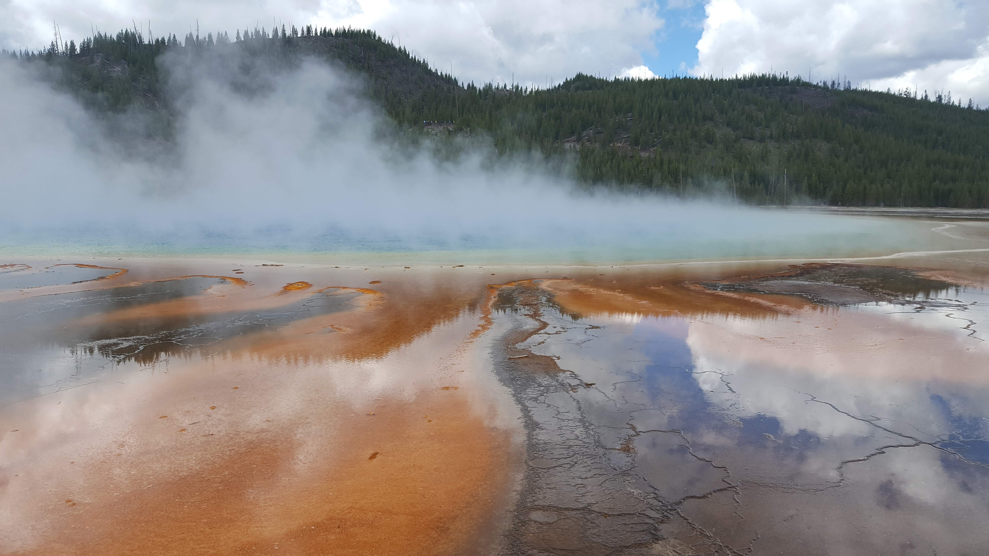
Yellowstone National Park
America’s first national park, founded in 1872
Unique geology, flora, fauna and interesting cultural signature
Rachel Blumhardt. Grand Prismatic Spring

Slide 5
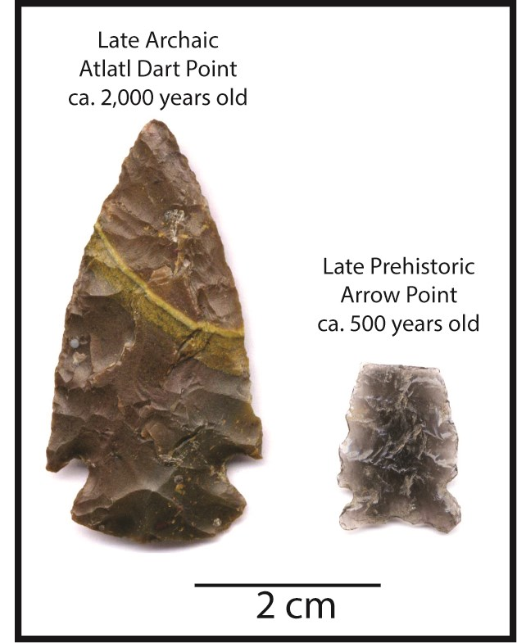
First Humans in YNP
First humans in Yellowstone NP 11,000 years ago: Clovis
Permanent settlements around 9,000 years ago: Cody Complex
Stone artifacts most common
Atlatl Dart Point
Arrow Point
MacDonald, Douglas. Comparison of Atlatl Dart Point (Left) and Bow and Arrow Point (Right) from Yellowstone Lake.

Slide 6
Ice Patch Archaeology
Ice patches: preserve organic materials in snow that hasn’t melted for thousands of years
Craig Lee, 2009: birch atlatl foreshaft found in an ice patch
Over 9,000 years old, Cody Complex age
Craig Lee. Ice Patch in Yellowstone NP

Slide 7
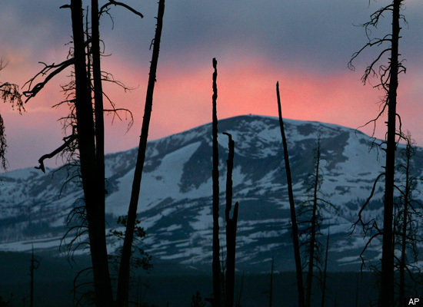
What Could We Lose?
Modern climate change threatens archaeological sites
Melting of ice patches: organic artifacts decompose when they are exposed to air
Bone/antler: about 10 years
Wooden: Less than 10 years
https://www.huffpost.com/entry/whitebark-pine-functional_b_656201. Yellowstone National Park

Slide 8
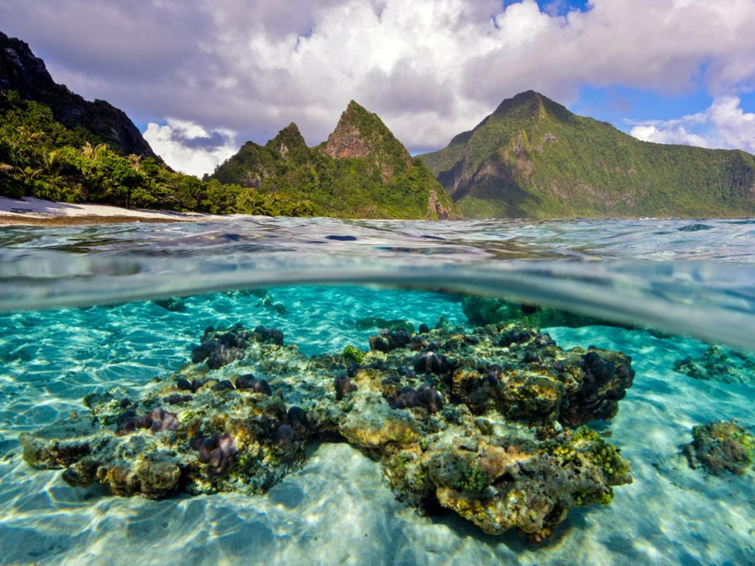
National Park of American Samoa
Located in the Pacific Ocean 2600 miles SW of Hawai’i
Founded in 1988
National Parks Service has units on 3 of the islands: Ofu, Ta’u and Tutuila
21 square miles, 2500 acres underwater
Cornforth Images, Alamy. Ofu Island’s Coral Reef, National Park of American Samoa

Slide 9
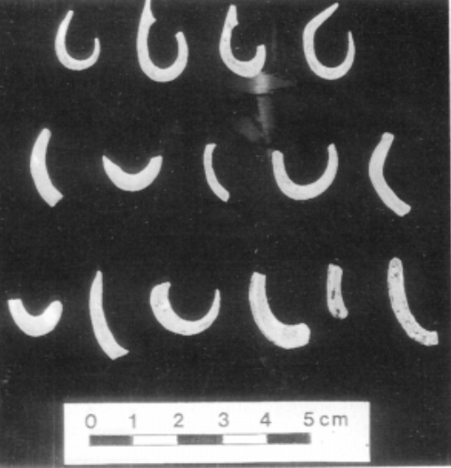
Ancestral Polynesian
To’aga site on Ofu
Ancestral Polynesian occupation (2,500-1,900 years ago)
Ceramics, fishhooks, faunal materials
Kirch et. al 1990. Shell fishhooks from To’aga site

Slide 10
Climate Change in AS
Ocean levels are rising (avg. of .1 inches per year in American Samoa)
Due largely to thermal expansion
Predicted 3 foot sea level rise over the next 100 years in American Samoa
Ocean Acidification
Due to an increase of carbon dioxide in the atmosphere being absorbed by oceans
Harms calcium-based shells of ocean organisms
Eli Keene. A seawall in American Samoa

Slide 11
What Could We Lose?
Beach erosion from rising ocean levels could threaten archaeological sites
Threats to Coral Reefs: Warmer Waters
Water needs to be warm but not too warm; 1.8º F above norm for a few weeks stresses the coral
Pacific Ocean temperatures increased by about .7º F over the past 50 years
American Samoan Coral: Resilient?
Undergo daily temp. fluctuations of up to 11º F every day
Could allow them to be more tolerant OR die more quickly because of increased exposure
NPS Photo. Coral Reef, Ofu Lagoon, American Samoa

Slide 12
Glacier Bay National Park and Preserve
Founded in 1925
Protects the 7 tidewater glaciers there
Glacier: forms when more snow accumulates than melts
Tidewater Glacier: their meltwater flows into the ocean
NPS Photo, nps.gov. Aerial View of Margerie Glacier

Slide 13
The Huna Tlinget
Native lands of the Huna Tlinget People
Little Ice Age Glacier advance circa AD 1700
Forced the people out of the area
Destroyed many older sites
Work in Glacier Bay NPP focuses on the past few centuries
How Europeans settlers/ glaciers affected settlement and subsistence
Steve Schaller/National Park Service via AP. Huna Tlinget Tribal House recently dedicated in Glacier Bay National Park and Preserve, AK

Slide 14
Climate Change in the Arctic
Climate is warming faster in the Arctic
Positive feedback loops
Thinner atmosphere
Albedo changes
Ice vs. water
https://climate.ncsu.edu/edu/Albedo. Graphic showing albedo differences depending on the color of the surface

Slide 15
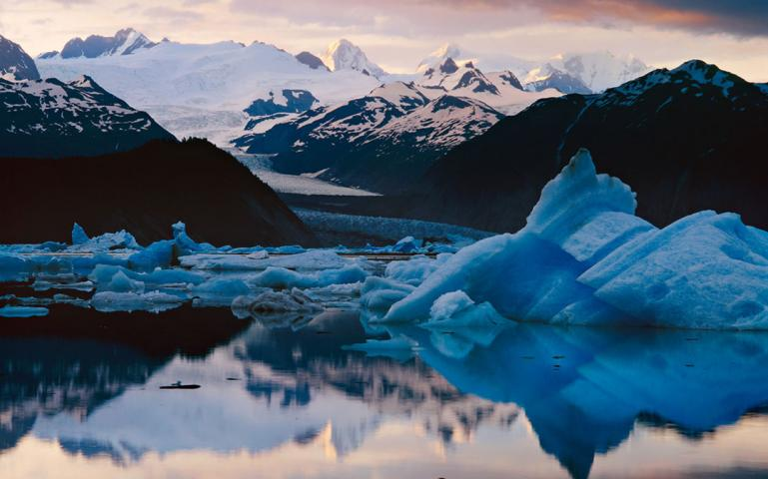
What Could We Lose?
Glaciers: over 50 glaciers, cover 48% of the land in park
Overall glacial cover down 11% (1952-2010)
Almost all of the
glaciers have
thinned/retreated
Carr CLIFTON/MINDEN PICTURES. Alsek lake, Glacier bay national park and preserve

Slide 16
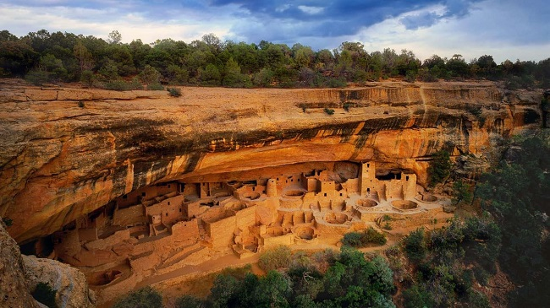
Mesa Verde National Park
Located in SW Colorado
Over 5000 known archaeological sites
Around 600 cliff dwellings
Created in 1906 to preserve and protect the cultural and architectural feats of the area
https://www.national-park.com/welcome-to-mesa-verde-national-park/. Cliff dwellings in Mesa Verde National Park, Colorado

Slide 17
Ancestral Puebloans
People have lived here for hundreds of years
Large village organization began around AD 750; large populations by AD 1100
Collapse/migration out in AD 1300
Drought?
Joshua Hardin. Cedar Tree Tower, a mesa top site in Mesa Verde National Park

Slide 18
Droughts and Fire
Downward shifts in precipitation
From 2000-2010, 4% lower than 20th century averages
Higher temps
From 2000-2010, temps were 1.3º F higher than 20th century averages
Longer, more intense fire seasons
Over half of the tree cover lost since 1906 because of fires
Bob Gibbons/Alamy Stock Photo. Mesa Verde National Park tree loss

Slide 19
What Could We Lose?
Wildfire damage
Dries soil, erosion
Rock Art
1996 Chapin 5 fire: damaged Battleship Rock Panel
Spalling
Aerial drops of fire suppressant stain sandstone
NPS Photos. Battleship Rock Panel before (upper) and after (right) the Chapin 5 fire

Slide 20
References:
“Examining the Evidence: Climate Change.” National Parks Service, U.S. Department of the Interior, home.nps.gov/yell/learn/nature/climate-examine-evidence.htm.
MacDonald, Douglas H. Before Yellowstone: Native American Archaeology in the National Park. University of Washington Press, 2018.
“Yellowstone National Park (U.S. National Park Service).” National Parks Service, U.S. Department of the Interior, www.nps.gov/yell/index.htm.
Climate Change in American Samoa. Pacific Islands Climate Education Partnership, 2014, www.soest.hawaii.edu/coasts/publications/AmSamoa Climate 2016.pdf.
Craig, P., et al. “High Temperatures Tolerated by a Diverse Assemblage of Shallow-Water Corals in American Samoa.” Coral Reefs, vol. 20, no. 2, 2001, pp. 185–189., doi:10.1007/s003380100159.
Craig, Peter. Natural History Guide to American Samoa. 3rd ed., National Park of American Samoa, 2009.
Henson, Robert. The Thinking Person's Guide to Climate Change . American Meteorological Society, 2014.
Kirch, Patrick V., et al. “An Ancestral Polynesian Occupation Site at Toaga, Ofu Island, American Samoa.” Archaeology in Oceania, vol. 25, no. 1, 1990, pp. 1–15., doi:10.1002/j.1834- 4453.1990.tb00225.x.
“What Are Corals?” What Are Corals? | International Coral Reef Initiative, www.icriforum.org/about-coral-reefs/what-are-corals.
Anisimov, O.A., D.G. Vaughan, T.V. Callaghan, C. Furgal, H. Marchant, T.D. Prowse, H. Vilhjálmsson and J.E. Walsh, 2007: Polar regions (Arctic and Antarctic). Climate Change 2007: Impacts, Adaptation and Vulnerability. Contribution of Working Group II to the Fourth As- sessment Report of the Intergovernmental Panel on Climate Change, M.L. Parry, O.F. Canziani, J.P. Palutikof, P.J. van der Linden and C.E. Hanson, Eds., Cambridge University Press, Cambridge, 653-685
Connor, Cathy, et al. “The Neoglacial Landscape and Human History of Glacier Bay, Glacier Bay National Park and Preserve, Southeast Alaska, USA.” The Holocene, vol. 19, no. 3, 2009, pp. 381–393., doi:10.1177/0959683608101389.
Crowell, Aron. The Hoonah Tlingit Cultural Landscape in Glacier Bay National Park and Preserve: an Archaeological and Geological Study. U.S Department of the Interior, National Park Service, Glacier Bay National Park and Preserve, 2013.
“Further Study of Ocean Acidification in Glacier Bay (U.S. National Park Service).” National Parks Service, U.S. Department of the Interior, www.nps.gov/articles/aps-15-1-9.htm.
“Glacier Bay National Park & Preserve (U.S. National Park Service).” National Parks Service, U.S. Department of the Interior, www.nps.gov/glba/index.htm.
National Park Service. 2017. State of the Park Report for Glacier Bay National Park and Preserve. State of the Park Series No. 52. National Park Service, Washington, DC
“Tidewater Glaciers.” National Parks Service, U.S. Department of the Interior, www.nps.gov/subjects/oceans/tidewater-glaciers.htm.
“An Uncertain Future.” National Parks Conservation Association, www.npca.org/articles/1622-an-uncertain-future.
Ancestral Pueblo People and Their World. National Park Service, www.nps.gov/meve/learn/historyculture/upload/ancestral_pueblo_people_2018_508_01-24-18-2.pdf.
“Crow Canyon Archaeological Center - Crow Canyon Archaeological Center.” Crow Canyon, www.crowcanyon.org/.
Holtz, Debra, et al. National Landmarks at Risk: How Rising Seas, Floods, and Wildfires Are Threatening the United States Most Cherished Historic Sites. Union of Concerned Scientists, 2014.
Jarus, Owen. “Mesa Verde: Cliff Dwellings of the Anasazi.” LiveScience, Purch, 14 June 2017, www.livescience.com/27360-mesa-verde.html.
Mesa Verde Archeology and Fire . National Park Service, 2007.
“Mesa Verde National Park (U.S. National Park Service).” National Parks Service, U.S. Department of the Interior, www.nps.gov/meve/index.htm.

Slide 21
Questions?

